Slide 1
ALIMA / Inserm
Clinical & Operational Research Alliance
MSF Scientific Days, London, May 24th 2018
Maternal factors associated with perinatal mortality: the 1,000 Days cohort study, Mirriah Niger
Dr. Renaud BECQUET
Senior Scientist, Epidemiology & International Health
Inserm, U1219 Research Centre, Bordeaux, France

Slide 2
Introduction
Perinatal mortality
  Definition: late foetal mortality (after 28 weeks of gestation) + early infant mortality (0-7d)
  In low-resource settings, with high prevalence of home-birth, often difficult to differentiate late foetal and early neonatal deaths
  Useful indicator to assess the quality of obstetric and early neonatal care
Perinatal mortality in Niger among the highest in the world
  10% (33 stillbirths/333 live births) in Zinder, Niger per Wessells et al Nutrients. 2017
  prevalence and associated factors are important to assess
  Identification of maternal risk factors may help with prioritization in birth planning, e.g. delivery at health centre vs. hospital
Notes:
Within

Slide 3
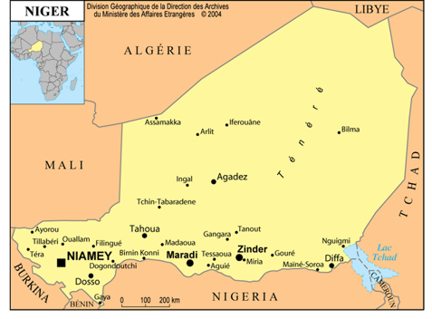
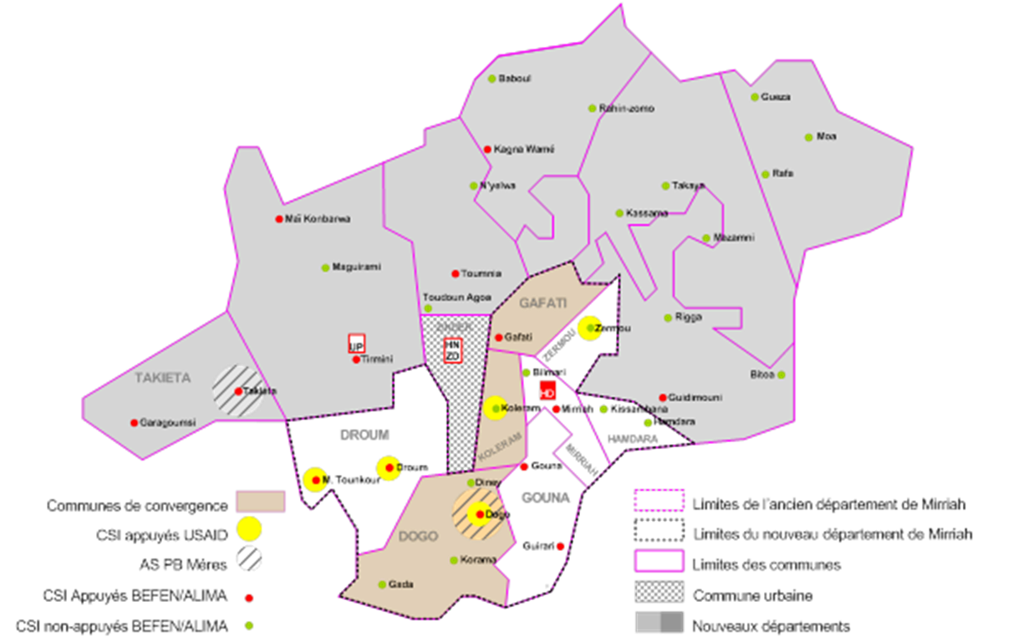
Introduction – Mirriah District, Zinder Region
Mirriah:
17 Health Zones, total population ~700,000
3/17 Health Zones → ‘1000 Days’ Health services initiated April 2015
‘1000 Days’ health services provided in 16 health structures,
  covering population of ~125,000
  ~30,000 children birth-59 months
  6,700 births expected annually

Slide 4
Objectives
To evaluate perinatal mortality and associated maternal risk factors in rural Niger
To assess the proportion of pregnant women presenting with danger signs identified during antenatal care (ANC), in relation with perinatal mortality and place of delivery

Slide 5
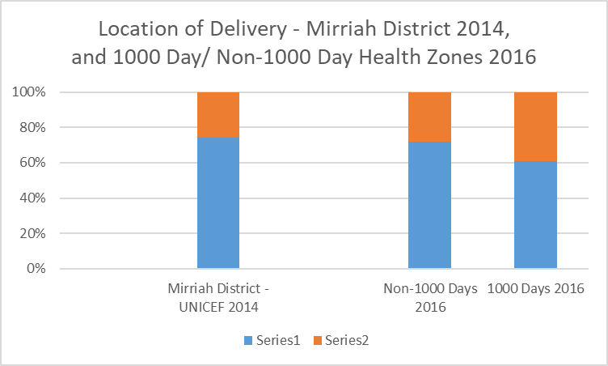
‘1000 Days’ Health Care Services
Pregnant & Lactating women
Newborns to 24 m
4 ANC visits
Tetanus vaccine
Malaria iPT (SP)
Mosquito net
Haemoglobin test
STI testing
Deworming
Nutritional support
Referral @ delivery
Medicalized delivery
Post-natal visit, incl contraception
Vitamin K @ birth
9 well-child visits
Standard EPI vaccinations
Anthropometry & oedema screening
LNS Nutributter™ (20 g or 120 kcal/d) from 6-24 m
Mosquito net
Malaria seasonal chemoprevention
curative care, incl SAM
Health Structure
Home
Notes:
Prior to implementing the 1000 Days health services, between 72% of deliveries were occurring at home according to a 2014 UNICEF survey conducted in Mirriah district. 2 years later, and approximately 14 months after launching the 1000 Days project, home deliveries in the 1000 Days Health zones have decreased to 60%, while health structure deliveries increased from to 40%. The non-1000 Days health zones surveyed at the same time as the 1000 Days zones show a similar proportion of home deliveries to 2014.

Slide 6
The ‘1,000 Days’ cohort
Pregnant & Lactating women
Newborns to 24 m
4 ANC visits
Tetanus vaccine
Malaria iPT (SP)
Mosquito net
Haemoglobin test
STI testing
Deworming
Nutritional support
Referral @ delivery
Medicalized delivery
Post-natal visit, incl contraception
Vitamin K @ birth
9 well-child visits
Standard EPI vaccinations
Anthropometry & oedema screening
LNS Nutributter™ (20 g or 120 kcal/d) from 6-24 m
Mosquito net
Malaria seasonal chemoprevention
curative care, incl SAM
Cohort implemented in 5 health facilities in rural Niger (Zinder region, Mirriah department)
  Inclusion of all pregnant women presenting for a first ANC visit: from April 2015 to June 2016
  Follow-up of mother-infant pairs until 24Mo post-partum
Notes:
Prior to implementing the 1000 Days health services, between 72% of deliveries were occurring at home according to a 2014 UNICEF survey conducted in Mirriah district. 2 years later, and approximately 14 months after launching the 1000 Days project, home deliveries in the 1000 Days Health zones have decreased to 60%, while health structure deliveries increased from to 40%. The non-1000 Days health zones surveyed at the same time as the 1000 Days zones show a similar proportion of home deliveries to 2014.

Slide 7
Methods: statistical analysis
Multivariate generalized linear mixed model to examine factors associated with perinatal mortality, including study site as a random effect
Creation of a complication score based on 6 danger signs identified during ANC:
  Age: ≤18 years or ≥35 years,
  First pregnancy,
  Multiple gestation,
  Severe anaemia (< 7g/dL),
  Positive malaria rapid diagnostic test (RDT),
  Pre-eclampsia (high blood pressure and proteinuria)
  assessed in relation to perinatal mortality and place of delivery

Slide 8
Pregnant women included in the study
N = 1745
- Unknown pregnancy outcomes: n = 50
- Abortions: n = 12
- Maternal deaths during pregnancy: n = 4
Women who gave birth
n = 1679 (96,2%)
Children alive at 7 days of life
n = 1595 (95,0%)
Perinatal deaths
n = 84 (5,0%)
Stillbirth: n=68 (4.0%)
Neonatal deaths: n=16 (1.0%)

Slide 9
Baseline maternal characteristics
Median (IQR) age: 25 (21-29) Min: 14; Max: 45
Median (IQR) parity: 3 (1-5) Min: 0; Max: 14
% MUAC<230mm: 29.9%
% height<155cm: 17.2%
Number of ANC visits: n=1 (15.5%); n=2-3 (47.8%); n=4 (36.7%)
Gestational age at first antenatal visit could not be reliably estimated due to late presentation

Slide 10
Multivariate analysis: factors associated with perinatal mortality
N = number of births; n=number of perinatal deaths
Characteristics | N | n | % |  | Multivariate model
 |  |  |  |  | OR | 95% CI | p*
ANC visits |  |  |  |  |  |  | 0.05
≥ 4 | 617 | 20 | 3.2 |  | 1
< 4 | 1,062 | 64 | 6.0 |  | 1.71 | [1.01 – 2.88]
Primiparity |  |  |  |  |  |  | <0.01
No | 1,416 | 58 | 4.1 |  | 1
Yes | 263 | 26 | 9.9 |  | 2.18 | [1.32 – 3.61]
Positive malaria RDT during pregnancy |  |  |  |  |  |  | <0.01
No | 1,575 | 71 | 4.5 |  | 1
Yes | 104 | 13 | 12.5 |  | 2.55 | [1.29 – 5.06]
Severe anemia during pregnancy |  |  |  |  |  |  | 0.04
No | 1,652 | 79 | 4.8 |  | 1
Yes | 27 | 5 | 18.5 |  | 3.01 | [1.06 – 8.52]
Albendazole received |  |  |  |  |  |  | 0.06
No | 342 | 26 | 7.6 |  | 1
Yes | 1,337 | 58 | 4.3 |  | 0.60 | [0.35 – 1.02]

Slide 11
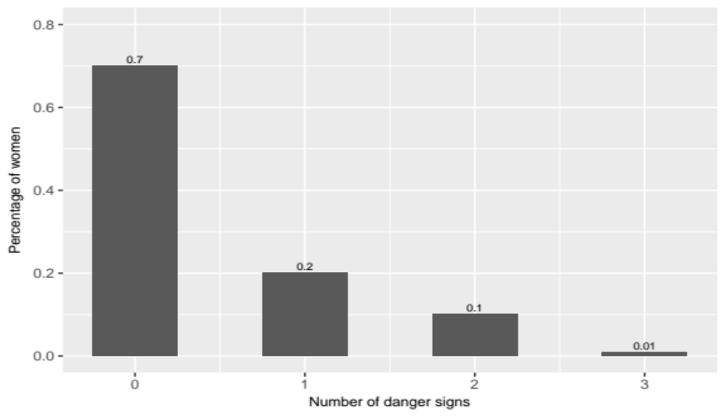
Identification of danger signs
30% of women experienced at least one danger sign

Slide 12
Danger signs in relation with perinatal mortality
 | N | n | % |  | Univariate models
 |  |  |  |  | OR | 95% CI | p*
Danger signs
0 | 1,171 | 41 | 3.5 |  | 1
≥ 1 | 508 | 43 | 8.5 |  | 2.45 | [1.58 – 3.81] | <0.01
Danger signs
0 | 1,171 | 41 | 3.5 |  | 1
1 | 328 | 27 | 8.2 |  | 2.30 | [1.39 – 3.81] | <0.01
≥ 2 | 180 | 16 | 8.9 |  | 2.75 | [1.51 – 5.02] | <0.01
Danger signs
0 | 1,171 | 41 | 3.5 |  | 1
1 | 328 | 27 | 8.2 |  | 2.30 | [1.39 – 3.81] | <0.01
2 | 164 | 14 | 8.5 |  | 2.65 | [1.41 – 4.98] | <0.01
3 | 16 | 2 | 12.5 |  | 3.78 | [0.83 – 17.30] | 0.09
N= Number of births
n= number of perinatal deaths
%= perinatal mortality rate
* Adjusted on study site as a random effect

Slide 13
Danger signs in relation with place of delivery
 | No danger sign N= 1,171 |  | At least one danger sign N= 508 |  | p
 | n | % | n | %
Place of delivery |  |  |  |  | 0.97
Health facility | 439 | 37.5 | 190 | 37.4
Home | 732 | 62.5 | 318 | 62.6

Slide 14
Conclusions
Perinatal mortality
  useful comprehensive indicator in environments where a large proportion of births occur outside of health structures
  should be more widely reported
This prospective cohort with minimal drop-out appears to show high perinatal mortality rate (50/1,000 births) but very difficult to bench-mark against other contexts
Perinatal mortality was associated with maternal risk factors that are easily identified during ANC
Higher proportion of women are delivering in health structures with 1,000 Day services but pregnant women with risk factors are not more represented in this group. Health workers can make better use of data collected during ANC

Slide 15
Acknowledgments
To the co-authors:
Anne Thomas, Deo Sibongwere, Maguy Daures, Benjamin Séri, Nafissa Dan-Bouzoua, Moumouni Kinda, Claire Levy-Marchal, Augustin Augier, Valérie Briand, Susan Shepherd
To the CORAL board of directors
Renaud Becquet (methodological co-chair), Susan Shepherd (medical co-chair), Augustin Augier, Solenne Barbe, Claire Levy-Marchal, Marie Japsard, Xavier Anglaret
To all the women and children who participated in the study
To the funders: ECHO, ALIMA, Inserm

