Slide 1
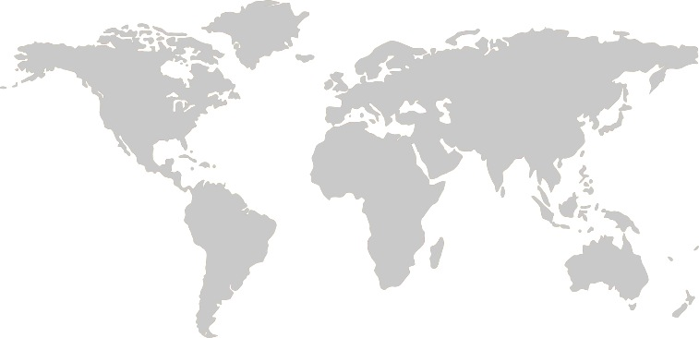
Smartphone based, real-time telemedicine for the management of neurological emergencies: a field-based quality improvement initiative Yogesh Jha, James Lee, Laura Hawryluck, Aziz Alali, James Maskalyk, Fabien Schneider, Annick Antierens, Yves Wailly

Slide 2
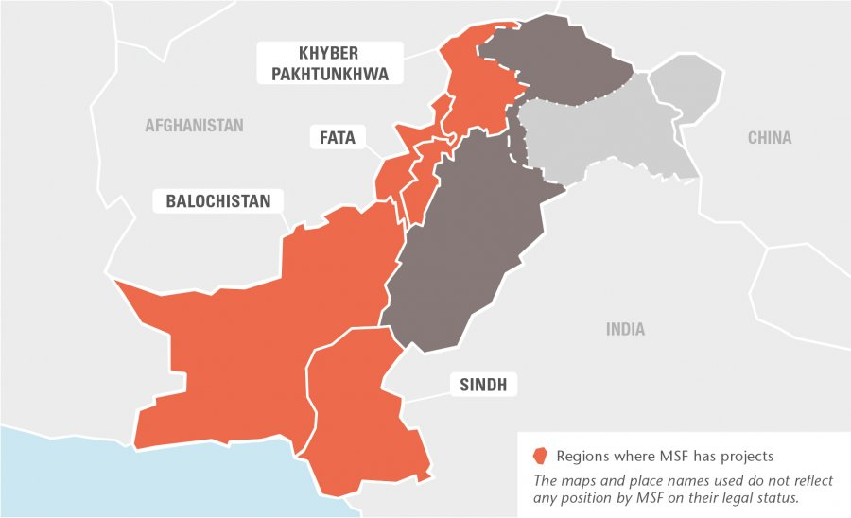
Introduction
Timurgara District Hospital (OCB), Pakistan.
MSF 2016
Management of neurological emergencies presents challenges:
Limited critical care capacity – Junior ER medical officers,
Lack of compliance between CT use and MSF guidelines,
Missed Computed Tomography (CT) findings,
CT scans cost,
Wait time and risks involved with unstable patient transfer or during the CT procedure.

Slide 3
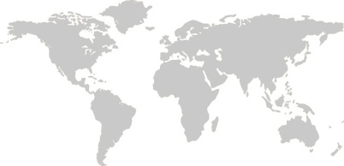
Introduction (2)
Aims:
Better support the medical officers in the ER,
Increased adherence to MSF guidelines in dealing with neurological emergencies,
Improve patient care with specialist consultation to minimize missed findings on CT,
Improve patient care by providing real-time ICU-level management advice in the resource-limited setting.

Slide 4




Methods (1)
A single smartphone (3G) was set up with a secure telemedicine application, for use by ER doctors.
4 consultants in critical care, neurosurgery, traumatology, and emergency medicine provided remote 24-hour support.
All neurological emergencies considered for CT were eligible for telemedicine consultation.
Data: 7 Dec 2017 to 4 Feb 2018 and ED doctors completed a survey.

Slide 5
Methods (2)
Descriptive analysis to assess the impact of intervention (mostly poof of concept based on outcome analysis).
Operational perspective to assess improvements to patient care by providing remote telemedicine support.
Ethics This project has had ethics oversight, according to the MSF Ethics Framework for Innovation.

Slide 6
Results (1)
155 consultations:
Mean first response time of 1min 52 sec (SD 3.5),
140/155 (90%) for CT requests and management advice:
74/140 (53%) traumatic brain injury,
47/140 (34%) suspected stroke,
19/140 (14%) altered mental status.
16/140 (11%), CT was not advised (did not meet MSF guidelines).
Management advice was given for 86/140 (61%) cases before CT.
Management advice was given for 124/140 (89%) cases after CT.

Slide 7
Results (2)
MSF Canada 2018
Notes:
MSF Canada 2018

Slide 8
Conclusion (1)
Real-time telemedicine consultations with distant experts was feasible and easy to set up in field context
Real-time telemedicine improved adherence to clinical guidelines:
- Reduced unnecessary CT scans
- Positively influenced acute patient care
Medical officers felt supported and learned from the telemedicine consultants

Slide 9
Conclusion (2)
Further studies with larger sample sizes are required to explore additional usefulness of such a low cost, but high impact telemedicine innovation at patient and system level

Slide 10
Acknowledgements
OCB Timurgara Project Team and Pakistan Mission Coordination Team
Telemedicine Support Consultants; Dr Aziz Alali, Dr Laura Hawryluck, Dr James Maskalyk, Dr James Lee
Yogesh Jha; Program Unit, MSF Canada
Dr Annick Antierens, Yves Walley, Petra Alders – OCB Medical Department

Slide 11

Thank you
telemedicine@toronto.msf.org
https://telemed.msf.org

