Slide 1

Monitoring of antimalarial drug efficacy using routine data
*Neil J Saad¹, Caroline De Cramer¹, Lieven Vernaeve¹, William Etienne², Chea Nguon³, Martin De Smet⁴, Jean-Marie Kindermans⁴
(1)Médecins Sans Frontières, Cambodia, (2)Médecins Sans Frontières Cambodia, (3)Centre for Parasitology, Entomology and Malaria Control,Cambodia, (4)Médecins Sans Frontières, Brussels, Belgium

Slide 2
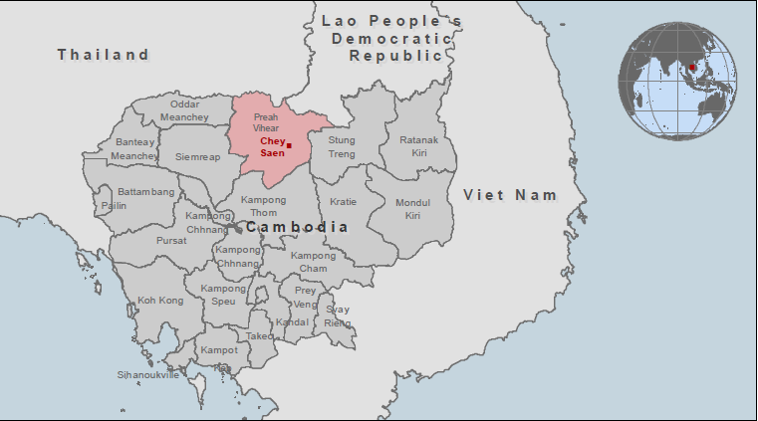
Project: to develop strategies to eliminate P.f malaria in area of artemisinin resistance (AR)
Goal: Avoid further spread of AR, which ultimately implies elimination of P.f malaria in areas of AR
Project site: Chey Saen district, Preah Vihear, Cambodia
Study period:
Oct 2015 – Apr 2018
https://mapcentre.msf.org

Slide 3
Project: to develop strategies to eliminate P.f malaria in area of artemisinin resistance (AR)
Specific project objectives linked to drug efficacy:
Early detection of decreasing ACT efficacy
  consider alternative drug regimen
  identify indication full efficacy study
Detection individual treatment failures
Components:
Case finding activities (Passive, reactive and proactive case detection)
Basic vector control
Monitoring of resistance (in vivo and in vitro)

Slide 4
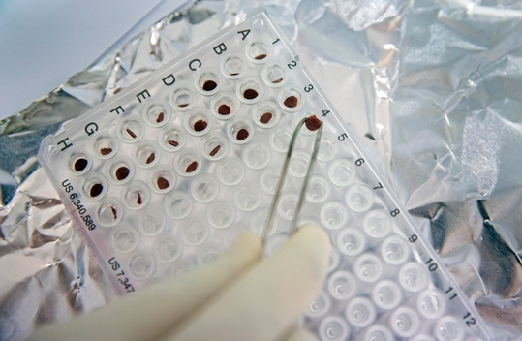
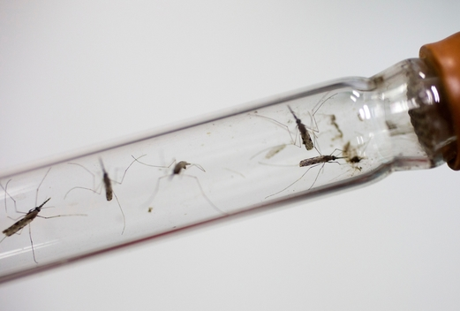
Research question…
Strengthened case management to ensure individual treatment success in place
Can we use this as an opportunity to evaluate alternative methodology of monitoring antimalarial resistance?
Copyright:Tim Dirven/Panos Pictures
Copyright:Tim Dirven/Panos Pictures

Slide 5
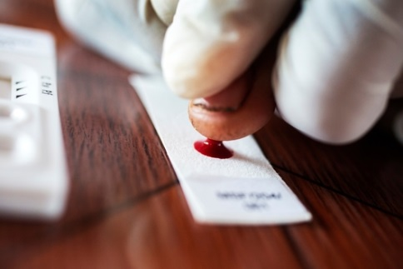
Methods (1): inclusion and strengthened monitoring of the patients
Detection of P.f malaria through passive, reactive or proactive case detection using RDT
Collection of dry blood spot (DBS) for P.f positive patients
  DBS analysed at the Pasteur Institute Cambodia
Day 0
Three days direct observed treatment
  dihydroartemisinin-piperaquine (DHA-PPQ)
  (Oct 2015 – Jan 2016)
  Artesunate-mefloquine (ASMQ) (Feb 2016 – now)
Day 0-2
Copyright:Tim Dirven/Panos Pictures

Slide 6


Methods (2): follow-up of patients
Copyright:Tim Dirven/Panos Pictures
Copyright:Tim Dirven/Panos Pictures
Follow-up 1: Collection of DBS for follow-up of treatment outcome (assessed using PCR)
Day 28
Follow-up 2: Collection of DBS for follow-up of treatment outcome (assessed using PCR
- only since Sept 2016) – research purpose
Day 63

Slide 7
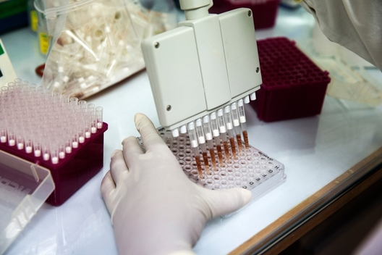

Methods (3): Monitoring of resistance
Monitoring of resistance at Pasteur institute Cambodia
  in vivo data (TF, reinfection/recrudescence, est. parasitaemia)
  molecular markers correlating with resistance
Throughout
Copyright:Tim Dirven/Panos Pictures
Copyright:Tim Dirven/Panos Pictures

Slide 8

Specific research questions
Are the ACTs still efficacious ? (outcome-related)
Is the outcome of day 28 parasitological PCR based treatment a good indicator to monitor ACT efficacy ? (methodology related)
Should all patients be included in the analysis, incl.
low parasitemic patients? (methodology related)
The study has been approved by the Cambodian and MSF ERB
Copyright:Tim Dirven/Panos Pictures

Slide 9
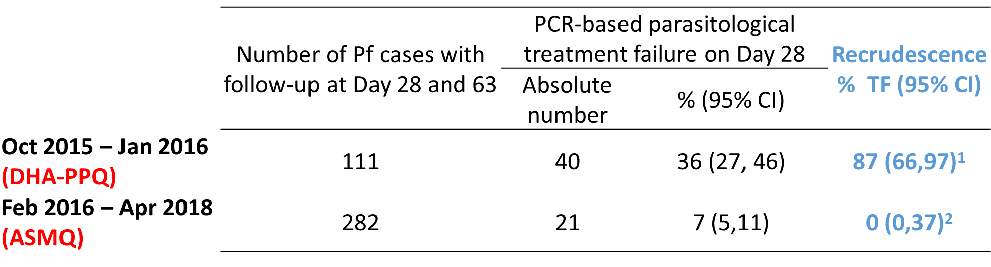
Are ACTs still efficacious?
PCR-based parasitological treatment failure (TF) 28 days post treatment
¹3/40 are reinfections and 17/40 had insufficient genetic material
²8/21 are reinfections, 8/21 had insufficient genetic material, 5/21 samples results pending
Conclusion: Use of dihydroartemisinin-piperaquine no longer justified
Notes:
1-Of the 128 Pf cases at Day 0, 111 were traced for follow-up at Day 28. This is 87% (95% CI: 80 ,92). From Oct 2015 –Jan 2016, Day 63 was not collected.
2-Of the 674 Pf cases at Day 0, 282 were currently traced for follow-up at Day 28 and 63. This is 44% (95% CI: 40 ,48). However, the number Pf cases at Day 0 also includes recent infections. For these, the Day 28 and 63 has not yet passed.

Slide 10
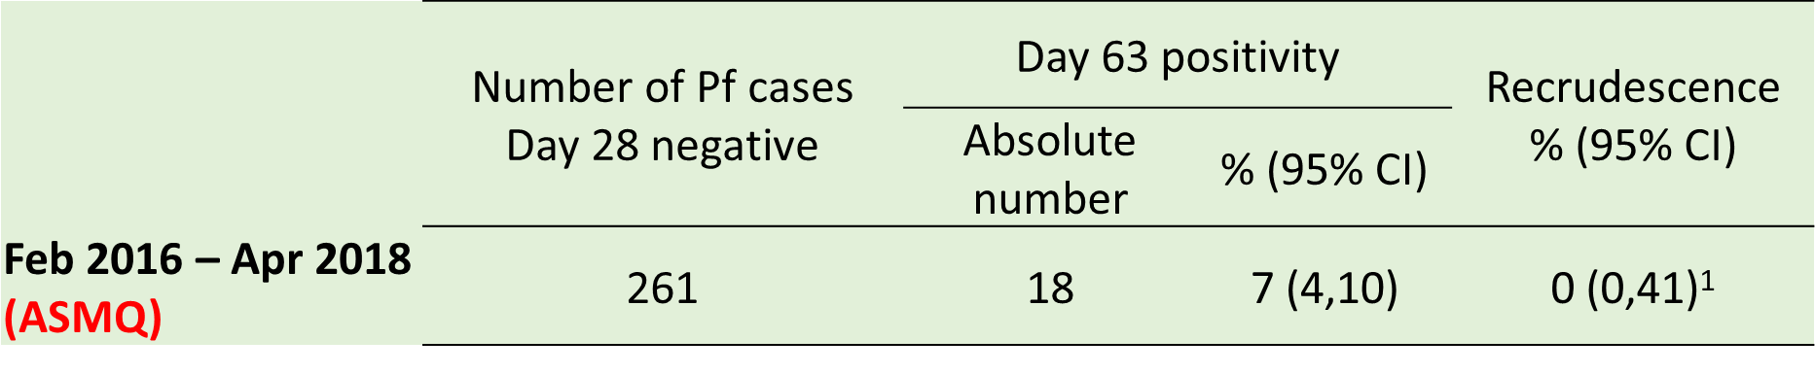
Is the choice of Day 28 appropriate?
Does Day 28 not underestimate resistance due to late recrudescences?
¹ 7/18 are reinfections, 9/18 had insufficient genetic material and the results for 2/18 samples is still pending.
Conclusion: Day 28 is an appropriate endpoint

Slide 11
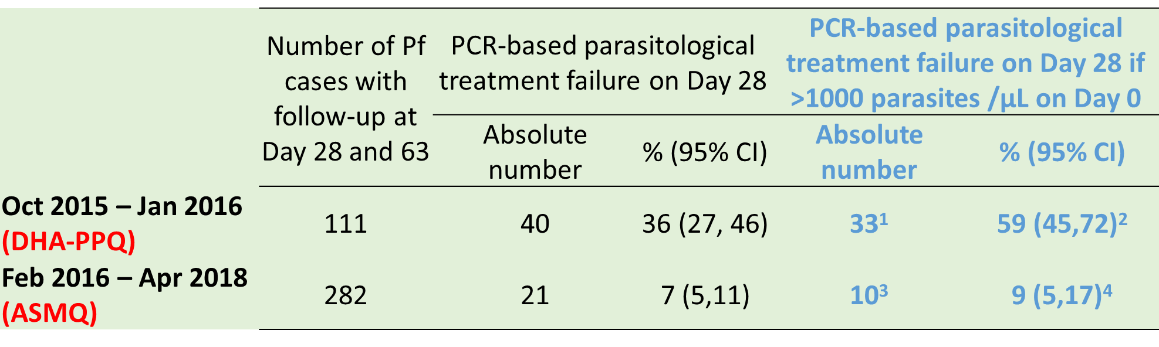
Is the inclusion of all patients appropriate?
Does inclusion of low parasitemic patients overestimate efficacy?
Note: Standard WHO protocol for therapeutic efficacy studies in low endemicity context: exclude patients with < 1000 parasites/µL
¹7/40 had a parasitaemia <1000 parasites /µL; ²56/111 initial Pf cases had > 1000 parasites/µ L,
³5/21 had a parasitaemia <1000 parasites /µL (6/21:results still pending. ⁴ 106/156> 1000 parasites/ µL
Conclusion: Including low parasitemic patients overestimates efficacy
Notes:
7/40 had a parasitaemia <1000 parasites /µL; ²56/111 initial Pf cases had > 1000 parasites/ L, which results in 59% (33/56) parasitological treatment failure on Day 28. ³5/21 had a parasitaemia <1000 parasites /µL and for 6/21 the parasitaemia results were still pending. ⁴ 156/282 initial Pf cases had parasitaemia data and 106/156> 1000 parasites/ L, which results in 9% (10/106) parasitological treatment failure on Day 28.
2 sample Chi squared test for equality of proportions with continuity correction:
P1: 61/393; P2: 43/162; two-sided; P-value:0.003667

Slide 12
Conclusions
Implementation is feasible - 60 % pts followed up on Day 28
PCR-based Day 28 treatment outcome is an appropriate indicator of efficacy
Including low-parasitemic patients (<1000 p/µl) may lead to overestimation of treatment efficacy

Slide 13
Relevance
Our high treatment failure rate of first line ACT
(DHA-PPQ) supported a priority switch to alternative ACT
(ASMQ)
This methodology is relevant in (pre-)elimination settings, especially in area with AR, where
  strengthened case management is in place
  need close monitoring efficacy
  and can be complementary to in vitro efficacy monitoring

Slide 14

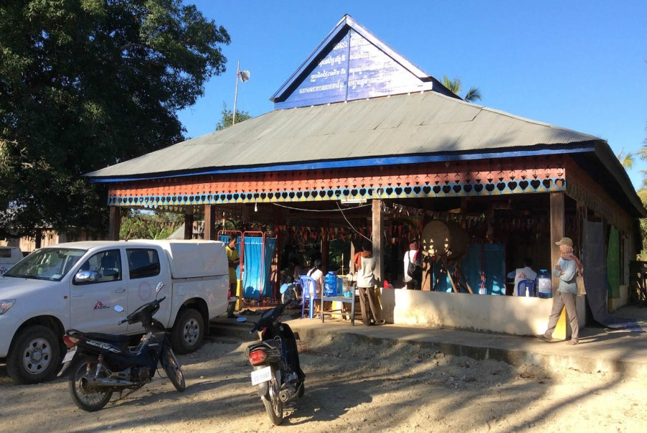

Thank you!
Study partners
Special thanks to:
the MSF national staff in Cambodia
the population of Chey Saen, Preah Vihear province, Cambodia
Copyright:Tim Dirven/Panos Pictures
martin.de.smet@brussels.msf.org

