Slide 1
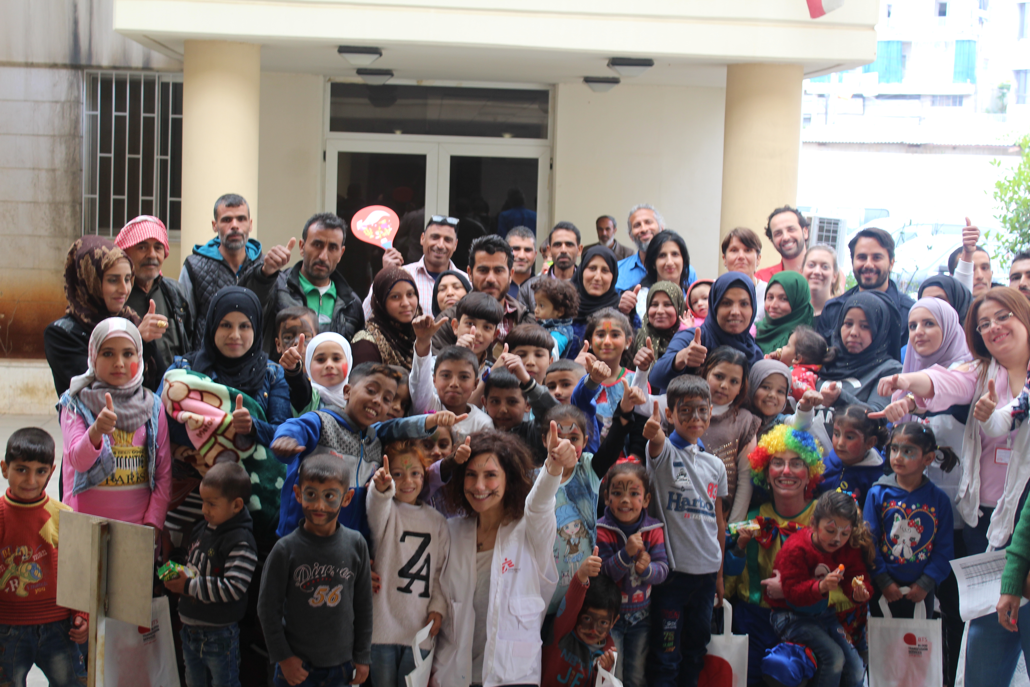
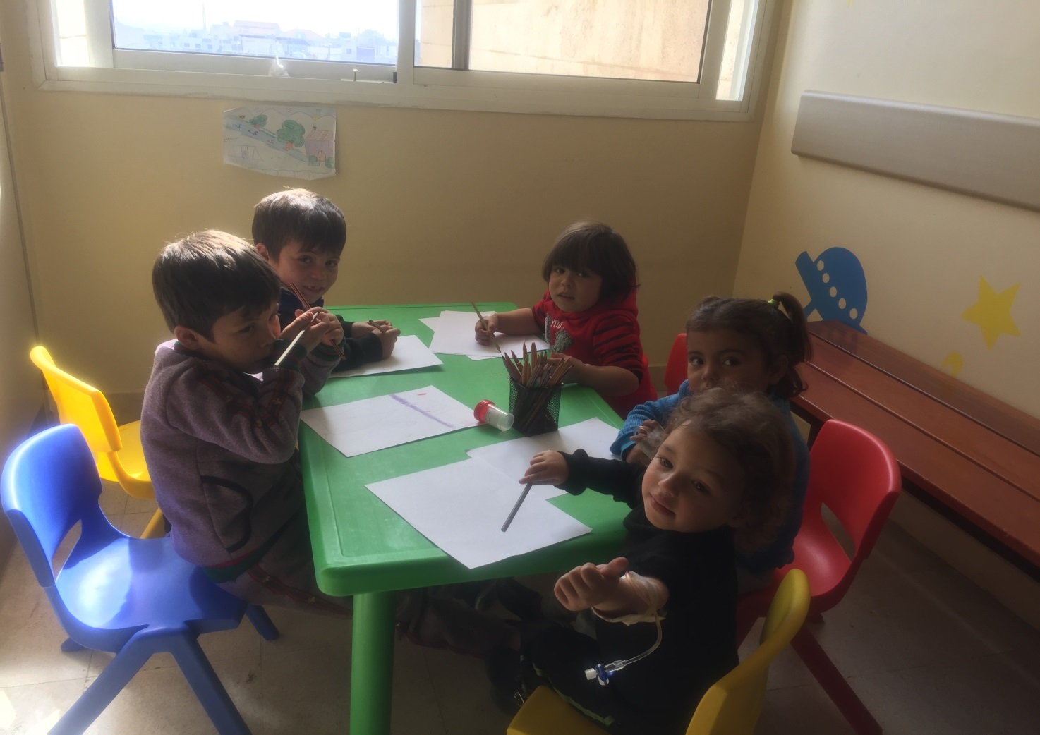
Treatment of thalassemia among paediatric Syrian refugees in Lebanon: MSF experience
L Issa¹, M Olla¹, Z Ghantous¹, R Malaeb², A Alayyan³, N Morton⁴
¹Médecins Sans Frontières (MSF), Beirut, Lebanon; ²MSF, Dubai, United Arab Emirates; ³MSF, Paris, France; ⁴MSF, Sydney, Australia
Background
Aim
Results
There are more than 8000 registered transfusion-dependent patients in Syria.
No published data is available about the prevalence of thalassemia among Syrian refugees in Lebanon
Thalassemia is a hereditary disease characterized by ineffective erythropoiesis and hemolysis leading to chronic anemia.
The recommended treatment for thalassemia includes lifelong regular blood transfusions, iron chelation therapy and comprehensive care including cardiac and endocrinology consultations.
The goal of transfusion therapy is to achieve appropriate hemoglobin level to promote normal growth, allow normal physical activities, and suppress ineffective erythropoiesis (target hemoglobin 9.5-11mg/dl).
Iron chelation is indicated when serum ferritin level >1000 ng/ml, which usually occurs after 10-12 transfusions.
Iron overload causes irreversible organ damage including heart failure, liver cirrhosis and hepatocellular carcinoma.
Refugees have no access for treatment of thalassemia in Lebanon; hospital admissions for blood transfusions and iron chelation medications are very expensive and UNHCR does not cover the costs of this treatment which is not affordable for refugees.
To describe the baseline clinical characteristics of MSF Paediatric thalassemia cohort, that was initiated in January 2018, as part of MSF Pediatric project in Bekaa Valley in Lebanon. MSF established a one-day thalassemia unit which provides comprehensive care for this complex neglected disease, that has a huge burden for the patients and their families especially among refugees in Lebanon.
Table 1: Clinical Characteristics (n=58) (Jan 2018/Jan 2019) |  | N | %
Age upon enrollment | Mean Range | 5.5 years 3 m-14.1 years | 35%
Diagnosed in the unit |  | 16 | 27.5%
Phenotype | Thalassemia Major Thalassemia Int. Sickle-thalassemia | 49 7 2 | 84.5% 12.1% 3.5%
Timing between Transfusions | < 14 days 14-21 days > 21 days | 17 19 22 | 29.3% 32.8% 37.9%
Average Hemoglobin | Pre Transfusion Post Transfusion | 8.5 g/dl 12.7 g/dl
Current iron chelation Treatment | Deferasirox (20 – 40 mg/kg) Desferoxamine (20 – 40 mg/kg) | 40 2
Treatment of thalassemia is lifelong blood transfusion & iron chelation
Table 2: Complications (n=58) | %
High LIC (n=20) | 90%
Cardiac iron overload (n=20) | 35%
Ejection Fraction < 50% | 0%
Hypothyroidism | 3.5%
Hypogonadism | 8.6%
Splenectomy | 19%
Thrombotic Events | 1.7%
Extramedullary Hematopoiesis | 29.3%
Hepatitis C | 15.5%
Positive PCR HCV | 6.9%
Since January 2019, 6 new patients were enrolled.
48 patients are on iron chelation.
*complications were acquired prior to enrollment in our cohort.
Methods
Inclusion criteria: Transfusion dependent thalassemia (TDT), non -Transfusion Dependent thalassemia (n-TDT), sickle thalassemia
Diagnosis was made or confirmed using hemoglobin electrophoresis and/or genetic studies for Beta thalassemia, with 16 patients diagnosed in the unit.
Data collected includes demographic and clinical characteristics, anthropometric details, quantity and frequency of transfusions, immunization status, lab and radiology investigations including MRI T2*, medications, psychosocial assessment of patients and their families and consultations.
Blood units are supplied in collaboration with Lebanese Red Cross.
First line for chelation therapy is oral DEFERASIROX (DFX), second line is DESFERIOXAMINE (DFO) which is delivered subcutaneously at home through a pump, DEFERIPRONE (DFP) is to be used as an adjunct to primary therapy for patients with cardiac iron overload, once available.
Iron chelation therapy costed 23,000 USD/month during 2018.
Conclusion
It is a new project for MSF, urged by the Middle East crisis that brought new medical and access challenges.
Cooperation with different Local NGO’s is essential for providing comprehensive care in the limited resources setting.
The presence of hepatitis C infection, high baseline ferritin levels and complications upon enrollment in this cohort, reflects the difficulties in access to safe and affordable treatment in this population.
The decrease in ferritin levels for most of the patients, and delivering appropriate and timely treatment for the newly diagnosed ones led to improvement in their quality of life.
Continuous increase in the number of patients and those on the waiting list, reflects the need to scale up.
The ability to scale up is limited by the high costs of the treatment, particularly ICT.
Currently 10 patients with thalassemia are waiting to be enrolled in our cohort
Acknowledgement
Special thanks to Khaled Mohammad our Data Officer who helped in putting this poster together.

