Slide 1


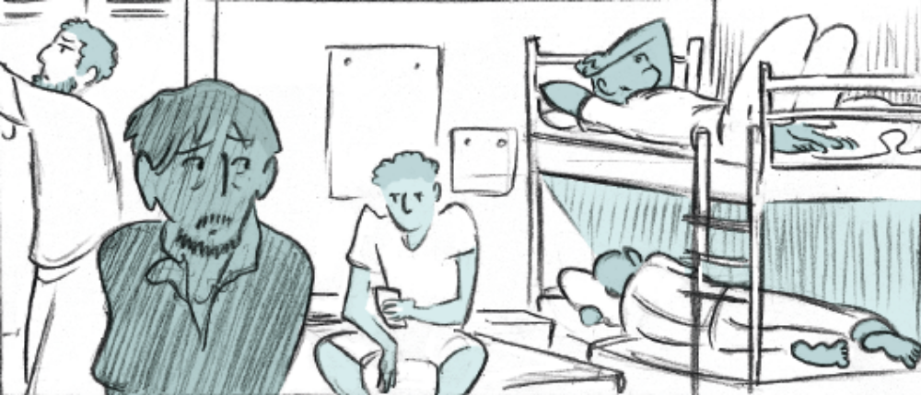
“Someone else is taking control”: qualitative exploration of autonomy and well-being for asylum seekers in two Belgian reception centres
Ella Lambe¹, Kate Whitehouse², Umberto Pellecchia², Michele Telaro¹, Rafael Van den Bergh²
¹Médecins Sans Frontières, Operational Centre Brussels, Belgium
²Médecins Sans Frontières, Operational Centre Brussels, Luxembourg Operational Research Unit (LuxOR)
Corresponding author: ella.lambe@gmail.com
Background
Results
In the centres, the staff are just protecting your life, not to die. That’s it. But, to be honest, it kills your emotions inside. It kills. You don’t feel your
value.
Asylum Seeker, Palestinian
Asylum seekers in European destination countries face prolonged stays in the national reception system.
During the implementation of an MSF psycho-social intervention in two Belgian asylum centres of the Federal Agency for the Reception of Asylum Seekers (Fedasil), a deterioration of mental health conditions was observed for long-term (>4 months) residents.
In order to improve the intervention, we explored the relationship between reception centre conditions, autonomy and well-being of asylum seekers.
Three themes related to well-being and autonomy emerged:
Insufficient and restrictive reception system processes: illustrated by frustration with regulations, limited control over daily life, absence of dialogue, and fractious relationships between asylum seekers and staff.
Environmental constraints and poor living conditions in the reception centres: including overcrowding, an absence of privacy and calm spaces, unsatisfactory food provision, and unhygienic sanitation facilities.
Lack of engagement and vision of future integration:
in particular insufficient facilitation of activities, training or entertainment leads to isolation, disengagement, and under-preparation for the future.
[The centres] are a bit like waiting rooms and I would try to turn them more into living rooms. Like actual places where people can live and maybe enjoy … to make the most out of the time – learn a new language, learn new skills, learn how to engage with other nationalities …
MSF Staff Member
Before when someone told me
“I have a headache”
I used to sit down and chat with them. Now
“I have a headache”,
I quickly get the paracetamol and give it to them because I know I have 10-15 other residents to see.
Fedasil Staff Member
©Ink Link, Louise Joor, 2018
Methods
This qualitative study was conducted in two reception centres in Belgium. 41 in-depth interviews were carried out with:
Asylum seeker residents (n=29)
Fedasil centre staff (n=8)
MSF project staff (n=4)
Purposive recruitment was used for asylum seekers (for variation in length of centre residency and family status) and staff (variation in job profiles). Interviews were conducted in English, French, or with a translator in Arabic or Dari. Interviews were audio-recorded, transcribed verbatim and manually coded using thematic analysis.
©Ink Link, Louise Joor, 2018
Post-migratory reception conditions in Belgium:
Conclusions
The reception system in this European “destination country” imposes constraints on asylum seeker autonomy and well-being.
Improved living conditions, access to comprehensive support (including but not limited to psycho-social care) and adapted opportunities to prepare for the future should be prioritised and implemented by relevant stakeholders.
Undermine personal autonomy
Acknowledgements
The research team thank the study participants, the translators, the volunteer transcribers and the MSF Belgium Project for their invaluable contributions to this study. This study was conducted through the Structured Operational Research and Training Initiative (SORT-IT).
Limit well-being
Hinder community integration
©Ink Link, Louise Joor, 2018

