Slide 1
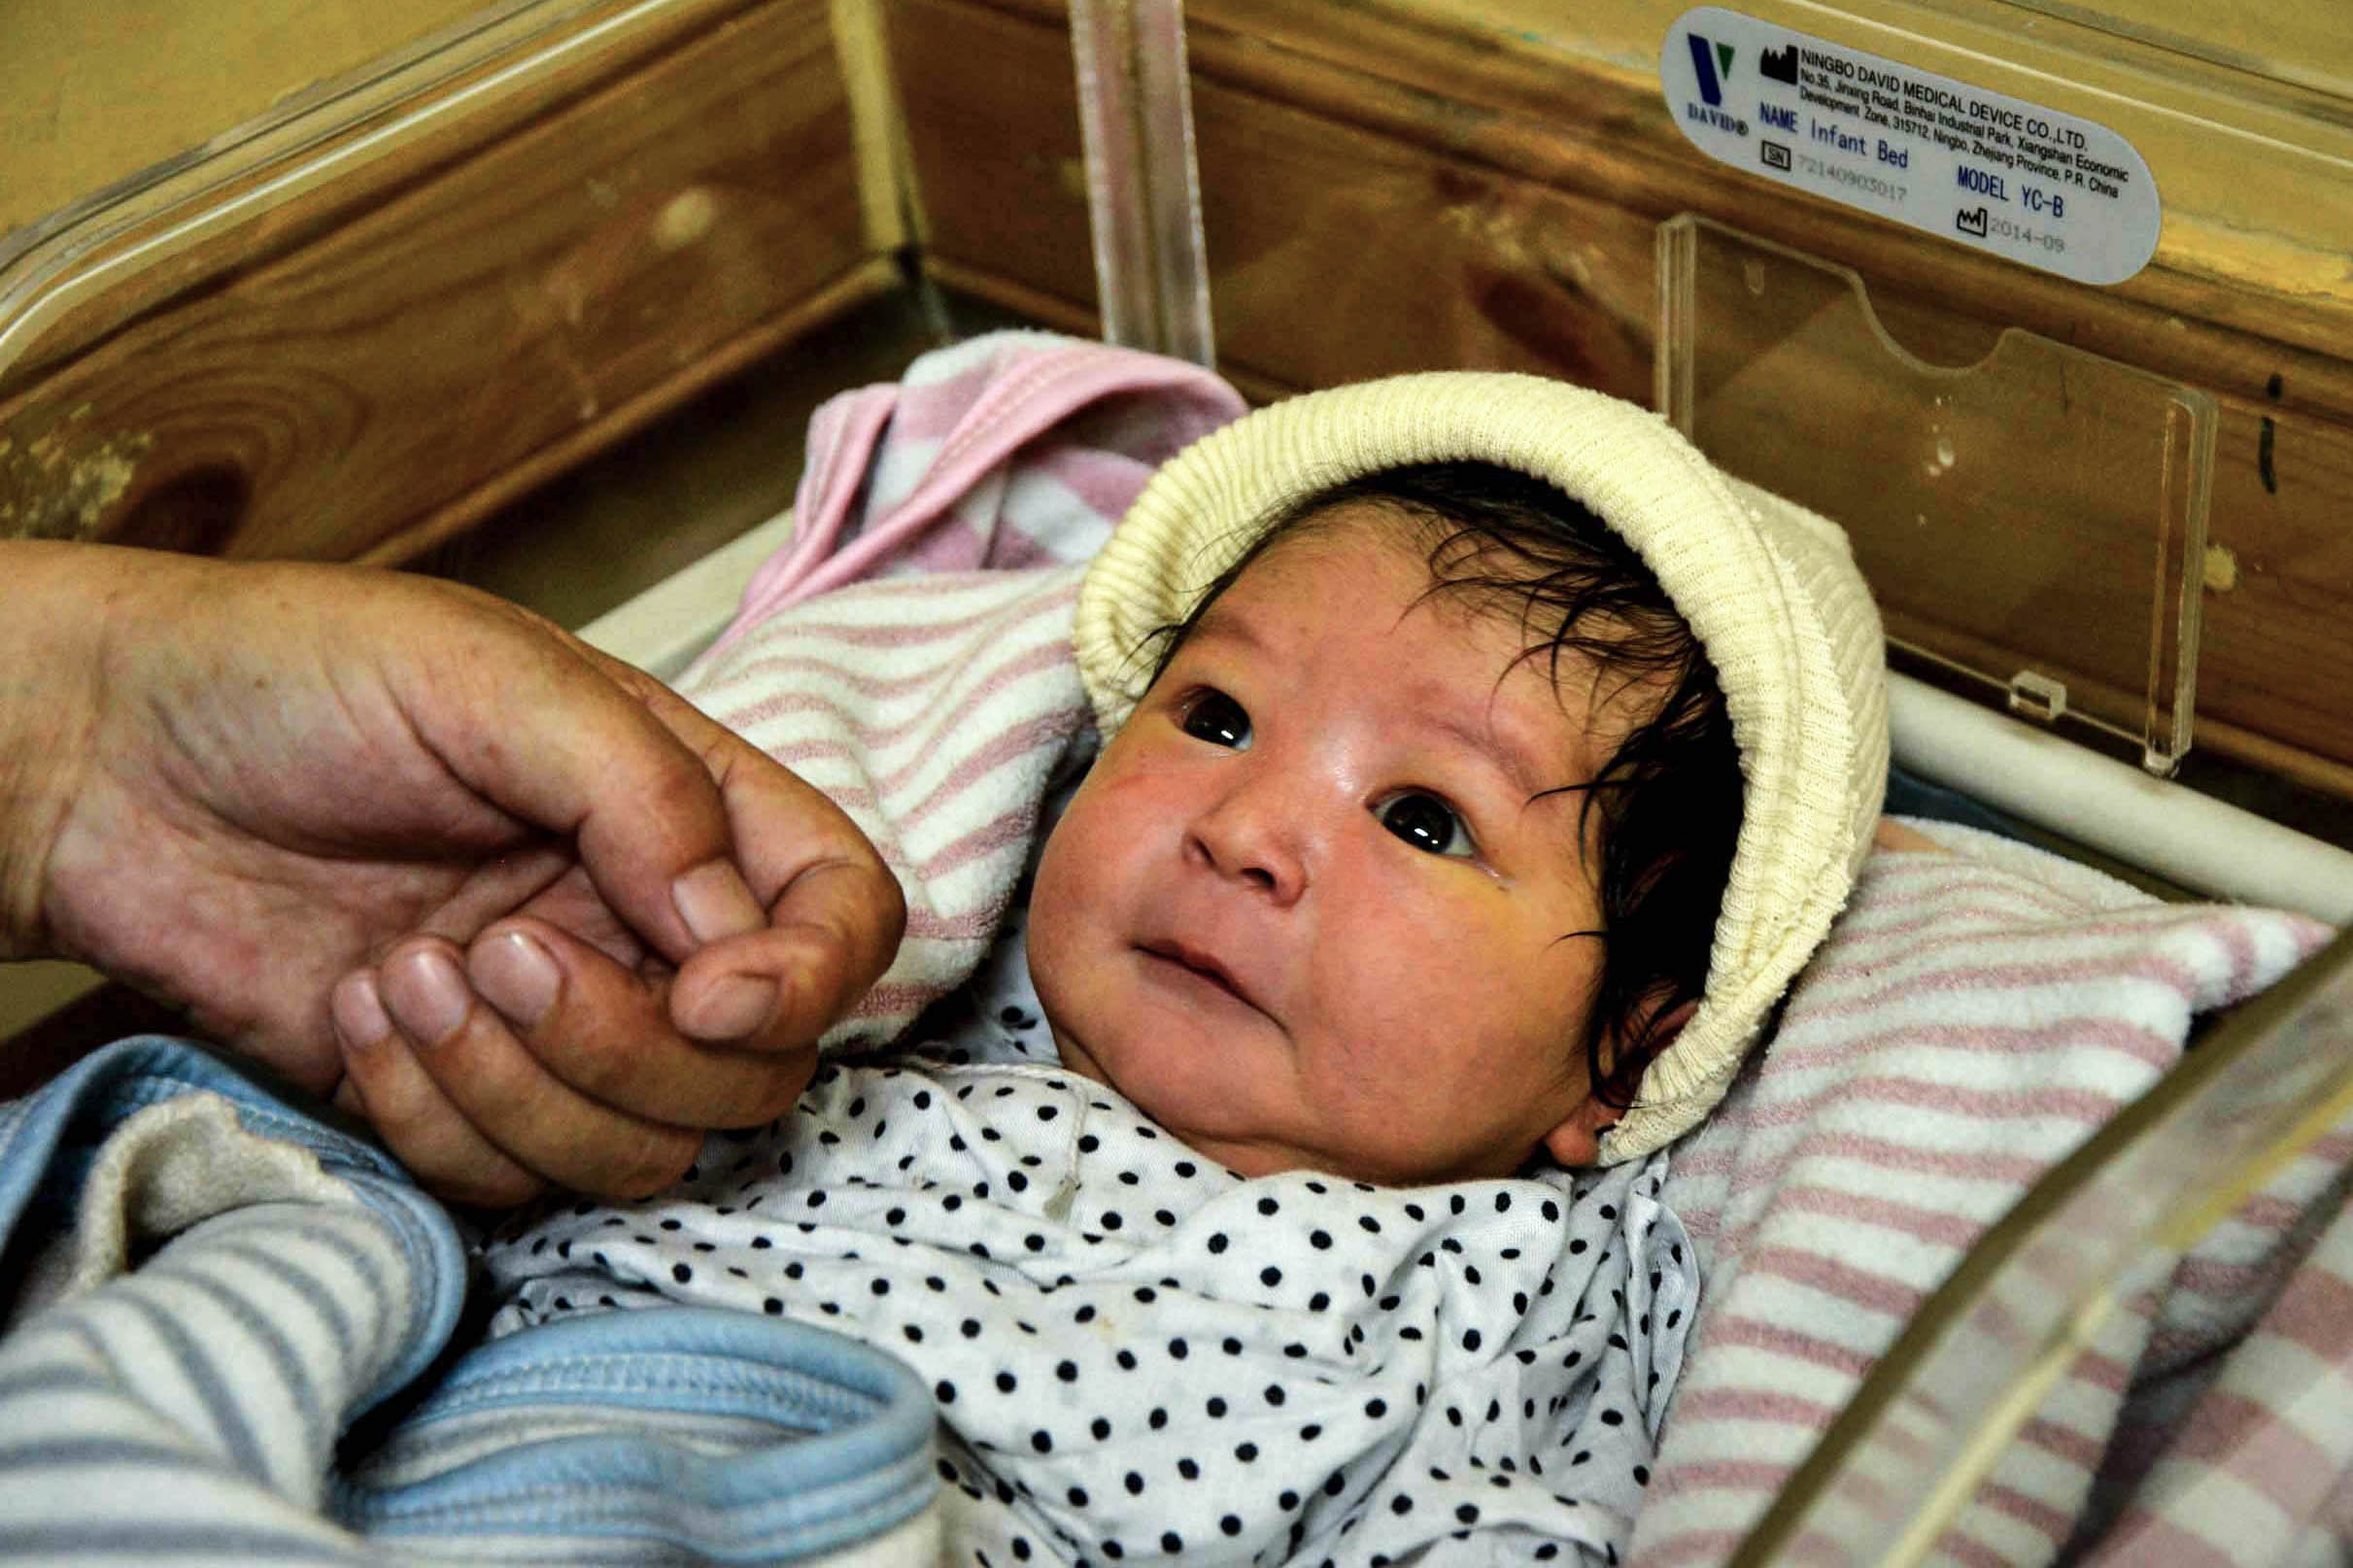
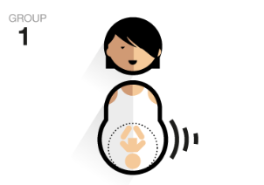

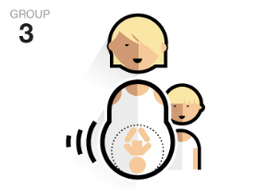

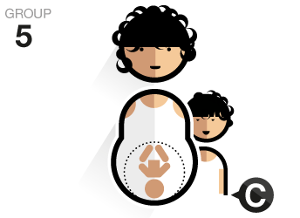
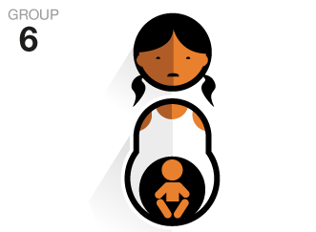
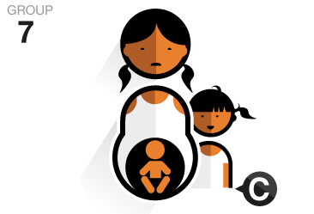



Implementation of the Robson classification of births, Dasht-e-Barchi Hospital, Afghanistan
Ghalib MK¹, Mukhtar W¹, Fotheringham C², Omar MF¹, Hemat H¹, Afzal F¹, Deslandes D¹, Morton N², Adel E¹
¹Medecins Sans Frontierès, OCP, Kabul, Afghanistan, ²Medecins Sans Frontierès, OCP, Sydney, Australia
Background and Aims
Methods
MSF’s Dasht-e-Barchi (DeB) maternity project in Afghanistan primarily serves the minority Hazara population in Kabul. This population has a high volume of deliveries (15630 in 2017) and a low rate of caesarean sections (CS) at 2-4%. The field team raised concerns in 2017 that their low CS rate could be contributing to a perceived high rate of birth asphyxia.
The Robson classification is a tool used to classify women according to characteristics at the time of birth that determine their risk of CS. It does not rely on identifying indication for CS. It is the method recommended by the WHO to compare CS rates between hospitals¹.
We aimed to:
Compare the CS rates for each Robson group at DeB to the rates recommended by the WHO
Identify if, using Robson classification, there is an obstetric population at increased risk of maternal or perinatal adverse outcomes.
A retrospective chart audit was performed of all births at DeB between 1 March and 30 June 2018.
Data collected for each patient included: Robson category, mode of delivery, composite of maternal mortality or maternal near miss (WHO classification), birth asphyxia, and perinatal death (Table 1).
Rates of outcomes were compared between Robson categories using Wilson’s method to calculate confidence intervals.
To our knowledge, this is the first Robson audit conducted in an MSF field
This is also one of few studies using the Robson classification to identify groups at increased risk of adverse maternal and perinatal outcomes
© Kate Stegeman/MSF
Table 1.
Robson group* |  | Nulliparous, singleton, cephalic, ≥37 weeks, spontaneous labour | Nulliparous, singleton, cephalic, ≥37 weeks, induced/ pre-labour CS | Multiparous, no previous CS, singleton, cephalic, ≥37 weeks, spontaneous labour | Multiparous, no previous CS, singleton, cephalic, ≥37 weeks, induced/ pre-labour CS | Multiparous, previous CS, singleton, cephalic, ≥37 weeks | Nulliparous, singleton, breech | Multiparous, singleton, breech | Multiple pregnancy | Singleton, transverse/ oblique lie | Singleton, cephalic, <37 weeks | Total
Births |  | 945 | 73 | 3389 | 77 | 184 | 32 | 88 | 78 | 5 | 140 | 5011
Caesarean sections | WHO 'guidance' rate | ≤10% | 20-35% | <3.0% | <15% | 50-60% | <50% | <30% | 60% | 100% | <30% | 10-15%
 | DeB rate | 2.65% | 19.18% | 0.88% | 11.69% | 14.67% | 15.63% | 13.64% | 14.10% | 100% | 5.71% | 2.91%
Perinatal deaths† or asphyxia‡ | Number | 22 | 1 | 74 | 4 | 3 | 10 | 21 | 7 | 1 | 5 | 148
 | Ratio per 1000 [95% CI] | 23 per 1000 | 14 per 1000 | 22 per 1000 | 52 per 1000 | 16 per 1000 | 312 per 1000 | 239 per 1000 | 90 per 1000 | 200 per 1000 | 36 per 1000 | 30 per 1000
 |  | [15 - 35] | [1 – 74] | [17 – 27] | [20 – 126] | [6 – 47] | [180 - 486] | [162 - 337] | [44 – 174] | [10 – 624] | [15 – 81] | [25 – 35]
*Robson Classification: Implementation Manual. Geneva: World Health Organization; 2017. Licence: CC BY-NC-SA 3.0 IGO.
†Intrapartum stillbirth or perinatal death prior to hospital discharge; ‡APGAR score ≤4 at 1 minute, ≤6 at 5 minutes or diagnosis at discharge
Results and Discussion
Conclusion
This audit has identified a
5011 deliveries were audited. The overall CS rate was 2.9% in this study period.
CS rates for each group were largely within the WHO guidance rates with the exception of groups 5 and 8.
The overall rates of perinatal death and birth asphyxia were 9 and 21 per 1000 births respectively, giving a composite adverse perinatal outcome rate of 30 per 1000 births, 95% CI [25-35].
Breech presentation was associated with a significant increase in adverse perinatal outcome for both primigravidas at 312 per 1000, 95% CI [180-486] and multigravidas at 239 per 1000, 95% CI [162-337].
Other potential risk factors such as previous CS, induction of labour and prematurity were NOT associated with an increased risk of adverse perinatal outcome.
Adverse maternal events were rare (5 cases) therefore no significant associations were identified.
This audit has a large sample size, which has enabled:
The obstetric activity at DeB to be accurately presented
Identification of statistically significant differences in the relatively rare cases of birth asphyxia and perinatal death between Robson groups
Direct comparisons between this audit’s rates of birth asphyxia and perinatal death cannot be made with the literature, as (i) definitions of ‘birth asphyxia’ are heterogenous, and (ii) perinatal deaths in this audit were limited to intrapartum stillbirth and death prior to hospital discharge rather than 7 days.
Nevertheless, rates of these outcomes could still be compared between Robson groups and significant differences were successfully identified. Robson audit can only identify association and not causation, as the underlying causes of birth asphyxia and perinatal death were not investigated as part of this audit.
Robson audit is feasible in MSF hospitals and WHO guidance CS rates appear appropriate.
MSF fields could potentially use Robson audit to identify high risk groups, although the audit itself cannot identify the reasons for increased risk.
At DeB, having identified a high risk group, the team has commenced an audit of breech births to investigate reasons for the association with adverse outcome, and to implement preventative strategies. We plan to re-audit in 1 year to assess if this has reduced rates of adverse outcomes.
population at significantly
increased risk of adverse
perinatal outcomes, those
with breech presentation
Acknowledgements
Patients, families and staff of Dasht-e-Barchi hospital
MSF Coordination, Kabul
Jenny Yang, Jovana Mastilovic and Alexandra Brown, MSF Australia
However, this audit has fulfilled its aim of identifying a high-risk population that can now be targeted with (i) a focussed audit of breech births to determine modifiable risk factors and (ii) strategies using this information to reduce adverse perinatal outcomes.
References
Robson Classification: Implementation Manual. Geneva: World Health Organization; 2017. Licence:CC BY-NC-SA 3.0 IGO.

