Slide 1
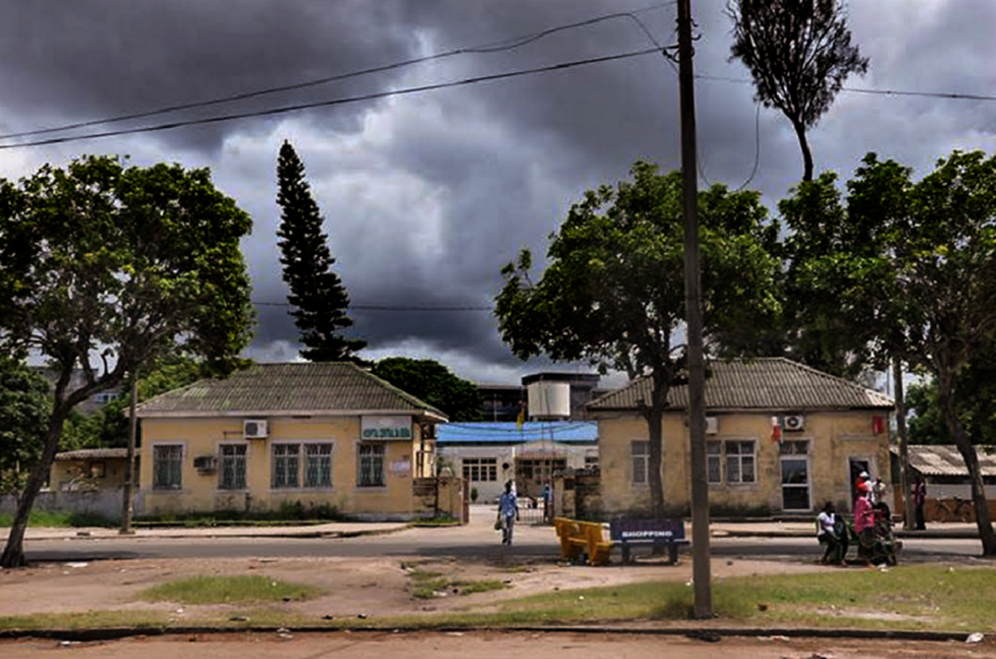
Outcomes for patients with advanced HIV disease at Beira Central Hospital: retrospective analysis
A Torrens¹, E Graglia¹, S Cruz¹, L Diamantino², JC Beirão¹, I Tarquino¹, C Perotti¹.
1. Medecins Sans Frontieres, Maputo, Mozambique; 2. Beira Central Hospital, Mozambique.
Background
54% of adult patients under observation at the emergency department were HIV(+)
There is a persistent burden of HIV-associated morbidity and mortality in countries most affected by HIV. Management of advanced HIV disease (AHD) started in Beira Central Hospital (BCH) emergency department (ED) in 2018 aiming to reduce morbidity and mortality related to opportunistic infections, mainly cryptococcal disease and tuberculosis, among HIV(+) in-patients. This study aims to describe clinical outcomes among AHD in-patients in BCH.
Methods
Beira Central Hospital main entrance.
Retrospective analysis of routinely-collected data of patients’ admitted at BCH ED. The analysis spanned July to December 2018. Standard descriptive statistics were used to report main findings.
23% of all HIV(+) patients hospitalized after been seen in the ED (regardless reason) died.
Results
E
ntry ED
H
IV screen
H
IV(
+
Among those with CD4 count <200 cl/µl, CrAg (serum) uptake was 95% (589/623), with 8% (49/589) positivity. 54 crypto CSF tests were done, with 14 positive. In total, 38 crypto meningitis treatment and 49 cryptococcemia preemptive treatments were initiated, and 75% (65/87) of those on same day of ED entry.
12% (127/1,039) of patients entered the ED already on TB treatment. Among the reaming 912 eligible, TB-Lam uptake was 71% (651/912), with 27% (177/651) TB positivity; and 282 patients had TB clinical diagnosis and 84% (384/459) initiated treatment at the hospital. In total 56% (586/1,039) of patients had TB.
Main diagnoses were: extrapulmonary TB 26% (271/1,039), anemia 26% (167/1,039), pulmonary TB 22% (228/1,039), pneumonia 21% (216/1039) and severe malnutrition 19% (201/1039).
62% (639/1,039) of patients were admitted in the wards. Outcomes of 987 patients was 80% (790/978) discharged, 17% (168/987) died, being 39% (66/168) of deaths before 48h. Average time in ED was less than 1 day and hospitalization 6 days (SD 7).
3,742
2,940
(
)
79%
)
1,595
(
5
4
%
)
H
IV(
+
)
assessed
1,039
(65%)
Figure 1. HIV screening at ED. BCH, 2018 S2.
1,039 HIV(+) patients were assessed. 49% (514) were male and mean age at entry was 39 (SD 12) years. 82% (852/1,039), were self-reported HIV(+), and of those 89% (678/852) were ART experienced, active in first line for a mean 3 years (SD 4y). 59% (615/1,039) presented danger signs at entry. 90% of
Lab samples were collected on same day of ED entry.
CD4 uptake was 96% (1,000/1,039), with 25% (260/1,039) with a CD4 count below 50 cl/µl and 35% (363/1,039) between 50-200 cl/µl.
Figure 2. Hospital outcomes among HIV(+) patients. BCH, 2018 S2.
Conclusions
The results highlight the high burden of AHD in BCH ED, considering majority of them were on 1st line ART failure, showing low CD4 count or danger signs. Leading causes of hospitalization were infectious diseases. This emphasizes the need for strengthening routine viral load for those receiving 1st line ART and isoniazid prophylaxis in the OPD.
High percentage of patients died in the first 48 hours after entry in ED, probably related to late arriving, condition severity and absence of intensive care. Still a high number of empirical treatments based on clinical diagnosis; need to improve the follow-up of protocols for laboratory diagnosis and treatment.
For questions or comments contact: msfocb-maputo-epidemio@brussels.msf.org or scientificday@london.msf.org
Acknowledgements
Ministry of Health of Mozambique, Sofala Provincial Health Department, Beira City Health Department, Beira Central Hospital and the MSF team in Beira Project.

