Slide 1
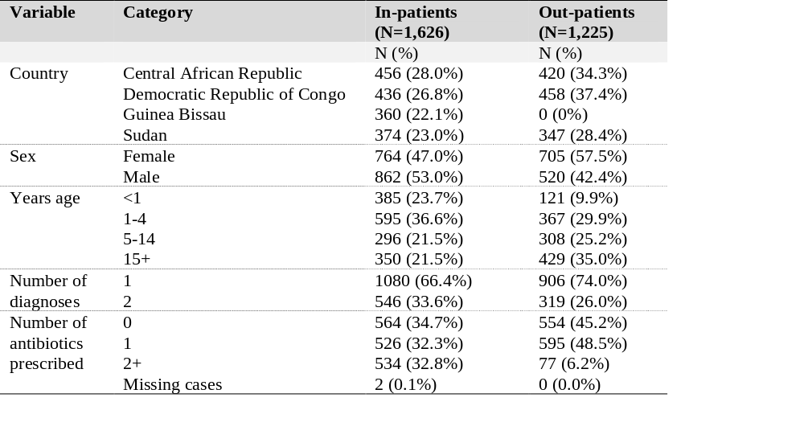
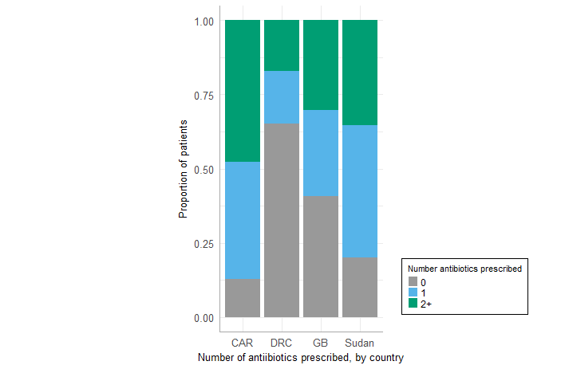
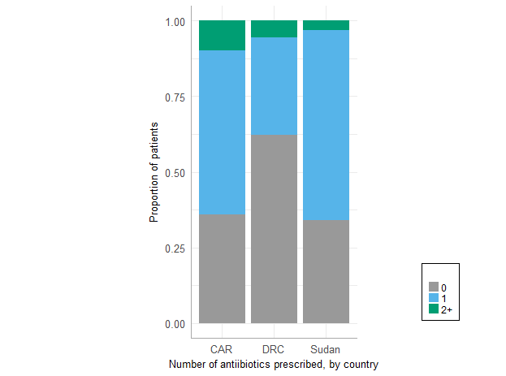
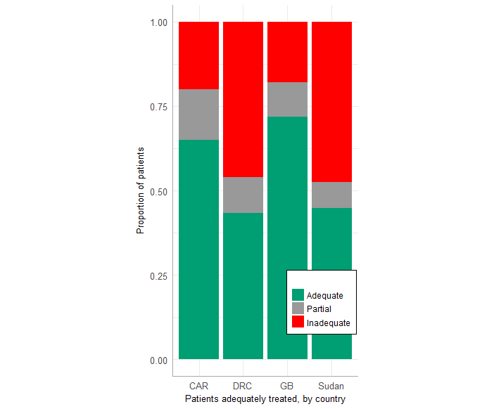
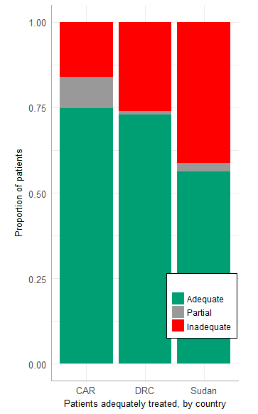
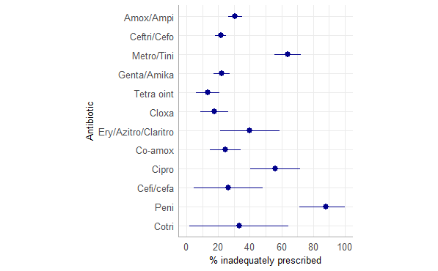
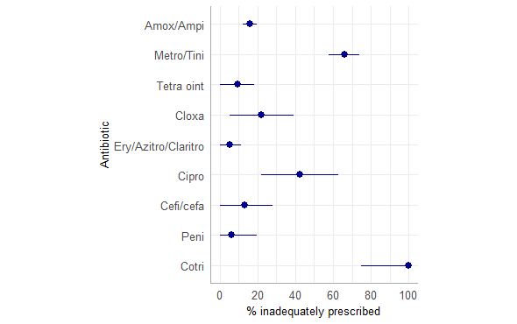
Appropriateness of antibiotic prescription in four MSF projects in Africa
Koscalova A.^{1,3}, Eibs T.¹, Jimenez C.², Lasry, E.², Kohler G.1^{1,2}, Owen N.B.^{1,4}, Turashvili M.¹
¹ MSF Evaluation Unit, Vienna, Austria; ²Médecins Sans Frontières, Barcelona, Spain; ³Slovak Medical University, Department of Infectious Diseases, Bratislava, Slovakia, ⁴Imperial College London, Department of Infectious Disease Epidemiology
Introduction
The growing development of antibiotic resistance hinders the benefit of antibiotics in controlling infectious diseases. Data on antibiotic use from the Sub-Saharan region is scarce. To evaluate the use of antibiotics (by prescribers and by patients) and to explore the main drivers within different contexts, a mixed methods evaluation was conducted in four MSF-OCBA projects: Lulingu, Democratic Republic of Congo (DRC); Kabo, Central African Republic (CAR), Tawila, Sudan and
Guinea Bissau (GB).
The quantitative results on adequacy of antibiotic treatment are presented here.
Results
The sample consisted of 1,626 in-patients and 1,225 out-patients, most of whom were children (Table 1).
Malaria, followed by lower respiratory tract infections (LRTI) and gastrointestinal conditions were the most common diagnoses.
Overall, one or more types of antibiotic were prescribed to 65% of in-patients and 55% of out-patients.
There was substantial variation by country in the number of antibiotics prescribed, with the proportion of in-patients receiving any antibiotics ranging from 87% in CAR to 35% in DRC.
(Figure 1a)
Table 1: Demographic and clinical characteristics
In-patients in CAR and DRC were also the most and least likely to receive multiple antibiotics, respectively. Prescription by country among out-patients followed a similar pattern (Figure 1b).
Among the 1,060 in-patients who were prescribed antibiotics, 58% were adequately treated, 12% were partially adequately treated and 31% were inadequately treated. The proportion adequately treated ranged from 43% in the DRC to 72% in GB (Figure 2a) and decreased step-wise with age (data not shown).
The proportion of out-patients who were adequately treated was higher than among in-patients, with 68% of the 672 who received antibiotics being adequately treated, 6% partially adequately treated and 27% inadequately treated. The proportion adequately treated ranged from 55% in Sudan to 75% in CAR (Figure 2b) and, as with in-patients, decreased with age.
Methods
Sampling
In- and out-patients were randomly sampled in clusters from Jan to Dec 2017
One patient record was randomly selected and then the 11 consecutive records (9 in Guinea Bissau).
The number of clusters sampled per month was proportional to the number of hospitalisations/ consultations in that month.
Variables
Demographics: Country, in- or out-patient, sex and age
Clinical variables extracted: diagnoses (1 or 2), antibiotic prescription
Clinical variables determined: adequacy of treatment (as defined by MSF or national guidelines)
Diagnosis work up not assessed
Data analysis
Calculated proportions (and 95%CI) of patients adequately, partially or inadequately treated. Partially adequate = a patient being prescribed one or more antibiotics correctly for their diagnosis but being prescribed another antibiotic incorrectly;
Calculated proportions (and 95%CI) of prescriptions which were inadequate for each antibiotic type and plotted.
Figure 1: Proportion of patients prescribed no antibiotics, one antibiotic or multiple antibiotics among a. in-patients and b. out-patients. CAR=Central African Republic, DRC=Democratic Republic of Congo, GB=Guinea Bissau
Figure 2 The proportion of antibiotic-receiving patients who were adequately, partially and inadequately treated, by country, among a. in-patients and b. out-patients. CAR=Central African Republic, DRC=Democratic Republic of Congo, GB=Guinea Bissau. There were no out-patients in Guinea Bissau.
Around a quarter of amoxicillin and ceftriaxone prescriptions, which were the most commonly prescribed antibiotics, were inadequate. (Figure 3)
Conclusion
Our data demonstrated wide use of antibiotics and relatively high proportion of inadequate treatment in all four project sites, varying by country, age group and health care level. Future antibiotic stewardship programmes in these contexts should focus on the high risk of misuse, targeting specific antibiotics, diseases and age groups.
Figure 3: Proportion of antibiotics prescriptions which were inadequate among a. in-patients and b. out-patients. Dots indicate proportion and lines indicate lower and upper 95% confidence intervals. Antibiotics are presented in descending order of frequency of prescription among the overall sample, respectively.
Acknowledgements
We thank all MSF field teams for their great support during the evaluation. We would also like to show our gratitude to all MSF and MoH staff that participated to this exercise. We are also immensely grateful to all community members that contributed to this evaluation.

