Slide 1
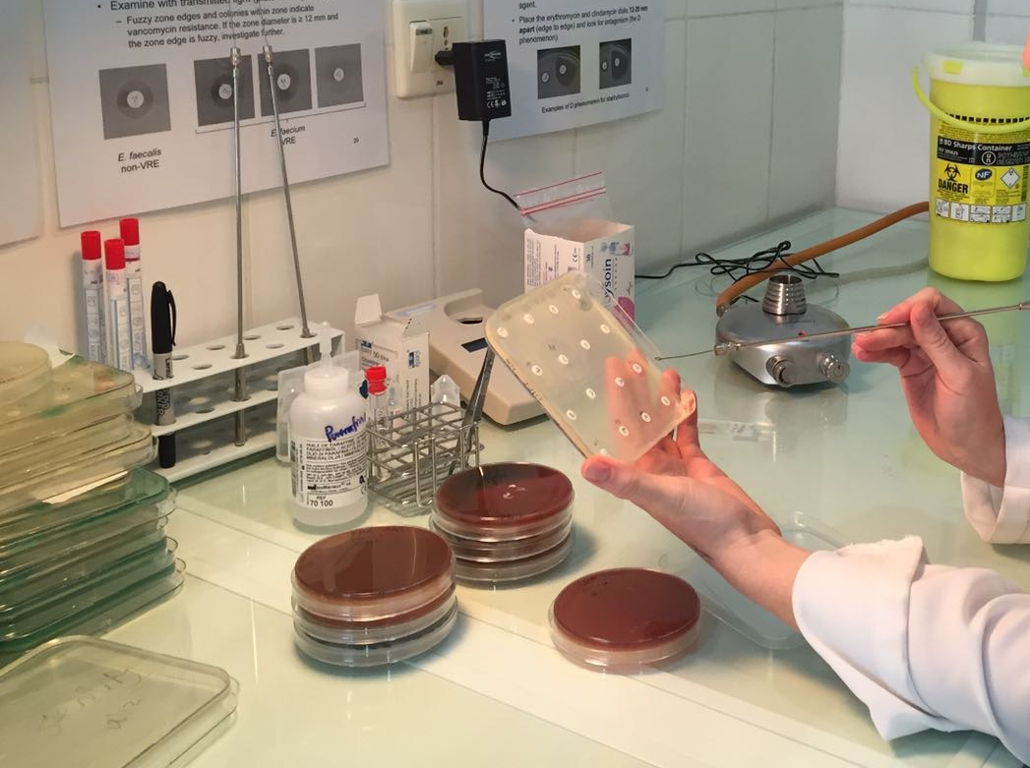
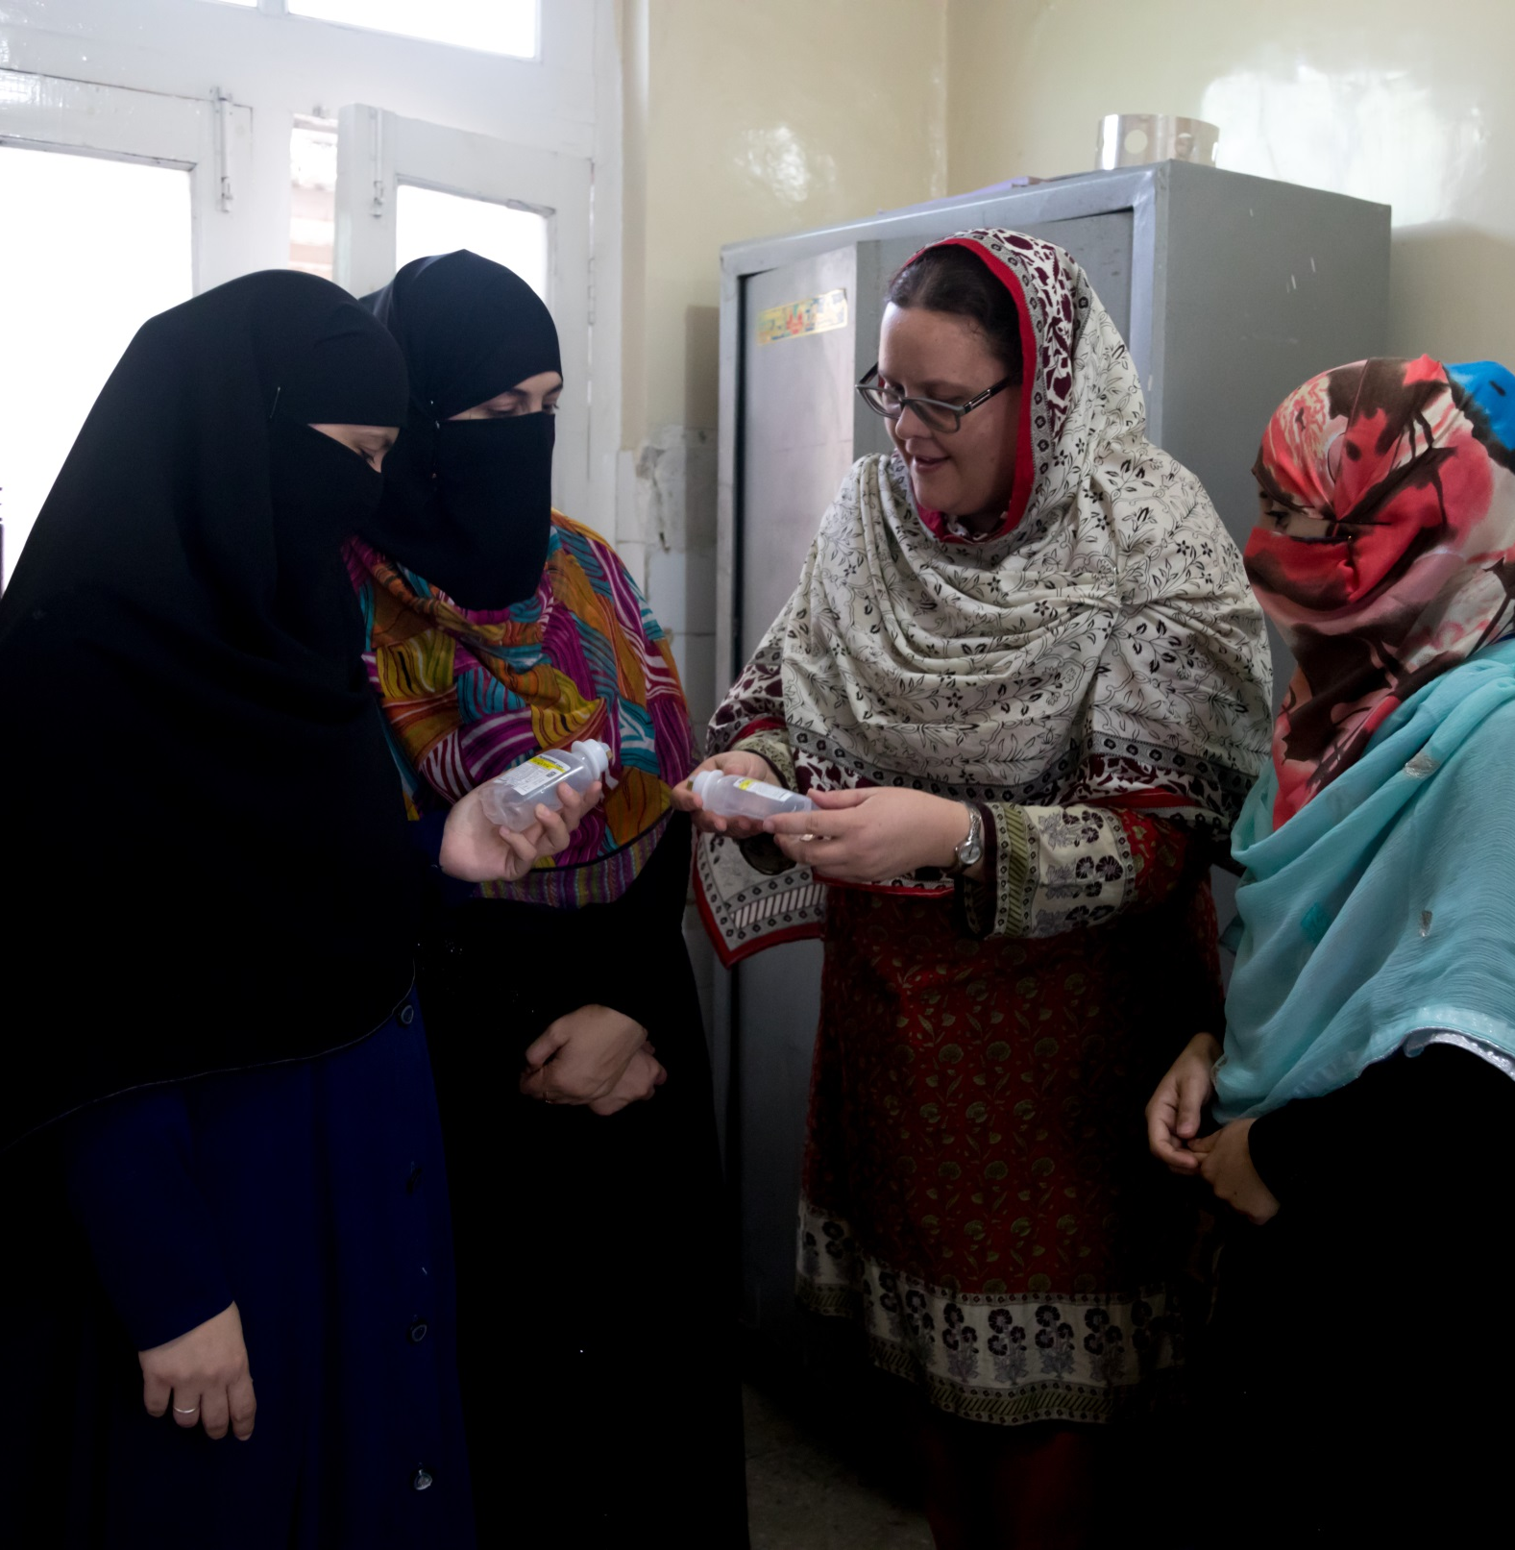
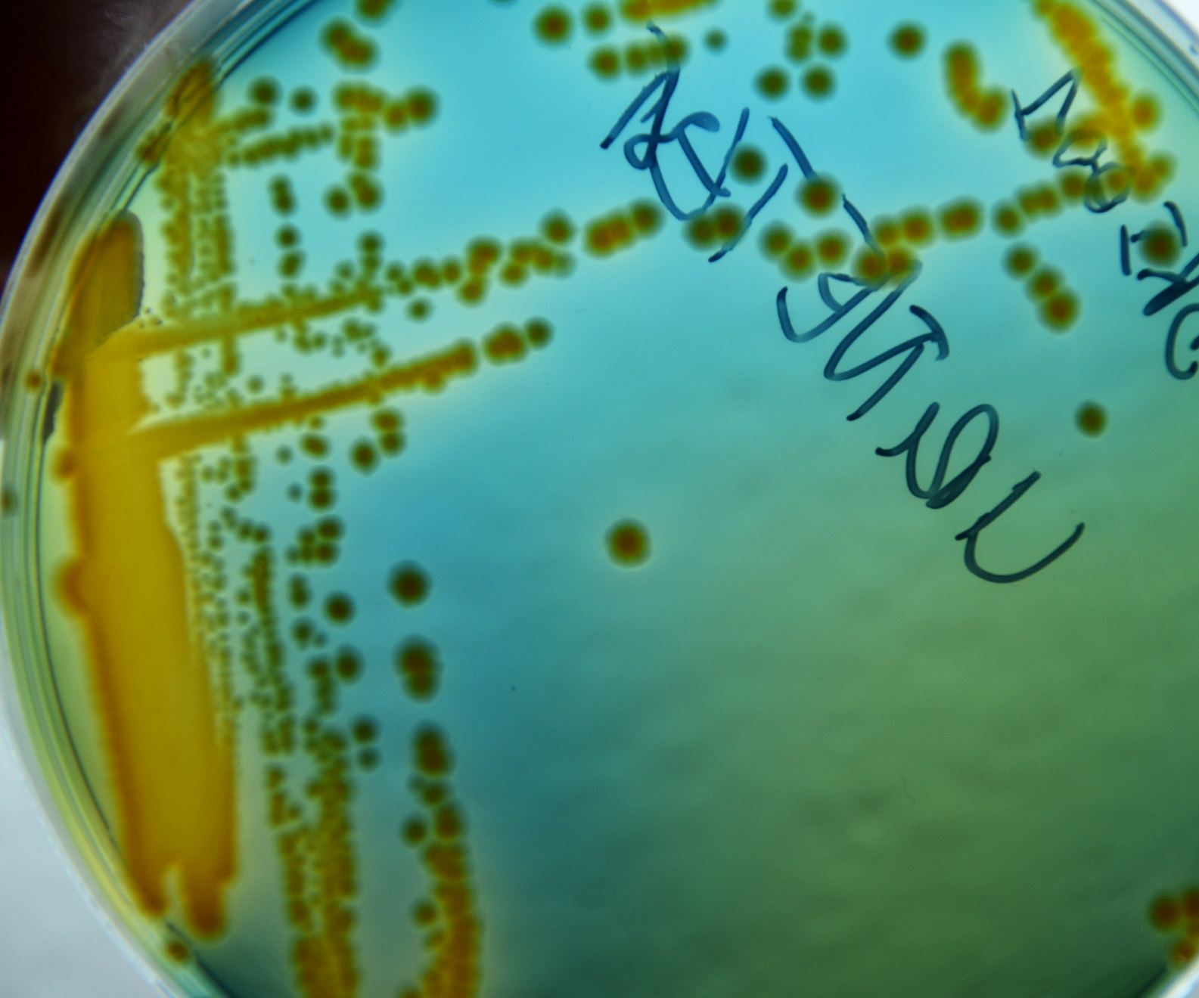
Prevalence of antibiotic resistance in patients with uncomplicated urinary tract infections, Timurgara District Hospital, Pakistan
Maarten Bullens¹, Andrei de Cerqueira Melo¹, James Lee^{1,3}, Said Raziq¹, Gul Ghuttai Khalid², Letizia Di Stefano⁴, Said Nawaz Khan¹, Anwar Zada⁵, Atta-Ur Rehman¹, Eric Lee¹, Rosa Auat⁴, Syed Mohammad Zeeshan⁶, Khalid Wahab⁶, Guido Benedetti⁷, Julita Gil Cuesta⁷, Anita Williams⁷
1. Médecins Sans Frontières – Operational Centre Brussels, Timurgara District Hospital Project, Pakistan 2. MSF-OCB, Islamabad Mission Coordination, Pakistan 3. MSF-OCB, Medical Department, Brussels, Belgium 4. MSF-OCB, Operations Department, Brussels, Belgium 5. Timurgara District Hospital, Pakistan Ministry of Health (MoH) 6. Aga Khan Laboratory, Karachi, Pakistan 7. MSF-OCB, Luxembourg Operational Research (LuxOR) Unit, Luxembourg
Multi-Drug Resistant Organisms
Aim
Results
Specific extended spectrum β-lactamase (ESBL) testing was not performed, however through interpretation of the resistance measurements of 3rd generation cephalosporin’s and monobactams, 29% of the K. pneumoniae and 65% of the E.coli isolated may be ESBLs (1).The S. aureus found in this study is an Methicillin-Resistant S. aureus (MRSA).
To assess the pathogens associated with uncomplicated urinary tract infections (UTI) and their antibiotic sensitivity in patients presenting at the Emergency Department (ED) of Timurgara DHQ
200 urine samples were tested, with significant bacteriuria found in 43 samples (22%), and one participant having a co-infection of E. coli and K. pneumoniae (44 isolates).
Methods
List of pathogens and frequencies detected in urine samples of participants (total n=44)
Study Population
Organism | n | %
Escherichia coli | 27 | 61
Enterococcus spp. | 7 | 16
Klebsiella pneumoniae | 7 | 16
Pseudomonas aeruginosa | 1 | 2
Staphylococcus aureus | 1 | 2
Streptococcus Group B | 1 | 2
Antibiograms of and percentage of resistance for Escherichia coli, Klebsiella pneumonia and Gram-positive organisms isolated from participants. Intermediate (I) and Resistant (R) have been combined.
Women 18 – 65 years old presenting with symptoms of an uncomplicated UTI (cystitis or pyelonephritis) to the ED of Timurgara District Hospital from September 2017 to December 2018.
Patients were excluded if they were pregnant, had more than three episodes of UTI in the past 12 months, or were being treated for urinary tract anomalies or other complicating factors (diabetes, cancer, gynaecological problems).
 | E. coli (n= 27) |  | K. pneumoniae (n= 7) |  | Gram-positive organisms (n= 9)
 | I+R (n) | % | I+R (n) | % | I+R (n) | %
Augmentin | 9 | 33 | 0 | 0 | 0 | 0
Ampicillin | 23 | 85 | 7 | 100 | 1 | 11
Aztreonam | 13 | 48 | 2 | 29 | 1 | 11
Cefixime | 18 | 67 | 2 | 29
Ceftriaxone | 18 | 67 | 2 | 29 | 1 | 11
Cefuroxime | 18 | 67 | 3 | 43 | 1 | 11
Ciprofloxacin | 14 | 52 | 0 | 0 | 6 | 67
Fosfomycin | 1 | 4 | 0 | 0 | 0 | 0
Gentamycin | 9 | 33 | 0 | 0 | 1 | 11
Nalidixic acid | 23 | 85 | 2 | 29 | 1 | 11
Nitrofurantoin | 3 | 11 | 3 | 43 | 0 | 0
Co-trimoxazole | 20 | 74 | 1 | 14 | 1 | 11
Of the 43 patients with a positive culture, 33 (78%) had experienced ≥1 UTI episodes in the previous 12 months.
Of these patients, seven had experienced ≥3 episodes of UTI in the past 12 months (21%).
First-line antibiotics prescribed empirically in the ED to participants according to MSF guidelines and the respective sensitivities of the isolates for those patients who had bacteriuria
 | All | Pos | R | I | S
Cefixime | 6 | 0 | - | - | -
Ceftriaxone | 2 | 2 | 1 | 0 | 1
Ciprofloxacin | 91 | 12 | 3 | 1 | 8
Fosfomycin | 101 | 28 | 1 | 0 | 27
Discussion
There are several limitations to this study. This is a single-site study with 200 samples from women.
For a full review of empiric therapy of UTIs, a broader representation of the population with more samples should be included.
There was also a potential for recall bias in the survey as the history of UTIs and previous antibiotic prescriptions was self-reported
The prevalence of bacteriuria (22%) in this study is lower than reported in similar studies (2). 14% of patients with bacteriuria were treated with an antibiotic that could be a failure and need further treatment. With the increase of microbial resistance, empiric therapy recommendations without taking local resistance data into account can lead to inferior treatment results.
There is a high level of ESBLs within this cohort, along with one isolate of MRSA. These organisms are circulating within the community and their presence should be taken note of for treatment guidelines of other infections.
Almost 60% of isolates tested for ciprofloxacin were resistant, with one-third of patients treated with ciprofloxacin having a resistant pathogen. Similar levels of resistance to ciprofloxacin have been reported in Pakistan². This high level of resistance to ciprofloxacin indicates that the use of ciprofloxacin as a first-line treatment for UTI in Pakistan should be discussed.
R: Resistant I: Intermediate S: Sensitive Pos: Positive
Sample Collection
In six of the 43 participants with positive bacteriuria (14%), the causative pathogen was resistant (or intermediate resistant) to the prescribed first-line antibiotic.
Nitrofurantoin was not available within the clinic to be prescribed during the time of this study.
As per routine method, all urine samples were tested using a dipstick.
Samples with a dipstick result of ≥25 leukocytes/µL and/or a positive nitrate test were sent to the Aga Khan Laboratory in Karachi for microbiological culture and sensitivity (MCS) testing.
The Kirby-Bauer method for disk diffusion and CLSI breakpoints were used.
Conclusion
This study highlights the presence of resistance within urinary pathogens to first-line antibiotics as per the MSF guidelines. It also indicates a high prevalence of resistance to ciprofloxacin and the presence of multi-drug resistant organisms within this population
In order to inform local prescription recommendations, continued surveillance should be implemented.
References
Laboratory Detection of Extended-Spectrum β-Lactamases (ESBLs) | HAI | CDC [Internet]. [cited 2019 Mar 6]
Jafri SA, Qasim M, Masoud MS, Rahman M-, Izhar M, Kazmi S. Antibiotic resistance of E. coli isolates from urine samples of Urinary Tract Infection (UTI) patients in Pakistan. Bioinformation. 2014;10(7):419-422
Acknowledgements
Nurses of Timurgara Hospital
Amjad Mohammad Khan, Muhammad Parvez, Mujeeb, Nazir Ahmad, Nadeem Ur Rehman
Notes:
There are several limitations to this study. It is a single site study with 200 samples from women.

