Slide 1
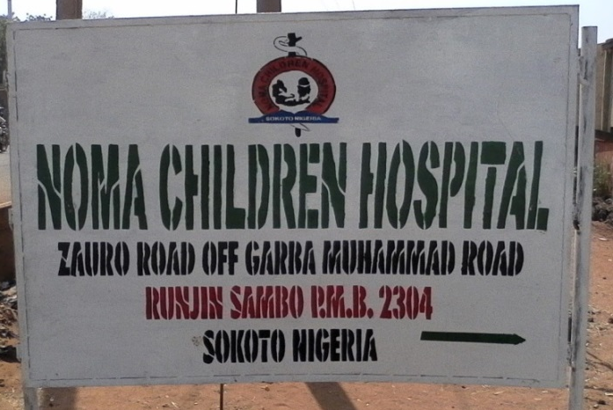

Prevalence of and beliefs about noma in northwest Nigeria
Juliana Oyemakinde
On behalf of the
MSF Noma Working Group
Notes:
Hello and thank you for this opportunity to present our research on noma, my name is Juliana Oyemakinde and I am the research study coordinator in Sokoto, Nigeria.
Today I will be presenting the aims, methods, results and conclusions of our study which aimed to assess the prevalence of and beliefs about noma in northwest Nigeria.

Slide 2
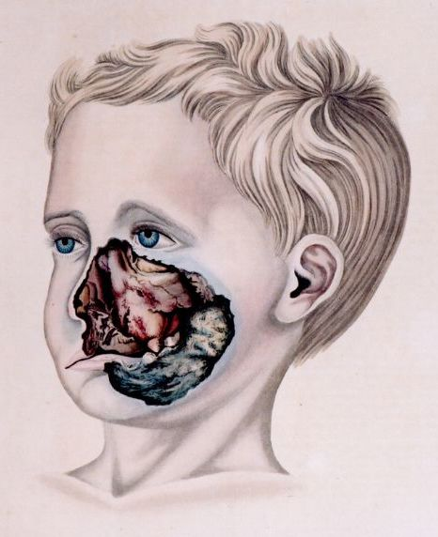
Noma
Rapidly acting orofacial gangrene
If untreated, reported 90% mortality (2)
Mostly affects children aged 2 – 5 (3)
Minimal research available
Risk factors:
    Nutritional factors and feeding practices
    Immunosuppression and co-infections
    Caretaker demographics
    Poor oral hygiene (2-4)
Noma - sketch from 1836 (1)
Prevalence of and beliefs about noma by Juliana Oyemakinde
Notes:
Noma, also known as cancrum oris
Is an infection of the oral cavity which causes disintegration of the cheek and sometimes nose and eye in under a week
If untreated, noma has a reported 90% mortality rate, and mainly affects children aged 2 – 5 years
For those who survive, noma leads to severe facial disfigurements, functionality issues and stigmatization
Limited research has been conducted on noma
And it has not yet been added to the WHO’s Neglected Tropical Diseases list
Noma typifies the complex interactions between malnutrition, poor sanitation, poor oral hygiene practices and immunosuppression.
Other risk factors include the caretaker being someone other than the mother, and colostrum not being given at birth.

Slide 3
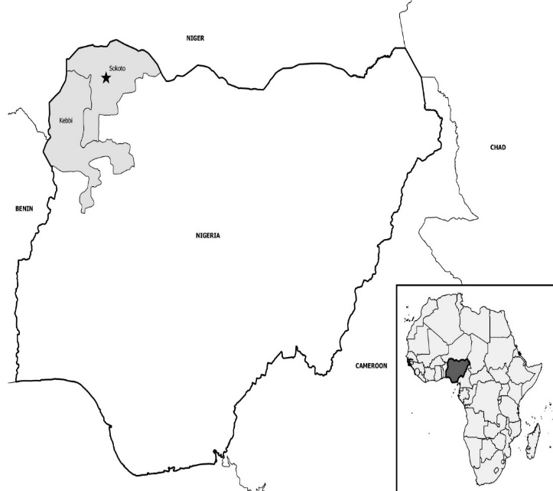
Noma Children’s Hospital
Run by the Nigerian Ministry of Health
MSF support since 2014
Programs include:
    Surgical interventions
    Nutritional support
    Psychosocial support
    Physiotherapy
    Outreach
Sokoto
Niger
Kebbi
Chad
Benin
Nigeria
Cameroon
Prevalence of and beliefs about noma by Juliana Oyemakinde
Notes:
The Noma Children’s Hospital in Sokoto has been providing treatment for noma patients for many years; and since 2014 MSF have supported programs at the hospital.
These programs include:
Surgical interventions
Nutritional support
Psychosocial support
Physiotherapy
Outreach

Slide 4
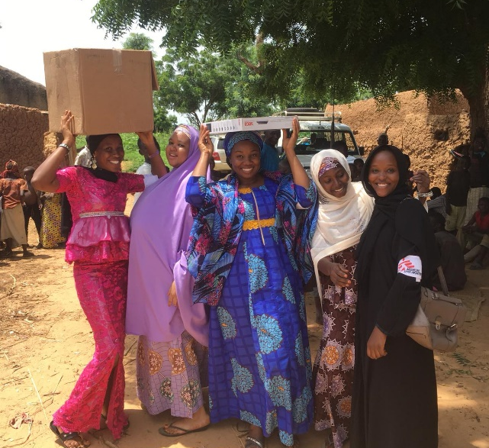
Aim
Operational research agenda
Study aim: Estimate the prevalence of noma and better understand naming and beliefs about the disease
Prevalence of and beliefs about noma by Juliana Oyemakinde
Notes:
This study forms part of a larger operational research agenda for noma, this agenda aims to add to the scant body of knowledge on noma, and to provide useful information on the disease for program planning and advocacy.
We aimed to estimate the prevalence of noma in northwest Nigeria to guide MSF programming
And
to better understand the concepts, perceptions and Hausa terms for noma in the Sokoto community.

Slide 5
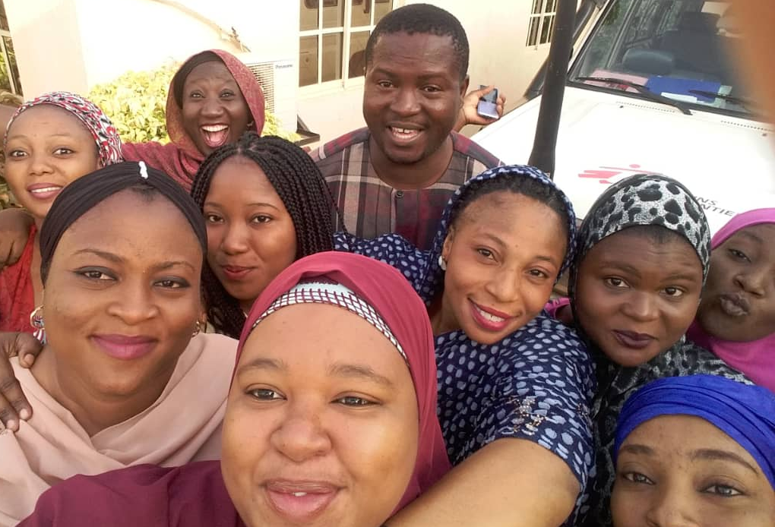
Methods- prevalence
Cross-sectional survey
Two stage cluster random sampling proportional to population size
Village geo-sampling using satellite imagery
Household questionnaire with caretaker
Oral screening and MUAC (2)
Weighted estimates of noma prevalence calculated
Prevalence of and beliefs about noma by Juliana Oyemakinde
Notes:
Methods
We carried out a two-stage study from June 2017 to November 2018 in northwest Nigeria. The prevalence study used two-stage cluster random sampling, proportional to population size, we conducted village geo-sampling using satellite imagery. We included 177 clusters and 3499 households, sampling all individuals aged under 15 years.
Caretakers answered a structured questionnaire. Oral screening was carried out using the World Health Organisation noma classification. Mid-upper arm circumference for those aged under 5 years were measured.
We conducted a weighted analysis of noma prevalence and severe and moderate acute malnutrition in children under 5 years.
Single and multivariate analysis, stratified by age group, was conducted using logistic regression to estimate factors associated with prevalence.

Slide 6
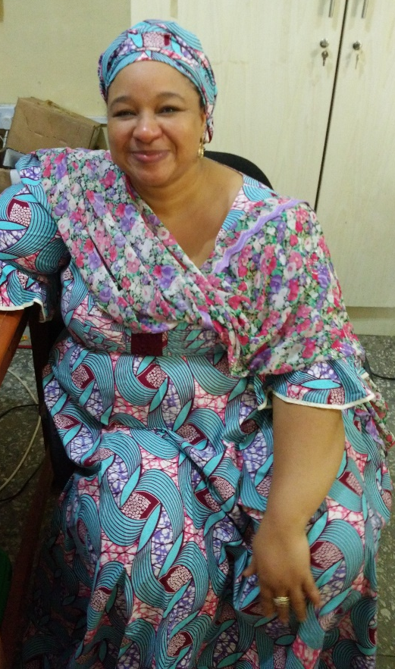
Methods- language and beliefs
5 focus group discussions
12 in-depth interviews
Emergent codes, patterns and themes compared
Ethics obtained from MSF, UDUTH, Sokoto and Kebbi ERB’s
Prevalence of and beliefs about noma by Juliana Oyemakinde
Notes:
Five focus group discussions were held with caretakers of noma patients and 12 in-depth interviews were held with hospital staff.
Topic guides used for interviews were adapted to encourage the natural flow of conversation.
Themes were identified.
Ethical approval was obtained from MSF, UDUTH, Sokoto and Kebbi Ethical Review Boards

Slide 7
Results- Demographics prevalence
HOUSEHOLDS | n | %
Total households | 3499 | 100.00%
Caretaker Gender Female | 3423 | 97.83%
Male | 76 | 2.17%
Household total | Median 5 | IQR 4, 7
CHILDREN
Total number of children | 7120 | 100.00%
Age groups 0-5 | 4268 | 59.94%
6-15 | 2852 | 40.06%
Gender of child Female | 3713 | 52.15%
Male | 3407 | 47.85%
Prevalence of and beliefs about noma by Juliana Oyemakinde
Notes:
In the prevalence survey 98% of caretakers were female and the median household size was 5.
From these households, we included 7120 children, 60% aged 0-5, and 52% were female.

Slide 8
Results- Weighted prevalence, SAM + MAM
Stage | N | Weighted Prevalence | 95% Confidence Interval
Stage 0: Simple Gingivitis | 181 | 3.1% | 2.6-3.8%
Stage 1: Acute necrotizing gingivitis | 10 | 0.1% | 0.07-0.3%
Stage 2: Oedema | 3 | 0.04% | 0.01-0.1%
SAM (MUAC <115mm) | 149 | 3.8% | 3.2-4.5%
MAM (MUAC 115 – 125mm) | 311 | 7.8% | 6.9-8.9%
Prevalence of and beliefs about noma by Juliana Oyemakinde
Notes:
Simple Gingivitis was identified in 3%, children, Acute necrotizing gingivitis in 0.1% of children and Oedema
in 0.04% children. No stage 3 to 5 noma was detected in our study population.
The prevalence of SAM was 4% and MAM 8%.

Slide 9
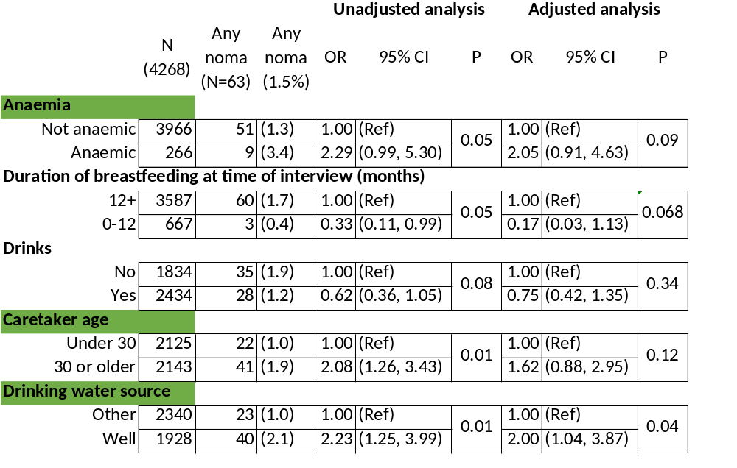
Results - 0-5 yrs
Notes:
The multivariate analysis showed that in the 0-5 age group noma cases were 2 times more likely than non noma cases to have anemia, a caretaker over the age of 30 and a well as the drinking water source.

Slide 10
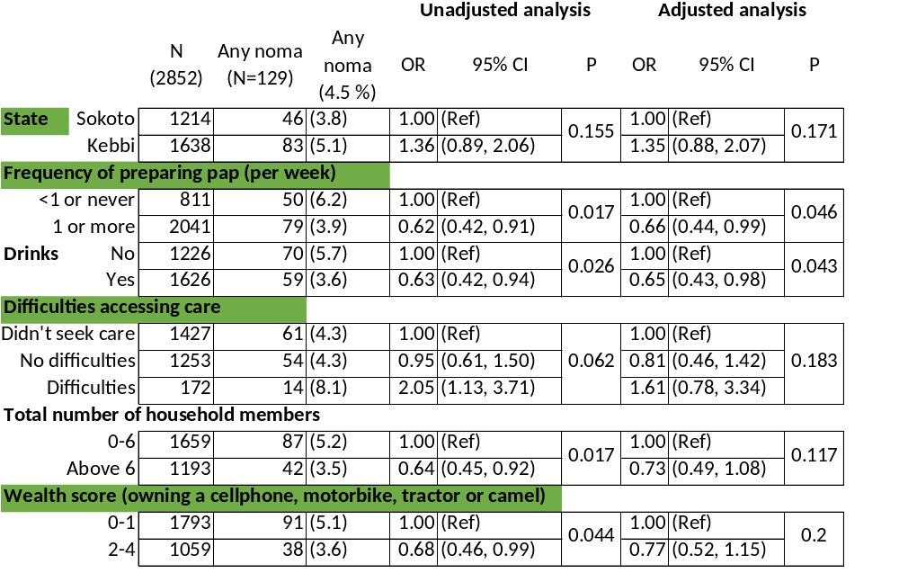
Results - 6-15 yrs
Notes:
The multivariate analysis showed that in the 6-15 age group noma cases were 1.5 times more likely than non noma cases to reside in Kebbi State and to have had difficulties accessing health care.
Respondents with no noma were more likely to have:
prepared pap once or more per week
have a higher wealth score

Slide 11
Results- Language and Beliefs
Names
Danhurawa
Iska
Maci Dan Wawa
Noma
Akin
Ciwon Daji
Tuareg
Spirits
Jinn
God
Animals/insects
Insect
Bird
Disease
Previous Infection
Measles
Prevalence of and beliefs about noma by Juliana Oyemakinde
Notes:
Our study uncovered two main themes: names including descriptions and explanations for noma, and risks and consequences of the disease.
Naming of the disease differed between caretakers and heath care workers.
Beliefs were varied; with a wide range of causes being reported including spirits, animals and insects and previous illnesses.
Difficulty in accessing care for noma patients was evident and the findings suggest a variety of actions taking place before reaching a health centre or health worker.
Barriers to care and lack of knowledge and trust were mentioned by some participants. The impact of noma was not limited to physical presentation; participants in our study spoke of the mental health strain the disease placed on them as carers, and stigmatisation was mentioned as a key difficulty.

Slide 12
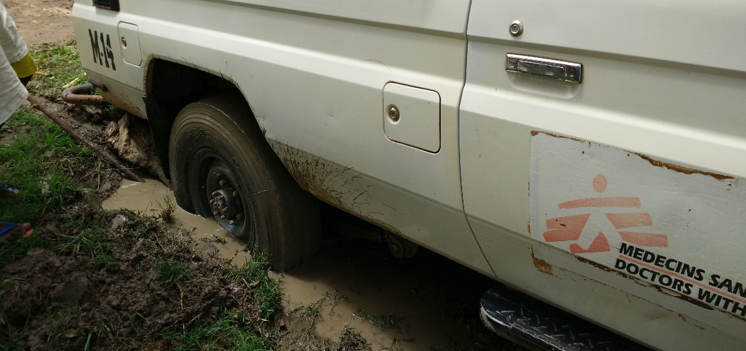
Limitations
  Security issues
  Road infrastructural difficulties
  Social desirability bias
  Limited cases identified
    Age
    Rapid progression of infection
Prevalence of and beliefs about noma by Juliana Oyemakinde
Notes:
There are several limitations which have impacted the projects. These include:
Security issues and Road Infrastructural difficulties limited the study area
Social desirability bias, especially in qualitative interviews
Ages included could limit cases found
Due to the rapid progression of noma, there is a chance we would only come across a fraction of actual cases due to the cross sectional design of the study

Slide 13
Conclusions
Findings:
Many precursor stages of noma were identified
Identifiable factors associated with high and low prevalence
Differences in disease naming and beliefs
Pluralistic understanding of noma
Implementation:
Outreach messaging, information booklets and patient communication at NCH
Advocacy to get noma on WHO’s Neglected Tropical Diseases list
Prevalence of and beliefs about noma by Juliana Oyemakinde
Notes:
Many cases of the precursor stages of noma were identified, particularly in children aged older than 5 years. The absence of stages 3-5 in our survey requires further investigation.
Factors associated with high prevalence of noma include health issues such as anemia, difficulties accessing health care, water source, and state of residence.
Factors associated with low prevalence of noma include food intake and preparation (including in infancy), household size and economic status of the family.
Our findings suggest there is no primary explanation within this community for the disease. Differences in disease naming illustrates the difference in beliefs and has an impact on health seeking behaviour.
Our findings from this study will be utilized in program planning including changes in outreach messaging, program information booklets and the language used to describe the disease when talking with patients.
The findings will also be used as part of an advocacy strategy led by the Nigerian Ministry of Health which aims to place noma on the WHO’s Neglected Tropical Diseases list

Slide 14
Acknowledgements
Patients and caretakers
MSF noma working group: Elise Farley, Modupe Juliana Oyemakinde, Jorien Schuurmans, Aisha Abubakar, Fatima Saleh, Gloria Uzoigwe, Karla Bil, Bukola Oluyide, Nma Muhammed Jiya, Simba Tirima, Adolphe Fotso, Mohana Amirtharajah, Jorieke Vynke, Raphael Brechard, Adeniyi Semiyu Adetunji, Koert Rietmeijer, Saskia van der Kam, Denise Baratti-Mayer, Ushma Mehta, Shafiu Isah, Chikwe Ihekweazu, Beverley Stringer, Annick Lenglet
Study team: Aisha Abubakar, Amina Abubakar, Linda Torhee, Dalhat Bello, Victoria Agboarumi, Hassana Abdullahi, Christiana Abuka, Jiya Hassan Abdulmalite, Hussaina Bala, Paschal Aneke, Christiana Peter, Betty Nwokocha, Aliyu Muhammad, Maryam Abdulmu-min Imam, Sarah John, Gladys Simon, Buhari Ahmed, Maryam Adeola, Maryam Suleiman, Emmanuel Ameh, Nafisa Abubakar, Victoria Egba, Angela Udie, Adaeze Ihechi Anyanwu,Eunice Yakuba, Shafaatu Muhammad Bala, Hussiena Mohammed, Farida Ahmed
Missing Maps project volunteers
Noma Children’s Hospital staff and Nigerian Ministry of Health
Prevalence of and beliefs about noma by Juliana Oyemakinde
Notes:
And a big thank you to:
The patients and caretakers who participated in this research
The MSF noma working group for their contributions to knowledge generation on this neglected disease
The hard working study team
The missing maps project volunteers
The Noma Children’s Hospital staff and the
Nigerian Ministry of Health for all their help on this project.

Slide 15
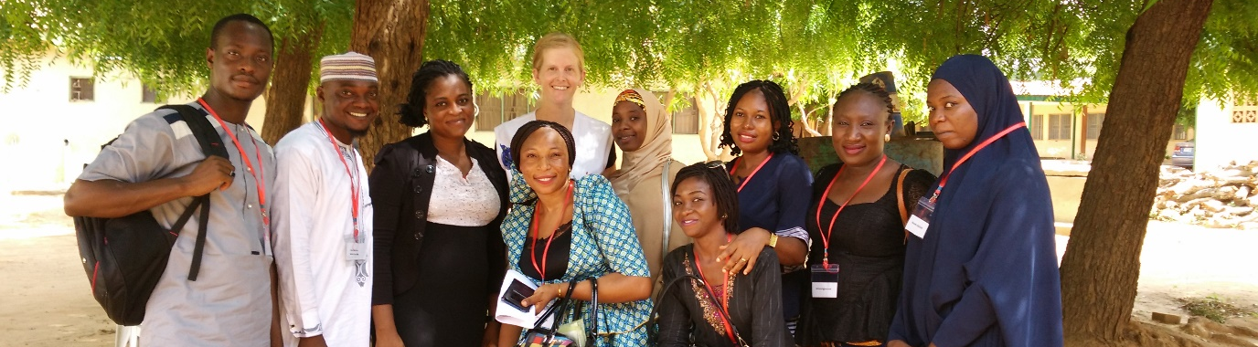
References
Robert Froriep. 1836. Pathologisch-anatomische Abbildungen aus der Sammlung der königlichen Charité-Heilanstalt zu Berlin.
World Health Organisation (WHO). Noma is a severe disease It is treatable if detected and managed early [Internet]. 2016. Available from: http://www.who.int/iris/handle/10665/254579%0AAdditional
Ashok N, Tarakji B, Darwish S, Rodrigues J, Altamimi M. A Review on Noma: A Recent Update. Glob J Health Sci. 2015;8(4):53–9.
E FarleyFarley E, Lenglet A, Ariti C, Jiya NM, Adetunji AS, Kam S Van Der, et al. Risk factors for diagnosed noma in northwest Nigeria : A case-control study , 2017. PLoS Negl Trop Dis [Internet]. 2018;12(8):1–11. Available from: http://dx.doi.org/10.1371/journal.pntd.0006631doi: 10.1371/journal.pntd.0006631
*All photographs included in this presentation are of the study teams involved in the research project and were taken after verbal consent was obtained
Na gode, thank you!
dupylola@yahoo.com
Prevalence of and beliefs about noma by Juliana Oyemakinde
Notes:
These are the references that have been used in the presentation, if anyone would like further reading on the topic please contact me.
Thank you!
Any questions?
Possible questions:
Why these studies were chosen and not other big gaps in knowledge?
Practical implementation of results
Link malnutrition and noma?
Link vaccination and noma?
From the presentation we say one pillar of outreach is prevention; how do we do this?
Did we expect a much higher prevalence?
Can this be extrapolated and if not, why not?
*Notes in case of questions
We weighted for survey design, actual population age and state
SAM-MUAC below 115mm; MAM-MUAC between115-125mm)
We calculated the prevalence and 95% confidence intervals (CI) of noma for all stages from the survey data.
The analysis accounted for the two stage clustered survey by adjusting the standard errors of the estimates using linearization.
The estimates and standard errors were further weighted to account for the actual population distribution of the two states as the survey sample underrepresented participants aged 6-15 years.
Variables with a univariate strength of association measured by a p value < 0.2 were chosen for inclusion in the multivariate analysis.
Frequencies of exposure to each factor included in the questionnaires were calculated. All data analysis was conducted with Stata 15 utilising the svy suite of commands for complex surveys.

