Slide 1
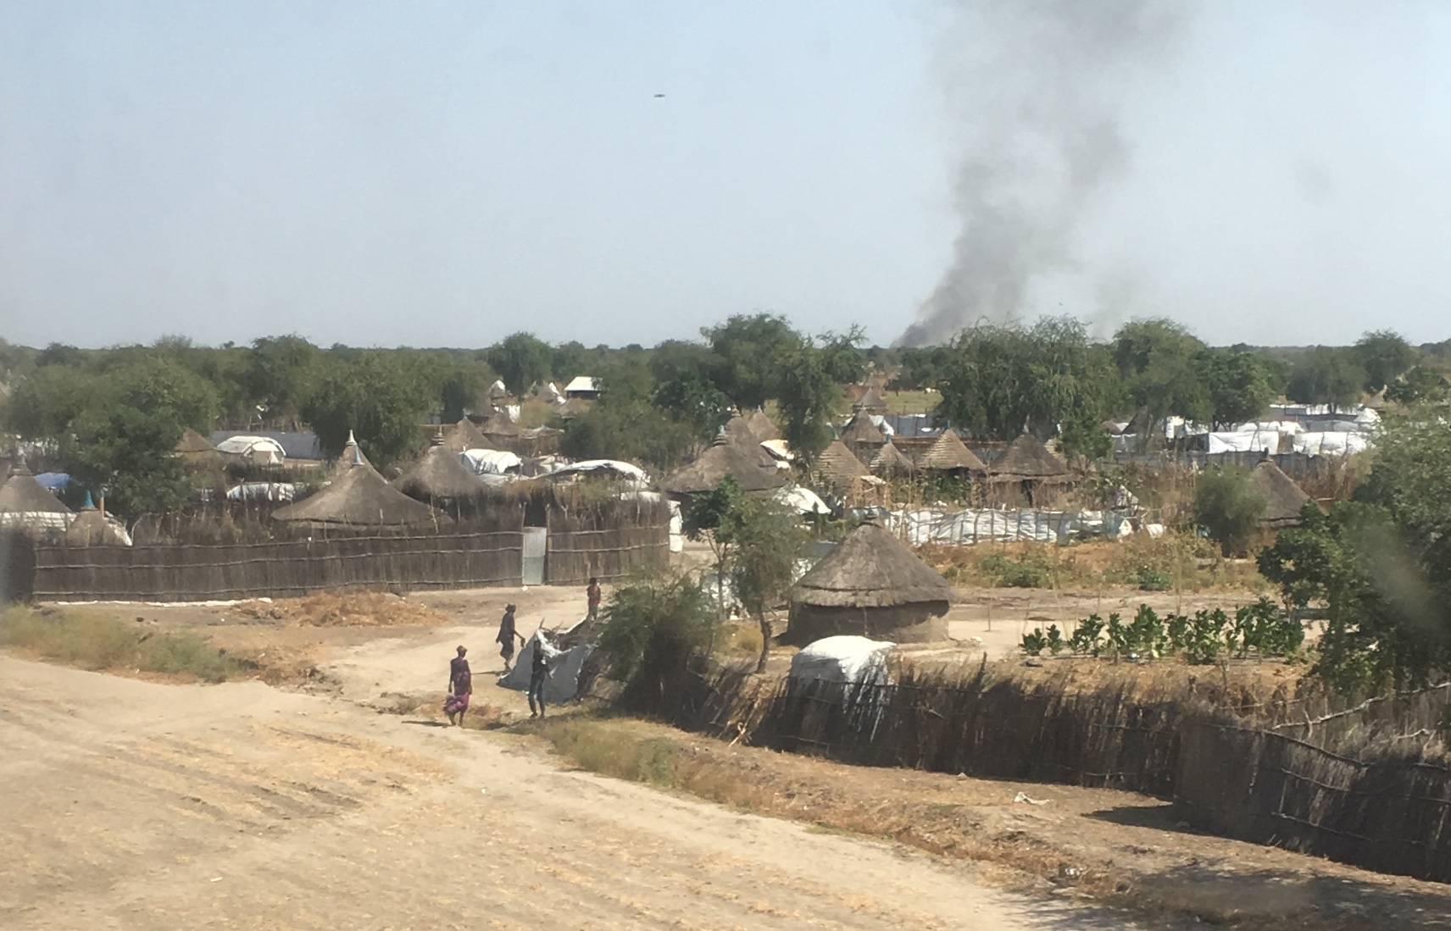
Outcomes of visceral leishmaniasis in pregnancy: retrospective cohort, South Sudan
Judith Pekelharing, Francis Gatluak, Tim Harrison, Fernando Maldonado, Koert Ritmeijer

Slide 2
Visceral leishmaniasis in South Sudan
Visceral leishmaniasis (VL, kala-azar) is a fatal parasitic disease transmitted by sand flies
Neglected Tropical Disease
South Sudan has the second highest disease burden in the world
MSF in Jonglei since 1993

Slide 3
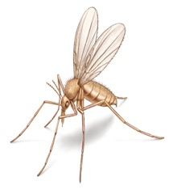
Visceral leishmaniasis in pregnancy
Immune system is modulated in pregnancy
Congenital visceral leishmaniasis is described
Poor maternal and pregnancy outcomes with first-line treatment (Sodium Stibugluconate (SSG)/Paromomycin (PM))
Treatment with Liposomal Amphotericin B (AmBisome)
Aim of the study:
To describe characteristics, treatment outcomes and pregnancy outcomes from a cohort of pregnant women with visceral leishmaniasis

Slide 4
Methods
Retrospective analysis using routine programme data
Time frame: Oct 2015 – Aug 2016 and March - Apr 2018
Visceral leishmaniasis in pregnancy
  All women in that period diagnosed with visceral leishmaniasis while pregnant
  Women already symptomatic during pregnancy but diagnosed during the first two weeks postpartum
Comparison group:
  Random sample (2:1) of non-pregnant women of reproductive age (15-45yr) with visceral leishmaniasis from the same period
Ethics: This research fulfilled the exemption criteria for posteriori analyses of routinely collected clinical data, and thus did not require MSF ERB review

Slide 6
Results
Included: 113 women with visceral leishmaniasis in pregnancy, 223 women in the comparison group
Excluded: medical file not available, pregnancy status unclear

Slide 7
Results: Complications during treatment
Complications during treatment | VL in pregnancy N=113 |  | Comparison group N=223 | Significance
 | Diagnosed while pregnant N=87 | Diagnosed postpartum N=26
Presentation: Hb on admission in g/dL | Median 9.0 IQR 7.7-10.3 | Median 7.8 IQR 6.9-8.7 | Median 10.0 IQR 8.4-11.3 | p 0.000
Complication: blood transfusion during treatment | 7 (9.7% ) | 4 (17.4%) | 3 (1.4%) | OR 9.3 95%CI 2.5-34.2 p 0.000
Complication: antibiotics for suspected bacterial infection | 49 (66.2%) | 22 (88%) | 40 (29.9%) | OR 6.0 95%CI 3.4-10.6 p 0.000

Slide 9
Results: Treatment outcomes
Treatment outcomes | VL in pregnancy N=113 |  | Comparison group N=223 | Significance
 | Diagnosed while pregnant N=87 | Diagnosed postpartum N=26
Treatment regimen AmBisome SSG/PM | 85 (97.7%) 2 (2.3%) | 19 (73.1%) 7 (26.9%) | 27 (12.1%) 196 (87.9%) | p 0.000
Treatment response: extension of treatment | 31 (35.6%) | 12 (46.1%) | 22 (9.8%) | OR 10.0 95%CI 4.8-20.9 p 0.000
Outcome Cure rate Mortality Defaulted | 84 (96.6%) 1 (1.1%) 2 (2.3%) | 25 (96.2%) 1 (3.8%) 0 | 218 (97.8%) 2 (0.9%) 3 (1.3%) | NS

Slide 10
Results: Pregnancy outcomes
Pregnancy outcomes | Diagnosed while pregnant N=81 | Diagnosed postpartum N=18
Still pregnant Delivered 1st trimester - abortion 2nd trimester delivery 3rd trimester: premature delivery 3rd trimester: term delivery Stillbirth Postpartum haemorrhage Retained products of conception | 64 (79%) 17 (21%) 5 2 9 1 1 6/17 (35%) 5/17 (29%) | 18 (100%) 4 1 7 4 1 ? 5/24 (21%) 6/24 (25%)

Slide 11
Take home message
Visceral leishmaniasis is a Neglected Tropical Disease, endemic in South Sudan
These data show good survival rates for women with VL in pregnancy, in a low resource setting
Availability of AmBisome, increased need for blood transfusion, (intravenous) antibiotics, and the need for adequate obstetric & neonatal care should be considered in treatment programs treating patients with VL in pregnancy
Topics for future research: pregnancy and neonatal outcomes after discharge, follow-up for VL after discharge / immunologic response

Slide 12
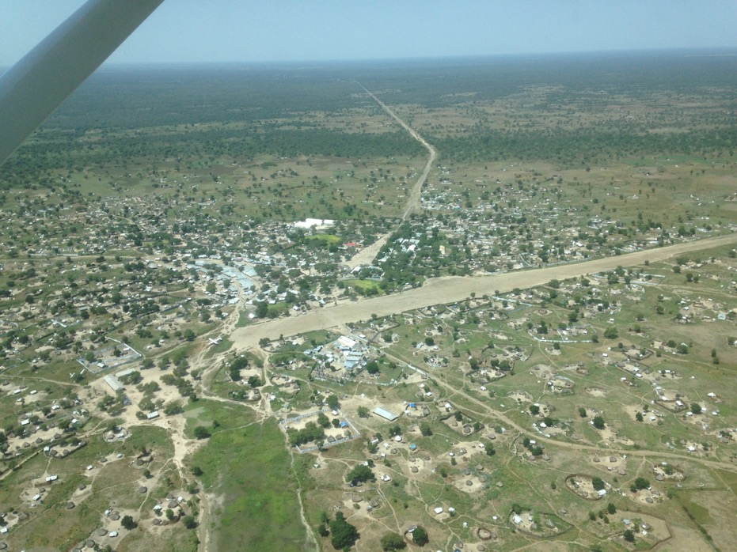
Acknowledgements
MSF teams in Amsterdam, Nairobi, Lokichoggio, Juba and Lankien

Slide 13
Literature
Author | Year | Country | Treatment regimen | No. of patients | Outcome | Pregnancy outcome
Mueller et al. | 2006 | Sudan | SSG (23) AmBisome (12) SSG+AmBisome (4) | 39 | All cured except 1 defaulter | 13 miscarriages (57%), all in SSG 1 preterm delivery in AmBisome
Adam et al. | 2009 | Sudan | SSG | 42 | 4 deaths (9.5%) (hepatic failure) | 2 miscarriages (4.7%) 2 preterm deliveries (4.7%)
Miah et al. | 2010 | Bangla-desh | SSG | 16 | All cured | 11 miscarriages (69%) 5 preterm deliveries (31%)
Adam et al. | 2018 | Sudan | SSG | 45 | 8 deaths (18%) (hepatic failure, anaemia) | 6 preterm deliveries (15%) 2 miscarriages (5%) 1 stillbirth (2.5%)
Morgan et al. | 2007 | Brazil | Meglumine antimoniate | 26 | All cured | 3 preterm deliveries (11%) 3 stillbirths (11%)

