Slide 1
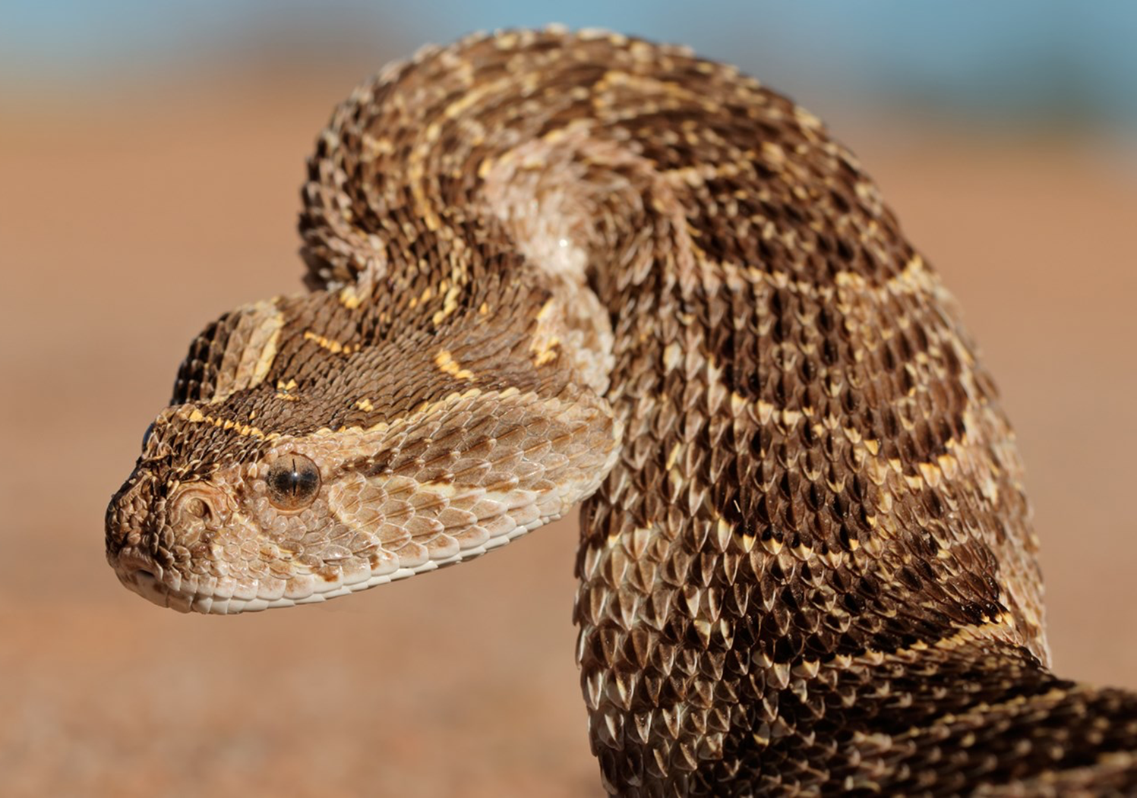
Two antivenoms for
Snakebite in South Sudan a prospective study
Gabriel Alcoba^{1,4}, Mohammed Said¹, Christine Mwongera¹, Samson Paul Baba², Richard Lino Lako², Ulrich Kuch³, François Chappuis⁴, Barbara Rusch¹, Iza Ciglenecki¹, Matthew E. Coldiron⁵
¹MSF (Agok, Juba, Geneva)
²Ministry of Health South Sudan,
³Frankfurt Uni., ⁴Geneva Uni. Hosp.
⁵Epicentre
© National Geographic

Slide 2
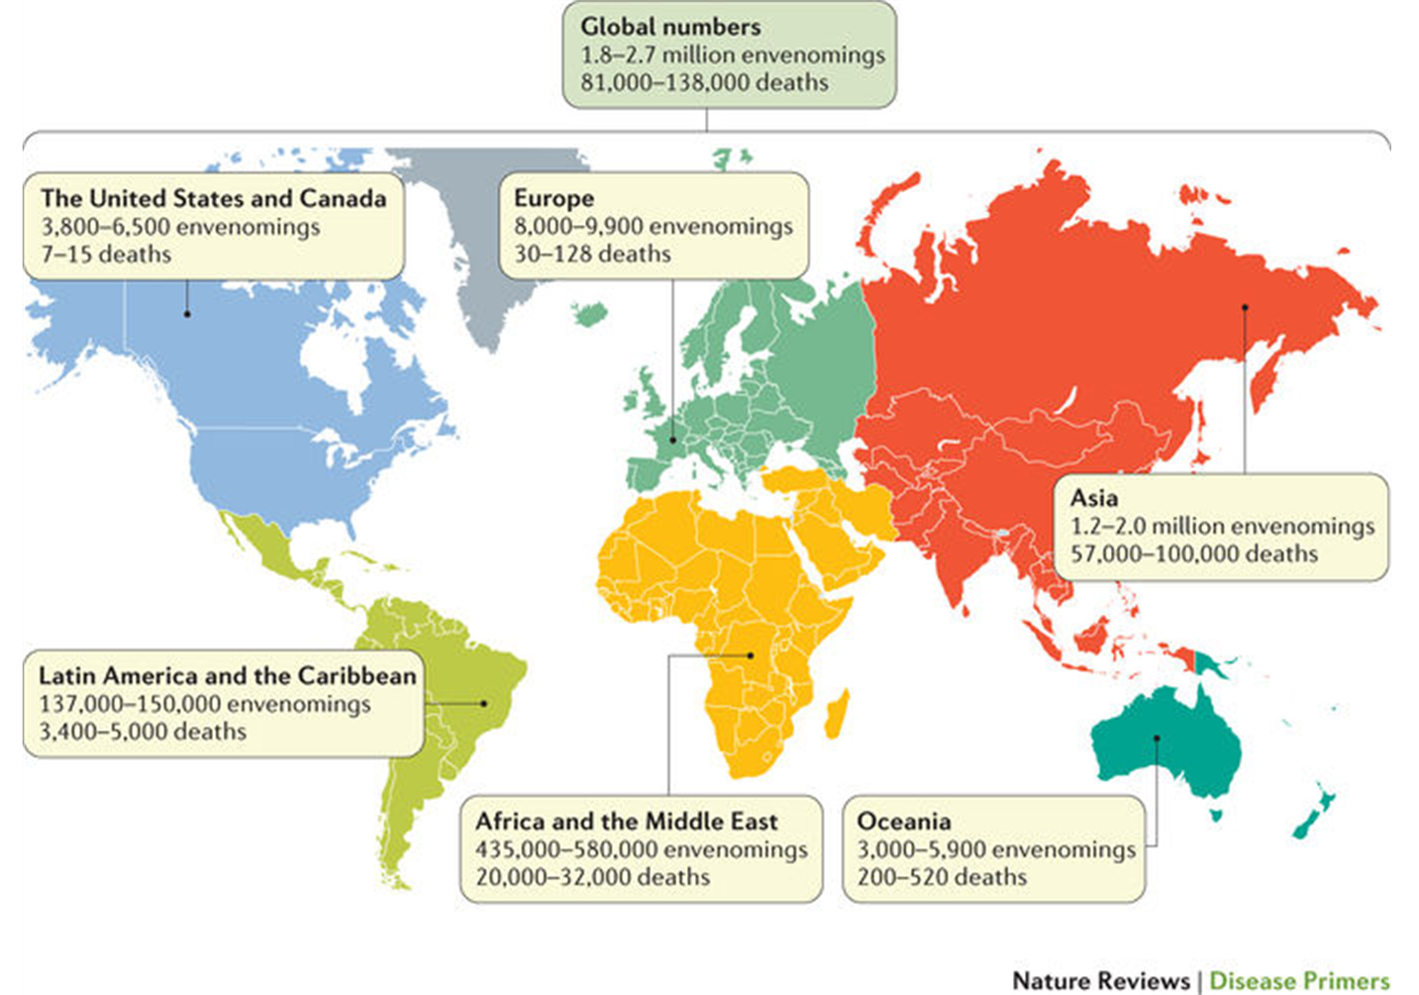
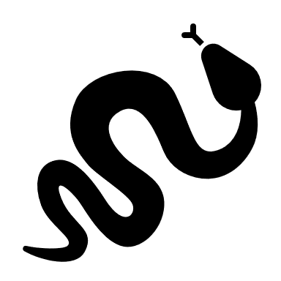
Global context
Snakebite envenoming is
a WHO priority neglected
tropical disease. WHO reports
yearly :
5.4 million snakebite victims
2.7 million envenomed (~50%)
81,000-138,000 deaths
>400,000 amputations
Gutierrez et al. 2017

Slide 3
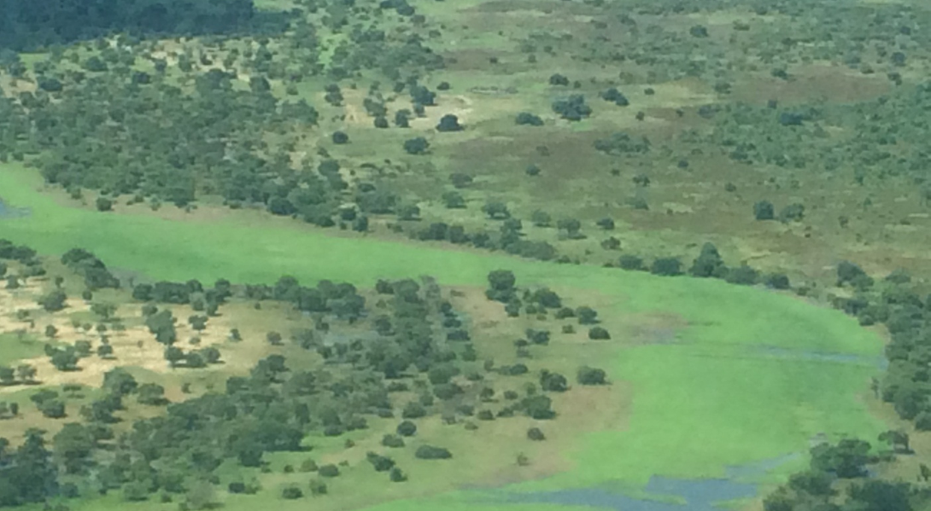
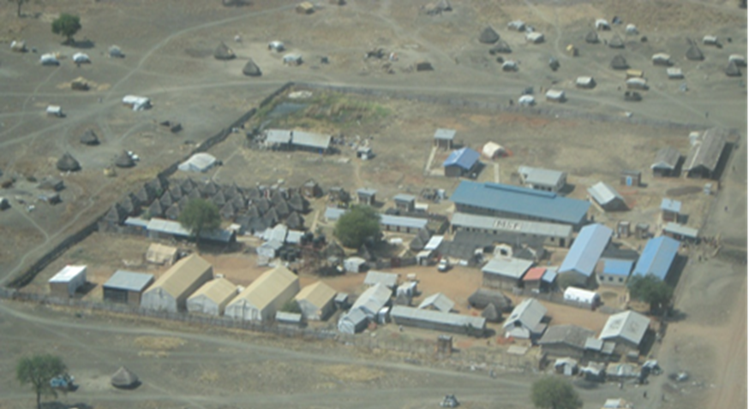
Agok, South Sudan
MSF supporting South Sudanese MOH Agok Hospital for >10 years
2014: First snakebite peak in Agok: up to 90 admitted in 1 month
2016: Last vials of Fav-Afrique expired, production not renewed
2017: New antivenom algorithm→
Echitab-Plus for cytotoxic & haemotoxic (vipers & spitting cobras )
SAIMR-polyvalent for neurotoxic
(cobras & mambas; some vipers)

Slide 4
Snakebite in Agok
Study period

Slide 5
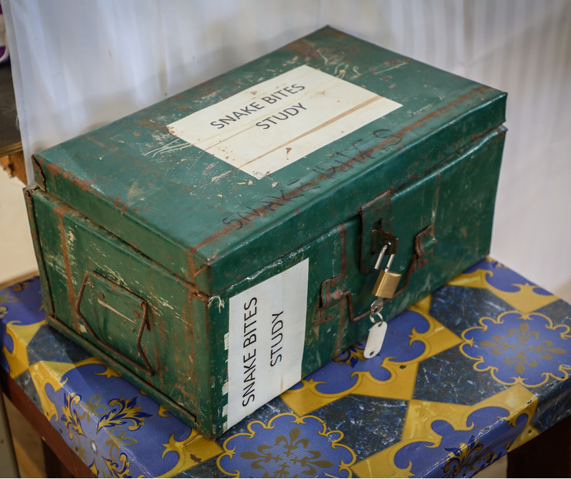
Aim & Methods
Describe clinical symptoms, cure rates, and adverse reactions associated with use of the 2 antivenoms at Agok Hospital
Prospective observational study
Clinical evaluations at admission, 6h, 24h, hospital discharge, and 28 days + Clotting tests at 0h, 6h, 24h
Patients identified snake species using a photo album and bite wounds were swabbed for snake DNA
Study approved by MSF & South Sudanese
Ethics committees

Slide 6
Patient characteristics
14 Mar- 24Nov2018: 314 patients
Age 1-80, median 20y (IQR 12-36)
F/M: 42% female
Occupation:
  Children/students: 27%
  Farmers/herders: 27%
  Not reported: 27%
  Other: 12%
  Housewives: 7%
Median distance to hospital:
5 km (IQR 3 to 15)
Median travel time to hospital:
2 hrs (IQR 1 to 3) [max 50hrs]
Transport:
  Walking 59%
  Motorbike 16%
  Public transport 14%
  Not reported 7%
  Bicycle 3%
  Cart 1%

Slide 7
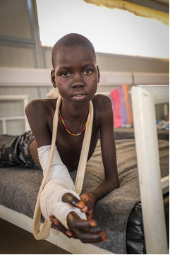
Description of bites
Bite site
  Foot: 73%
  Hand: 17%
  Other: 10%
14% had multiple bites
54% bitten between 6pm-6am
Circumstances:
  At home: 44%
  In the village: 16%
  In the fields: 29%
  Other: 11%
(MSF) photo taken with consent of patient & parent

Slide 8
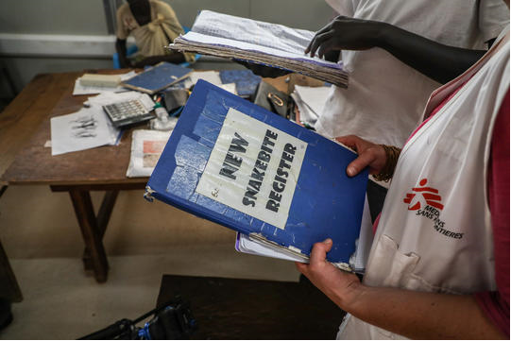
Initial symptoms
Cytotoxicity:
  94% had swelling
  Mild (Local): 41%
  Severe:
  To knee/elbow: 45%
  To hip/shoulder: 8%
  Face: 0.3%
  5% had necrosis at presentation
Haemotoxicity
  Local bleeding: 9%
  Non-clotting blood: 2%
No neurotoxic syndromes

Slide 9
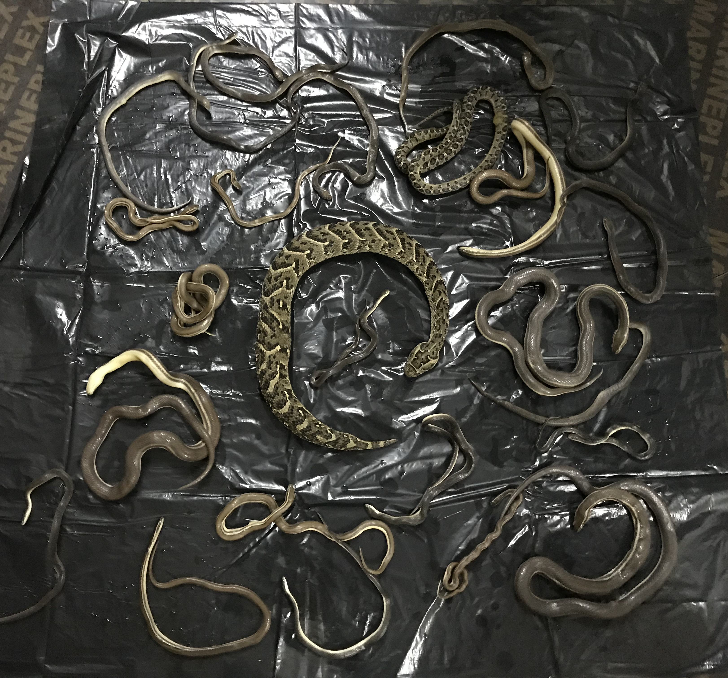
Snakes & treatments
29% saw the snake
  Puff adder/Kurieth (Bitis arietans): 52
  Spitting Cobra/Pien (Naja nigricollis): 21
  Carpet viper (Echis pyramidum): 1
  Others: 17
26% used traditional treatment(s) before arriving to hospital
  Black stone, cow dung, charcoal, incisions, herbs, raw eggs, perfume..
36% required antivenom

Slide 10
Adverse reactions
 | Echitab-Plus (N=108) 525 vials | SAIMR (N=2) 6 vials
Itching | 11 (10%) | 0
Urticaria-hives | 5 (5%) | 0
Wheezing on auscultation | 0 | 0
Respiratory distress | 0 | 0
Abdominal pain | 2 (2%) | 0
Vomiting | 1 (1%) | 0
Hypotension | 0 | 0
Anaphylactic shock | 0 | 0
Fever (pyrogenic reaction) | 1 (1%) | 0
Treatments: Adrenaline / Anti-Histamines / Steroids | 2 / 5 / 6 | 0 / 0 / 0

Slide 11
Evolution over first 24 hours
Cytotoxicity (297 patients at admission):
  53% severe – improved
  6 progressive swelling → entire limb or chest
Haemotoxicity (27 patients at admission)
  Local bleeding: 27→ 2 persistent
  Bleeding from gums: 0 → 2
  Mucosal bleeding: 0 → 1
Neurotoxicity (0 patients at admission)
  1 patient became semi-conscious (near coma)

Slide 12

Outcomes
At time of discharge
3 deaths (CFR=1%) and 1 amputation
3% had non-healed wounds
4% had reduced range of motion,
11% had persistent pain
At 28 days post-discharge (N=39)
11 patients had persistent pain
7 patients had symptoms consistent with serum sickness

Slide 13
Conclusions
New antivenom protocol seems safe and effective
  Lots of experience with EchiTabPlus, little with SAIMR-polyvalent
EchiTabPlus well-tolerated
No purely neurotoxic cases difficult to draw conclusions
Limitations of a difficult algorithm : SAIMR given for critical cases > finally not neurotoxic cases.
True Polyvalent & affordable antivenoms are urgently needed

Slide 14
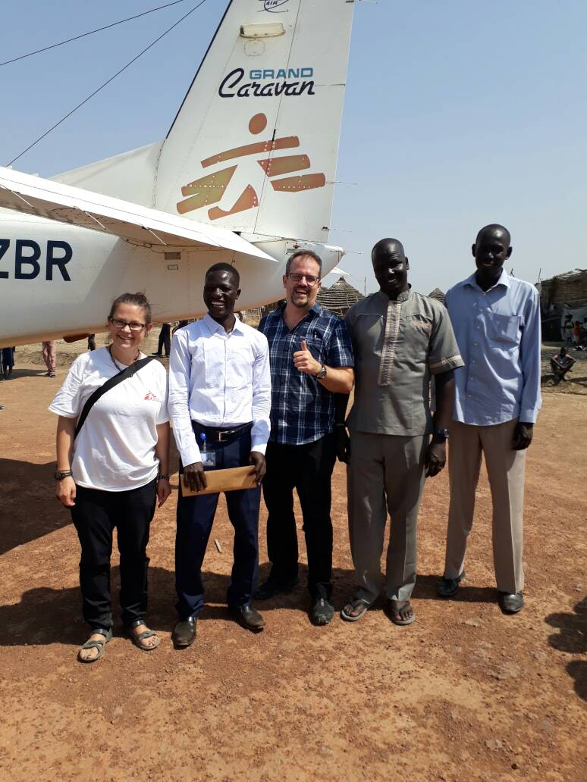
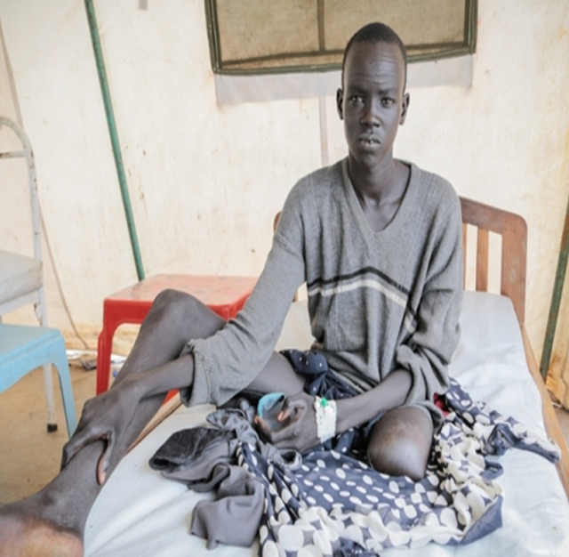
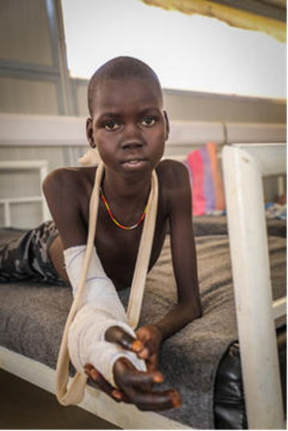
Acknowlegments: we would like to express our sincere gratitude to all patients & staff at Agok hospital and the Ministry of Health of South Sudan

