Slide 1
Evaluating new regimens for the treatment of chronic Chagas disease: BENDITA, a randomized trial
Fabiana Barreira
Chagas Senior Cinical Manager
MSF Scientific Days 2019

Slide 2
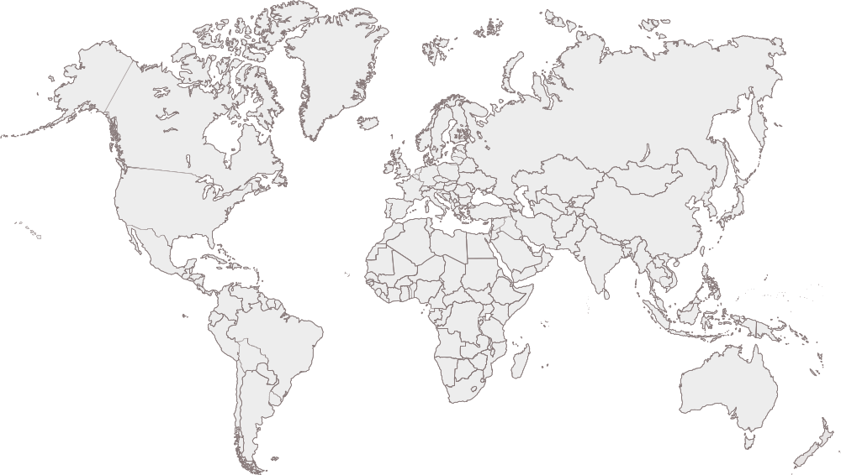
DNDi, a new model for drug development
Non-profit drug research & development (R&D) organization founded in 2003
Addressing the needs of the most neglected patients
Harnessing resources from public institutions, private industry and philanthropic entities
8 regional offices
Brazil; Democratic Republic of Congo, Kenya & South Africa; India, Japan & Malaysia; & USA
Founding Partners
Indian Council for Medical Research (ICMR), Kenya Medical Research Institute (KEMRI), Malaysian MoH, Oswaldo Cruz Foundation Brazil, Médecins Sans Frontières (MSF), Institut Pasteur France, WHO/TDR (permanent observer)
Notes:
2

Slide 3
Bendita Study
BEnznidazole New Doses Improved Treatment and Associations
Double-blind, Double-dummy, Phase 2 Randomized, Multicenter, Proof-of-Concept, Safety and Efficacy Trial to Evaluate Different Oral Benznidazole Monotherapy and Benznidazole/E1224 Combination Regimens for the Treatment of Adult Patients with Chronic Indeterminate Chagas Disease
3 sites in Bolivia, 2016 – 2018
Approved by local ethics committees and regulatory agency
Fabiana Barreira, MSF, Bendita Study

Slide 4
Background and Rationale
Bendita Study
Fabiana Barreira, MSF, Bendita Study

Slide 5
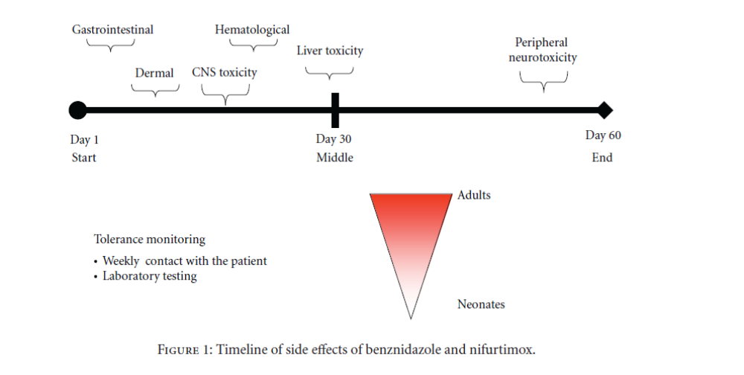
Limitations of current treatment
Benznidazol - safety and treatment duration
Sosa-Estani et al. 2012 J Trop Med
Fabiana Barreira, MSF, Bendita Study

Slide 6
Chagas disease - limitation of current treatment
100%
100%
NEW REGIMENS of BZN
Combinations
Tolerability gap
80%
80%
Current BZN Therapy
Current BZN Therapy
Tolerability
Efficacy gap
Tolerability
Efficacy
Efficacy
80%
100%
80%
100%
Fabiana Barreira, MSF, Bendita Study
Notes:
Os dados dos estudos anteriores, como o realizado na Bolivia, nos sugerem que BZN é uma droga eficaz, entretanto existe tanto uma lacuna de eficácia com cerca de 80% de resposta sustentada em 12 meses quanto um gap de tolerabilidade, com uma proporção de indivíduos (10-20%) que não completam o tratamento, a maioria devido a reações adversas e a longa duração de tratamento.
Levando em consideração esses resultados, duas abordagens devem ser perseguidos (Figura 2):
Mudança no regime de dosagem atual de BZN em adultos para reduzir a exposição a droga e melhorar a tolerabilidade, mantendo a eficácia
O desenvolvimento de uma terapia de combinação para melhorar a eficácia, com tolerabilidade mantida ou se idealmente, melhorada
(A terapia combinada tem como objetivo de solucionar o gap de eficácia mas pode ou não pode solucionar o gap de tolerabilidade)
Teniendo en cuenta estos resultados, dos enfoques para la optimización del tratamiento de Chagas están para ser seguidos (Figura 2): 1) El cambio del actual régimen de dosificación adulta de BNZ para reducir la exposición, mejorar la tolerabilidad, mientras que se mantiene la eficacia; y, 2) Desarrollo de una terapia de combinación para mejorar la eficacia y mantener o mejorar la tolerabilidad. La anterior no se refiere al intervalo de eficacia existente. La terapia de combinación pretende abordar el intervalo de eficacia y puede o no abordar el intervalo de tolerabilidad

Slide 7
Need for an alternative treatment regimen
To address:
Adverse and severe adverse events that may be related to dose and duration of treatment
Offer an improved benefit/risk profile
Improve acceptability of treatment among patients, care givers and physicians
Fabiana Barreira, MSF, Bendita Study

Slide 8
Benznidazol efficacy – recent RCTs
Trial | Chagas Azol (Molina , 2014 ) | STOP Chagas (Morillo, 2017 ) | E1224-001 (Torrico, 2018)
Study design and sample size (BZN arm) | Comparison between arms Open label 12M follow-up Adults N: 26 | Placebo controlled Single blinded 12M follow-up Adults N: 30 | Placebo controlled Double-blinded 12M follow-up Adults N: 45
Dosage | 150 mg bid for 60 days | 200 mg bid for 60 days | 5 mg/kg/d bid for 60 days
Country adults | Spain | Argentina, Chile, Colombia, Guatemala, Mexico, Spain | Bolivia
Molecular test (% Negative) | Rt-PCR (61.6%) | PCR 86.7% - 6M (95% CI: 74.5% to 98.8%) | PCR (82%, 67·9%–92·0%)
Fabiana Barreira, MSF,
Bendita Study

Slide 9
Trial Design and Results
Bendita Study
Fabiana Barreira, MSF, Bendita Study

Slide 10
Population: Adults with chronic indeterminate Chagas Disease (>=18 yo - <=50 yo, PCR Positive) (N=210)
Tested dosages :
Follow-up: 10 weeks, 12 weeks, 4M, 6M, 12 M
Primary Objective: Efficacy measured by PCR at End of treatment sustained until 6 months of follow-up, in comparison to placebo
Secondary Objectives: 12 months, Safety, and others.
Sites: Plataforma de Atención Integral de Pacientes con Enfermedad de Chagas, Bolivia: Cochabamba (PI Faustino Torrico), Tarija (PI Lourdes Ortiz), Sucre (PI Wilson Garcia)
Spain: ISGlobal, Barcelona (PI Joaquín Gascón)
Standart Regimen (fixed dose) | BZN 300 mg - 8 weeks
Short duration | BZN 300 mg - 4 weeks
 | BZN 300 mg - 2 weeks
Short dose | BZN 150 mg - 4 weeks
Combination | BZN 150 mg - 4 weeks + E1224 300 mg
 | BZN 300 mg - 8 weeks (weekly)+ E1224 300 mg
Comparator | Placebo
Fabiana Barreira, MSF, Bendita Study

Slide 11
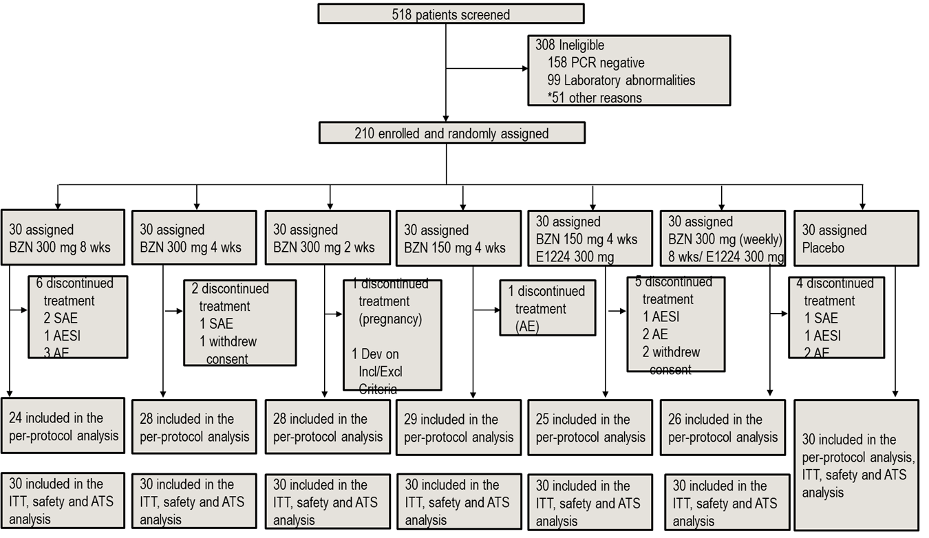
Study Profile
Fabiana Barreira, MSF, Bendita Study
Notes:
Figure 1: Trial profile
ITT=Intention to treat. ATS=all treated set. *Other reasons were 10 patients with electrocardiogram abnormalities, 10 not able to comply with protocol, 8 pregnancies, 7 unlikely to cooperate with the trial, 3 with signs or symptoms of chronic cardiac and/or digestive Chagas, 2 with clinical conditions, 2 with no confirmatory serology, 2 because of weight, 1 treated with BZN of NFX in the past, and 6 with more than one reason (negative PCR, laboratory abnormalities, signs or symptoms of chronic cardiac and/or digestive Chagas, unlikely to cooperate, treated with BZN of NFX in the past, clinical conditions and weight)

Slide 12
Analysis of parasitological response at EOT and until 6 months of follow up – primary efficacy endpoint – and at 12 months of follow up – secondary efficacy endpoint (ITT and PPS)
 |  | BZN 300 mg 8 wks | BZN 300 mg 4 wks | BZN 300 mg 2 wks | BZN 150 mg 4 wks | BZN 150 mg 4 wks/ E1224 300 mg | BZN 300 mg (Weekly) 8 wks/ E1224 300 mg | Placebo
 |  | (N=24/ 30) | (N=28/ 30) | (N=28/ 30) | (N=29/30) | (N=25/30) | (N=26/30) | (N=30/30)
PPS | 6 months of follow up | 86.4 | 88.9 | 82.1 | 86.2 | 83.3 | 84.0 | 3.3
 | 12 months of follow up | 78.3 | 88.9 | 78.6 | 82.8 | 83.3 | 84.0 | 3.3
ITT | 6 months of follow up | 89.3 | 89.3 | 82.8 | 83.3 | 85.2 | 82.8 | 3.3
 | 12 months of follow up | 82.8 | 89.3 | 79.3 | 80.0 | 85.2 | 82.8 | 3.3
Overall summary of TEAE (all treated set) | BZN 300 mg 8 wks | BZN 300 mg 4 wks | BZN 300 mg 2 wks | BZN 150 mg 4 wks | BZN 150 mg 4 wks/ E1224 300 mg | BZN 300 mg (Weekly) 8 wks/ E1224 300 mg | Placebo
 | (N=30) | (N=30) | (N=30) | (N=30) | (N=30) | (N=30) | (N=30)
 | n (%) | n (%) | n (%) | n (%) | n (%) | n (%) | n (%)
Subjects with any severe TEAE | 2 (6.7) | 0 | 0 | 0 | 2 (6.7) | 4 (13.3) | 0
Subjects with any serious TEAE | 2 (6.7) | 1 (3.3) | 0 | 0 | 1 (3.3) | 2 (6.7) | 0
Subjects with any TEAE leading to treatment discontinuation | 6 (20.0) | 1 (3.3) | 0 | 1 (3.3) | 3 (10.0) | 4 (13.3) | 0
Note: A treatment-emergent adverse event (TEAE) is an adverse event with a start date on or after the date of the treatment.
Fabiana Barreira, MSF, Bendita Study

Slide 13
Summary: efficacy, safety* and compliance
* measured as patients discontinuing treatment due to AEs
Fabiana Barreira, MSF, Bendita Study

Slide 14
Conclusions
Bendita Study
Fabiana Barreira, MSF, Bendita Study

Slide 15
Conclusions
  All treatment arms demonstrated superior efficacy against placebo at the primary efficacy endpoint (6M) and at sustained parasitological clearance at 12M
  For the 8 weeks 300 mg BZN regimen, the rate of efficacy was as expected, and consistent with other studies using standard regimens (5 mg/kg/day for 60 days)
  The 2 weeks 300mg BZN regimen efficacy was of 79% (sustained negative PCR at 12 months) with no patient discontinuing treatment due to related adverse event
  Short course BZN regimen showed very good safety profiles, with 0.0-3.3% rates of treatment discontinuation.
  Compliance was very good in all treatment arms.
Fabiana Barreira, MSF, Bendita Study

Slide 16

















THANK YOU
TO ALL OUR
PARTNERS & DONORS
STARR
International
Foundation
& other private individuals
and foundations

