Slide 1
Implementation of directly observed therapy pre-resistance test for patients experiencing virologic failure in Maputo, Mozambique
Ernesto de Abreu, Robert Deiss, Natalia Tamayo Antabak, Lucas Molfino, Iza Ciglenecki, Maira Marra Chanese, Ana G. Gutierrez

Slide 2
HIV/AIDS in Mozambique
Approximately 1,800,000 people are living with HIV in Mozambique (2016)
  Overall prevalence (12.5%) is eighth highest in the world and is much higher in Maputo (~17%)
Only 54% of adults receiving treatment
83,000 new infections, 62,000 AIDS-related deaths (2016)
  Decreased by 24% and 46% since 2010, respectively
Goals: expand coverage to 81% of adults and 67% of children by 2020
UNAIDS Fact Sheet, 2019

Slide 3
ART Resistance
There are few studies which document the prevalence and type of common ART drug resistance mutations in Mozambique along with the overall mutation profile
A recent study of pediatric care in six health care centers of Maputo, Mozambique found virologic failure rates of 30%, with treatment resistance a primary factor (Vaz, 2018)
MSF-Mozambique initiative: Using DOT, before sending genotypes, to support patient adherence and optimize resistance testing

Slide 4
Centro Referencia de Alto Mae (CRAM)
Ambulatory reference center for patients with advanced HIV infection
  CD4 < 100 cells/uL or with complicated opportunistic infections (e.g. cryptococcal meningitis)
  Kaposi’s Sarcoma
  Drug users, Hepatitis C co-infection
In addition CRAM is the only health center providing “third-line” (integrase inhibitor-based) treatment in Mozambique
Notes:
Will comment that by nature, this is a population with many barriers to adherence and also high-risk for treatment failure (in setting of prior therapy)

Slide 5
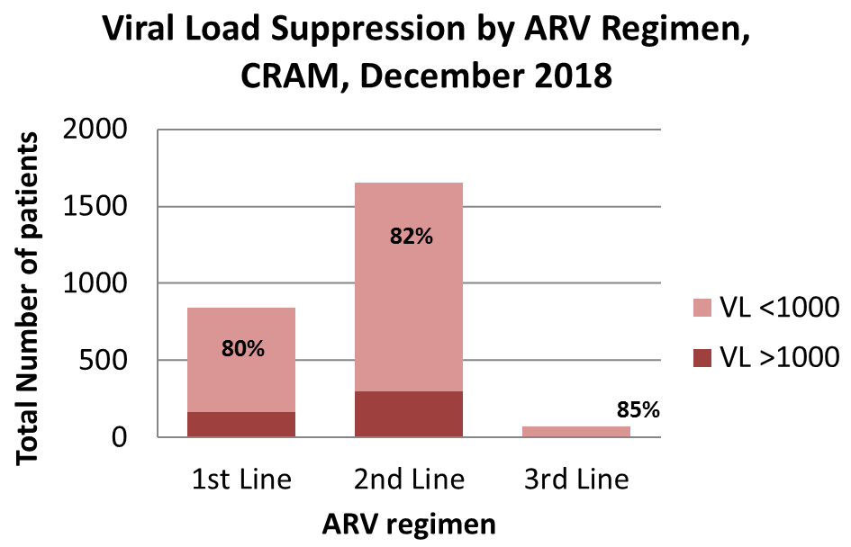
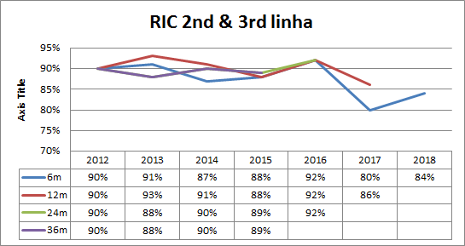
CHARACTERISTICS OF CRAM PATIENTS
Basic Demographic Information
Total = 2569 | N (%)
By ART Regimen | 1st Line 842 (33%)
 | 2nd Line 1653 (64%)
 | 3rd Line 74 (3%)
Gender | Female: 1310(51%)
CD4 at admission | Median 103 cells/ul (IQR 36,314)
Percentage of RIC
RIC for 2nd & 3rd ARV Regimen, CRAM,
December 2018
Notes:
Nat: If you want to present all this information in one slide, better to use animations.
Nat: The gree table I’d suggest to take out. But add RIC

Slide 6
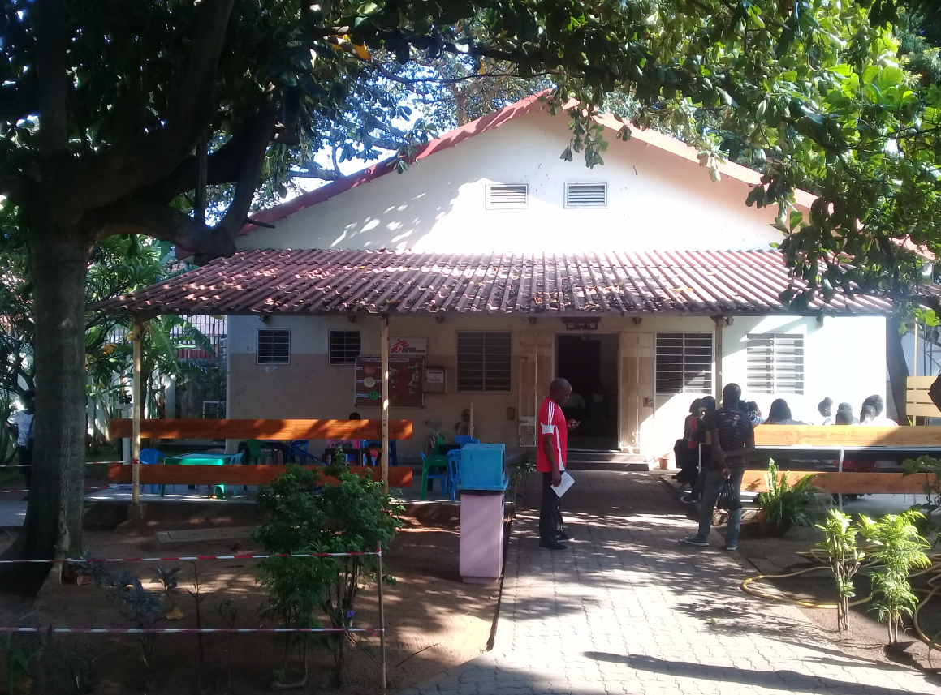

Slide 7
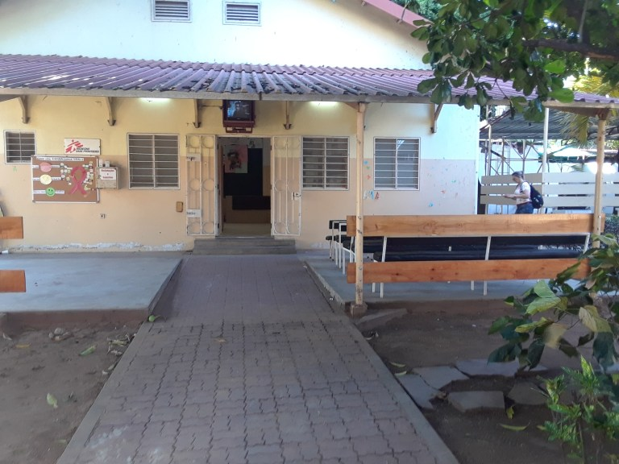
Notes:
I love that Natalia is in this picture. ☺ I’ll add one more = view from the front.

Slide 8
The problem……
Non-adherence is one of the most common reasons for virologic failure and can lead to selection of resistant strains
  Nonetheless, in a genotype analysis, drug mutations may be masked (“wild type” predominates)
62% of genotypes sent from CRAM between 2015-18 had no major PI mutations, despite being considered “2nd line failures”
Genotypic testing is expensive and often unavailable or difficult to access in resource-challenged areas
THEREFORE…..
How can we ensure maximal adherence, uncover true resistance mutations and thereby improve the yield of genotypic testing?

Slide 9
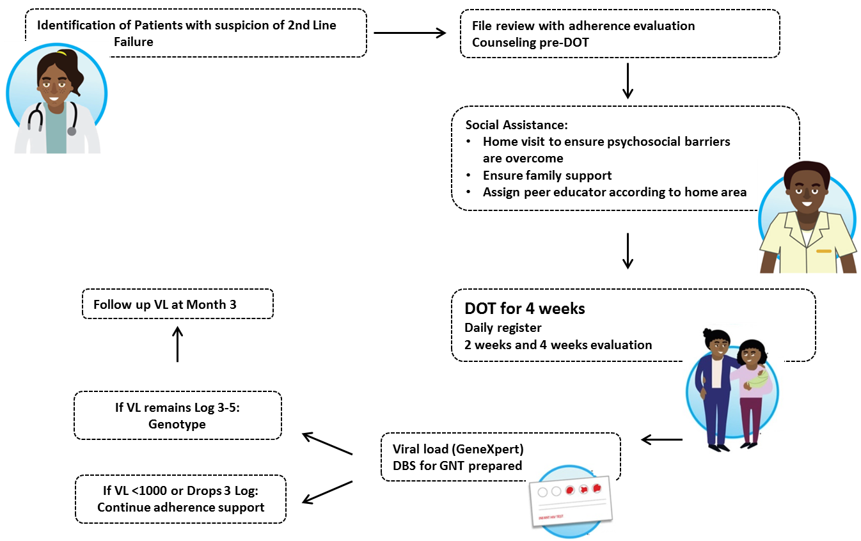
solution: pre-Genotype dot?
Notes:
Not to explain the whole process but basically remark:
Selection of patients, persistant high viral load despite all available adherence strategies
A peer educator is assigned to do the DOT for 4 weeks
There is an intermediary and final evaluation
GNT done if VL >1000 (we performed for this cohort some plasma and some DBS genotypes)

Slide 10
ANAlysis
Retrospective data analysis of patients receiving pre-genotype DOT between May and December 2018
Project is ongoing and frequently refined
DOT pre-genotype patients meet the following criteria:
  VL>1000 with suspected 2nd line failure
  Have been on PI-based regimen for > 2 years
  Completed all available adherence strategies

Slide 11
results
43 patients with suspected failure of 2nd line regimen identified
  17 patients excluded
  4 declined participation
  6 patients lived outside MSF coverage area (and activist was difficult to find)
  7 waiting for activist to be located
26 patients (60%) were enrolled on the pre-Genotype DOT strategy
  Median Age 34 (IQR: 20,47), 5 patients <18 years
  56% male
  Median CD4 = 116 cells/uL
  Median exposure to ART= 8 years (IQR: 6, 11)
Notes:
Nat: here will come the question of inclusion criteria, why 26/43?

Slide 12
results
24/26 (92%) patients completed 4 weeks DOT
  14 (58%) patients experienced VL suppression
  3 (13%) patients experienced VL reduction > 3 logs
  7 (29%) patients underwent genotyping
7 patients who underwent genotyping:
  3 patients with major mutations for PI, they all started a 3rd Line ART regimen
  2 patients with major mutations for RT but full susceptibility to at least 1 NRTI and PI
  2 patients showed no major mutations

Slide 13
Results (FOLLOW-UP)
Of the 14 patients who suppressed VL after DOT:
  6 (43%) patients remained undetectable at 3 months post-DOT
  5 (36%) patients had detectable VL at 3 months post-DOT
  3 (21%) VL results pending
3 patients who experienced VL reduction > 3 logs:
  Intensive counseling for 3 months with a follow-up VL
    2 patients with re-increase of 2 Logs
    1 patient still waiting result

Slide 14
conclusions
Peer DOT is a useful strategy to ensure adherence while providing social support
  High acceptance from patients, and activists often helped uncover barriers to treatment adherence
DOT helped reduce the number of patients needing genotypes while also maximizing yield and improving the proper interpretation of results
Pre-Genotype DOT can improve proper resource allocation in low income settings where genotype testing is frequently unavailable and/or expensive
Further research/analyses may demonstrate cost-savings from this strategy

Slide 15
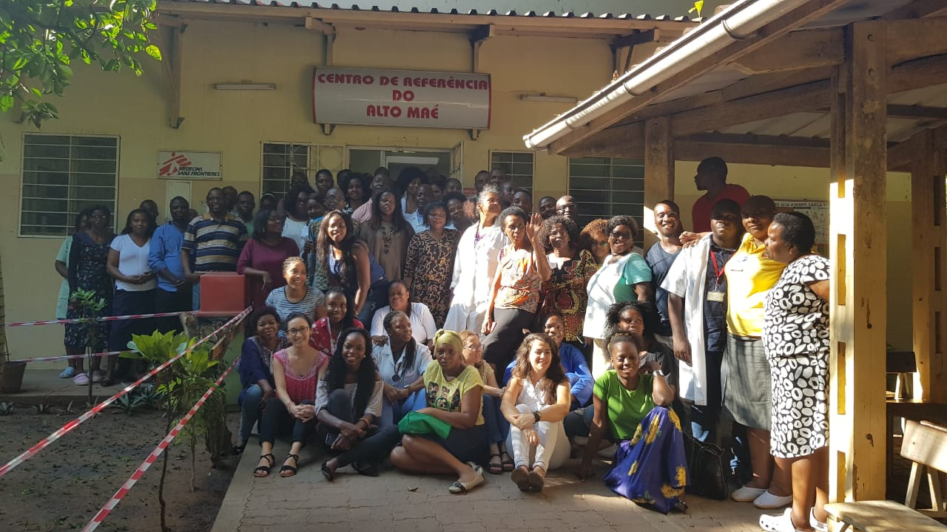
Acknowledgements
MSF/CRAM psycho/social team: Ernesto, Mefina, Leonor
Patients, families/caregivers and peer educator
CRAM medical, laboratory, administrative and data management teams
MOH, Mozambique
Notes:
Add some last names/persons to PSEC team? Geneva people? A group photo would be great.

