Slide 1
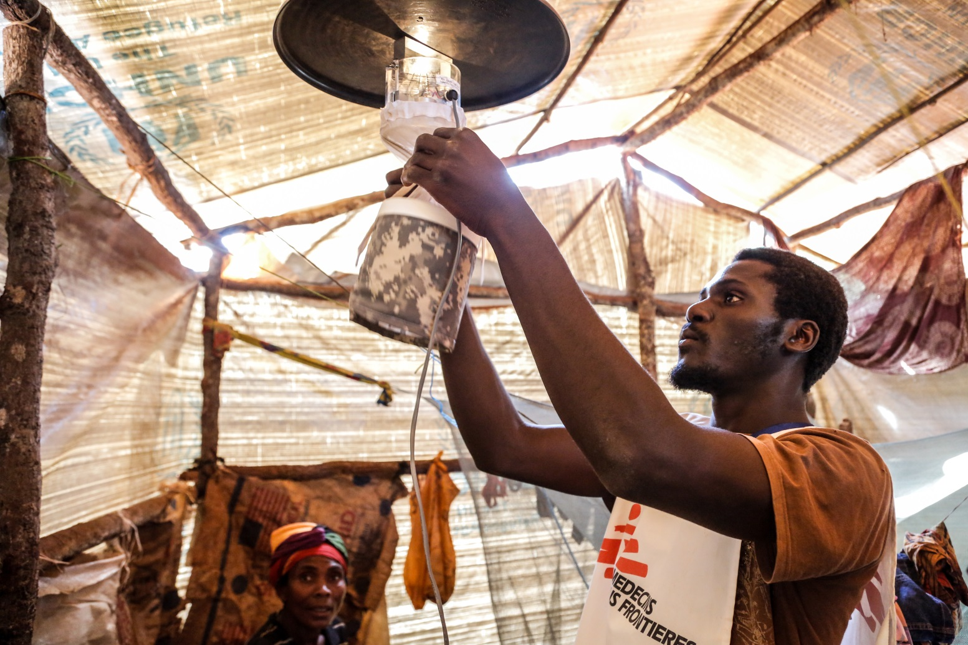
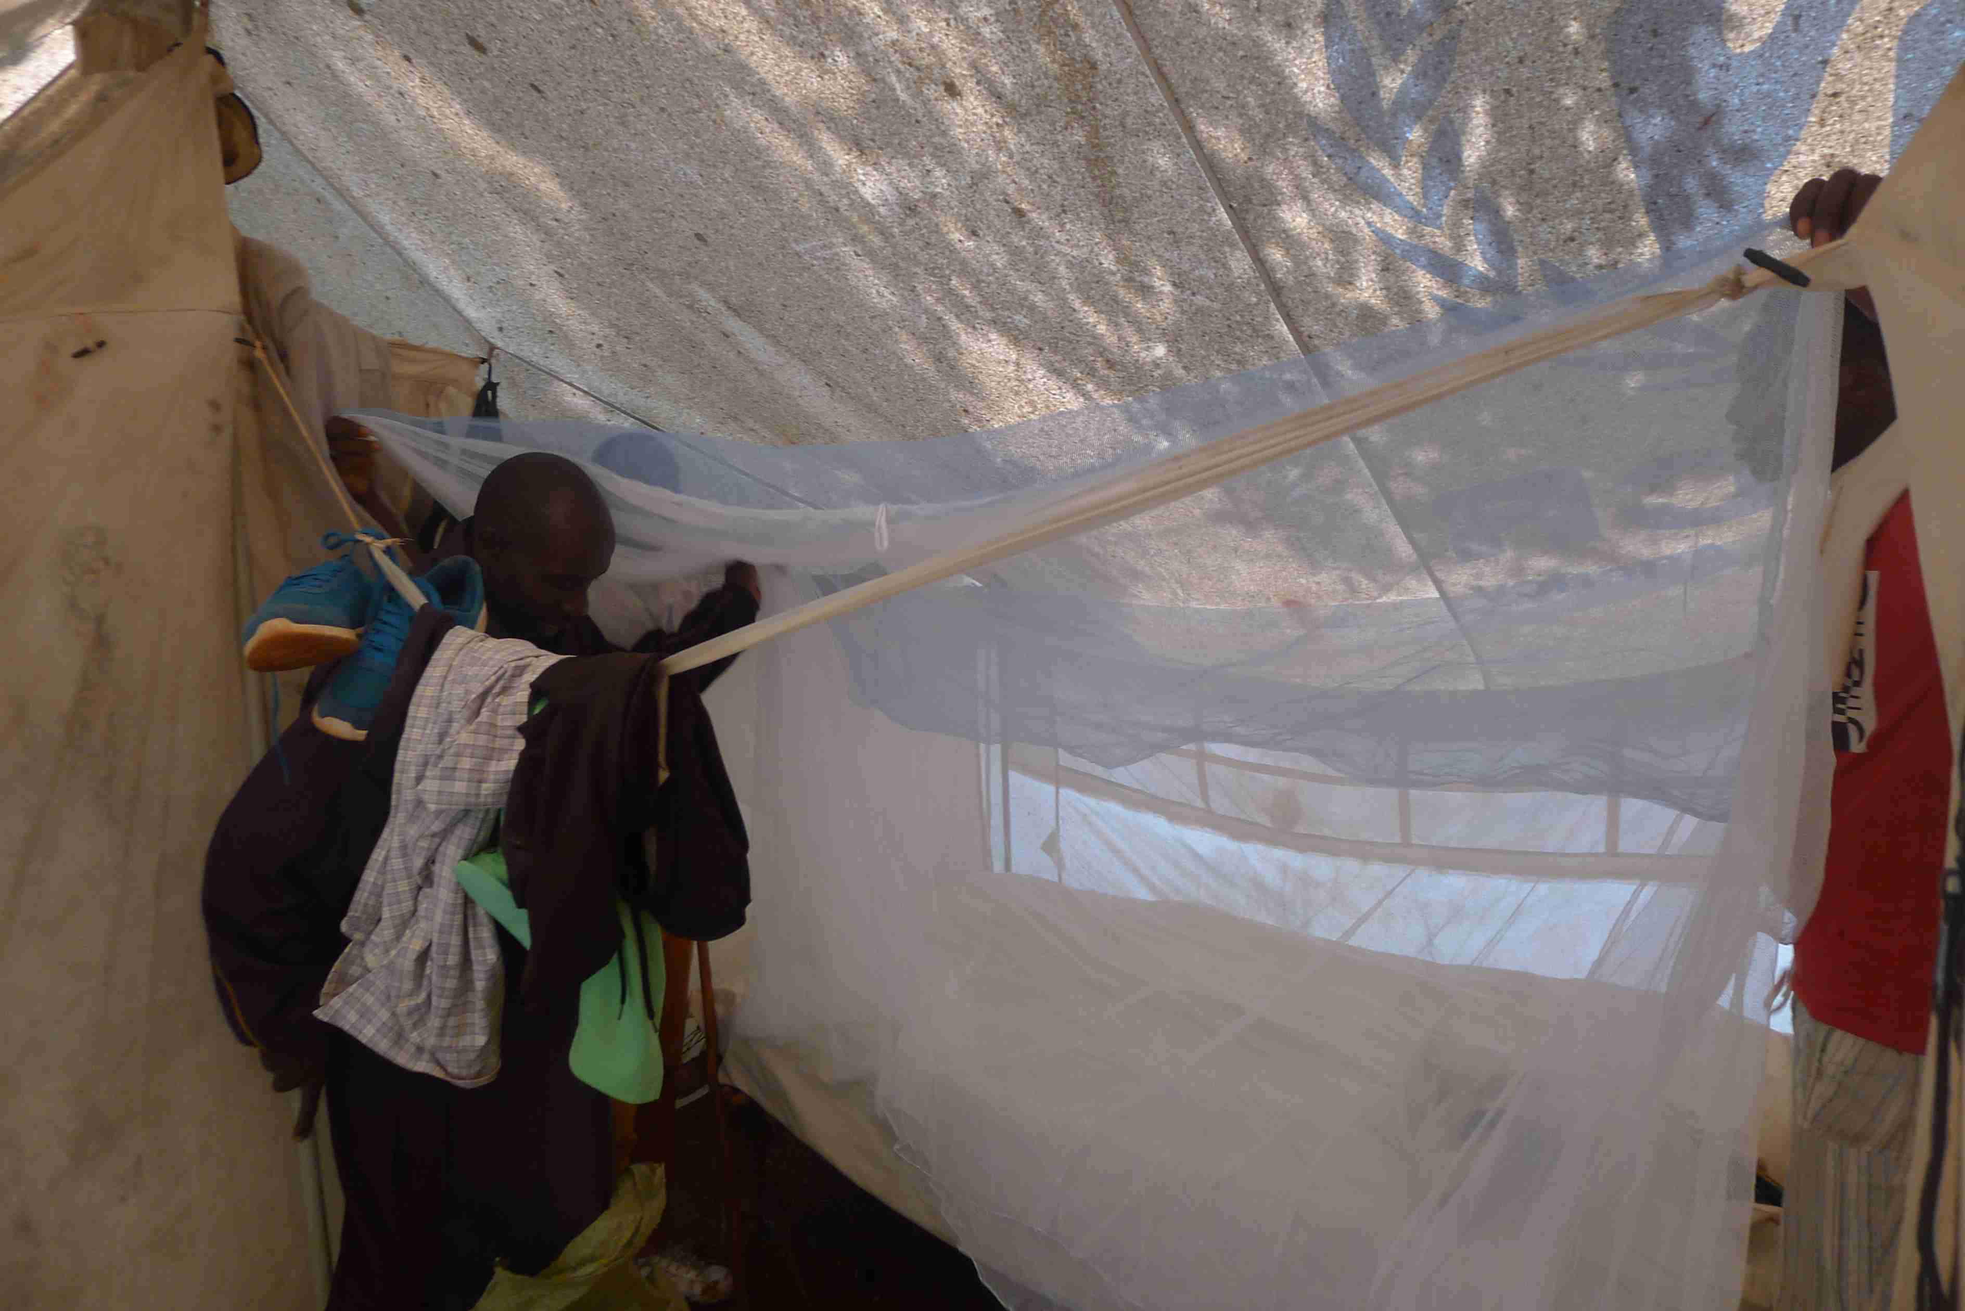
Integrated vector control strategies for malaria prevention Nduta camp - Tanzania
MSF Scientific Days – May 2019
Malaria control Strategy
@Louise Annaud/MSF
@Luc Brondel/MSF

Slide 2
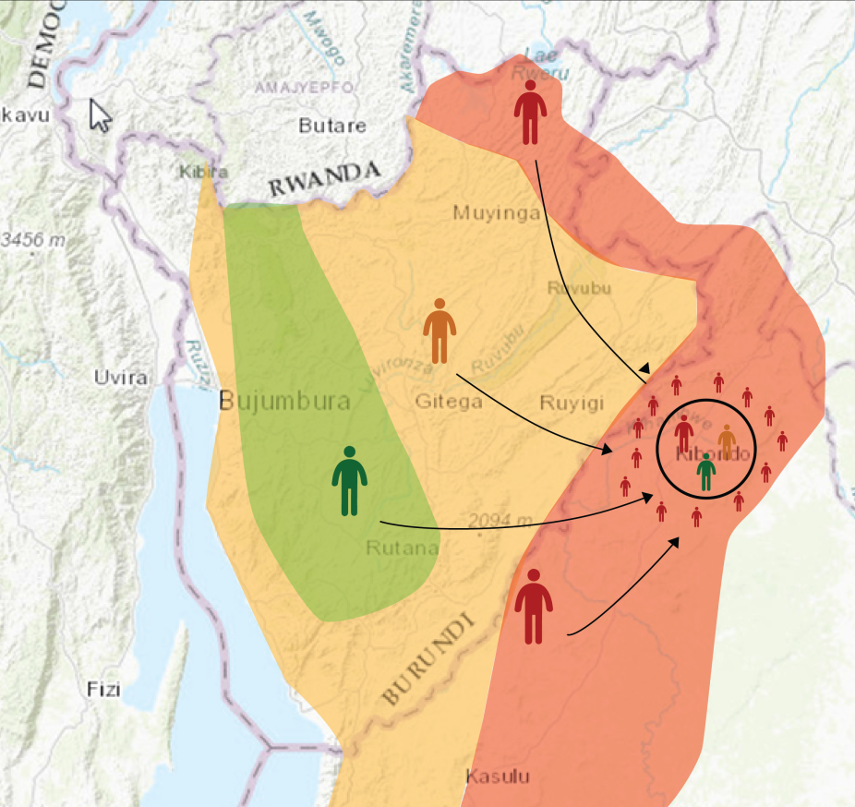
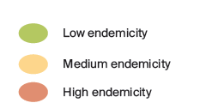
BACKGROUND
Poor living conditions:
Up to 126,000 people, mass shelters, makeshift sheeting shelters and tents
Insufficient waste water management
Environmental and climatic conditions: flood plains
Ineffective traditional preventive measures:
LLIN distribution and coverage gap
Evidence of resistance to pyrethroids insecticide
IRS restricted by TZ government in temporary structures
Notes:
LLIN gap census in 2016 & 2017 october show respecively 17% & 14% of capacity use of intact net
Resistence to pyrethroid 29& susceptibility

Slide 3
 | 2015 | 2016 | 2017
% of morbidity | 41% | 27% | 34%

Slide 4
INTEGRATED MALARIA CONTROL STRATEGY
Objective | Radically reduce the malaria burden in the vulnerable population in Nduta camp
Components | 1. Early diagnosis and treatment
 | 2. Integrated surveillance and monitoring systems: epidemiological and entomological
 | 3. Vector control - adapted Targeted mosquito nets distribution: 1st and 2nd generation Chemical control of larvae: larviciding Environnemental control
 | 4. Mass Drug Administration (MDA) : considered but not feasible
Partners | Community MOSHI / Pan-Africa Malaria Vector Research consortium NGOs MoH
Documentation & Advocacy

Slide 5
INTEGRATED SURVEILLANCE & MONITORING
Epidemiological surveillance
Incidence of Malaria, analysed by administrative zone of origin and bi-weekly
Entomological surveillance:
Anopheles gambiae and funestus density: monitoring with 15 light traps / zone, bi-weekly
Resistance testing and analysis of sporozoite rate (capacity of transmission linked to probability of a mosquito to get infected and probability to become infectious)
  confirm vulnerability area and identify priority areas where to timely implement the most effective tools
  → monitor impact of the interventions

Slide 6
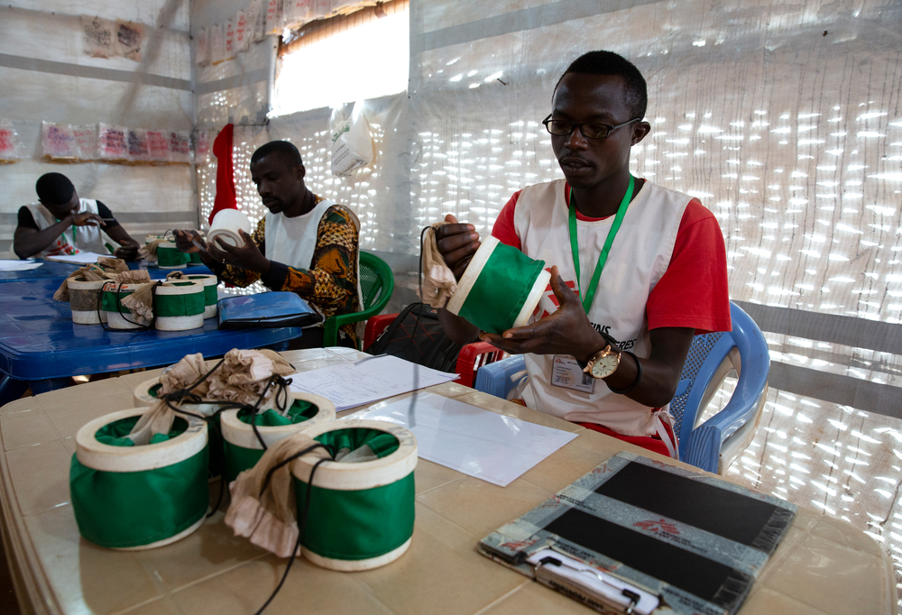
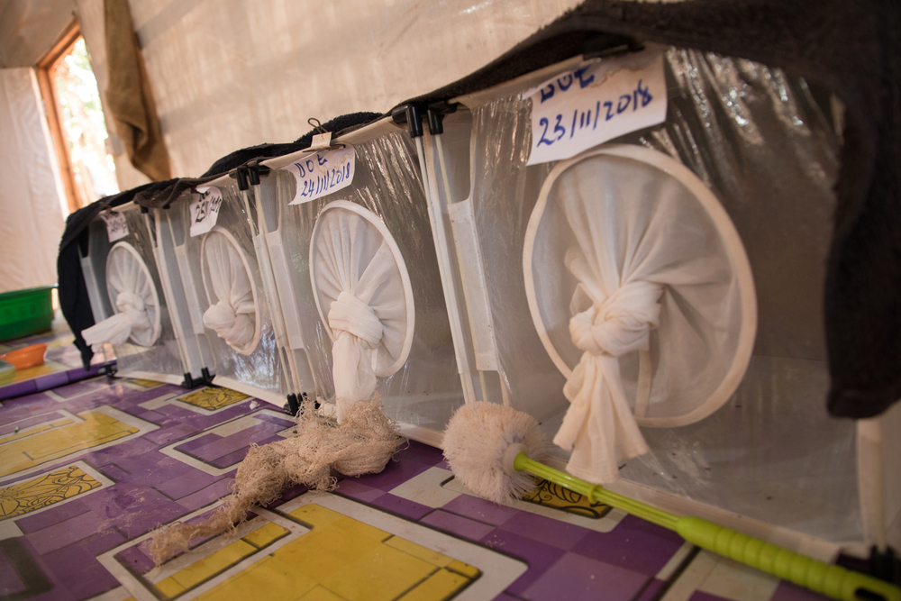
Entomology surveillance lab
@ Ellie Kealey/MSF
@ Pierre-Yves Bernard/MSF

Slide 7
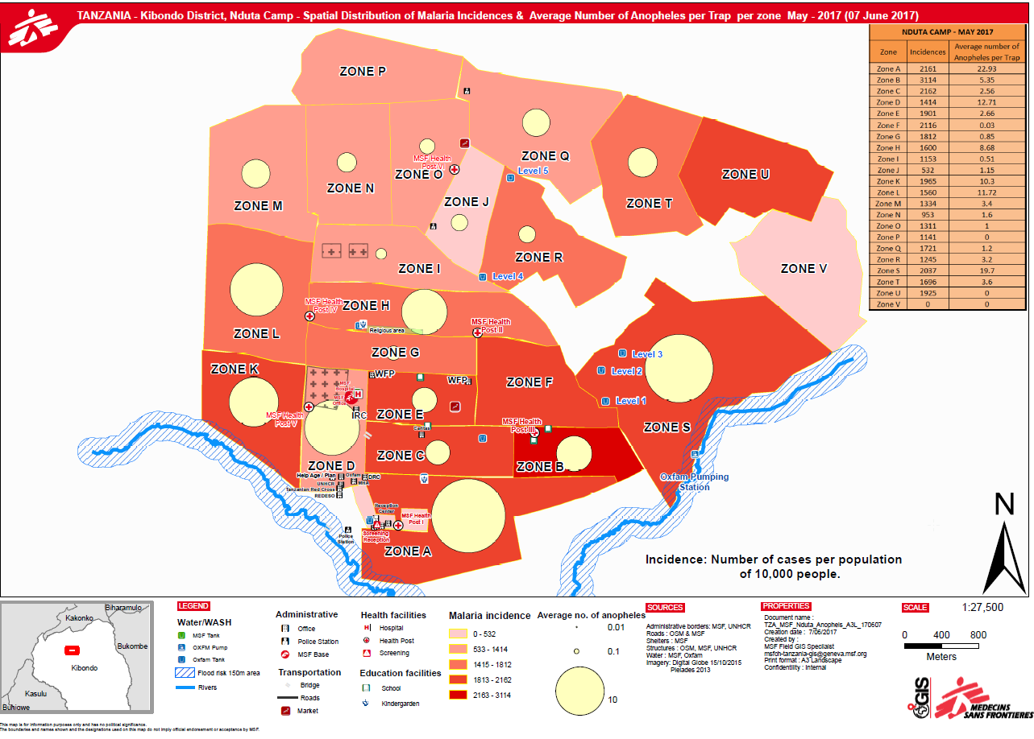

Slide 8
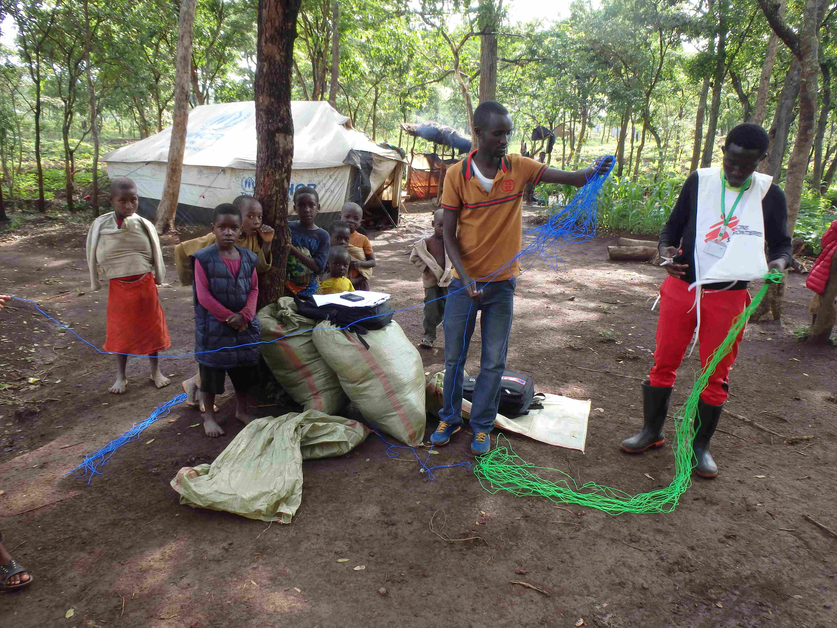
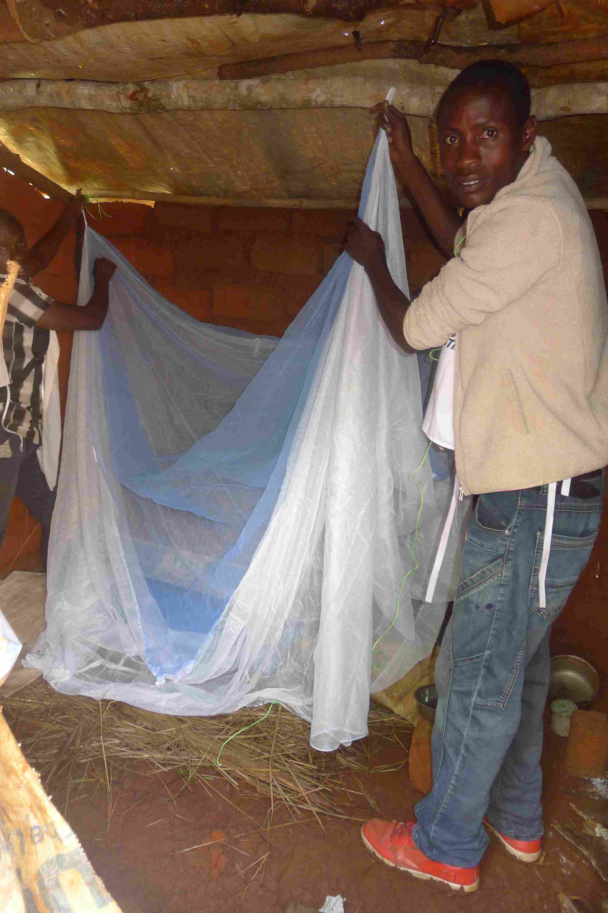
MOSQUITO NET DISTRIBUTIONS
Standard pyrethroid nets were ineffective to kill the Anopheles because of insecticide resistance, thus a need for more expensive nets including a synergis compound (PBO)
In 2017-2018 season: OCG capacity to cover only about half of the population with new generation nets
PBO treated nets distributed in priority areas identified through surveillance (22435) , standard nets in the rest of camp (19070)
House to house distribution by Health Promoters, after census and needs identification surveys, to ensure maximum use
@Luc Brondel/MSF
@Luc Brondel/MSF

Slide 9
LARVICIDING ACTIVITIES
Identified breeding sites were treated with BTI (bacterial larvicide) 3 times a year:
  > beginning of the rainy season: to delay the exponential growth of Anopheles population & provide time to organise treatment capacity
  > between the 2 rainy seasons: to minimise the potential of the big rainy season
  > at the end of the rainy season: to reduce the inter-seasonal transmission

Slide 10
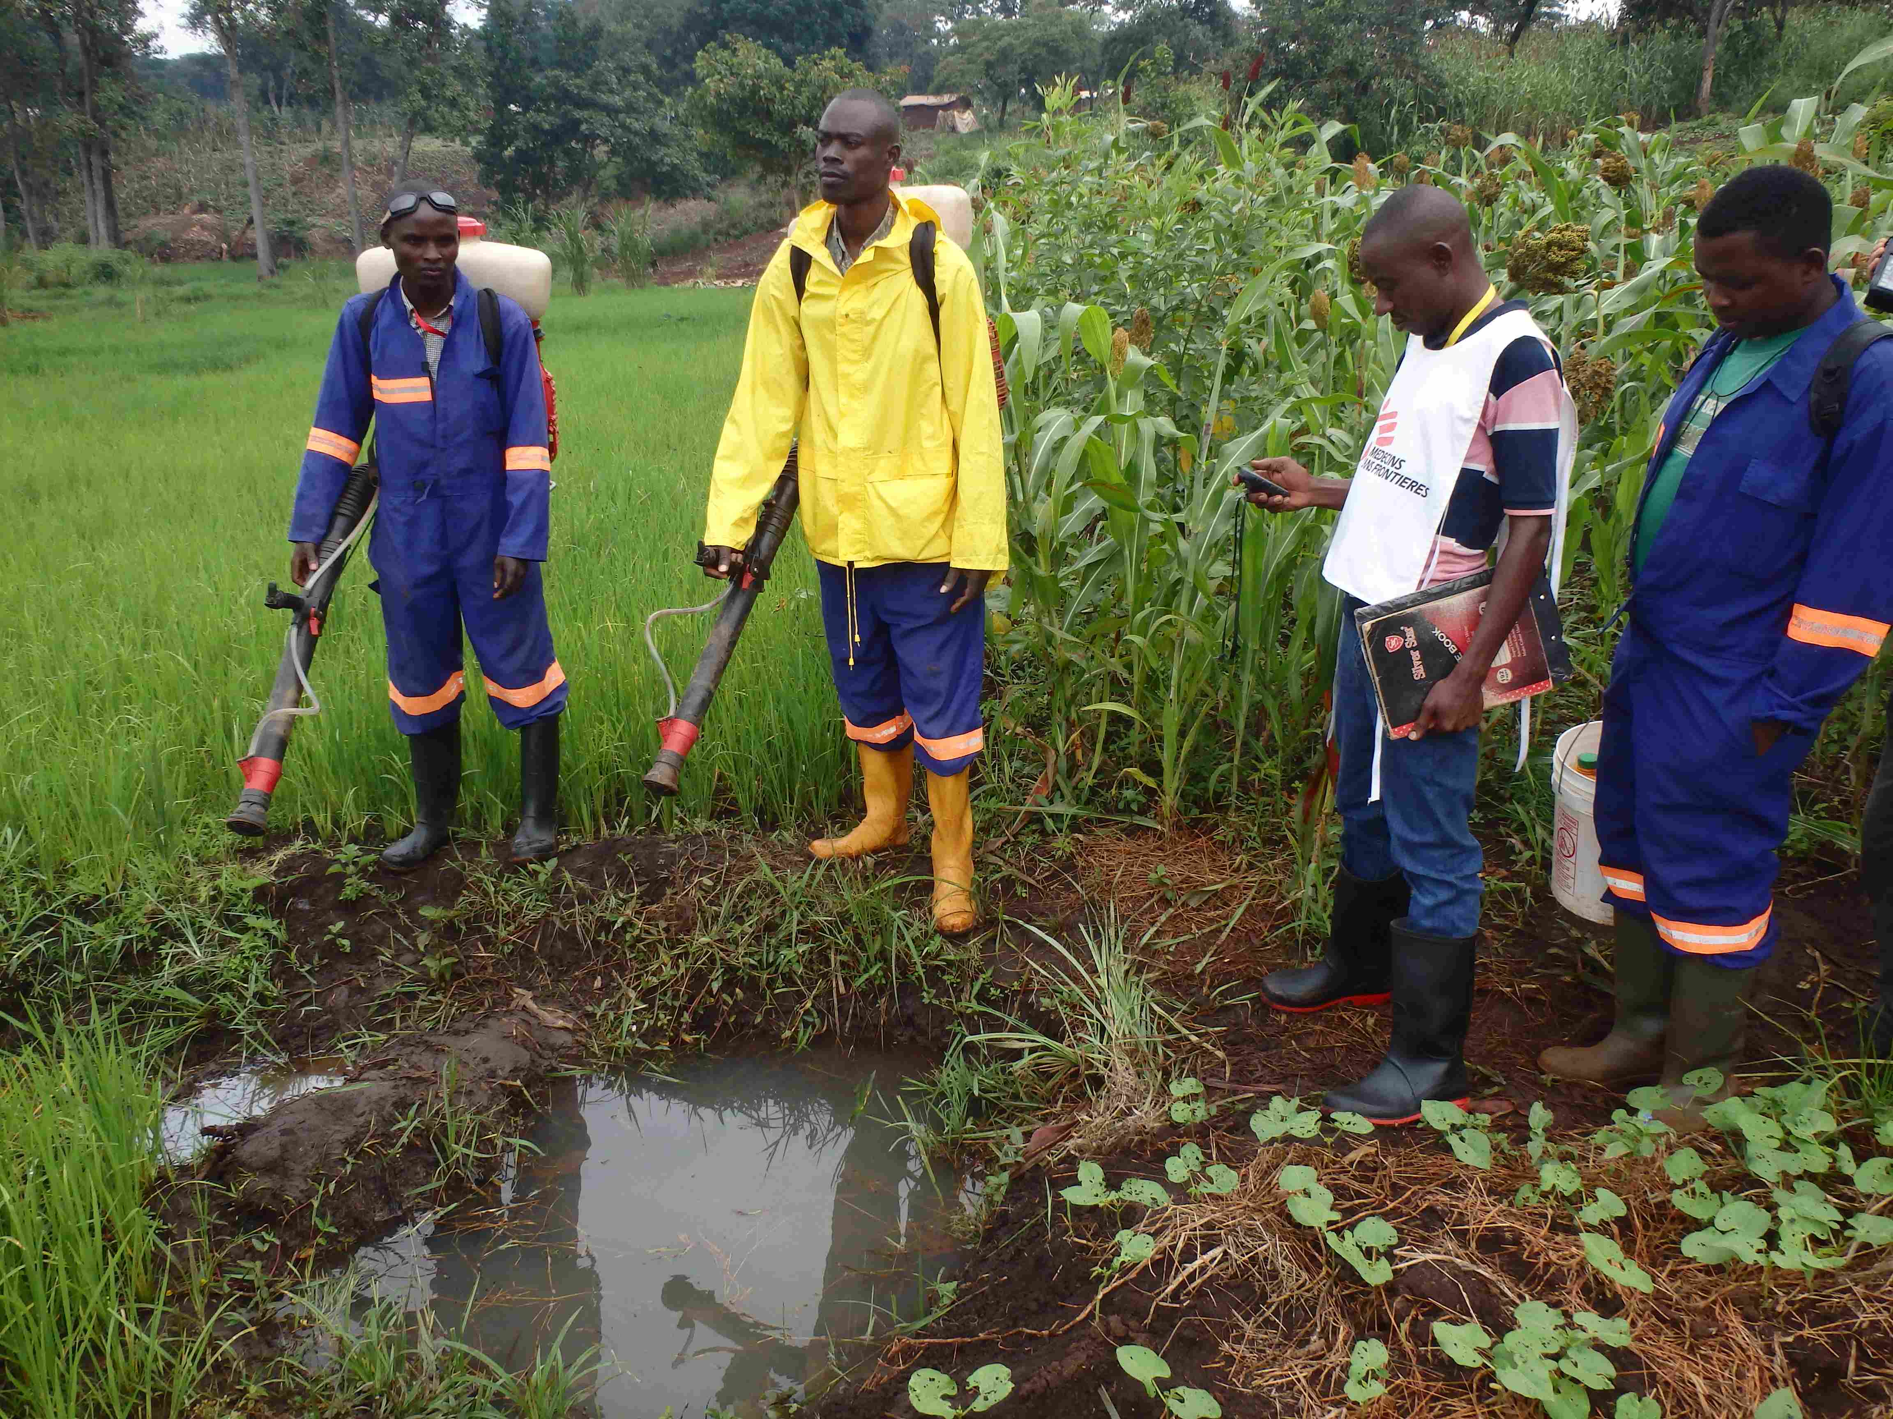
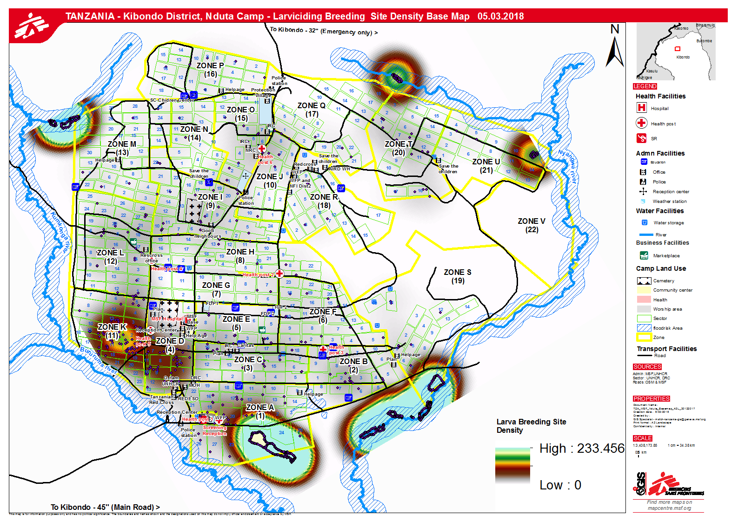
Larvicide activity
@Luc Brondel/MSF
Notes:
Larviciding

Slide 11
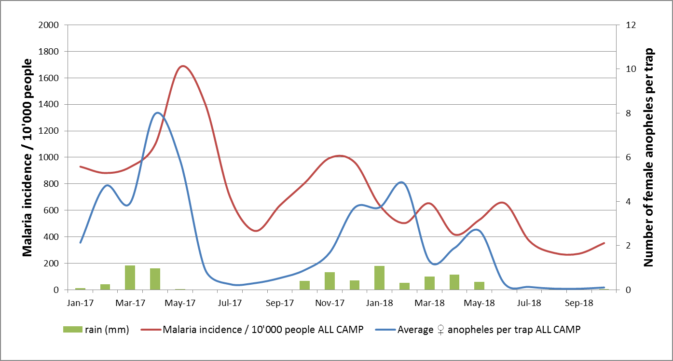
RESULTS (1/3)
LARVICIDE 2ND ROUND (all zones)
LARVICIDE 3nd ROUND (all zones)
Distribution Permanet 3.0
+ larvicide
(Priority zones)
Distribution Olyset
+ larvicide
(non- Priority zones)
Distribution
Permanet 3.0
(all zones)
Malaria incidence rate (/10,000/2weeks), aopheles density and precipitation in all zones of Nduta Camp
from January 2017 to October 2018
Notes:
Octobre: pas d’autorisation du gouvernement pour mettre en place la MDA, decision de continuer avec le contrôle vectoriel
Etat des lieux couverture en moustiquaires:
-couverture totale de personnes qui peuvent dormir sous une moustiquaire 43,7%
-coverture de moustiquaire intactes 15.6%
- Usage important (nb of moustiquaire utilisées/ nombre de moustiquaire dispo)

Slide 12
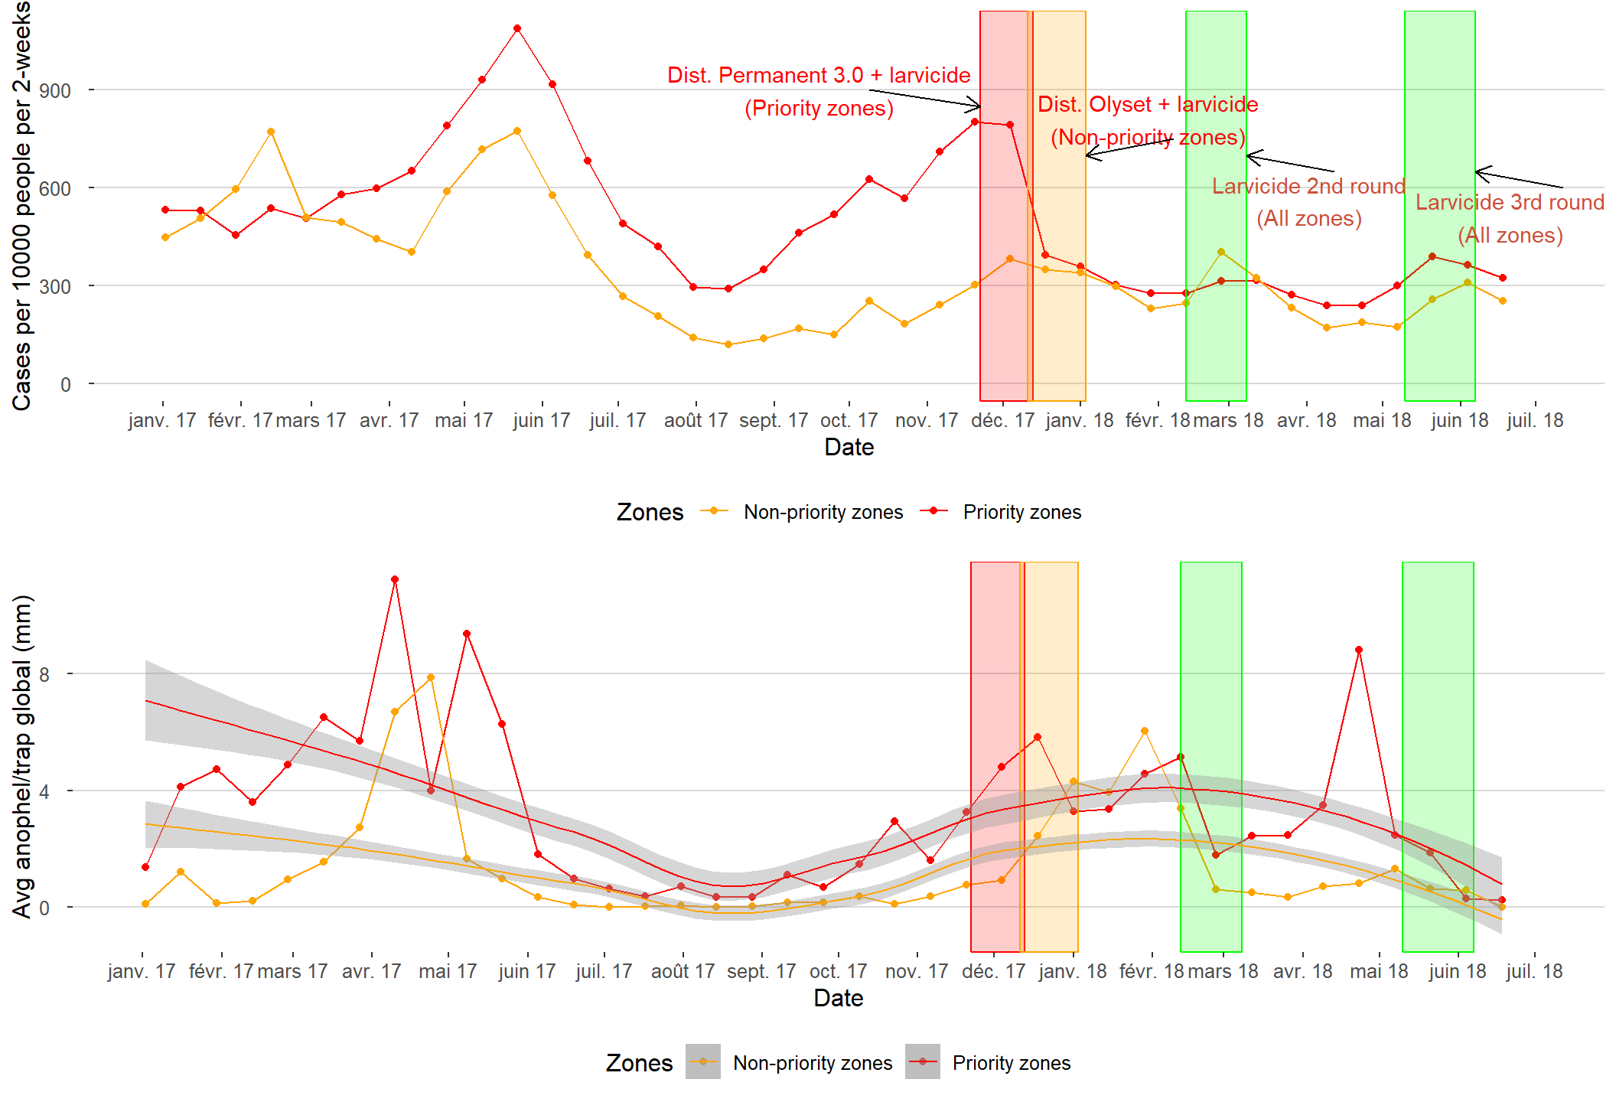
RESULTS (2/3)

Slide 13
RESULTS (3/3)
 |  | Priority Zone (PZ) |  | Non-Priority Zone (NPZ) |  | Differences: priority (PZ) versus non-priority zones (NPZ
 |  | Before Intervention | After Intervention | Before Intervention | After Intervention
EPIDEMIO | Malaria incidence (biweekly; 10,000pop) | 678 (SD, 196) | 306 (SD, 46) | 555 (SD, 131) | 263 (SD, 69) | PZ: ↓54.9% NPZ: ↓52.6% | (p-value <0.001) (p-value <0.001)
ENTOMO | Mosquito density (/trap) | 5 (SD, 3) | 3.1 (SD, 2.2) | 1.9 (SD, 2.5) | 1.8 (SD, 1.9) | PZ: ↓38.0% NPZ: ↓5.2% | (p-value <0.08) (p-value <0.91)
 | Sporozoite rate (%) | 4.9 95%CI 3.1-8.3 | 1 95%CI 0.3-2.2 | 4 95%CI 2.1-6.8 | 2.4 95%CI 1.2-4.5 | PZ: -3.9 NPZ: -1.6 | 95%CI 1.7-6 95%CI -1-4.2

Slide 14
LIMITATIONS
Data collection: epidemiology and entomological
  Mosquito samples only collected inside the households
  Data availability: Different periods for different indicators
Context evolution, with drastic increase of target population
2 intervention zones not comparable as such - different risk factors impacting mosquito density and blood feeding behaviours
Multifactorial relationship between intervention and reduction of malaria incidence

Slide 15
CONCLUSIONS
Reduction of malaria incidence in the whole camp, both in priority and non priority zones
Reduction of entomologic indicators was more pronounced in the areas receiving PBO treated nets
While causality between intervention and reduction cannot be proved, due to the multifactorial aspect of malaria transmission, the data (e.g. sporozoite rate) suggest that PBO treated nets could be more efficient in this context of high insecticide resistance
Importance of comprehensive surveillance activities to inform the adaptation of malaria control interventions
Quality & Targeted malaria prevention are feasible for a large population in heterogenous context

Slide 16
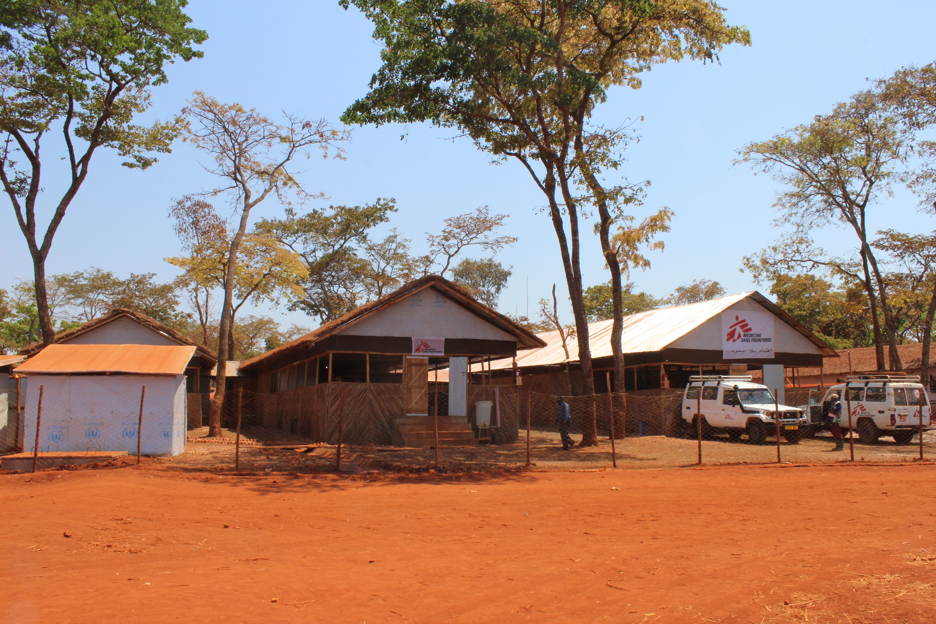
THANK YOU
Thanks to:
Tanzania MoH
Jovin Kitau & Natacha Protopopoff - Moshi University
MSF team in Nduta (Watsan, GIS, HP and medical)
Manuel Albela and Iza Ciglenecki /MSF OCG

