Slide 1
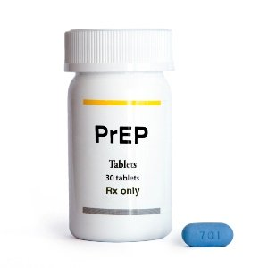
Pre-exposure prophylaxis for HIV prevention in the public healthcare system in Eswatini
MSF SCIENTIFIC DAYS 2019
Notes:
I will be presenting study findings from a study on …. Mainly to understand the social- cultural and programmatic conditions that influence PrEP initiation, adherence and continuation amoung AGYW 16-25 and Pregnant, breastfeeding women

Slide 2
INTRODUCTION
Pre-exposure prophylaxis (PrEP) holds great potential as a HIV prevention intervention in settings with high HIV incidence (1.36%)
HIV prevalence of 27.2% among adults aged 15 years and above in 2016
Evidence on PrEP limited for African contexts in routine settings
MSF and the Ministry of Health (MoH) have operated a PrEP demonstration project in Eswatini since Sep 2017
Notes:
2. regarding its programmatic feasibility remains
3. to December 2018

Slide 3
AIM AND OBJECTIVES
To explore the social-cultural and programmatic conditions that influence PrEP initiation, adherence and continuation/discontinuation of adolescent girls and young women (AGYW), 16 - 25 years, and pregnant and breastfeeding women (PBW)
To develop operational and policy recommendations to guide a national roll-out of PrEP
Notes:
2. regarding its programmatic feasibility remains
3. to December 2018

Slide 4
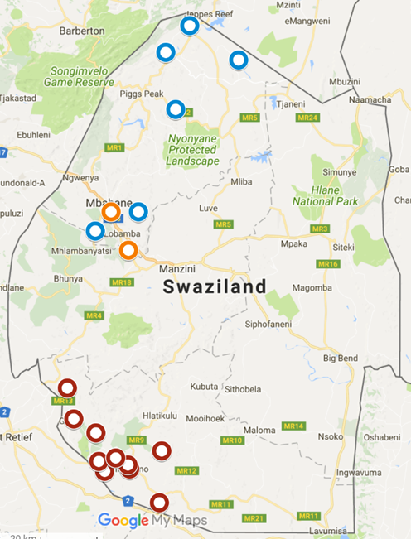
STUDY DESIGN
The study used both qualitative and quantitative methods
The MSF study took place in 12 clinic sites in the Shiselweni region between Sep 2017 and Dec 2018
This study was approved by the MSF Ethics Review Board and by the Eswatini Ethics Committee
Notes:
2. 9 PHC facilities of Nhlangano and 01 Secondary health center, 1 Satellite Fixed HIV testing site and 01 safe space in Matsanjeni
Inform about the focus being Quali

Slide 5
Study Methods
Inclusion Criteria
Target population
Age ≥16 years
HIV negative
Positive screening for high risk of HIV acquisition
Willingness to adhere to daily PrEP
Exclusion Criteria
Acute HIV Infection
Possible renal impairment (CrCl <60 ml/min)
Weight <40 kg
Unable to provide consent (e.g. due to mental illness or incarceration)

Slide 6
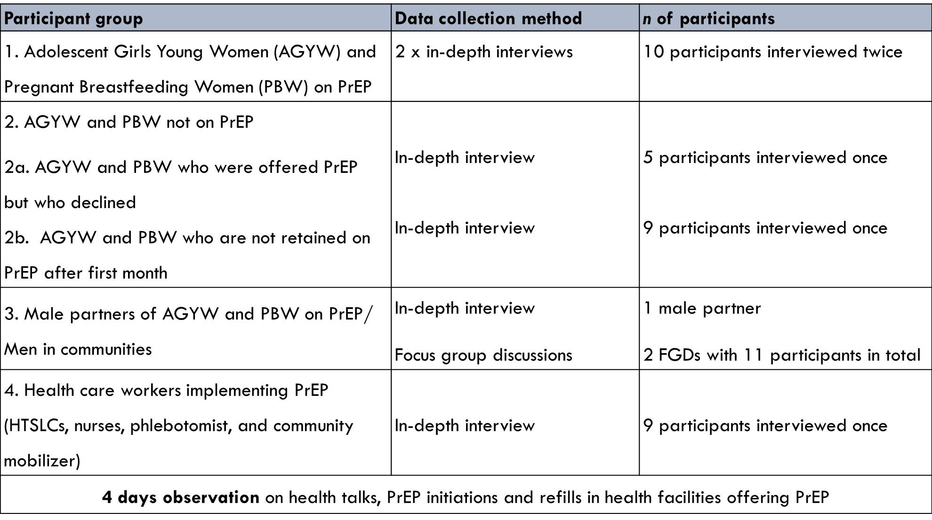
Qualitative Method

Slide 7

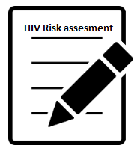
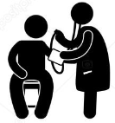

RESULTS
PrEP UPTAKE
RETENTION
Month 1 | 58%
Month 3 | 39%
Month 6 | 29%
2003
Screened for substantial risk
1592
At
substantial risk
538
screened for
PrEP eligibility
503
initiated
on PrEP
Most screening & initiation: young women 16-25 years
Most screening entry point: ANC
Highest uptake: MSM (100%) FSW (85%) and serodiscordant couples (63%)
PrEP
tablets
79%
34%
86%
Overall uptake among those at risk: 32%
Notes:
Entry point being ANC
Reason for the drop down to 32 % was that others preferred other prevention methods

Slide 8
RESULTS Cont…
Five themes explained PrEP initiation and continuation
HIV risk perceptions
Drove PrEP initiation and continuation and were shaped by challenges in negotiating protected sex
Feelings of autonomy and responsibility
Women perceived PrEP as enabling them to take responsibility for, and control of their health
“I feel at risk, even though he is taking the pills [ARVs], I am not convinced that I am safe. He is not responsible because sometimes he just goes somewhere and comes back home late and then he will not be able to take his pills” (woman in HIV serodiscordant relationship, age group 21-25yrs).
“I feel free, because I have succeeded on my wish to have something to protect me from the virus - something which you are going to use alone. People can end up being irritated if you keep pushing them to use these things [condoms]” (PBW, age group 21-25yrs).
Notes:
1. Perceptions of HIV risk drove PrEP initiation and continuation were shaped by challenges in negotiating protected sex

Slide 9
RESULTS Cont…
Disclosure and social support
Emotional and financial support from partners or family members influenced PrEP continuation
Drug-related issues
Triggered PrEP discontinuation
Patient-provider relations
Influenced women's PrEP engagement both positively and negatively
“My grandmother knows that I am taking the pills.[…] She is happy that my risks of getting HIV are now low and she said I should continue taking and be committed to it as it is going to help me” (PBW, age group 16-20yrs)
“I was just tired of the pills, because they are big and they are like ARVs. You have to take them every day and yet they are difficult to swallow. I felt like I have to take it for the rest of my life, I have to take it every day without rest…I would understand if the pill was small. It is like I already have the virus, since I’m taking ARVs and there’s no difference” (PBW, age group 21-25yrs)
Notes:
2. Side effects, pill burden or misconceptions that PrEP is lifelong →

Slide 10
LIMITATIONS
Inability to get enough male partners
It is likely that the female PrEP clients’ multiple concurrent relationships were underreported
Adherence issues among PrEP clients might have been underreported
A large number of clients discontinuing PrEP were not followed up (LTFU)
Gender Based Violence (GBV) and Intimate Partner Violence (IPV) are also likely to have been underreported
Notes:
to participate in this study, therefore FGDs were conducted, documenting perspectives and hypothetical answers rather than real-life experiences
Due to strong female norms of respectibility
due to the strong and strict emphasis on adherence within health facilities
due the sensitive nature of topic

Slide 11
CONCLUSION
PrEP provision within a routine setting appeared feasible
Support for PrEP engagement requires ongoing, client-centred counselling that acknowledges fluidity in women's HIV risk as well as perceptions of risk
Clearer guidance for HCWs on how to deliver PrEP aligned to the client’s risk and seasons of risk is needed
Community level intervention to promote PrEP acceptance among women's partners and families following disclosure
Notes:
3. The potential for PrEP to empower women may be undermined without community-level interventions to…

Slide 12


ACKNOWLEDGMENTS
We thank all the participants who took part in this study, and the MSF/MoH project staff
A special thanks to the staff at health facilities who assisted in the recruitment of PrEP clients for the study
Notes:
SO WITH THAT WE WILL LIKE TO

Slide 13
ACKNOWLEDGMENTS
Pia Juul Bjertrup¹, Charlie Mamba¹, Nqobile Mmema¹, Qhubekani Mpala¹, Velibanti Dlamini¹, Edwin Mabhena¹, Nombuso Ntshalintshali¹, Robin Nesbitt¹, Aung Aung¹, Michelle Daka¹, Muzi Nzima¹, Marie Luce Tombo¹, Sindy Matse², Alex Telnov³, Nelly Staderini³, Alan Gonzalez³, Barbara Rusch³, Iza Ciglenecki³, Alison Wringe⁴, *Bernhard Kerschberger¹
¹Médecins Sans Frontières (MSF), Mbabane, Eswatini; ²Ministry of Health, Mbabane, Eswatini; ³MSF, Geneva, Switzerland; ⁴London School of Hygiene and Tropical Medicine, London, UK
*MSFCH-Swaziland-Hom@geneva.msf.org
Notes:
SO WITH THAT WE WILL LIKE TO

Slide 14
THANK YOU

