Slide 1
Refused and referred: persistent stigma and discrimination amongst people living with advanced HIV in Bihar, India
Mohit Nair, Pragya Kumar, Sanjay Pandey, Amit Harshana, Shahwar Kazmi, Fernanda Falero, Laura Moreto-Planas, Neeraj Agarwal, CM Singh, Alok Ranjan, Sakib Burza

Slide 2
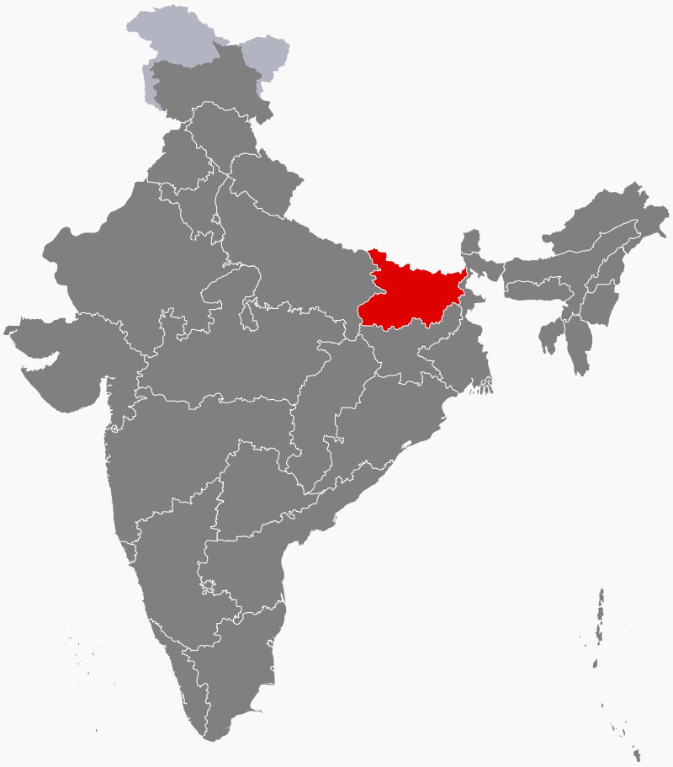
Introduction
>2.1 million people living with HIV in India
Patients with advanced HIV in Bihar often face difficulties in accessing treatment
Routine stigma and discrimination are often implicit and anecdotally reported
Our study aimed to explore how people living with HIV perceived care and treatment in two districts of Bihar

Slide 3

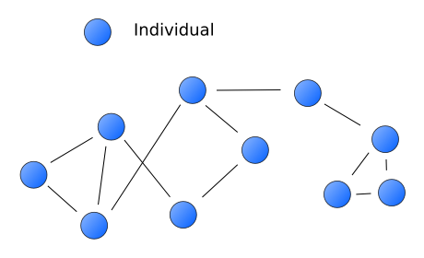

Methods (1)
Purposive selection of two districts
N=71 semi-structured, in-depth interviews with:
      35 HIV positive patients
  10 community members
  26 healthcare providers
Snowball sampling
We obtained ethics approval from MSF ERB and All India Institute of Medical Sciences (Patna) ERB
51 men
20 women

Slide 4
Methods (2)
Verbatim transcription and translation of audio recordings
Grounded theory analysis
  Code→ category→ theme→ theory
Constant comparison of codes
Coding framework iteratively developed
by two researchers
Open coding
Axial coding
Selective coding

Slide 5
Results (1)
“Society sees them with disgust…someone with HIV is not a good person…a morally incorrect man”
Male, Age 22
Society conceptualizes HIV as a “dirty” or “immoral” illness
Enacted stigma contributes to internalized stigma and self-isolation
Anticipated stigma in healthcare settings
limits public disclosure of illness
“I eat food separately. I do not feed the children”
Male, Age 30

Slide 6
Results (2)
Intentional and non-consensual disclosure of status
Mandatory screening for HIV instead of universal precautions
Denial of treatment and referral to tertiary centers (commonly reported in private sector)
Pervasive fear of HIV is a driver of stigma

Slide 7
CORE THEORY
Stigma continues to hamper access to care, particularly outside the capital city and especially in the private healthcare system

Slide 8
Limitations
Not able to include many key populations (i.e. sex workers, transgender individuals, etc.)
Results are applicable to our particular context and cannot be generalized

Slide 9
Conclusion
Our findings suggest persistent levels of stigma against people living with HIV/AIDS in healthcare settings
Current approaches to tackling stigma are largely punitive and assume a high level of knowledge
Progress is required in adopting universal precautions and improving the standards of professionals’ education about modes of HIV transmission

Slide 10
Acknowledgements
Patients, community members and healthcare personnel
MSF field team and capital coordination team
Dr. Pragya Kumar, Dr. Sanjay Pandey, and the Community and Family Medicine Department

