Slide 1





“Nothing in the world can serve those people like palliative care”:
Qualitative analysis of refugee and provider experiences in Jordan, Rwanda, and Bangladesh
Rachel Yantzi
McMaster University
Notes:
-check consistency of capitalization
-check consistency of font
-check consistency of quotations
-consistent description of participants quoted (either include or don’t include country)

Slide 2


Aid When There is “Nothing Left To Offer:”
A Study of Ethics and Palliative Care in International Humanitarian Action — 2016-2019
Purpose:
To develop evidence clarifying ethical and practical possibilities, challenges, and consequences of palliative needs during public health emergencies.
To inform realistic, context-sensitive guidance, education, and practices for the provision of palliative care during public health emergencies.
www.humanitarianhealthethics.net
Notes:
What are the moral obligations of international aid agencies?
What are practical realities of palliative care in humanitarian crises?
Ethics approval obtained from HiREB and McGill REB
Ethics approval was obtained in Jordan from the Jordan University of Science and Technology
In Rwanda from the Rwanda National Ethics Board.
No in-country data collection was performed in Bangladesh

Slide 3
“If I’m treating this one, how is that going to affect those who are salvageable?”
Experiences from humanitarian aid response indicate the need for palliative care
High mortality rates in some humanitarian disasters
Death is inevitable
Natural disaster, conflict, forced migration
Some will die as a result of the event, others were dying before
Response framework is rescue oriented, save as many lives as possible
Pressure from donors and funders to record high numbers of lives saved as measures of accountability
www.humanitarianhealthethics.net
Notes:
Humanitarian healthcare providers do their utmost to save lives.
This is a primary moral imperative.
While most humanitarian aid organizations recognizing the dual goals of saving lives and relieving suffering, responses tend to be focused on rescue.
The unescapable reality is that many patients will die due to injury or disease. Death is inevitable, in the context of disasters, conflict, forced migration, some will die as a result of the event and others were already living with life limiting illness.
-balancing sometimes competing priorities

Slide 4
12 International Humanitarian Aid Workers
Public Health Emergency: Ebola crisis in Guinea
Natural Disasters: Various Locations
Critical Interpretive Synthesis
International Survey
International Interviews
In-depth Case Studies
Protracted Refugee Situation: Rwanda
Acute Refugee Situation: Jordan
Acute Refugee Situation: Bangladesh
12 Humanitarian Policy Makers
www.humanitarianhealthethics.net
Notes:
Discussing results from in-depth case studies.
-selected three case studies that highlighted different types of refugee crises: acute vs. protracted, SES of displaced population, cultural differences
-Initial plan to do only the Rwanda and Jordan case studies but then the Rohingya crisis developed and we had the opportunity to remotely interview staff involved in a small local palliative care intervention: iterative nature of qualitative research
-Jordan was initially selected to represent an acute refugee situation but it has since developed into a more protracted crisis while Bangladesh is more acute

Slide 5
www.humanitarianhealthethics.net
Notes:
Many obstacles to providing palliative care in humanitarian emergencies emerged from the initial 24 interviews that were conducted

Slide 6
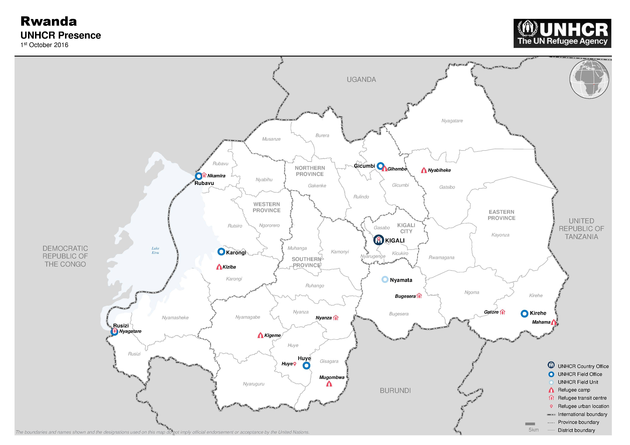
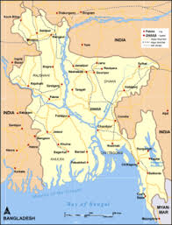
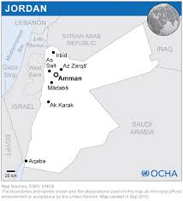
Case Study Recruitment
https://www.unhcr.org/rw/where-we-work
Rwanda
10 refugees in two camps
6 local HCPs
1 agency representative
http://www.wikiwand.com/en/List_of_railway_stations_in_Bangladesh
https://reliefweb.int/map/jordan/jordan-location-map-2013
Jordan
8 refugees
5 Jordanian nationals
2 local HCPs
1 international HCP
Bangladesh
1 local palliative care physician
2 lay health workers
www.humanitarianhealthethics.net

Slide 7
Methods
Qualitative, constructivist approach
Interpretive Description (Thorne, 2016)
In-depth, open-ended interviews
Analysis using Nvivo 11 qualitative data analysis software
www.humanitarianhealthethics.net

Slide 8
Case Specific Themes
“People say that I am going to die soon because I have cancer, a disease that does not heal, a disease which is more serious than HIV / AIDS… recently I went to [Hospital] to do some follow up on my medical file, and some of my stuff were stolen; they do it even when I am in the house, or if people know I'm sleeping” –Refugee Participant
Rwanda
Protracted Refugee Situation
Social Death & Stigma
Concerns about Family & Children’s Well-being
Jordan
Bangladesh
Acute Refugee Situation
Socio-political Context
Expectations of Comprehensive Healthcare
Acute Refugee Situation
Blurring of Curative & Palliative Care
Personal Satisfaction & Pride in the Work
www.humanitarianhealthethics.net
Notes:
-Rwanda: people coming from DRC and Burundi, with even weaker health systems. Some come explicitly to seek care even though Rwanda’s health system is still quite weak
-Jordan: Syrian refugees were often middle class and had access to high quality health care
-Socio-political context: required to interview Jordanian Nationals to demonstrate parity with local citizens to prevent tensions/perceptions of preferences for refugees
“People say that I am going to die soon because I have cancer, a disease that does not heal, a disease which is more serious than HIV / AIDS… recently I went to [Hospital] to do some follow up on my medical file, and some of my stuff were stolen; they do it even when I am in the house, or if people know I'm sleeping”

Slide 9
Overarching Themes
Labyrinthine care pathways and long waits
Silence around death & dying
The false dichotomy
Small things that make a difference
Inadequate access to symptom control
www.humanitarianhealthethics.net

Slide 10
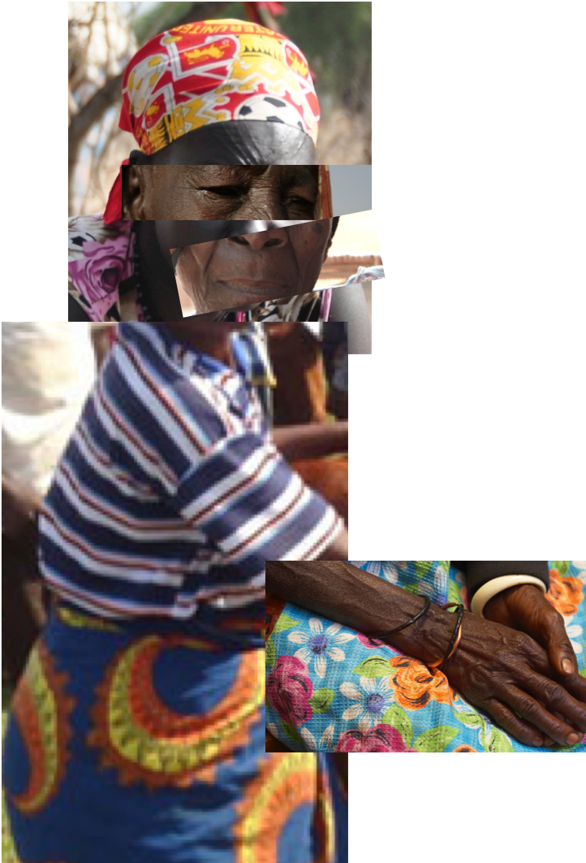

Labyrinthine care pathways and long waits
“They said that the referral was in 2017 and since then it's now 2018 you need to bring in a new one…So she went so she came here, they gave her another referral which by that time she was having another swelling … they did an ultrasound and they found there is almost a 2 cm sub tissue mass.”
-Refugee Participant
“They stopped providing me with food coupons because I couldn’t go for required verifications”
-Refugee Participant
www.humanitarianhealthethics.net

Slide 11

Inadequate access to symptom control
“Actually for palliative patients they're doing nothing, I should not say that but they are doing very little. They can’t even provide pain management you know an organization like [HUMANITARIAN ORGANIZATION] they don't have morphine or morphine tablets. This is frustrating isn't it? … At least they can give pain management to the patients who are having moderate to severe pain. So it cannot, it should not happen. They do not have any morphine. They are referring patients to my organization which is I think the smallest organization in the camps… An organization that is working all over the world. Why should that be?”
-Physician from Local NGO
www.humanitarianhealthethics.net
Notes:
-need to protect her identity, cannot indicate location
-grassroots interventions in all the settings: local volunteers

Slide 12
Inadequate access to symptom control
“Yeah most of the time the patients at that time they did not get the care they needed. They had severe pain but they only got paracetamol. ‘They gave us Ceclo and paracetamol and so that doesn't help my pain so why should I go?’ So whenever one stroke patient or paralysis patient they go to the doctor they say we have nothing to do for you so they feel some sort of neglected that's why they did not appear in the camps”.
-Physician from Local NGO
www.humanitarianhealthethics.net
Notes:
-large aid organizations don’t have access to pain meds that are effective so over time patients don’t even attend clinics because they know they won’t receive effective treatment

Slide 13

Silence around death & dying
“She told me ‘father, father I do not want to die. I want to live at least three months because my son will get married soon’. Then I became very emotional, I looked at her and smiled. I told her ‘aunt, you are not going to die. You will recover’. This patient is still alive. The doctor said that the she would not survive but she survives because God gave her life.
-Lay Health Worker
"In my experience, we don’t talk about death. In general in Rwanda, because in our culture it’s kind of inappropriate to talk about death, even if someone is still breathing. Why? Because, life is really more important than death. And we don’t talk about it."
-Local Healthcare Provider
www.humanitarianhealthethics.net
Notes:
-in all three settings, many participants were unaware they were dying or felt it was inappropriate to talk directly with patient about their prognosis

Slide 14

The false dichotomy
“The interest to provide such kind of a treatments or services, it’s not optimal because normally they focus on the life-saving, basic intervention, but not to such kind of services like rehabilitation, palliative care, these kind of things, they don’t - especially during the emergencies.”
-International Healthcare Provider
www.humanitarianhealthethics.net

Slide 15

Small things that make a difference
“If someone could just bring the water to my tent.”
-Refugee Participant
“Holding the hand of someone who’s dying and letting that one go peacefully. But to that person, that will be what he’s leaving this world with. Someone who cares.”
-Local Healthcare Provider
www.humanitarianhealthethics.net

Slide 16
False dichotomy
“Given the humanitarian’s oft-cited dual imperative to alleviate suffering and preserve human dignity, how is it that palliative care has been side-lined in the development and delivery of humanitarian health programmes? Arguably the most pervasive justification remains the claim that health services must be rationed in such a way as to privilege life-saving interventions in resource scarce contexts. The imperative to save lies is clearly a priority in such circumstances where lives can be saved, but this justification generates a false dichotomy between palliative and curative approaches, and downplays the feasibility of integrated programming”.
  Smith, James, and Tammam Aloudat. "Palliative care in humanitarian medicine." (2017): 99-101.
Notes:
One of the main moral argument against the application of PC is said to be a choice between curative or palliative care, a dichotomy.
-people are dying potentially curable illness, what is the role of palliative care.?
-Our research shows that there are many ways in which the two happen simultaneously.
We have been hearing stories for months about how it is being done, even if not recognized formally, not budgeted as a line item, or as part of a targeted donor campaign.
We need to be working at all levels to address global and local health system barriers to palliative care. Palliative care was recognized as an essential component of holistic, comprehensive humanitarian healthcare, and should never act as a substitute to health system improvements for curative care.

Slide 17
Prognostic uncertainty
Silence around death & dying
Integrated palliative care
Fears & taboos around hastening death
Blurring of curative & palliative care
www.humanitarianhealthethics.net
Notes:
-you often don’t know if someone will survive or not: difficult to predict regardless but with even few diagnostic resources, uncertainty around what is available etc.
Silence: Western ideal to speak openly about death but it us not likely appropriate or possible in a crisis to push our values in this area. How do we provide palliative care when we can’t speak openly about death. Sometimes possible to find culturally appropriate ways with guidance from local cultural brokers.
Fears/Taboos: In Rwandan context, if seen as hastening death, will be rejected. Needs to be integrated, relief of suffering, accompaniment needs to be a priority for all patients
-all of these factors point to the importance of integrating palliative care strategies into comprehensive care for all patients whenever possible
Blurring: particularly in Bangladesh, pallcare seemed synonymous with comprehensive care for those seen as “unsalvagable” by acute care services. Many were actually given effective curative treatments
Answer seems to be the integration of psychosocial supports, effective symptom relief and other aspects of palliative care for all patients, potentially alongside curative treatments

Slide 18
“Help them to land softly”
Advocacy at the micro, meso and macro levels
Integrating the 'small things'
What CAN be done for this patient?
Palliative Care is Just Good Care
“The patient was sent to us with a broken arm without any splint... I told that doctor that could you please make a splint, and he said we don't have those facilities”
-Local Physician
“We go to these patients and give encouragement for living. When a patient receives palliative care then, Inshallah, they live longer, and even if they do not live longer they live peacefully”
-Lay Health Worker
www.humanitarianhealthethics.net
Notes:
What CAN be done for this patient: when a patient with lung cancer has a broken arm, we can still treat the broken arm
-we can still make sure they are not alone
-we can still manage their pain
-informed consent: if I can’t give you your diagnose
-palliative care alongside curative

Slide 19



Practical Suggestions
Using technology to assess and monitor palliative patients remotely
Expanding the role of psycho-social workers in assessing local practices around death and dying
Dedicated tents for dying patients and grieving families during mass casualty events
Good Samaritans in Rwanda
Facilitating Community Supports
‘So I guess the palliative care in her case was let’s get the community to help her…So we made a plan… that every day the women would go and see her twice a day. See how she was doing’
’You had to create a little bubble the best you can’
www.humanitarianhealthethics.net

Slide 20
Thank you!
We are ever so grateful to the participants, particularly those living with serious health challenges, for taking the time to talk with us. The narratives shared were moving, thought-provoking, and invaluable.
Thank you to elhra-R2HC for funding to support this project.
Thank you to the HHE research group for your support of the full study.
Co-PIs: Lisa Schwartz & Matthew Hunt
Alphabetically: Ibraheem Abu-Siam, Takhliq Amir, Oumou Bah Sow, Carrie Bernard, Kevin Bezanson, Ani Chénier, Philip Cotton, Sonya de Laat, Pathé Diallo, Laurie Elit, Leigh-Anne Gillespie, Wejdan Khater, Sékou Kouyaté, Emmanuel Musoni, Elysée Nouvet, Lynda Redwood-Campbell, Jhalok Talukdar, Ross Upshur, Olive Wahoush, Rachel Yantzi, Laila Zeheya.
www.humanitarianhealthethics.net

Slide 21
For more information visit:
www.humanitarianhealthethics.net
www.humanitarianhealthethics.net

