Slide 1
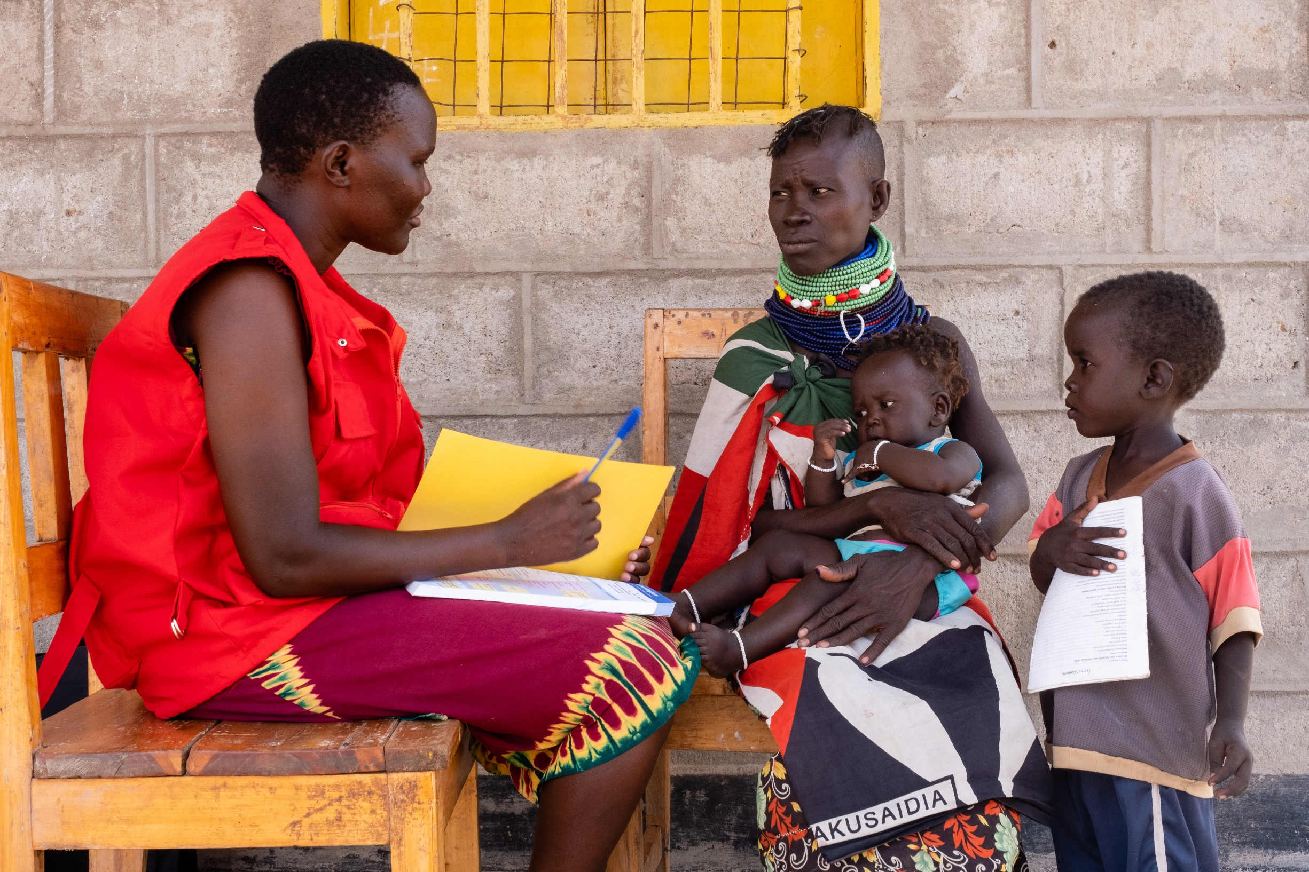
Simplified tools for delivery of acute malnutrition treatment by community health workers in humanitarian contexts
Conflict of Interest
The author has declared no conflict of interest.
Photo by Alan Winslow
Authors: Naoko Kozuki, Olatunde Adesoro, Elburg van Boetzelaer, Olusola Oresanya, Annie Zhou, Helen Counihan, Prudence Hamade, Regine Kopplow, Bethany Marron

Slide 2
Introduction
49.5 million children are wasted; 16 million of these children are severely wasted.
Despite global efforts to scale up outpatient treatment programs known as community-based management for acute malnutrition (CMAM) programs, only 4.4 million children under five were treated for severe acute malnutrition (SAM) in 2017.
Barriers to access
  Opportunity costs
  Distance
  Awareness of malnutrition and treatment

Slide 3
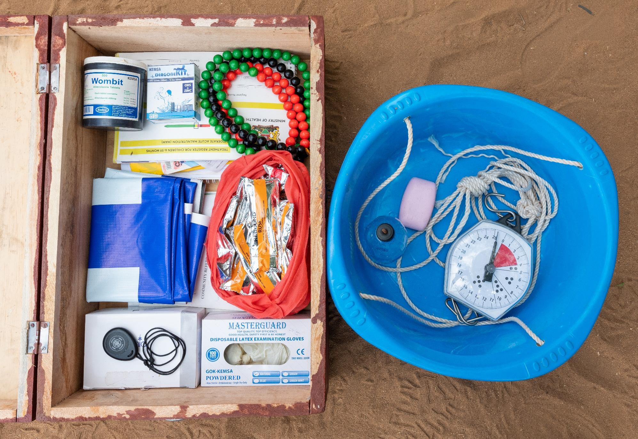
Introduction
Integrated community case management (iCCM) is a global strategy that utilizes CHWs to increase access to life-saving treatment for pneumonia, diarrhea and malaria.
Currently, malnutrition is only addressed by iCCM as a referral trigger.
While a few studies indicate community-based models promising to provide treatment for SAM, models adapted for low-literacy settings have not been studied.
Photo by Alan Winslow

Slide 4
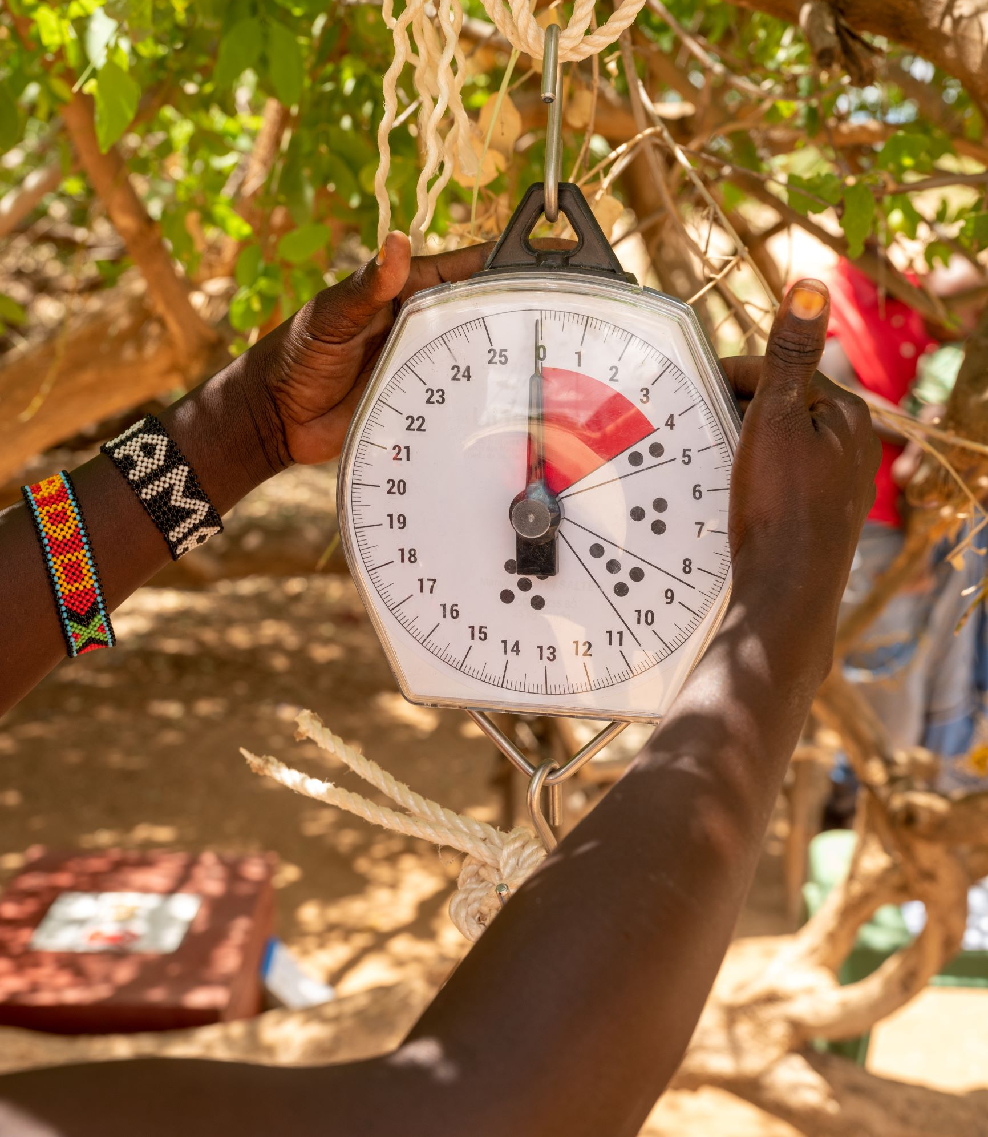
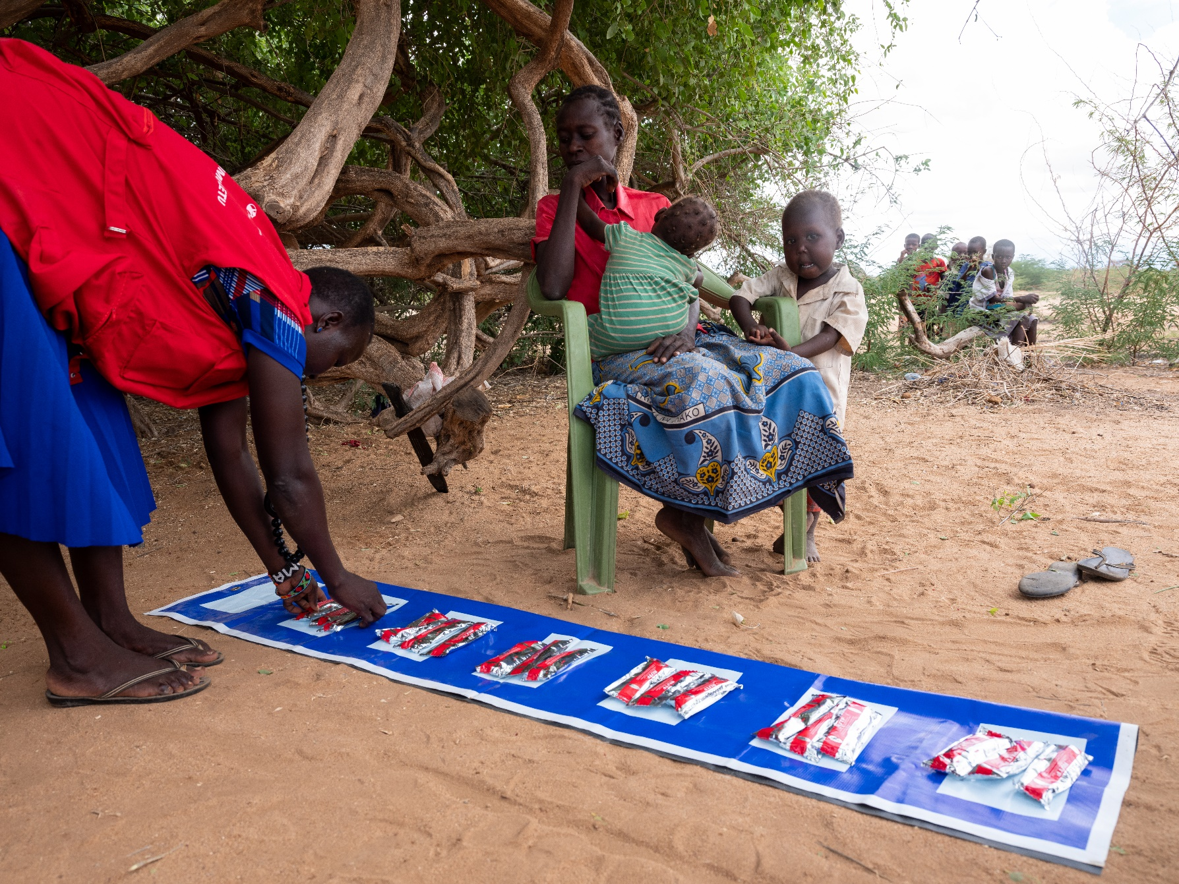
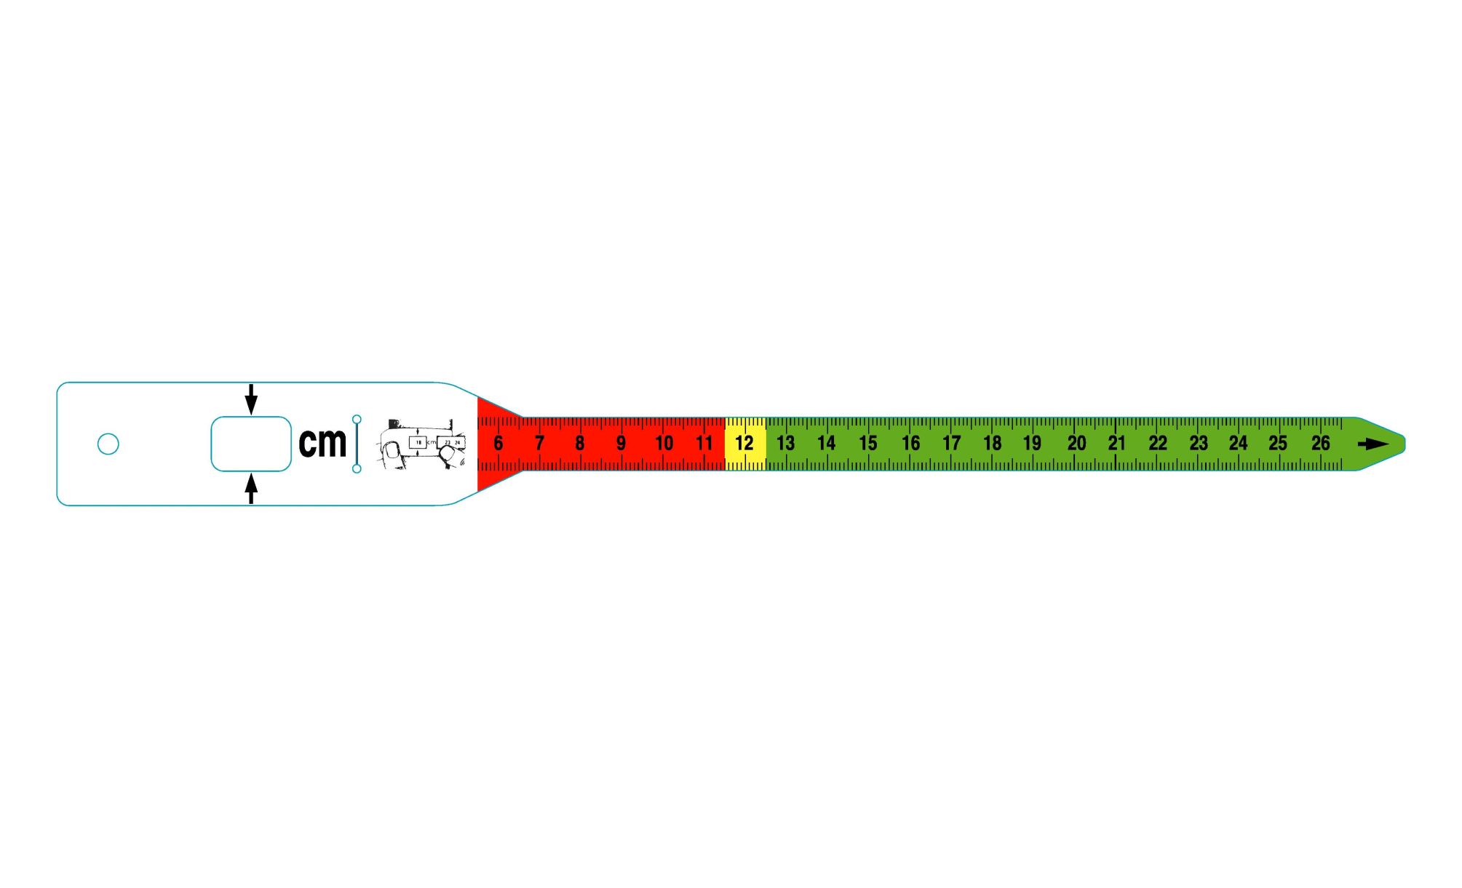
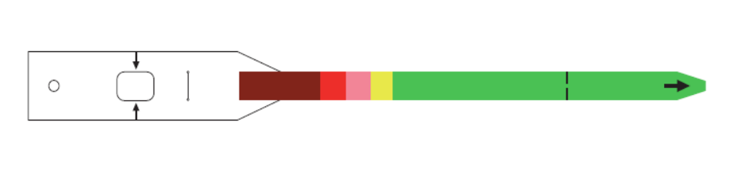
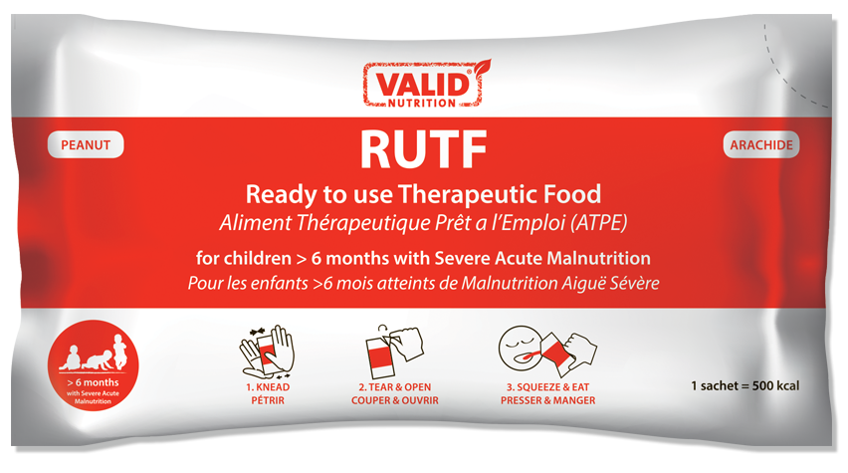
Simplified Toolkit
Assessment
Treatment
Photos by Alan Winslow

Slide 5
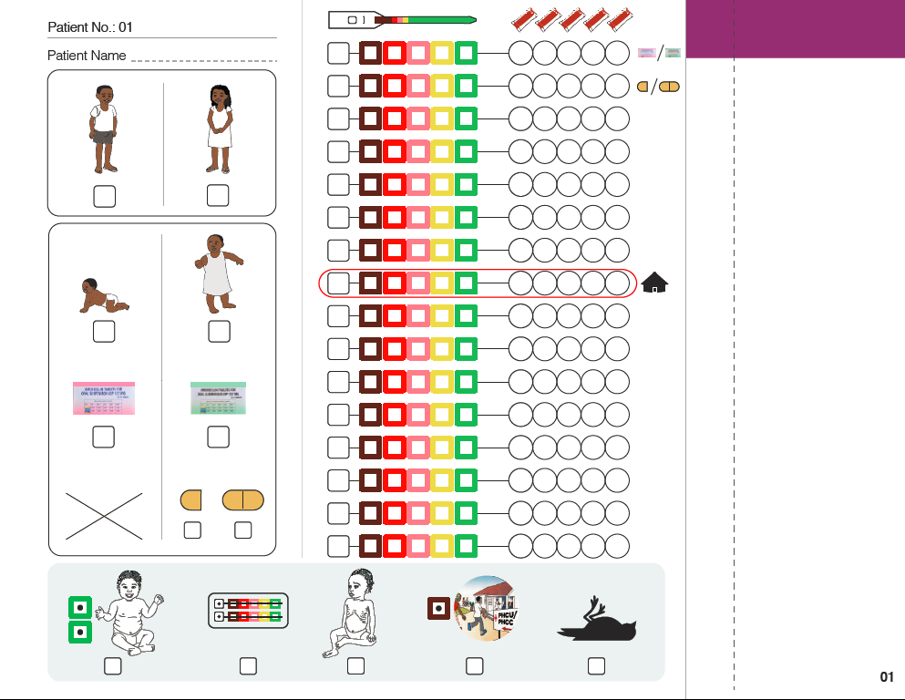
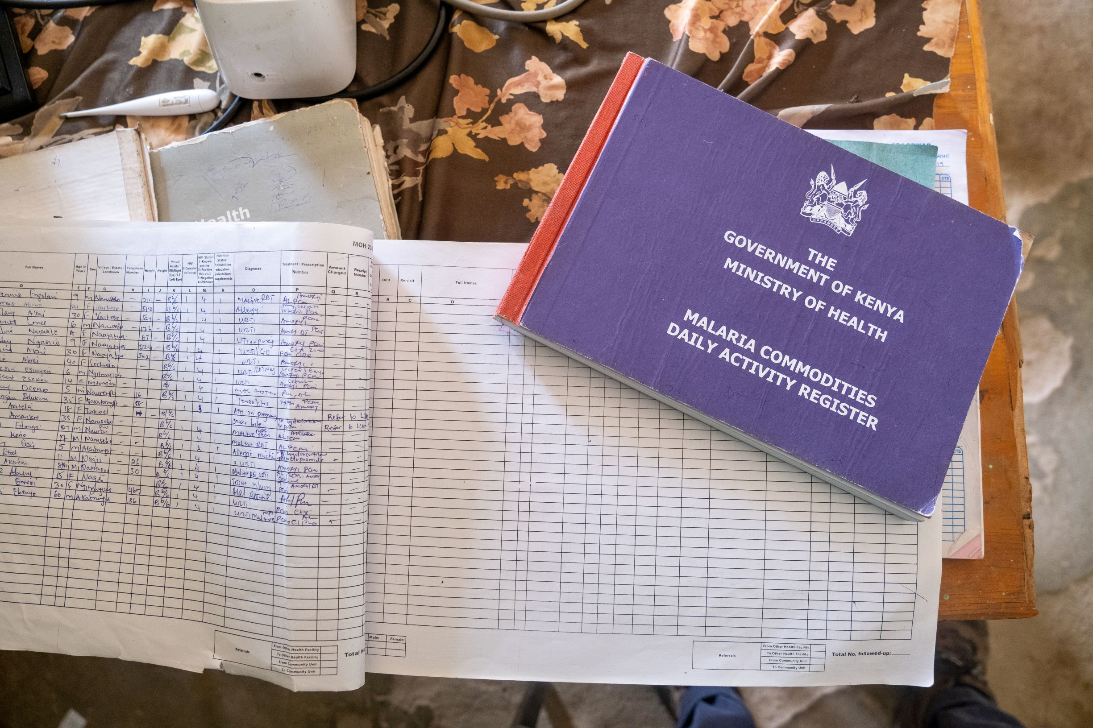
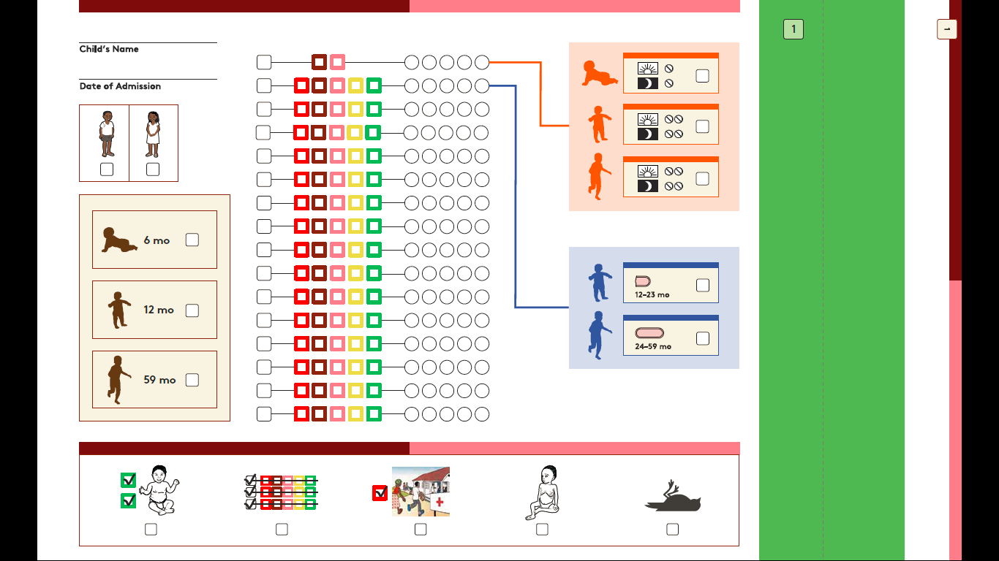
Simplified Toolkit
Recording
South Sudan
Kenya
Photo by Alan Winslow

Slide 6
Methods
Study Objective:
To assess the feasibility and acceptability of low-literate community health workers providing treatment for uncomplicated cases of severe acute malnutrition in their home communities, using simplified tools and job aids.
Methods (prospective mixed-methods feasibility studies):
Quantitative
  Sociodemographic data
  CHW performance score (after 80% benchmark)
  SAM treatment outcomes
  # of weeks to discharge
Qualitative
  Semi-structured interviews and focus group discussions with key stakeholders
    CHWs, caregivers, health workers, communities
Notes:
.

Slide 7
Results – CHW Performance
 | South Sudan Aweil South | Nigeria Niger State | Malawi Nsanje | Kenya Isiolo | Kenya Turkana
CHWs deployed | 44 | 67 | 57 | 47 | 61
Median (range) # children treated | 7 (1-15) | 4 (1-12) | 1 (1-6) | 4 (1-21) | 4 (1-15)
Median (range) # of supervision checklists per CHW | 3.5 (1-7) | 10 (1-28) | 5 (1-13) | 12 (4-14) | 3 (1-8)
Avg overall performance score (range) | 94% (61-100) | 96% (73-100) | 99% (75-100) | -- | --
Avg score per task– albendazole | 78% | 84% | 82%* | -- | --

Slide 8
Results– Treatment Outcomes
 | South Sudan Aweil South n=308 |  | Nigeria Niger State n= 288 |  | Malawi Nsanje n=27
 | n | % (95% CI) | n | % (95% CI) | n | % (95% CI)
Cured | 147 | 75% (68.3 – 81.3) | 180 | 73% (67.6-78.6) | 23 | 100%
Default | 30 | 15% (10.8 – 21.4) | 54 | 22% (17.3-27.7) | 0 | 0%
Non-response | 18 | 9% (4.8 – 16.9) | 11 | 4% (2.5-7.9) | 0 | 0%
Referred | 113 | -- | 43 | -- | 4 | --
Median (range) # of weeks to recovery | 8.0 (3-16) |  | 6.5 (4-12) |  | 6.0 (3-10)

Slide 9
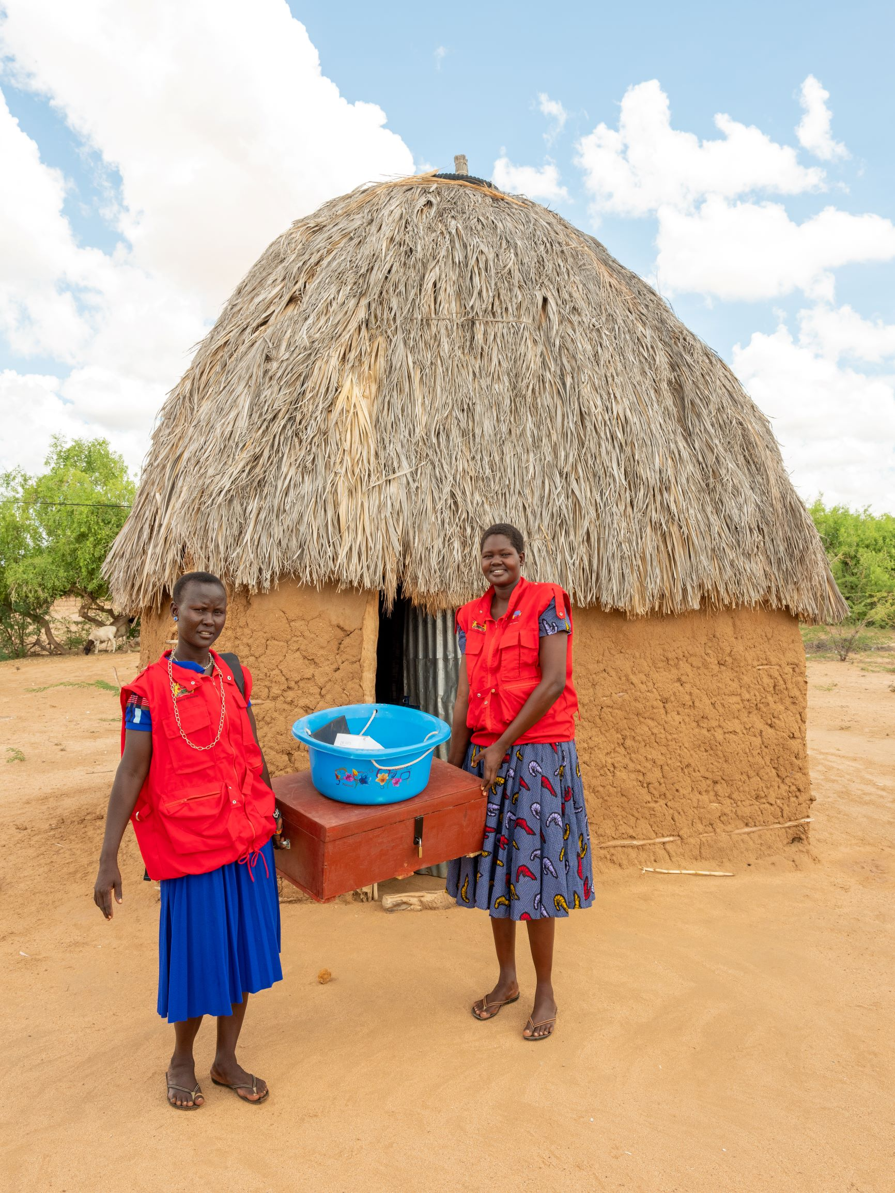
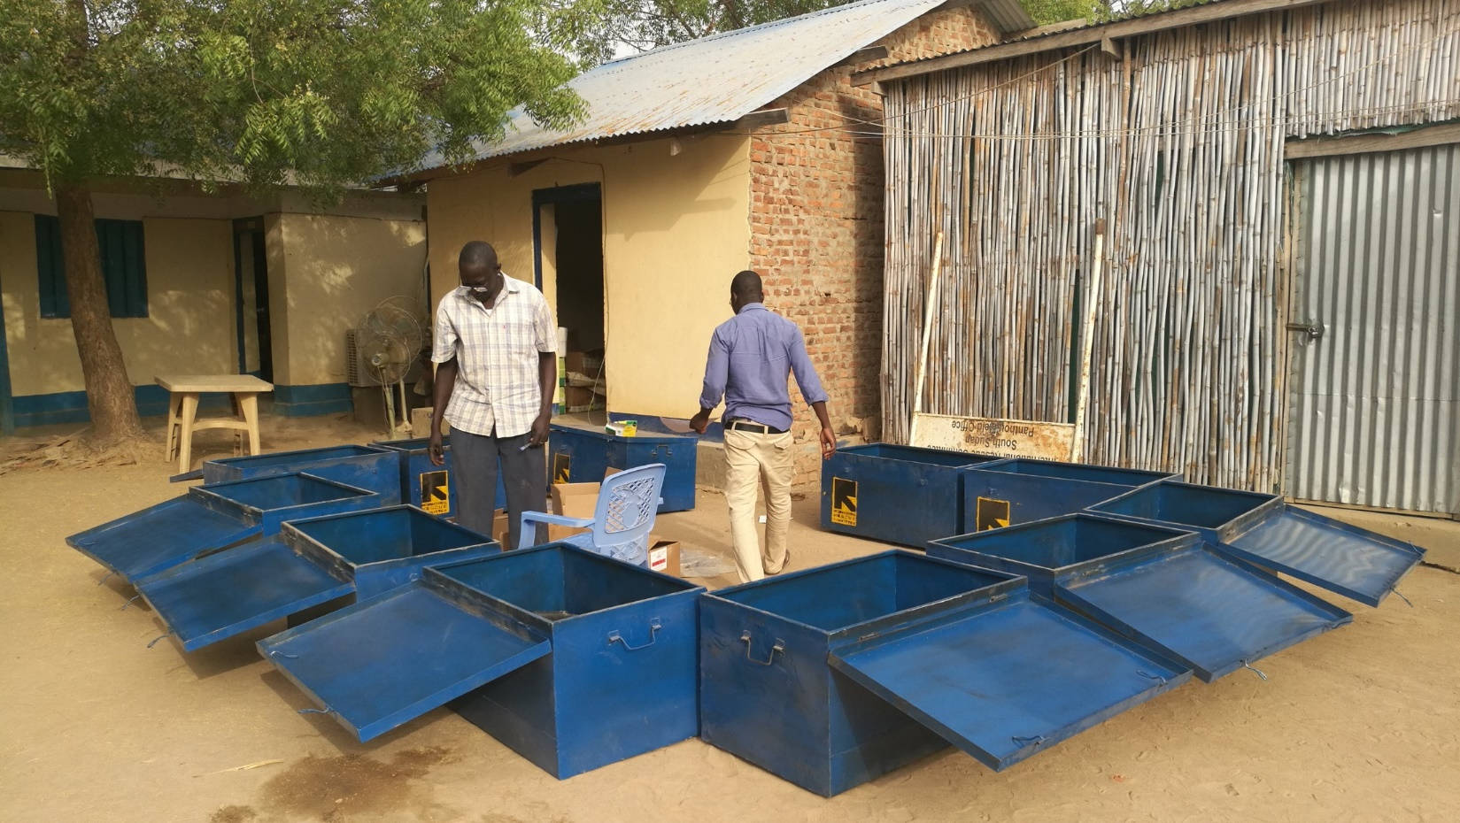
Qualitative findings
Positive feedback – common
Reduction in distance (opportunity cost, transit fees), free care, timeliness of care
CHWs felt more respected by caregivers and community members
Positive feedback – unique
Initial concerns about security of keeping RUTF in the house, but had no issues after ‘fixing the house door’ (South Sudan)

Slide 10
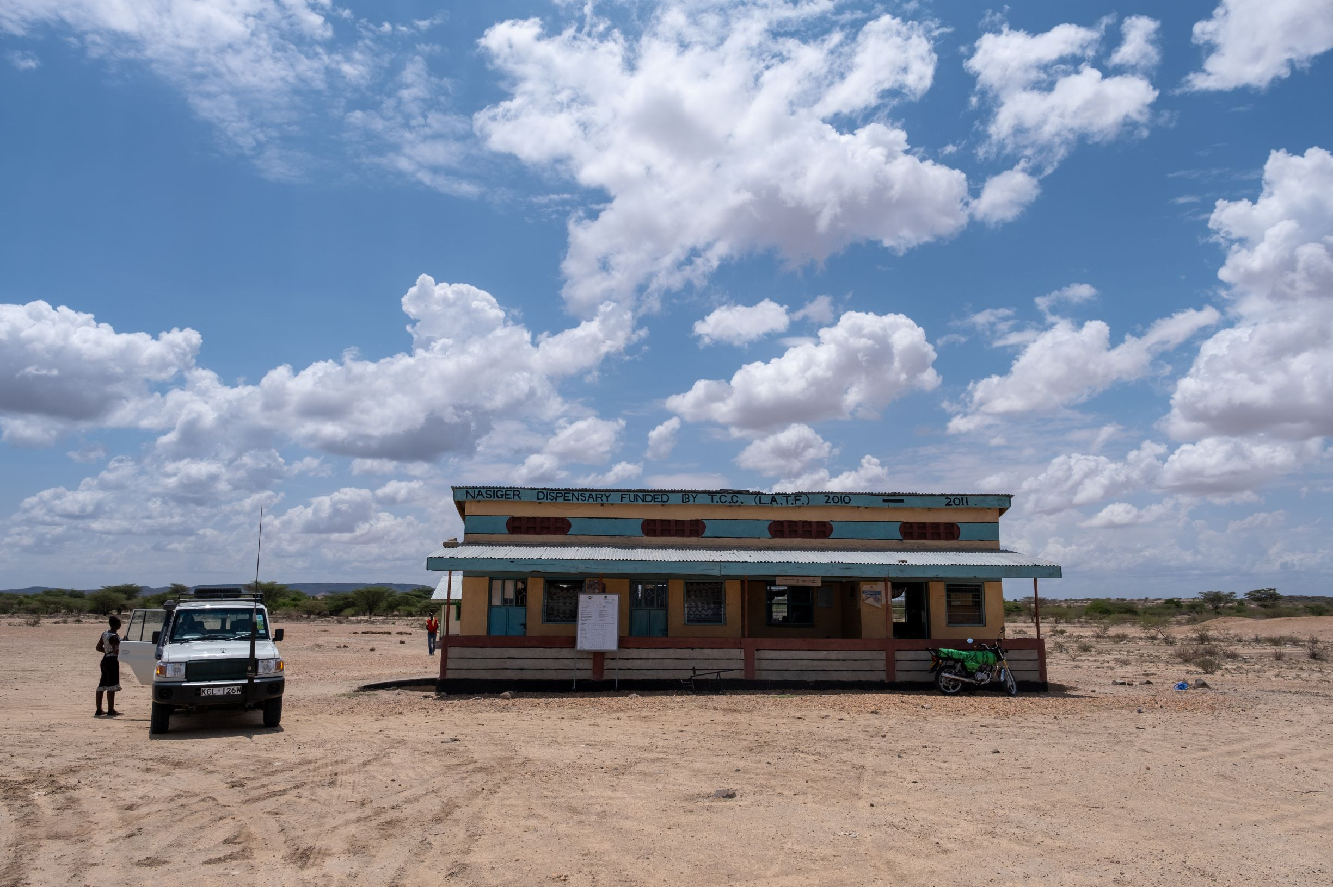
Negative feedback – common
Difficult to turn away moderately malnourished cases
iCCM and SAM treatment tools not integrated
Skepticism: are CHWs playing favorites?
Logistical challenges of access
Photo by Alan Winslow
Negative feedback—unique
iCCM program only received quarterly supervision, so frequency of supervision required was difficult (Nigeria)
Community misperception – treatment refusal because some didn’t recognize that CHW treatment was the same as the health facility (Malawi)
Caregivers stopped care-seeking after realizing child was “better” (South Sudan)

Slide 11
Conclusions
Overall,
High performance by low-literate and literate CHWs
CHWs can achieve acute malnutrition cure rates comparable to Sphere standards
High acceptance by CHWs and caregivers
However,
CHWs may perform lower when new medications are introduced
Distance may not be the only barrier to increasing coverage of acute malnutrition treatment
Supply chain an issue – proper supply tracking was difficult even in small pilots

Slide 12
Limitations
Treatment protocol not identical across sites – data not exactly "apples to apples"
Each pilot program received heavy support from implementing partners – need to investigate under "real life conditions" for scale-up
No gold standard way to test performance – e.g. IRC recommended written / verbal exam for subsequent pilots to ensure rare conditions (e.g. co-morbidity of malnutrition + iCCM conditions) are caught

Slide 13
Potential adaptations in context of COVID-19
Logistical issues that this model seeks to address further exacerbated in pandemic
CHW community-based treatment can reduce congestion at outpatient treatment sites
MUAC only treatment protocol can be implemented whilst maintaining infection prevention and control (IPC) guidance
Emerging evidence on outpatient simplified treatment protocols can be easily adopted by CHWs

Slide 14
Acknowledgements
Participating community health workers, supervisors, health facility in-charges and staff
South Sudan national and county MoH
Nigeria national and state MoH
Malawi national and district MoH
International Rescue Committee South Sudan research team
Malaria Consortium Nigeria research team
Concern Worldwide Malawi research team
Alan Winslow, photographer
Eleanor Crook Foundation
Naoko Kozuki¹, Olatunde Adesoro², Elburg van Boetzelaer³, Olusola Oresanya², Annie Zhou⁴, Helen Counihan⁵, Prudence Hamade⁵, Regine Kopplow⁶, Bethany Marron⁴
Author affiliations: ¹International Rescue Committee, Washington, DC, USA; ²Malaria Consortium, Abuja, Nigeria; ³International Rescue Committee, Panthou, South Sudan; ⁴International Rescue Committee, New York, NY, USA; ⁵Malaria Consortium, London, UK; ⁶Concern Worldwide, Berlin, Germany

Slide 15
Resources
Simplified Toolkit Development
Field Exchange
  Casie Tesfai, Bethany Marron, Anna Kim and Irene Makura (2016). Enabling low-literacy community health workers to treat uncomplicated SAM as part of community case management: innovation and field tests. Field Exchange 52, June 2016. p3. www.ennonline.net/fex/52/communityhealthworkerssam
  Human Centered Design (HCD) consultants
    Quicksand http://quicksand.co.in/
    Lucas Nene, individual consultant: https://www.linkedin.com/in/lucasnene
  Final simplified toolkit
    acutemalnutrition.org
South Sudan
Maternal & Child Nutrition
  Van Boetzelaer E, Zhou A, Tesfai C, Kozuki N. Performance of low‐literate community health workers treating severe acute malnutrition in South Sudan. Matern Child Nutr. 2019;15(S1):e12716. https://doi.org/10.1111/mcn.12716
Journal of Global Health
  Naoko Kozuki, Casie Tesfai, Annie Zhou and Elburg van Boetzelaer. Severe acute malnutrition treatment delivered by low-literate community health workers in South Sudan: a prospective cohort study. J of Glob Health. In press (2020).

Slide 16
Resources
South Sudan (continued)
Wiley video abstract
  English: https://vimeo.com/325042535
  French: https://vimeo.com/342703415
Nigeria
Research brief
  Improving access to treatment for severe acute malnutrition in Nigeria
Project video
  Fighting malnutrition in rural Nigeria
Kenya
Research brief
  Linking CMAM and iCCM in Kenya: https://knowledgeagainsthunger.org/research/treatment/linking-cmam-and-iccm/
Research Protocol
  Integrated and simplified approaches to community management of acute malnutrition in rural Kenya: a cluster randomized trial protocol https://doi.org/10.1186/s12889-019-7497-3
  Nutrition portal; Kenya National Ministry of Health, Nutrition and Dietetic Unit http://www.nutritionhealth.or.ke

