Slide 1




A Randomized Trial of AmBisome® Monotherapy and Combination of AmBisome® and Miltefosine for the Treatment of Visceral Leishmaniasis in HIV-Positive Patients in India
CTRI/2015/05/005807

Slide 2
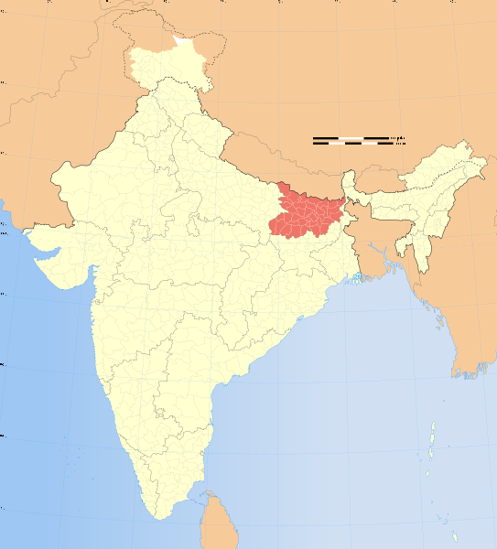
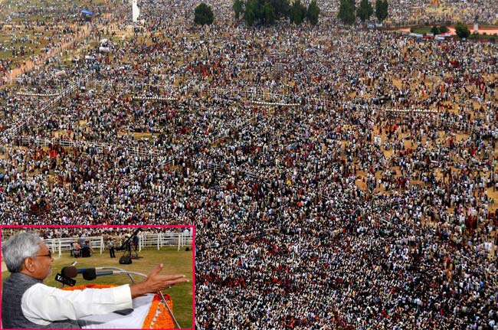
Background
  Visceral Leishmaniasis (VL) or Kala-Azar (KA)
    Neglected disease- affects poor, rural population
    Fatal if untreated
Caused by the protozoan parasite L. donovani
Vector: sandfly, anthroponitic spread
Endemic in Bihar (population 110 million)
Bihar holds 50% of worldwide burden of VL
HIV/AIDS in Bihar: Estimated 115,000 cases across Bihar
Well below 90:90:90 target
Notes:
Quite some repetition of facts so i re-organised

Slide 3
Importance of VL-HIV co-infection
35 countries around the world reports HIV-VL Co-infection
PLHIV have ↑↑↑ risk of developing VL while VL accelerates HIV progression
Higher rate treatment failures, relapse & mortality
Reservoir of transmission (super spreaders), and emergence of drug resistance
Increasing trend of co-infection rates as surveillance improves
Threat to regional elimination goals
Neglected population within an already neglected disease

Slide 4
Study Objectives
General Objectives
To evaluate safe and effective treatments for Visceral Leishmaniasis in HIV co-infected patients in India
Primary Objective:
To evaluate efficacy at day 210 following start of treatment of regimen comprising:
  AmBisome® total dose 30mg/kg plus miltefosine 100mg daily for 14 days
  AmBisome® total dose 40mg/kg alone over 24 days (5mg/kg on day 1-4, 8, 10, 17, 24)
Secondary Objectives:
To assess treatment response through initial cure at day 29
To evaluate relapse-free survival at day 390 (after final cure assessed at day 210).
Other objectives:
To evaluate CD4 count and viral load in all patients at specified time points

Slide 5
Methods and Study design
Single center study at RMRIMS (ICMR), Patna
Open label, parallel arm, non-comparative randomised trial
75 patients in each arm (total 150)
80% power to show primary endpoint >80% assuming a true value >90%
All patients to start or be continued on ART and CPT
ART started on D15 unless TB then D29
Ethics approval from the MSF, RMRIMS and LSHTM ERBs

Slide 6
Trial endpoints
Primary Efficacy Endpoint:
Alive and disease free (absence of signs and symptoms of VL) at day 210
Secondary Endpoints:
Initial cure at Day 29 as defined as:
Clinical improvement and a negative parasitological assessment by tissue aspirate.
Relapse-free survival at 12 months as defined as:
Alive and disease-free (defined as absence of signs and symptoms of VL) from day 210 to 390
Safety
Assessment of safety during treatment and 1 month follow-up.

Slide 7
Inclusion/exclusion criteria
Inclusion criteria:
• Confirmed HIV positive as per national guidelines
• Parasitologically confirmed VL by histology
• Age ≥ 18 years
• Written and audio-recorded informed consent
Exclusion criteria:
• Women of child-bearing potential not using an assured method of contraception
• Pregnant or lactating
• Clinical or biological evidence of severe cardiac, renal or hepatic impairment.
• Known hypersensitivity to AmBisome® and/or miltefosine.
• Concomitant severe infection/disease which precludes evaluation of response to study medication
• Creatinine >1.2

Slide 8
VL status at admission and ART compliance
 | AmBisome® | AmBisome® + Miltefosine
VL patient type
Primary, n (%) | 35 (47) | 46 (61)
Relapse, n (%) | 40 (53) | 29 (39)
On ART at baseline | 43 (57) | 39 (52)
On ART by patient type n (%)
Primary VL | 25 (58) | 27 (69)
Relapse VL | 18 (42) | 12 (31)
Among those on ART, when started, n (%):
≤3 months previously | 9 (28) | 7 (19)
>3 and ≤6 months previously | 2 (6) | 3 (8)
>6 months previously | 21 (66) | 26 (72)
Patients fully compliant with ART n(%) | 31 (97) | 34 (94)

Slide 9
Baseline CD4 and Viral Load
 |  | AmBisome® |  | AmBisome® + Miltefosine
 |  | ART at baseline |  | ART at baseline
 |  | No | Yes | No | Yes
CD4 count (cells/µl) | <100 | 22 (51.2) | 9 (28.2) | 18 (46.2) | 16 (44.4)
 | 100 to 199 | 18 (41.9) | 17 (53.1) | 14 (35.9) | 15 (41.7)
 | ≥200 | 3 (7%) | 6 (18.7) | 7 (18) | 5 (13.9)
 | Median (IQR) | 96 (65-159) | 131 (99-174) | 104 (71-181) | 108 (78-172)
Viral Load (copies/ml) | <1000 | 0 | 25 (78.1) | 1 (2.6) | 22(61.1)
 | 1000 to 99999 | 10 (23.3) | 6 (18.8) | 5 (12.8) | 9 (25.0)
 | ≥100,000 | 33 (76.7) | 1 (3.1) | 33 (84.6) | 5 (13.9)
 | Median (IQR) | 541012 (109809-2427609) | 70 (0-496) | 464017 (136642-1148738) | 127 (0-12768)

Slide 10
Relapse-free survival at day 210 and day 390: ITT complete-case
 | AmBisome® | AmBisome® + Miltefosine
Total Screened | 260
Total Randomized | 75 | 75
Withdrawn from study | 0 | 1* (1%)
Treatment failure | 5 (7%) | 0
Initial cure at day 29 | 70 (93%) | 74 (99%)
Relapse free survival on day 210 | 64 (85%) | 72 (96%)
Died on or before day 210 | 4 (4%) | 1 (1%)
Relapse up to day 210 | 2 (3%) | 1 (1%)
Relapse free survival on day 390 | 60 (80%) | 64 (85%)
Died between day 210 & day 390 | 1 (1%) | 0
Relapse between day 210 & day 390 | 2 (3%) | 7 (9%)
390 days follow up pending | 1 (1%) | 1 (1%)
* Patient exhibited hypersentitivity to test dose of AmBisome so did not receive any treatment dose

Slide 11
Relapse-free survival at day 390 : stratified by TB status
 | VL-HIV-TB |  |  | VL-HIV
N (%) | Mono | Combo | Overall | Mono | Combo | Overall
Total Randomized | 16 | 15 | 31 | 58 | 58 | 116*
Treatment failure | 2 (13) | 0 | 2 (6) | 3 (5) | 0 | 3(3)
Died on or before day 210 | 3 (19) | 1 (7) | 4 (13) | 1(2) | 0 | 1(1)
Relapse up to day 210 | 0 | 0 | 0 | 2 (3) | 1(2) | 3 (3)
Died between day 210 & 390 | 1 (6) | 0 | 1 (3) | 0 | 0 | 0
Relapse between day 210 & 390 | 1 (6) | 3 (20) | 4 (13) | 1(2) | 4(7) | 5 (4)
Relapse free survival by day 390 | 9 (56) | 11 (73) | 20 (65) | 51(88) | 53(90) | 104 (89)
*1 Patient exhibited hypersentitivity to test dose of AmBisome so did not receive any treatment dose and 2 patients has their 390 days follow up pending

Slide 12
VL-HIV-TB co-infection
21% of patients (31/150) were TB infected; 27 pulmonary , 4 EPTB
CFR 19% vs 0.8% in Non TB cases (p <0.001)
All but 1 SAEs were in TB patients
68% (n=21) were diagnosed in the first 29 days, of whom 13 (32%) were identified immediately prior to initiating VL treatment.
8/31 (26%) patients with TB developed IRIS
Mean change in CD4 count from VL treatment initiation to day 29:
  +114 cells/µl (95%CI 91-137) for the 68 patients already on ART at presentation,
  +101 cells/µl (95%CI 82-120) for 71 patients starting ART on day 14
Leaving 3 week gap between ART and ATT initiation seemed beneficial

Slide 13
Conclusions
Both treatment arms appears to be safe
Greater efficacy in combination therapy, halving treatment duration
↑ treatment failure in monotherapy
↑ relapse in combination arm between day 290 and 390
Diagnosis and management of HIV-VL-TB patients is challenging
Need for early diagnostic tools for TB in VL-HIV
IRIS seems to be major challenge, delaying ART may be helpful
Still major knowledge gaps – primary/ secondary prophylaxis?

Slide 14
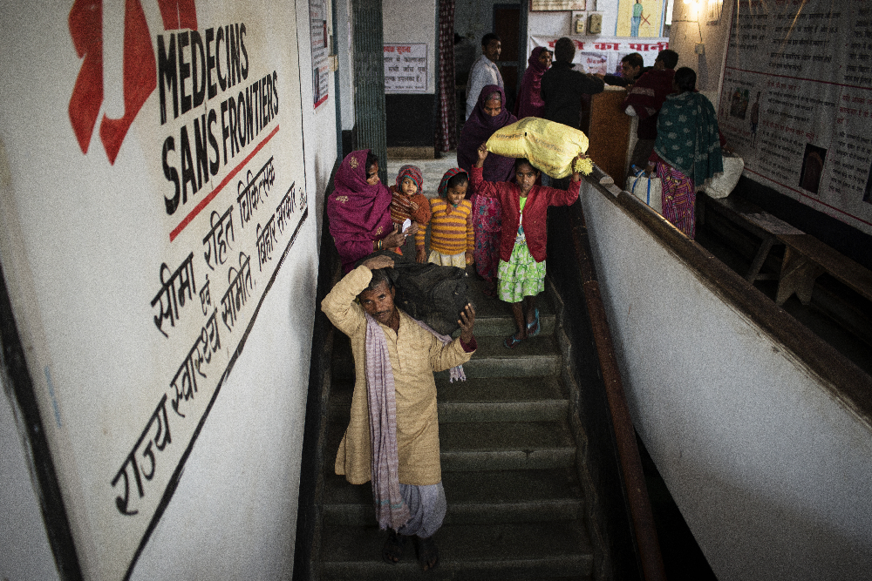
Special thanks to:
Field Team in Patna
RMRI Patna
NVBDCP
Study Participants

