Slide 1
Using social media for patient and community engagement: MSF’s experience in Lebanon
MSF Scientific Days-Innovation
*Jinane Saad, Mario Fawaz, Jesse Verschuere
@Jinanos

Slide 2
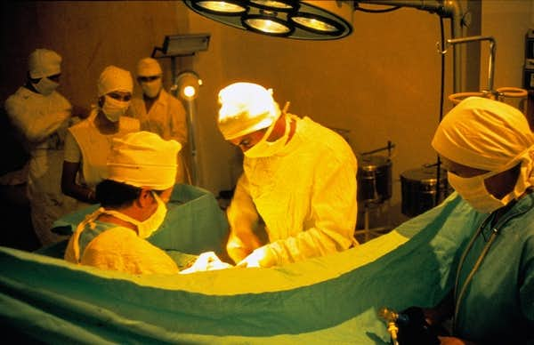
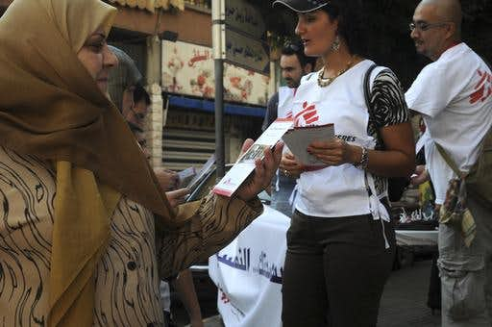
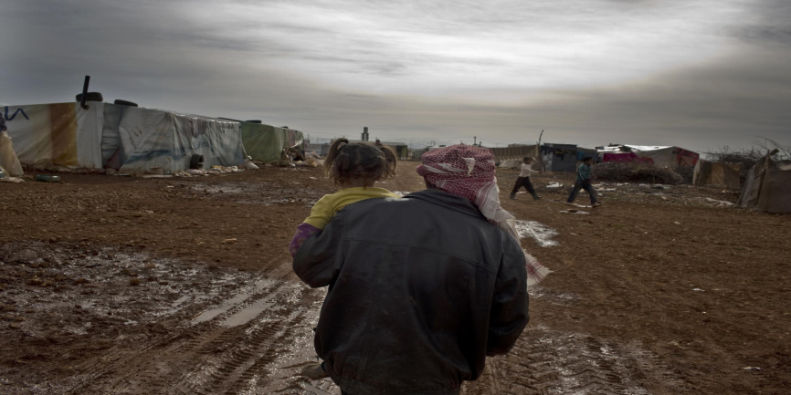
MSF In Lebanon:
42-year relationship between MSF and Lebanon
Hospital in Beirut ,1981/MSF
Palestinian refugee camp of Burj el-Brajneh, 2009/Lara Arapguirlian
Makeshift refugee camp, Baalbek, Bekaa valley, 2013/ Michael Goldfarb/MSF
Notes:
1976: Year MSF first worked in the country
2008: MSF is continuously present in Lebanon since 2008
2011: Response to the influx of refugees following outbreak of the Syrian war.

Slide 3
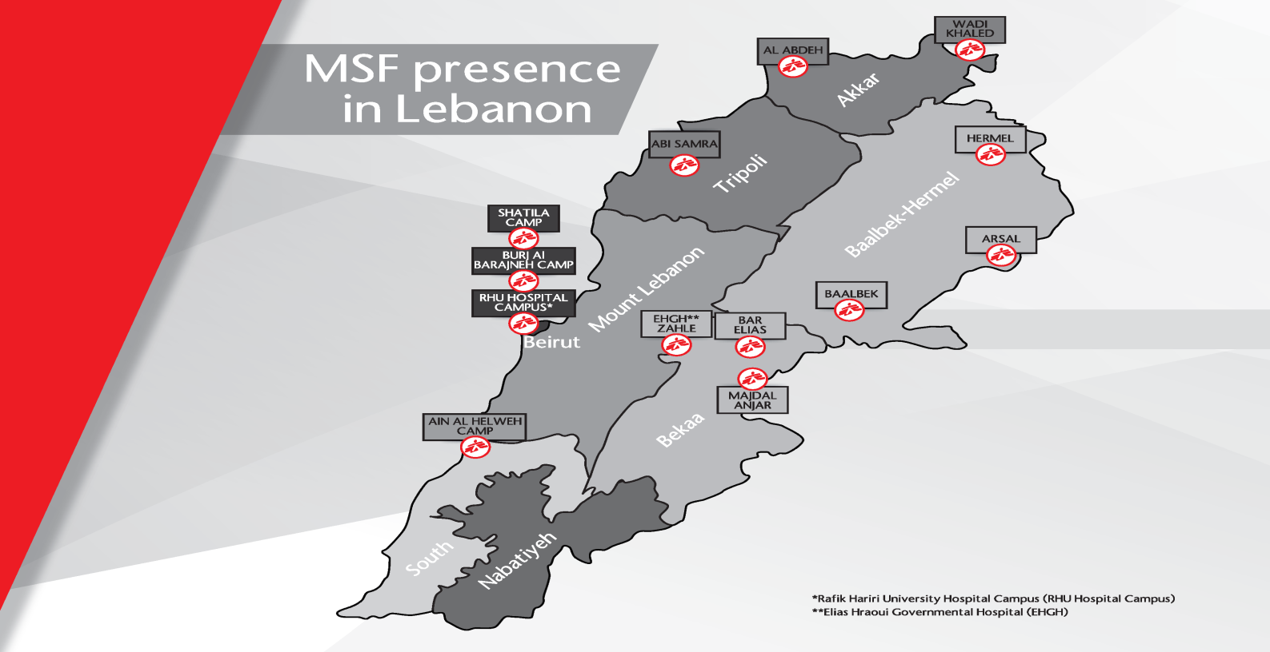
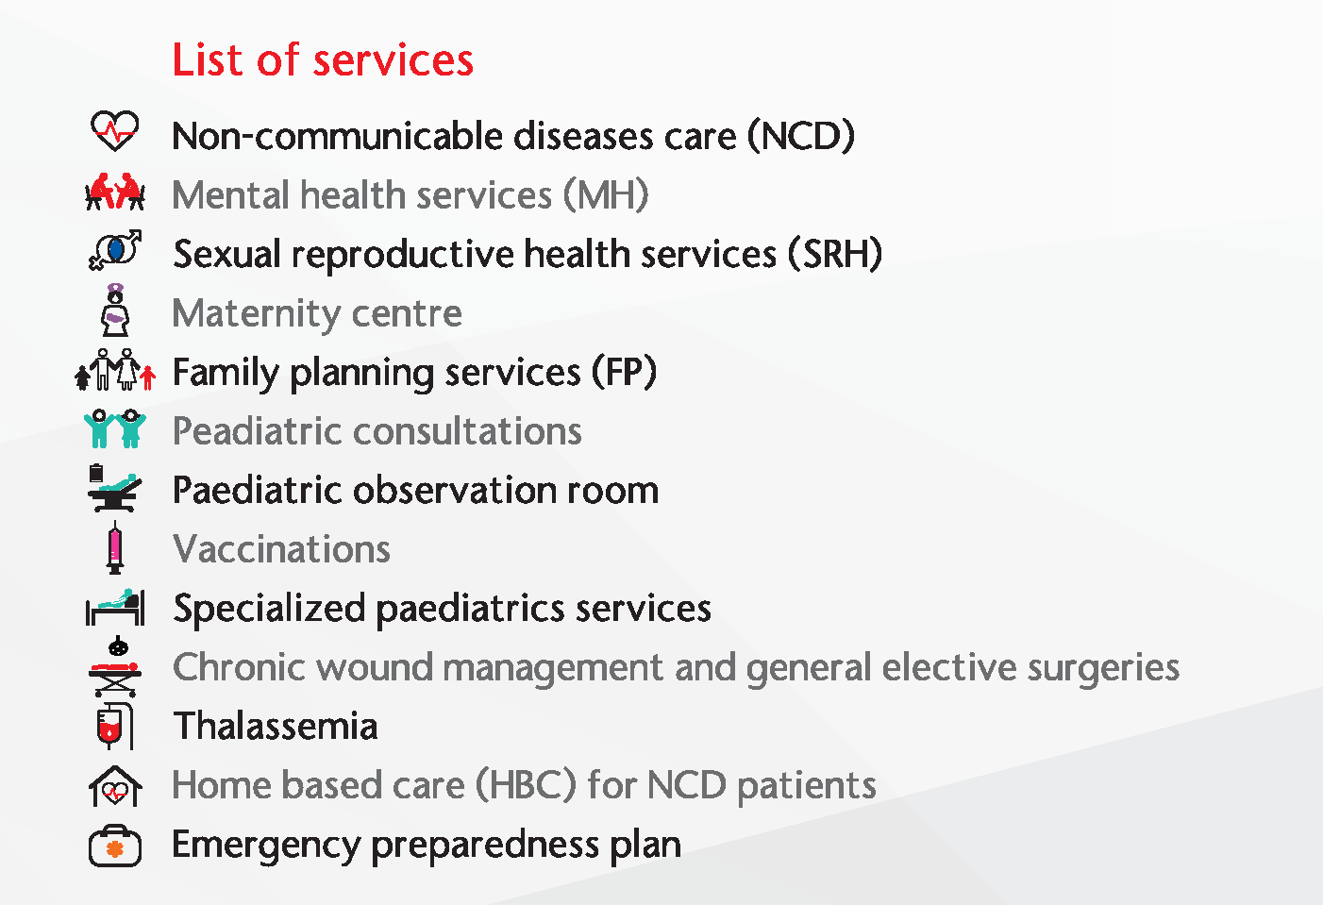
MSF In Lebanon:
Facilitating access to healthcare for vulnerable communities
Notes:
More than a one million Syrians have fled into Lebanon since the conflict began in 2011, in neighbouring Syria, making Lebanon the country hosting the largest number of refugees per capita.
An important number of Syrian refugees are living in deplorable conditions and are unable to meet their own basic needs.
Lebanon's health system highly privatised, Access to healthcare is a challenge for vulnerable communities in Lebanon
MSF is currently present across 13 different locations in Lebanon, running primary healthcare programmes with a focus on non-communicable diseases care, sexual reproductive health and mental healthcare, in addition to three mother and child care centres. At secondary and tertiary healthcare levels, MSF provides paediatrics services and non-emergency surgeries, responding to the needs of the most vulnerable populations in Lebanon.

Slide 4
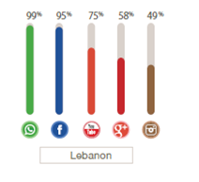
Social Media Use In Lebanon
75% : Internet penetration in Lebanon in 2016
(internetworldstats.com)
WhatsApp was the most used social media channel in Lebanon, followed by FaceBook.
99% of total SM users in Lebanon are subscribers in WhatsApp.
95% of social media users in Lebanon are current subscribers in Facebook.
(Arab Social Media Report, 2015)
Over one million refugees are connected in Lebanon (UNHCR Connecting Refugees Study, 2016)
Notes:
86% of Syrian refugee households in Lebanon own a
mobile phone (smartphones). Another 6% have access to one. (2017 UN vulnerability survey (VASyR)
91%:Internet penetration in Lebanon in 2019

Slide 5
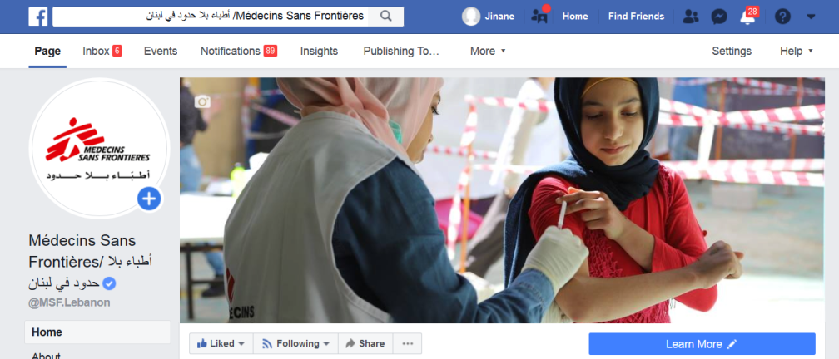
MSF use of Social Media in Lebanon: FACEBOOK
March 2016: Creation of Lebanon FB page
Main objectives:
Visibility
Support the local and regional recruitement
Engagement with local communities?!
Notes:
To further explore the potential of social media in helping to engage with patients and local communities…the FB page was from the very beginning used as a complementary tool alongside existing Community engagement and health promotion (HP) approaches in Lebanon, providing a two-way communications platform between MSF and the community.

Slide 6
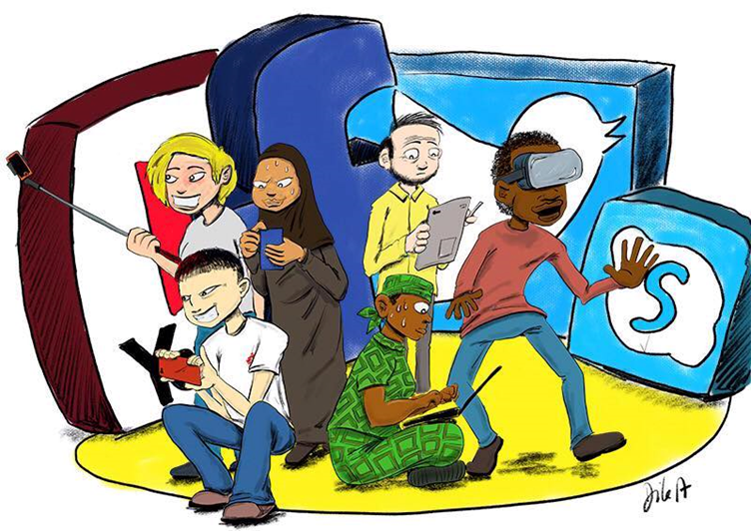
MSF use of Social Media in Lebanon:
“Since 2016, the MSF Lebanon Facebook page was used systematically as a complementary tool alongside existing Community engagement and health promotion (HP) approaches in Lebanon, providing a two-way communications platform between MSF and the community.”
The aim is to asses the potential of social media in helping to engage with patients and local communities.
David DiLerenzo

Slide 7
Methodology
Descriptive, retrospective analysis between Jan 2018-Dec 2018 of:
Facebook fans’ profiles (demography, gender, age, language of peopole who like the page)
Online engagement on the Facebook page (videos views, reactions, number of direct messages, comments.…)
MSF’s published content (categorisiation by topic)
In debth analysis of conversations: categorisation by topic of private messages and comments sent to the page in Q4 2018.
Description of the management process of the FB page

Slide 8
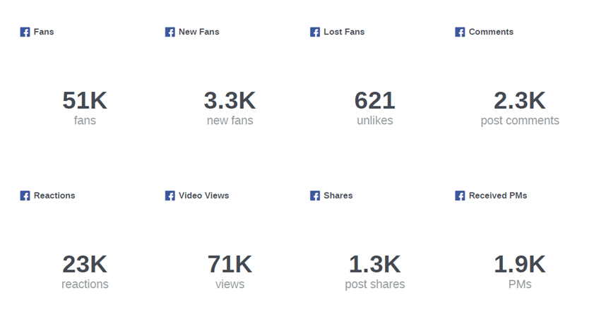
Methodology
Data was extracted using:
Hootsuite & Facebook insights (provide overview of page performance)
Sysomos (extraction of direct messages and comments content)
Manual extraction (to cover the gaps mainly related to content of the conversations)
Q4 2018, Page performance

Slide 9
Ethics
This description/evaluation of an innovation project did not involve human participants or their data; the MSF Ethics Framework for Innovation (or equivalent) was applied to help identify and mitigate potential harms.

Slide 10
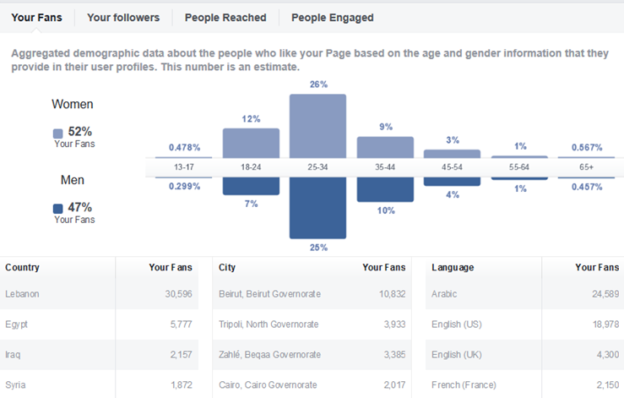
Results
Facebook fans Profile (users who “like” the page):
50,600 fan by end of December 2018
60.28% of our fans on Facebook are from Lebanon, the majority are based the regions of MSF’s operations (Beirut; North & Bekaa)
52% are female, 47% are male, almost equally represented
51% are aged between 25 and 34 years.
48.3% have Arabic as their first language
Our fans are online 7 days a week

Slide 11
Results
Facebook engagement:
conversations
Nb of Videos’ views | Nb of Reactions (likes, love etc..) | Nb of Personal messages received | Nb of comments
242.2K | 79 K | 7.6K responsiveness rate of 94%. | 9.6 K

Slide 12
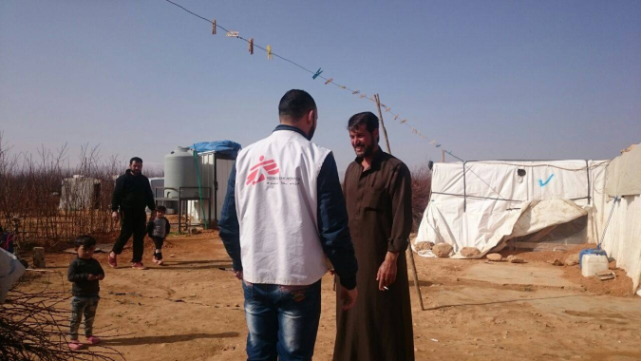
Results
MSF’s published content: (Main topics covered on MSF Lebanon FB page)
Total number of posts: 374 (average of 1 post/Day)
51.7 % of posts are related to MSF operations in Lebanon
42.7% are institutional posts including recruitments
5.6 % are related to Then & Now Exhibition

Slide 13
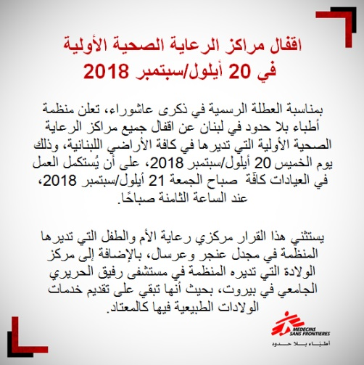
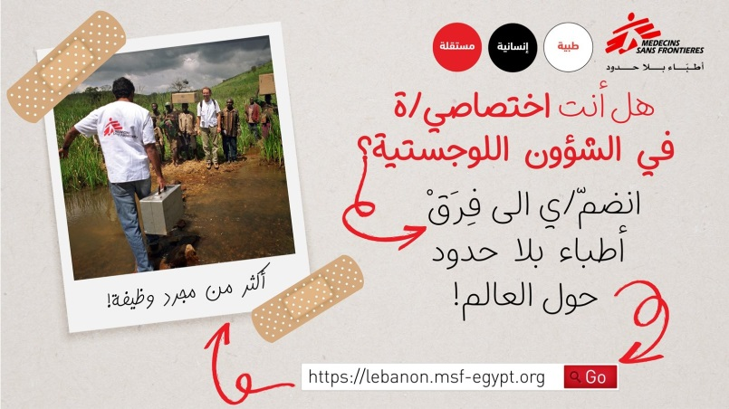
Results
MSF operations posts include:
MSF Lebanon activities: (27%)
Information to patients and Health Promotion: (12%)
Media coverage about MSF projects in Lebanon: (5%)
Jobs in Lebanon: (6%)
Associative posts: (1%)
Institutional posts include:
MENA HR Recruitment:(12%)
MSF principles, news from MSF
around the world: (30%)

Slide 14

Generated Content:
Bar Elias: series of posts about the hospital targeting patients
Post | Post Type | Date | Number of Comments (incl. replies) | Relevant Comments per topic
Announcement of the hospital and the services | Photo | Sept 6 | 60 | 10 asking about jobs and vacancies 4 asking about services 3 asking about more information (dates,...) 6 sending greetings and wishing us good luck
Announcement of opening dates of the hospital | GIF | Sept 24 | 43 | 9 asking about jobs and vacancies 5 asking about services provided in the hospital 1 sending greetings and wishing us good luck 2 asking other questions (other MSF services)
End of rehabilitation of Bar Elias Hospital | Photo | Sept 17 | 37 | 5 asking about jobs and vacancies 1 asking about services provided in the hospital 7 sending greetings and wishing good luck
Day 1 of the IPD and surgical activities | Photo | Nov 23 | 32 | 1 asking about services The rest of the comments are greetings
Things you should know about the hospital | Video | Oct 1 | 34 | 3 asking about services 1 asking about MSF addresses in Lebanon The rest of the comments are greetings
3 questions to Project Coordinator in Bar Elias | Video | Nov 28 | 30 | 1 patient thanking us for the good treatment he received 9 asking about services 2 asking about jobs and vacancies
Team photo | Photo | Oct 18 | 26 | 4 asking about jobs and vacancies 2 asking about services
OPD announcement | Photo | Oct 16 | 20 | 7 asking about services 2 asking about jobs and vacancies
Announcement of opening dates and services | Photo | Sept 25 | 19 | 4 asking about services 1 asking about jobs and vacancies The rest of the comments are greetings
Visit of the PHC representatives | Photo | Oct 4 | 18 | 3 asking about services 2 asking about jobs and vacancies 1 asking about address of the hospital

Slide 15
Generated Content: Mental Health
Between the 8 and 13 of October we posted 14 posts about Mental health this generated DMs & Comments directly related to MH.
Private messages:
MH 1: Hello, do you have mental health specialists in Nabatieh? Or where is the closest clinic to Nabatieh, and how much do you charge? Do you have a French speaking psychologist too? Thank you
MH 2: I need a psychologist. How and where and what’s your system? I live in Mazraa area.
MH 3: Regarding the mental health services, do you have a clinic in Saida?
MH 4: Hello, I have some problems, and I need to talk to a psychologist please as soon as possible.
MH 5: Hello, I live in Tripoli; can I know where the closest clinic to me is?
Comments:
MH 6: Is there any mental health department in Beirut?
MH 7: How can we reach out to you? I am from the south.
MH 8: My daughter is 2 years and a half old and she has these symptoms. How can I treat her?
MH 9: How can we reach out to you? I am from Miye Miye camp in Saida.
MH 10: How to reach out to you?
MH 11: I am tired I need help.
MH 12: Please, I need the address of a psychologist.

Slide 16
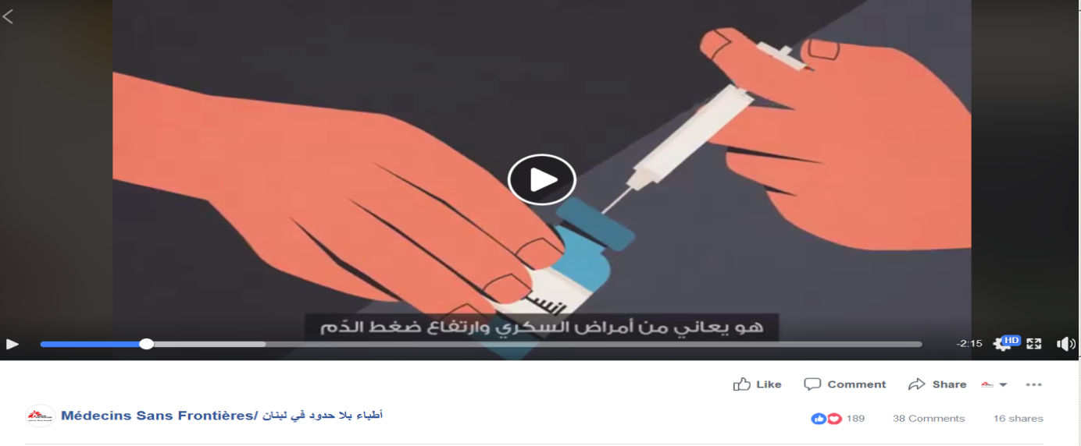
Generated Conversations: Health promotion
Animation video about diabetes produced in collaboration with HP team
189 reactions
38 comments
asking us about medical advice about insulin doses
sharing personal stories about diabetes
asking us about jobs and vacancies
asking us about NCD services
asking us info about MSF services (clinic location,...)
thanking us for addressing this topic and wishing us good luck

Slide 17
Generated Content: Information to patients:
We update our patients about change of admission criteria, working hours, move of clinics’ locations and vaccination or blood donation activities.
 | Post | Post Type | Date | Number of Comments (incl. replies) | Division of Comments per person
1 | Blood Campaign Announcement , Zahlé | Poster | May 9 | 30 | 4 thanking us 5 asking us for drives in other locations 1 questioning the service
2 | Moving to the Birth centre | Photos | Jul 20 | 22 | 5 asking about more info 4 thanking us and sending greetings
3 | Change in admission criteria in Shatila WHC | Poster | Feb 19 | 17 | 1 asking about services 2 asking about other services in other clinics 2 asking for more info 2 asking about jobs and vacancies 3 thanking us and wishing us good luck
4 | Suspending our activities in Shatila due to unrest | Poster | Mar 9 | 15 | 3 asking us where to go in that case 4 thanking us and wishing us good luck 2 asking for more info

Slide 18
Results
Conversations Analysis (Q4 2018)
Based on categorisation by topic of content of direct messages and comments
Most common topics:
Jobs enquiries (in Lebanon or around the world)
Questions about services in other countries (Iraq, Yemen, Algeria...)
Volunteering requests
Information about Services/health issues covered by MSF in Lebanon;
Requests for services not available in MSF
Feedback (Complaints, Greetings)

Slide 19
Results
Conversations Analysis (Q4 2018)
Total number of conversations via DM in Q4: 381
Total number of conversations via Comments in Q4: 915
In Q4, 2018, 29% of the conversations via direct messages & 34% of the comments received on the page were directly related to MSF activities and services in Lebanon and generated by patients ad communities.
Notes:
Conversations = many messages or comments sent by users around a same topic + MSF replies
Not individual messages or comments

Slide 20
Patients and community feedbacks per topics
Requesting info about delivery services
Asking for clinics locations and services, working hours
Complaining about not being admitted in specific service
helping in crossing the borders from Syria to Lebanon
Financial support, medical tests, online consultatiosn
Thank you & Greetings MSF
Complaining about staff behavior
Selling a kidney
Asking about TOP services

Slide 21

How we do it?
Editorial planning
Operational content
Institutional content
Evaluation & Reporting
Community management
Publishing
Content creation
Posting on Social media
Reactions from communities
Replies from coms team
Reporting to the projects
Info from projects
Feedback from projects to FC team
Feedback from FC team to community
Operations & Medical teams
Field Communications Team
Notes:
Example of the waiting area

Slide 22
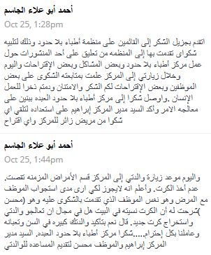
Feedbacks
«The central importance of the use of SM (for what I experienced & accepting I may be proven wrong) is surrounding acceptance! The number of times the initiative of the FB page allowed us to spot discontent of patients or communities (or the opposite) & engage contact with the concerned people is to my view the main added value to this…«
HOM Lebanon, OCB, March 2019
Patients thanking us for following up on a complaint he submitted on FB

Slide 23

Conclusion
Our findings suggest that digital engagement with the communities can provide complementary tools, as part of broader community engagement and HP strategies.
As of Jan 2019 we have now started a regular analysis and reporting system, feeding information to operational and medical teams from these online conversations with communities.
We are also planning a digital HP campaign, with specific resources for implementation and measurement of impact.
Limitations of our work include difficulties on assessing the impact of digital HP on communities, and challenges in extracting Facebook analytics. Our findings may be specific to regions with high internet penetration.

Slide 24
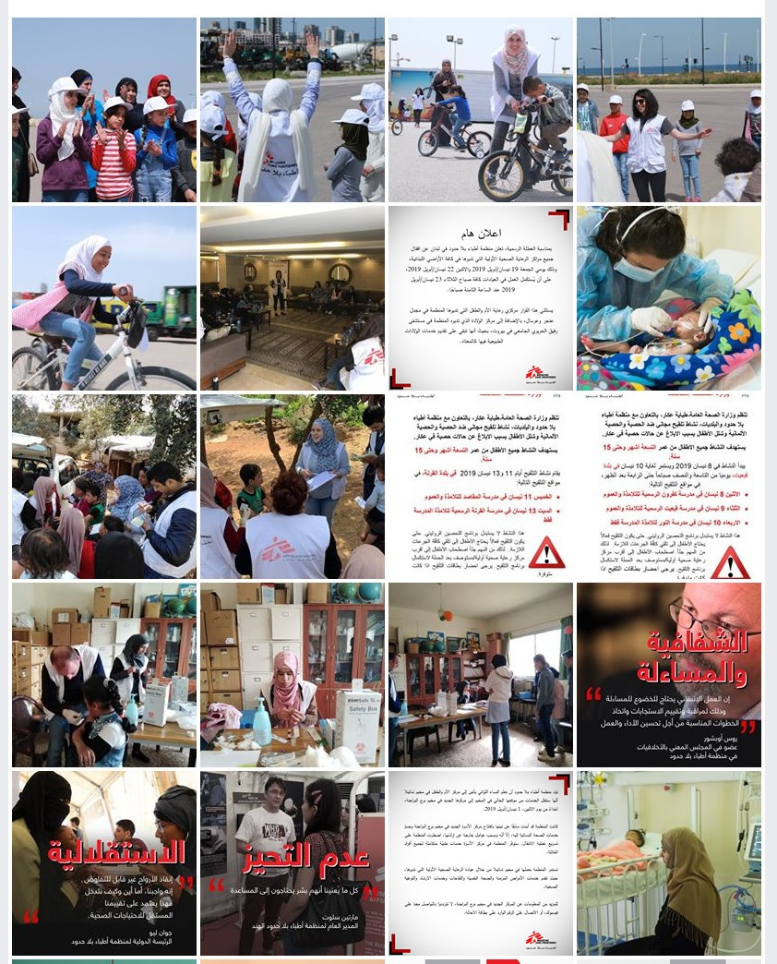
Thank you
Jinane SAAD
Field Communications Manager, MSF, Lebnaon
msf-lebanon-com@msf.org
Twitter: @Jinanos

