Slide 1
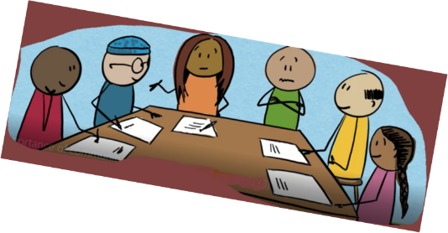
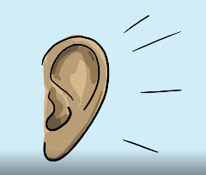

When your story becomes our story msf story of change learning from a co-created health promotion pilot
Annette de Jong
Health Promotion & Community Engagement advisor MsF-H
Annette.de.jong@Amsterdam.msf.org
Notes:
Story telling is how we make sense of our world. We all tell stories. Its how we share emotions, experiences and identities,
Taking stories seriously – both in the telling and listening of them – allows the health promoter to better understand the suffering, its root causes, how communities and groups function, and to work more effectively with them.
-we listen, catching stories on perception, experiences and believes around the disease
-We tried to understand the health seeking behaviour pathways and the people playing important roles in the communities..
-And finally Together with the community members we co-created a health promotion story in which we share information on prevention, recognition and treatment possibilities.
These stories were contagious, went viral and traveled far. They changed health practices of the health care workers and of community members. They changed me.

Slide 2
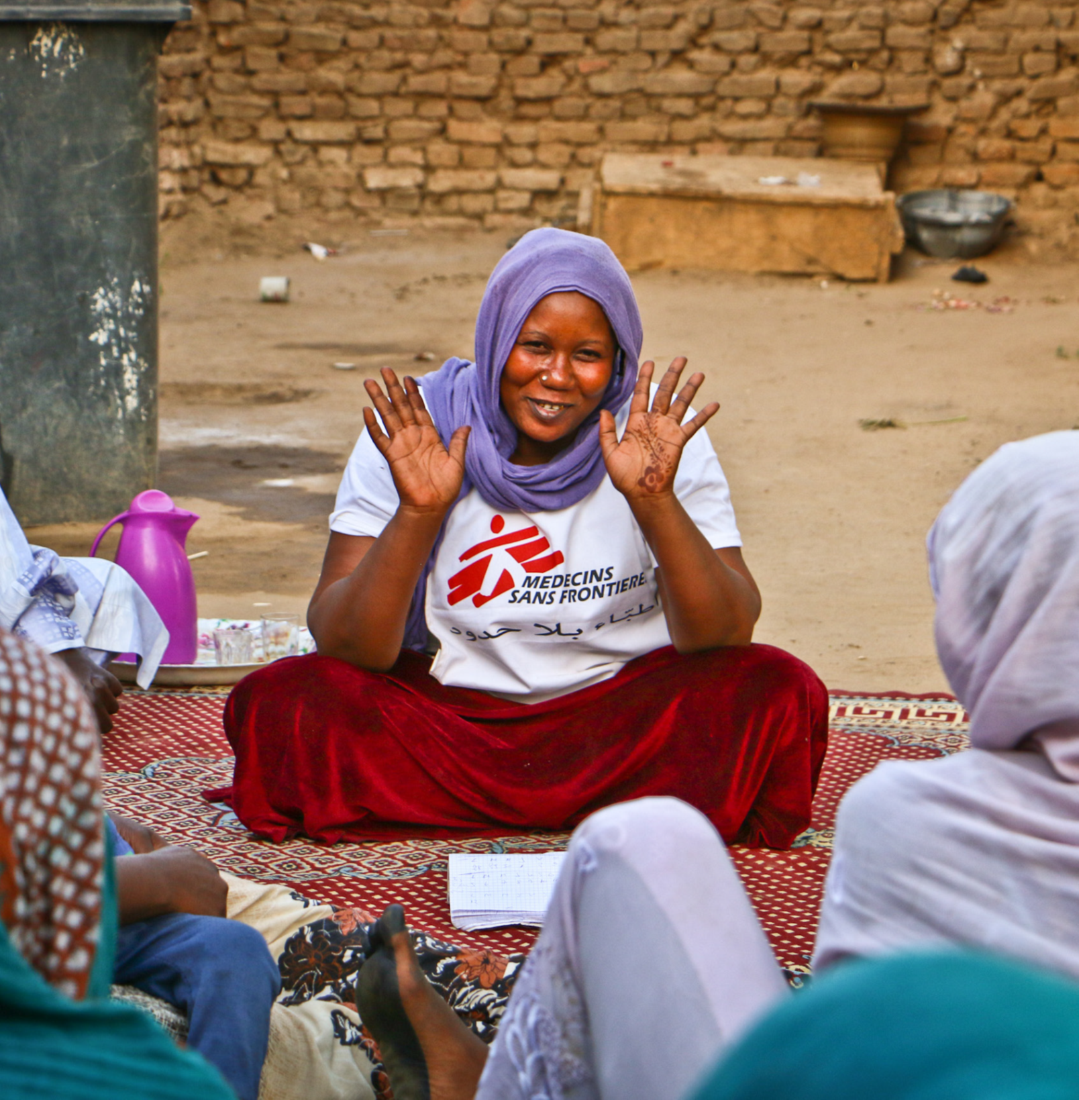


The story of Abubakhar
Notes:
Lets listen to a piece of the story of Abubakhar, a co-created health promotion story, developed during our pilot in North West Nigeria
–

Slide 3
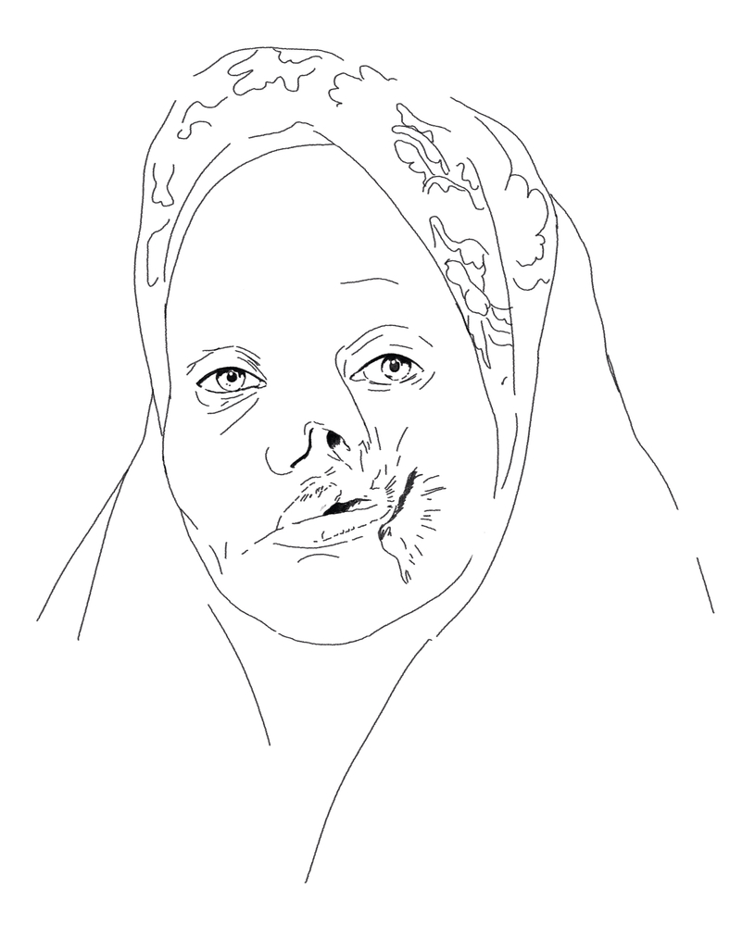

Neglected disease
Severe disfigurations
>90% mortality without Treatment
Preventable
High discrimination and stigma
Difficult to find cases
Difficult to convince family to seek care
Chloé Fournier
Notes:
As you could hear in the story, MSF is providing specialist treatment and reconstructive surgery for patients suffering from Noma in Nigeria. And The msf MSF health promotion team sensitize communities, while actively searching out new cases
Noma is a horrific neglected disease which mostly affects children under 5 living in poverty and poor health. It starts with bleeding gums and spreads rapidly through the face causing severe disfigurations. Although Noma can be prevented and treated with antibiotics. More than 90% of Noma patients die because they don’t get to healthcare in time. A health care tragedy that can be better understood if you literally sit down and listen to their stories.
We found that there is a lot of stigma around Noma, Noma is associated with evil spirits and the children are often excluded from their families and social village life and hide away. And when the affected children were painstakingly identified it took a long negotiating process with the family to convince them to access our medical services.
Therefore we wanted to pilot the ‘story of change’ approach: To help people to recognize and prevent Noma, and to timely seeking health care. We anticipated the story would travel to places where the outreach workers cannot go and so reach all the patients who are suffering from this disease.

Slide 4
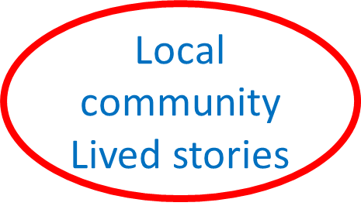
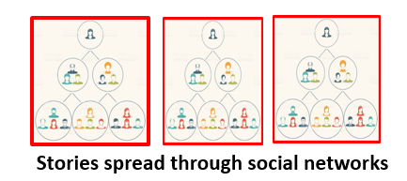
MSF biomedical facts Health promotion
messages
Myths
Believes
experiences
Notes:
This is how the method works

Slide 5

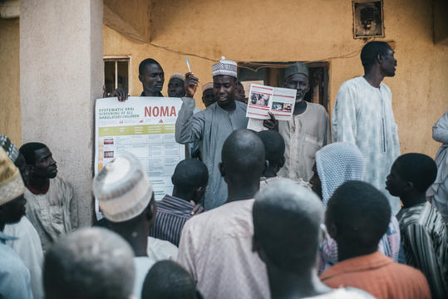

Notes:
Let me tell you about our experience.
Imagine a very remote village. Its hot around 38 degrees, dusty, no electricity and flowing water.
The village is far from the main road, no school, no telephone or internet network. Most people never left the village, especially women.
And then the msf car arrives. All man and children come / run to the car to see what's happening. Msf health promoters get out the car with a flyer and poster of NOMA disease:
MSF’s health promotion frequently involves one-way communication with communities, lecturing about Noma disease: supported with tiny pictures on a poster and brochures explaining the bacterial cause and the different stages of NOMA and the importance of good personal hygiene, variation of food to prevent Noma and about the services MsF is offering.
Most people in the village have never heard of msf, Noma and bacteria before and they are not really sure what to make of our stories.

Slide 6
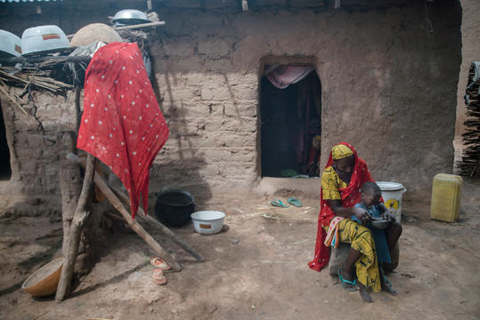

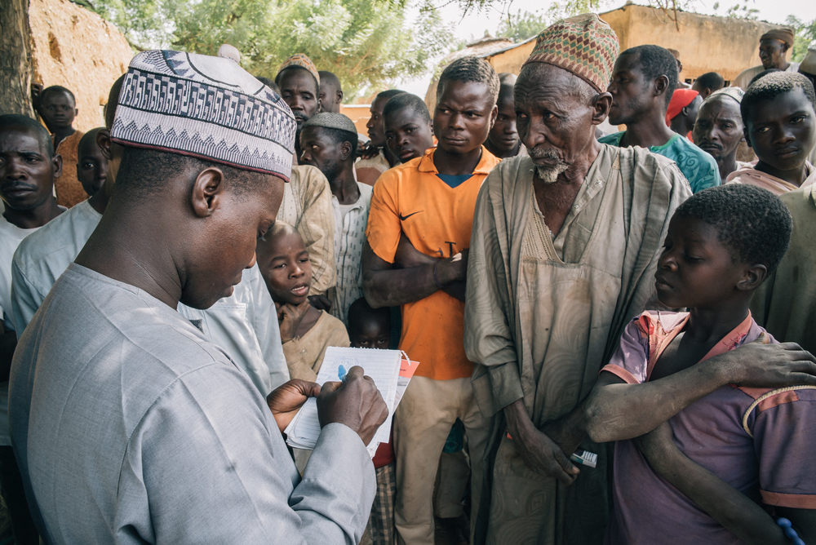
Step 1 workshop & collecting stories
Notes:
With the pilot -msf story of change- we wanted to pilot a new approach………
Step 1: we organized a workshop with the health promotion team about active listening (ear), listening and collecting stories .
Then the health promoters headed into the communities, listen, engaged , meet the key figures and get a better understanding of people’s experiences and perceptions of Noma through listening and collecting their stories. In total we collected 50 stories about the disease.

Slide 7
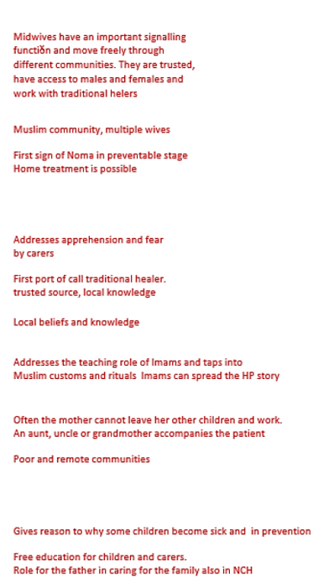
Notes:
Step 2 . Analysing the stories; we looked for patterns, repeating words, local names for Noma, beliefs, local treatment and so on.We now had a much better understanding of the communities’ perception, knowledge, and experiences with Noma.
For example
Midwifes have an important role in signalizing, they can move freely in the family compounds and between villages
Grandmothers play an important role in care taking
First port of seeking care is mainly the traditional healer
Often poor families, widowed of single mothers
Imams play an important role for spreading news and organizing community support
Noma has many local names: like evil wind. Or disease that doesn’t cure
Treating Noma is a community effort

Slide 8
Step 3: Co-creation with key community members
Women and male group
Main character
Challenges
Support and friends
Final good outcome
kurt vonnegut
Notes:
Step 3.
MSF staff then invited a group of key community members to create a story that combines medical health information with local narratives about the disease.
Together we decide on the main character, his challenges, his support and the good outcome
This is the final story, the story of change , the story of Aboubakhar.

Slide 9
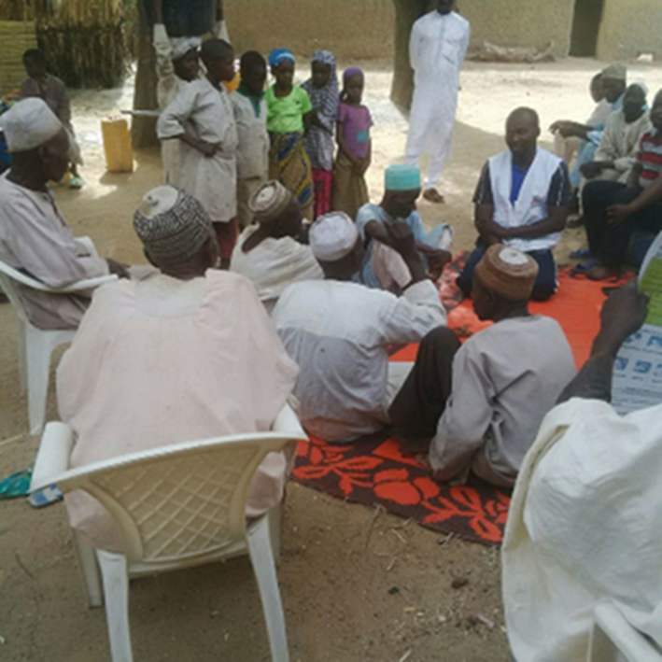
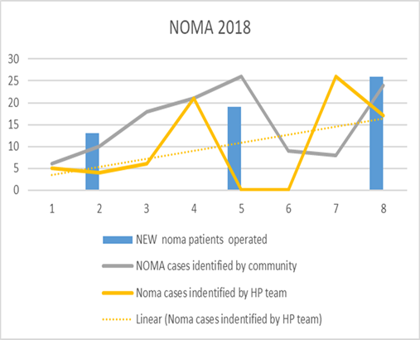
Step 4 sharing and spreading of the story
Notes:
The health promoters and key community members now use and spread the story in the community.
Through observations, recordings and medical data collection we found that:
In the weeks after starting to tell the story of Aboubakhar, it seemed that the story was traveling; more patients were making their way to the clinic. Between Jan and Aug 2018, MSF monthly medical reports showed an increase of patients being identified with Noma by community members and health promotion staff, and an increase of patients seeking care. The blue are the surgical interventions: the yellow line: In Feb 2018, six patients were identified by the outreach team, in May 2018, 21 patients, and in Aug 2018, 26 patients. Similarly, we saw increased numbers of referrals from key community members.
67% of patients mentioned, verbal information shared by relatives, neighbour’s/friends as key informant of Noma services
But even so important we saw a change in the health promotors attitude; instead of lecturing a standard message, they rolled out their mats and exchanged stories with the community. People felt connected to the story , they were re-telling the story to others and shared their own story or brought children like Aboubakhar to the HP staff to check. Observers reported it was easier to take patients to the hospital, with less discussion than before.

Slide 10
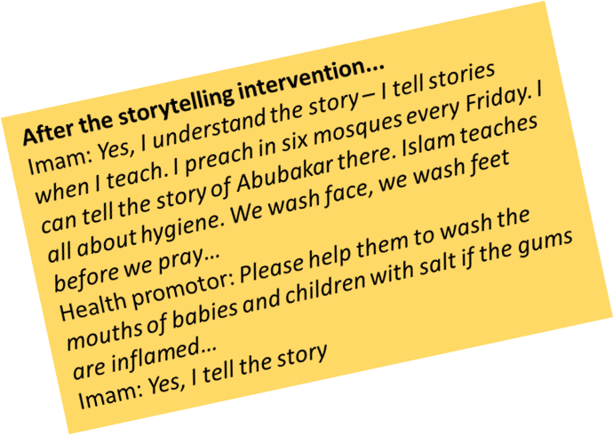
In conclusion; MSF story of change
  Simple
  Sustainable
  Cost effective
This method can be adapted for other settings and behaviours, providing local co-creation is used as a fundamental principle.
Notes:
There is a broad consensus that HP has no or little impact when its not lead by participatory approaches, therefore we need to push for methods where we treat patients, their families and communities as partners to improve our response and to improve better health outcomes.
Story of change is a simple, sustainable, cost effective method for health promotion. Which can be adapted for other se.ttings and risk practices. It’s a method in which local listening and co-creation is used as a fundamental principle

Slide 11
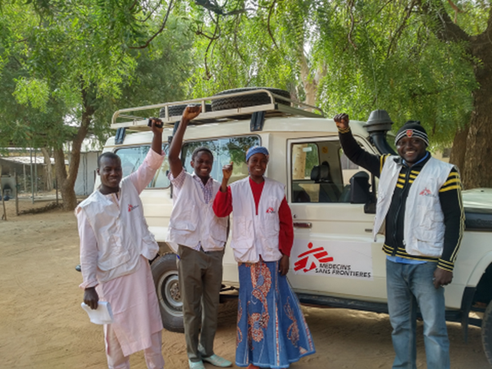
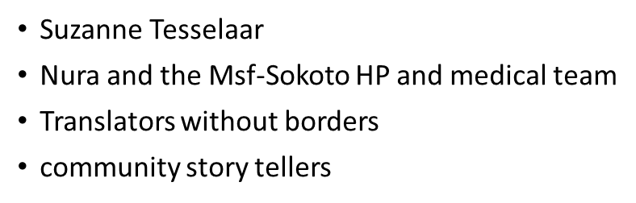

Make our story your
Story of Change…
Thank you
If you want to know more; please contact
Annette.de.jong@Amsterdam.msf.org
Notes:
If you like to hear more, please contact me; My name is Annette de Jong, I am working as an adviser on health promotion & community engagement for MsF. Holland
I want to thanks the key persons in this pilot:

