Slide 1
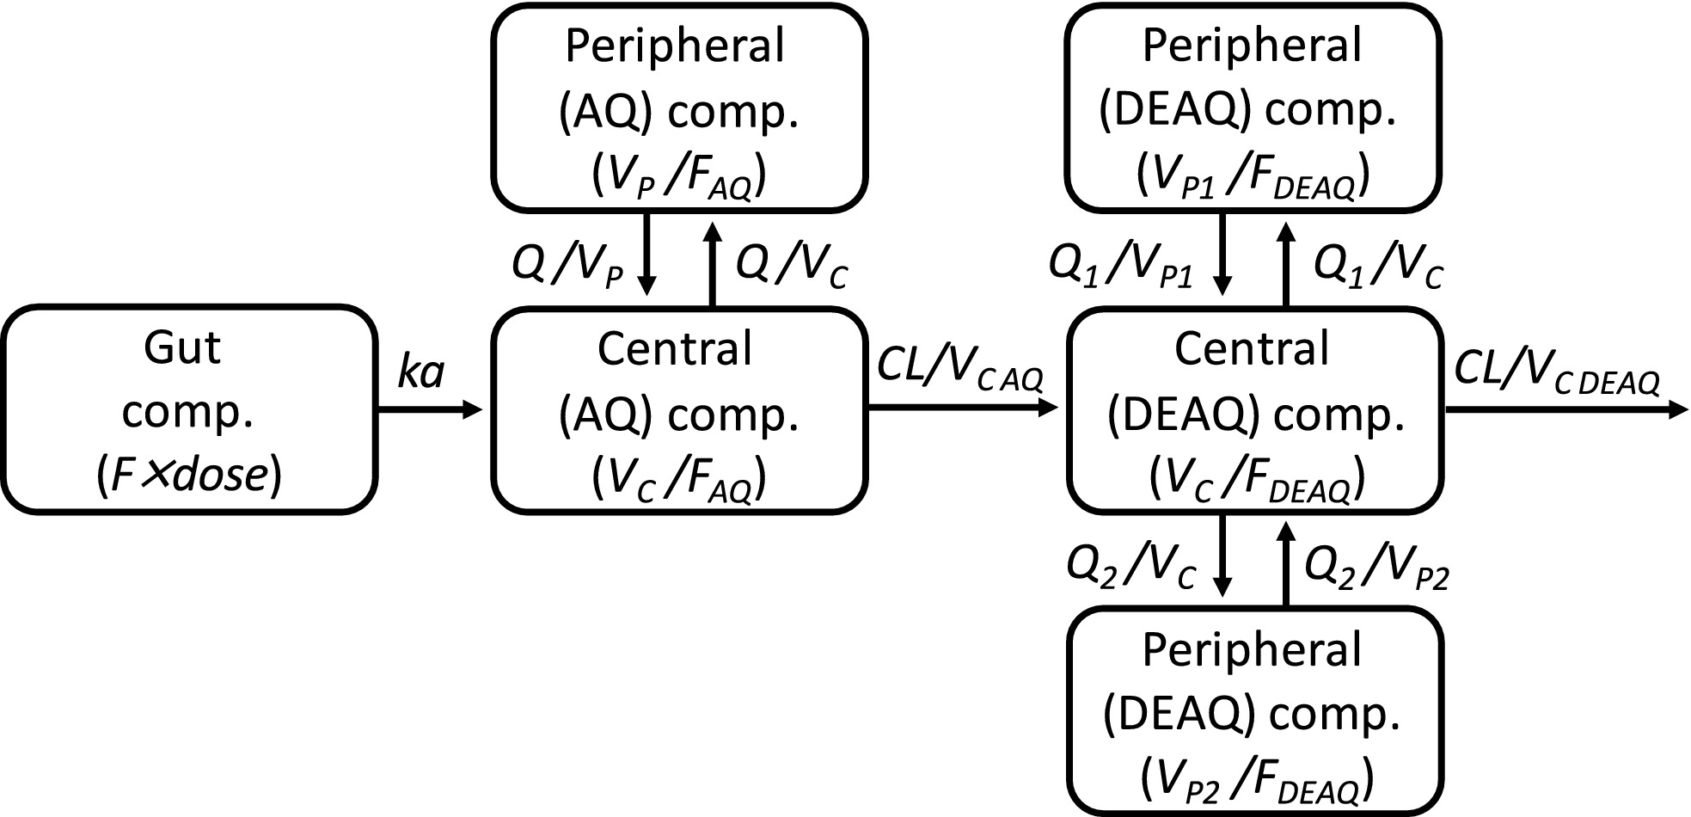
Use of population pharmacokinetics to assess adherence to amodiaquine when used for seasonal malaria chemoprevention
Conflict of Interest
The author has declared no conflict of interest.
Matthew Coldiron, Epicentre

Slide 2
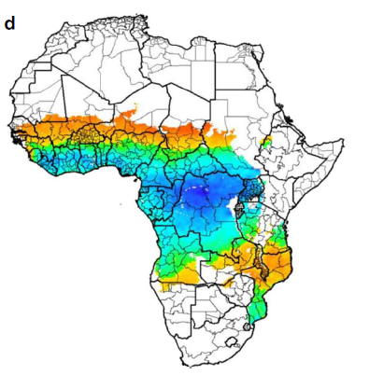
Seasonal malaria chemoprevention (SMC)
Targets children aged 3-59 months in the Sahel
Monthly treatment courses
      Day 1: Sulfadoxine-pyrimethamine (SP) + amodiaquine (AQ) given by a health worker
      Day 2+3: AQ given by a caregiver at home
3-4 months a year during rainy season
75% reduction in malaria incidence
Cairns, et al. Nature Communications (2012) 3:881.

Slide 3
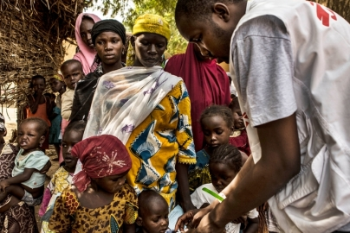
MSF and SMC
2013: MSF begins supporting SMC in Niger
2014-15: malaria incidence remains high despite SMC
2016: pilot of first-dose non-directly observed therapy (DOT) strategy in Magaria, Niger
2016: case-control study to evaluate SMC’s effectiveness
      Main results presented at MSF Scientific Days 2018
      85% overall protective effectiveness, but significantly lower in
      first-dose non-DOT areas so strategy abandoned
      Sub-study to evaluate adherence
Photo : Juan Carlos Tomasi/MSF

Slide 4
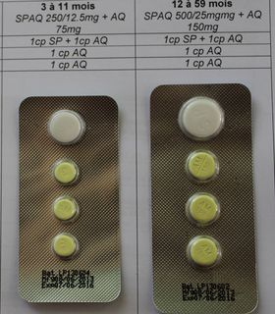
Why assess adherence?
Poor adherence to days 2+3 of treatment course could lead to decreased protection of SMC
Adherence to malaria treatment varies
      What about preventive measures like SMC?
Self-report may overestimate adherence
      Plasma drug concentration is objective
      Pharmacokinetics of AQ in SMC not previously described
Photo : Bachir Assao

Slide 5
Objectives
Describe the population pharmacokinetics (PK) of AQ in children receiving SMC under ideal conditions
Compare drug concentrations of children enrolled in case-control study to objectively assess their adherence

Slide 6
Field methods – population PK
165 children aged 3-59 months in Magaria village
SMC doses administered at home by study nurses each day for 3 days
Capillary blood collection
    0-8 hours after first dose
    0-6 hours after third dose
    6-12 hours after third dose
    12-24 hours after third dose
    4-7 days after first dose
    14-35 days after first dose
Ethics committee approvals
CCNE Niger 14/2016/CCNE
MSF-ERB 1624

Slide 7

Lab methods – population PK
Joel Tarning's lab at Mahidol-Oxford Tropical Medicine Research Unit
Concentrations of AQ and desethylamodiaquine (DEAQ) determined using liquid chromatography tandem mass spectrometry-based assay
Concentration-time data evaluated simultaneously using nonlinear mixed-effects modelling
Sensitivity and specificity of different cut-off thresholds evaluated
    Basis for assessment of adherence in case-control population

Slide 8
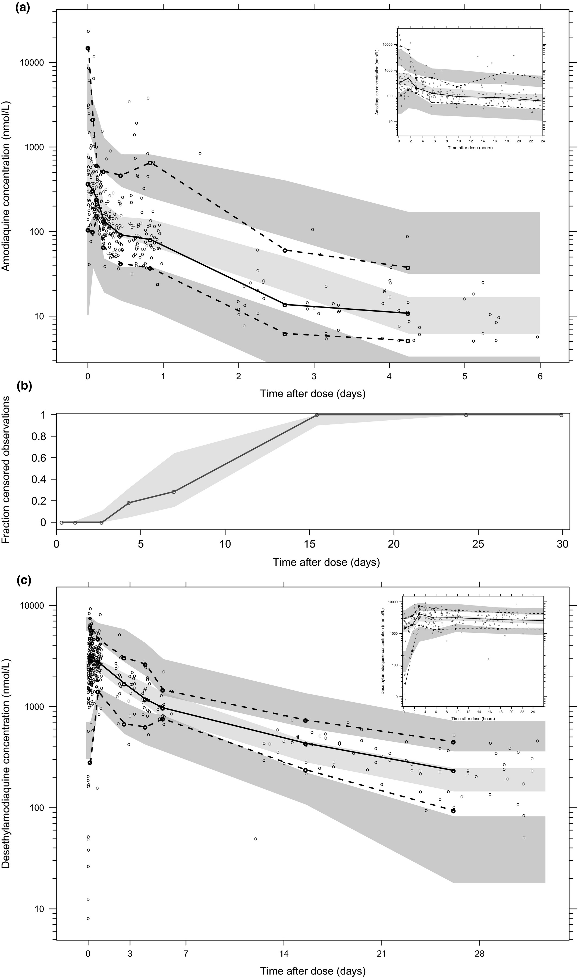
Results – population PK
Amodiaquine
Desethylamodiaquine
Ding et al. Clin Pharmacol Ther. 2020;107(5):1179-1188.
doi: 10.1002/cpt.1707

Slide 9
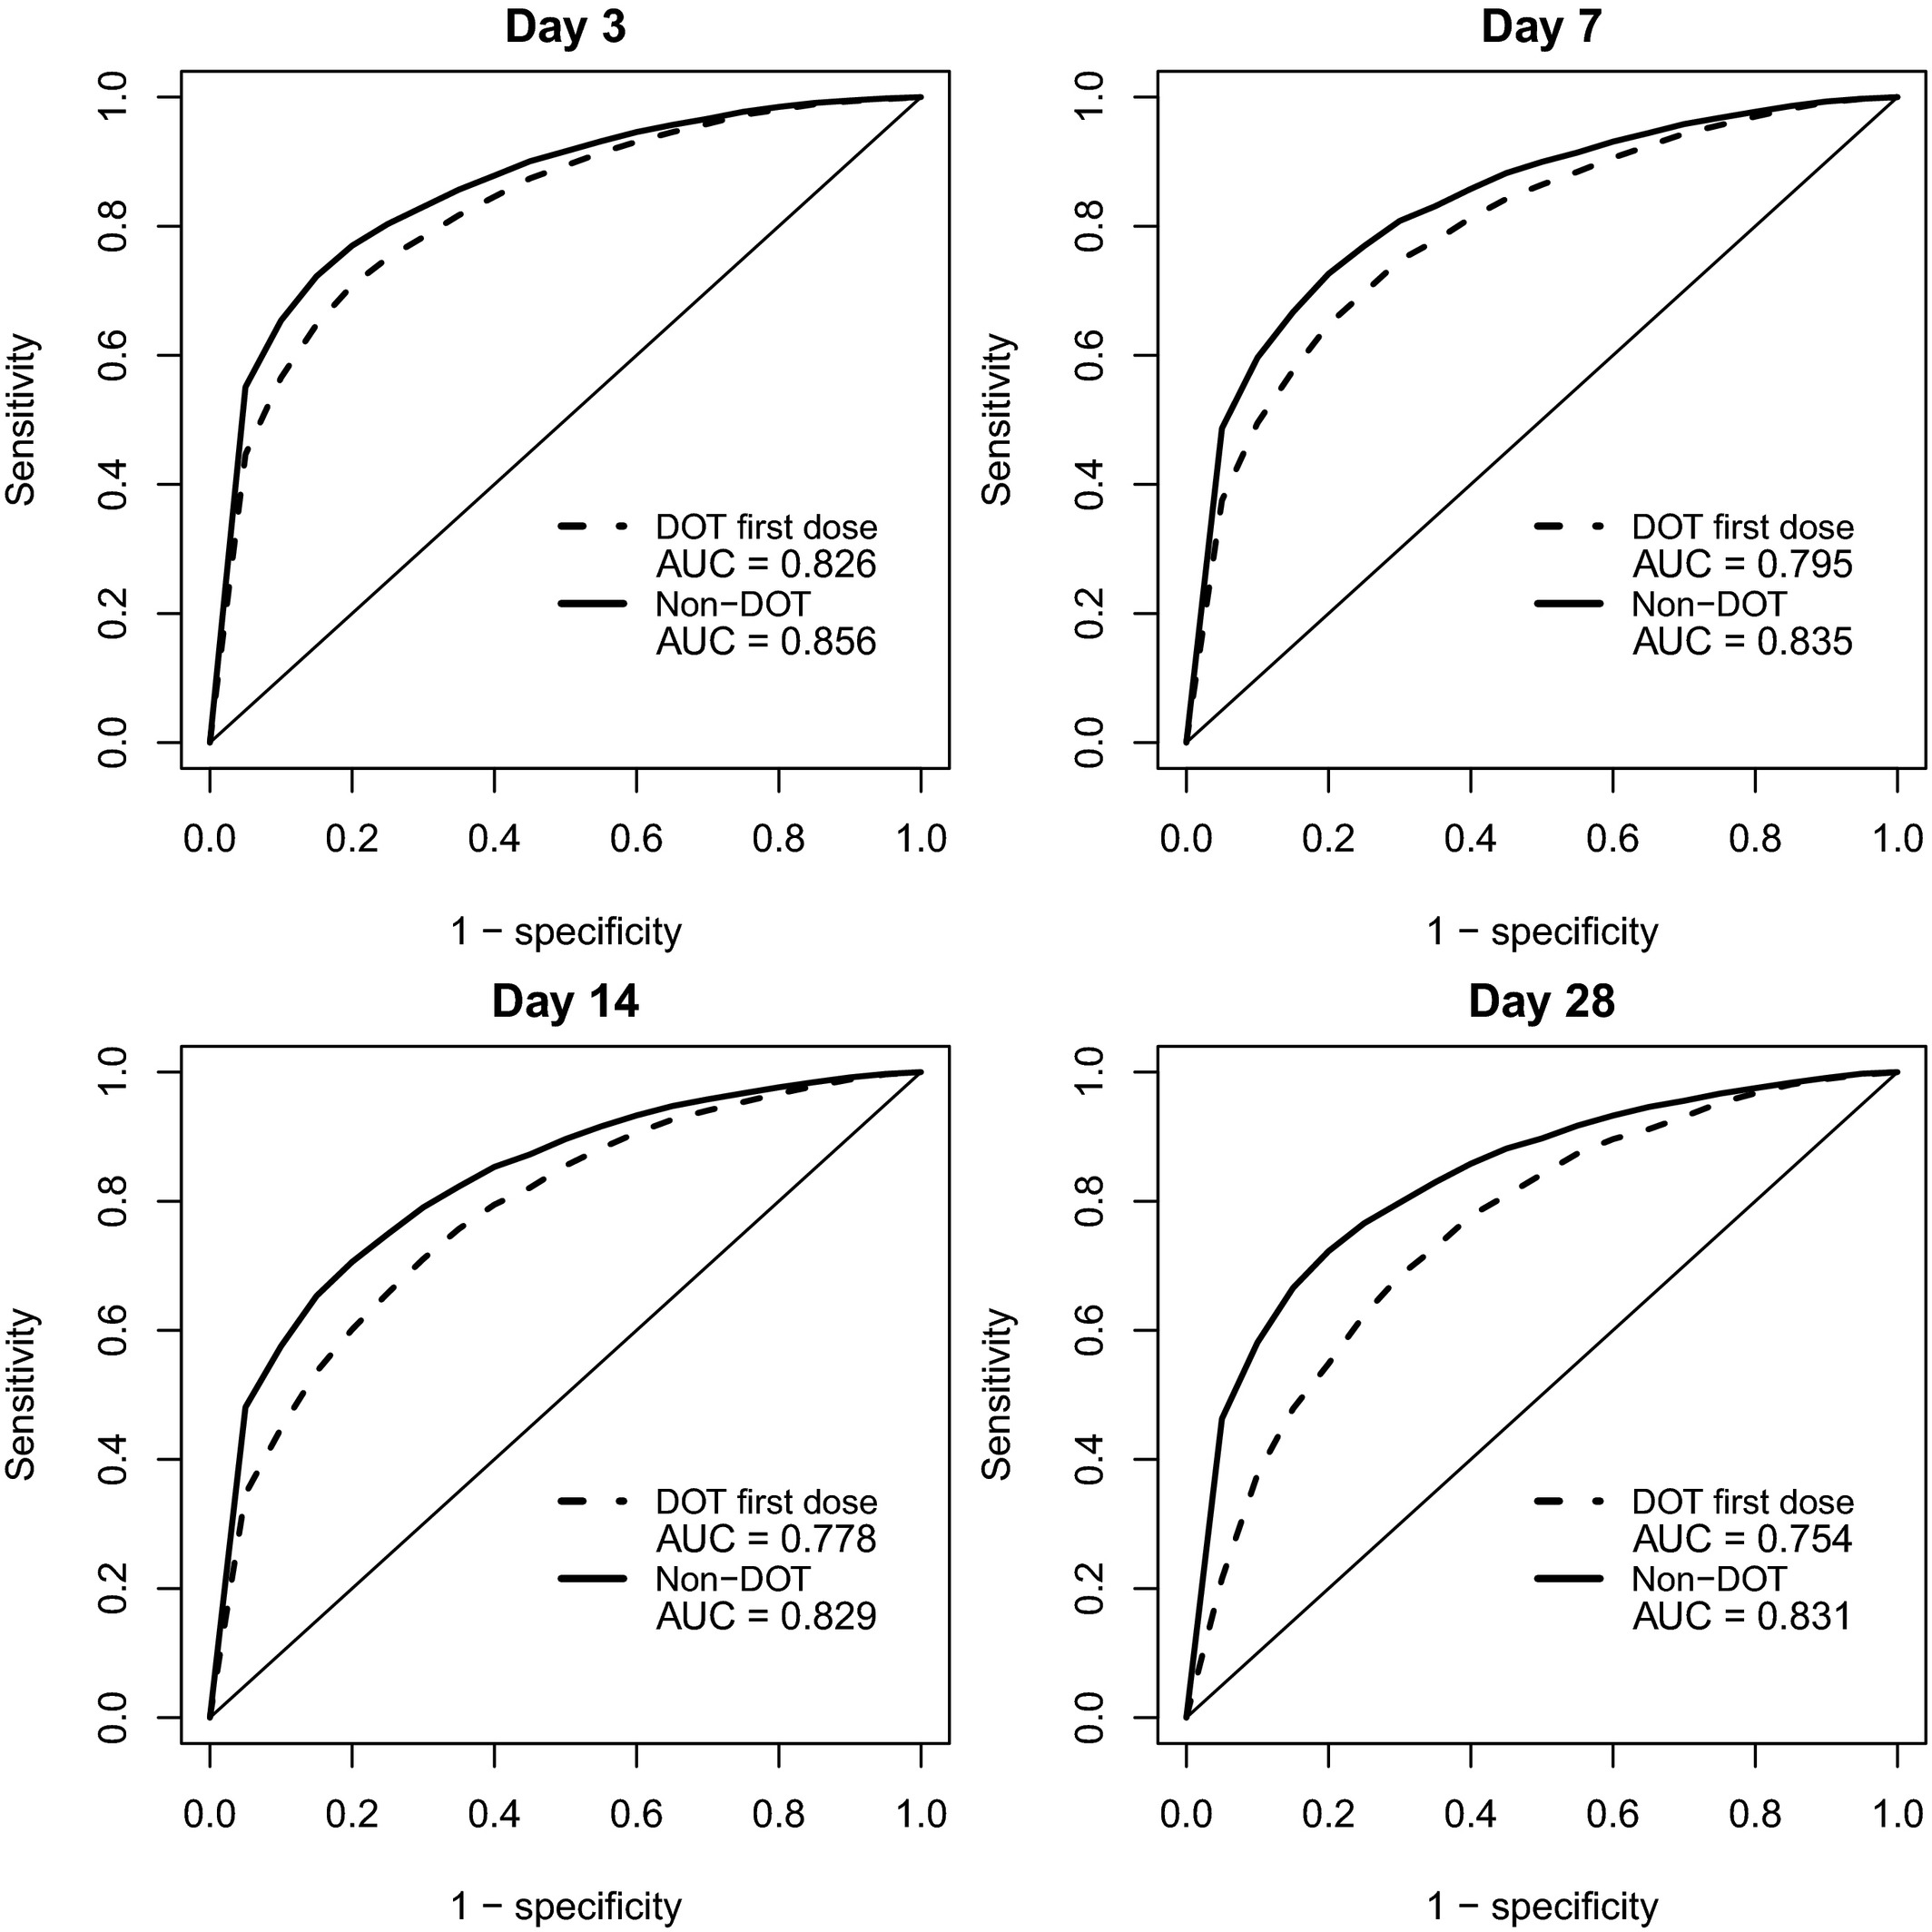
Results – cut-off thresholds
Good discriminating capacity: area under the curve (AUC) >0.75 at all time points
Thresholds between 20th and 30th percentiles had best overall performance
      Sensitivity: 65-77%
      Specificity: 70-80%
      Most conservative threshold of 5th percentile had 95% specificity
Ding et al. Clin Pharmacol Ther. 2020;107(5):1179-1188.
doi: 10.1002/cpt.1707

Slide 10
Results – correct adherence
 | 5th percentile cut-off | Optimal percentile cut-off
Controls
First-dose DOT (n=327) | 55 (17%) | 27 (8%)
First-dose non-DOT (n=349) | 61 (18%) | 29 (8%)
Cases
First-dose DOT (n=84) | 8 (10%) | 6 (7%)
First-dose non-DOT (n=109) | 5 (5%) | 3 (3%)
Ding et al. Clin Pharmacol Ther. 2020;107(5):1179-1188.
doi: 10.1002/cpt.1707

Slide 11
Conclusions
First description of the population PK of AQ when administered as part of SMC
    Robust model with good predictive performance
    Limitations
    Convenience sampling was used for population PK cohort
    Single-site study
    Poor adherence to 3-day course of AQ during SMC
    Possible explanations: medicine hoarding, SMC fatigue, spitting/vomiting,
    giving to older children not targeted by SMC, etc.
    Effectiveness of SMC was high despite poor adherence to AQ
    Suggests that benefit was largely due to single-dose SP
    Poor adherence to AQ may lead to resistance of both AQ and SP

Slide 12



Acknowledgements
MORU
Joel Tarning
Junjie Ding
Daniel Blessborn
Markus Winterberg
Ministry of Health, Niger
Hadiza Jackou (NMCP)
Salifou Atti
Mahaman Yarima Bako
Epicentre
Bachir Assao
Ousmane Guindo
Nathan Sayinzoga-Makombe
Abdoul-Aziz Mamaty
Céline Langendorf
Rebecca Grais
Staff in Maradi and Magaria
MSF
Alena Koscalova
Iza Ciglenecki
Michel Quere
Ann Mumina
Staff in Magaria and Niamey

