Slide 1
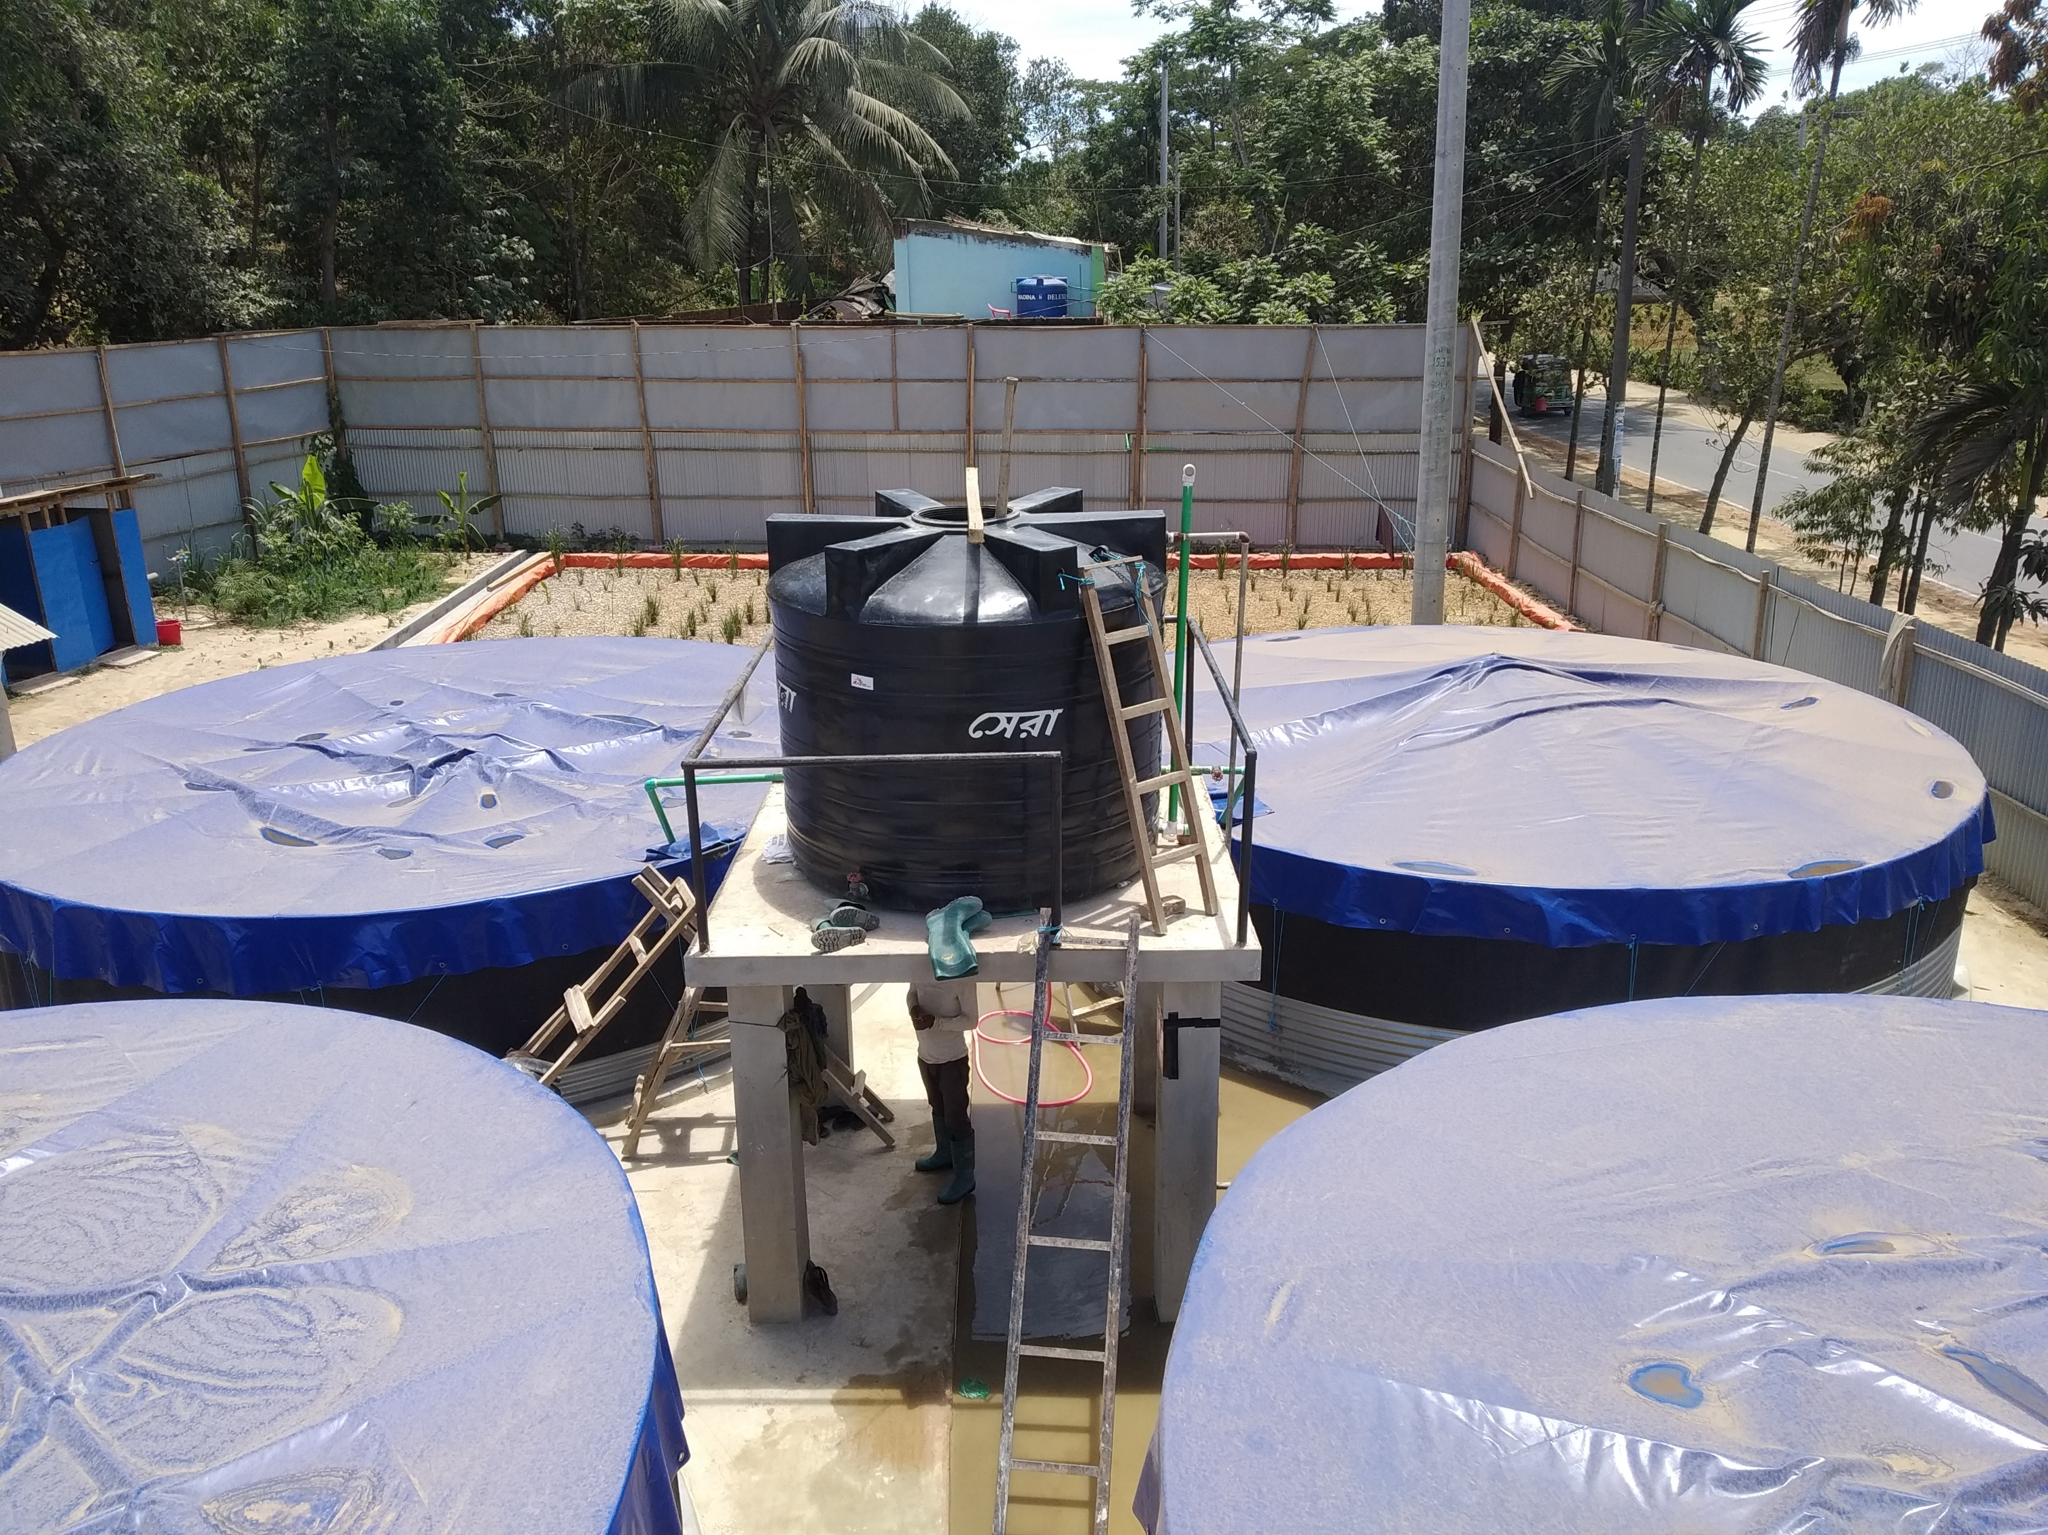
Faecal sludge treatment using lime stabilisation in Cox’s Bazar, Bangladesh
Conflict of Interest
The author has declared no conflict of interest.
Mohammed Ziaul Haque

Slide 2
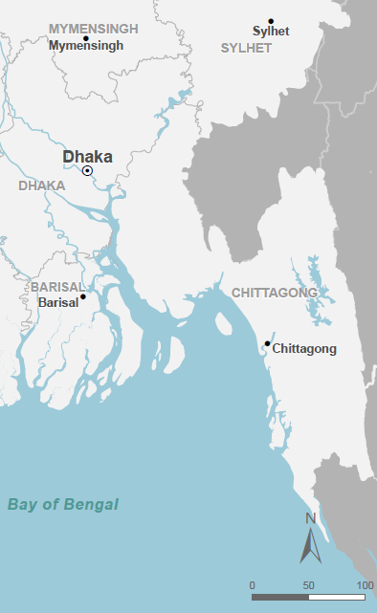
Introduction
2017: more than 750,000 Rohingya refugees are displacement to Cox’s Bazar
Vast quantities of human excreta being produced
MSF set up and ran a faecal sludge treatment plant (FSTP) from 2018 to help manage this
Primary aim: To reduce the risks of epidemic and endemic disease transmission.
Secondary aim: Reducing environmental pollution.

Slide 3
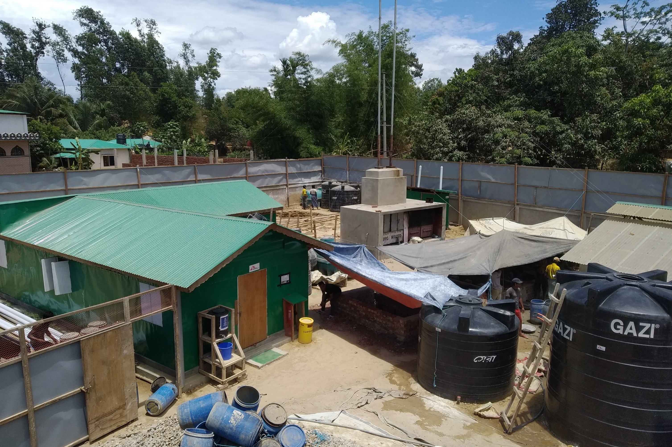
Introduction
Faecal sludge management (FSM): an emerging discipline without a good body of evidence or operational experience to guide decision-making
Innovation project: to assess the use of lime stabilisation (Hydrated Lime) as the primary treatment technology

Slide 4
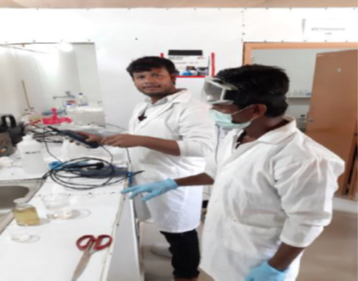
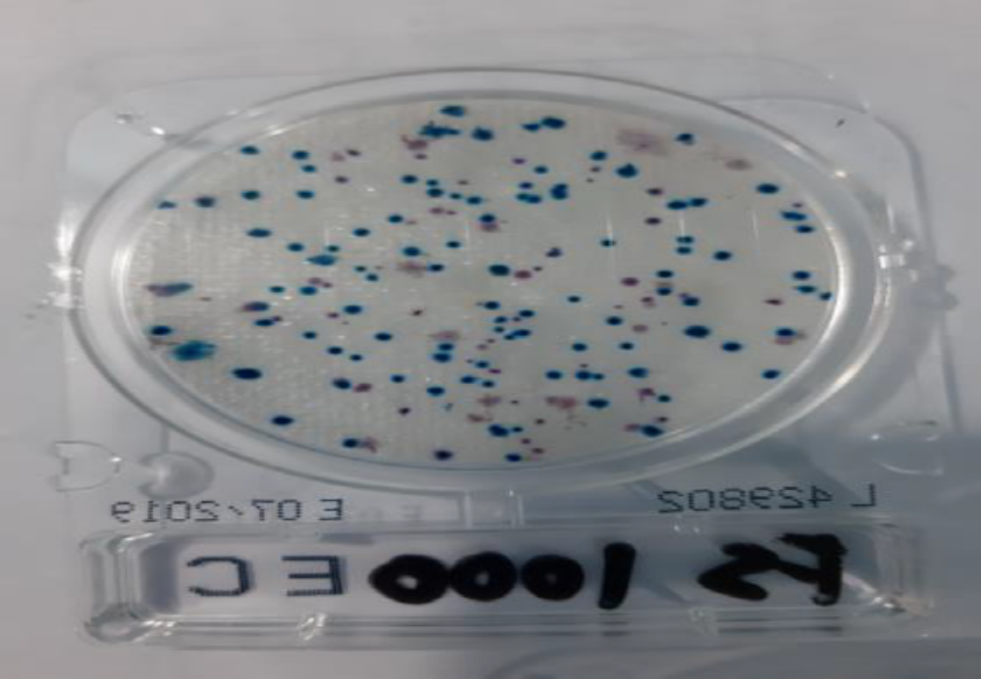
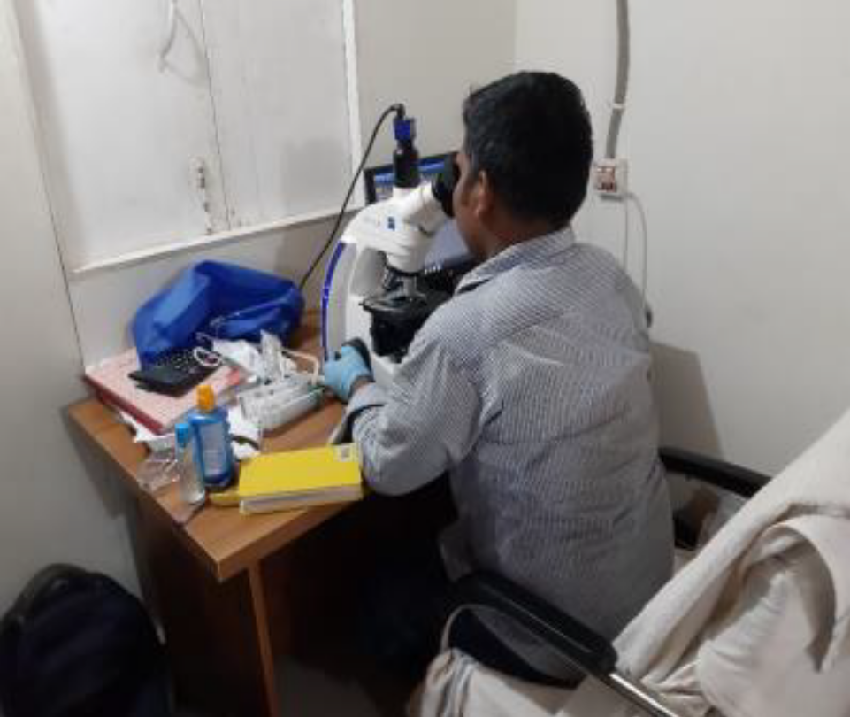
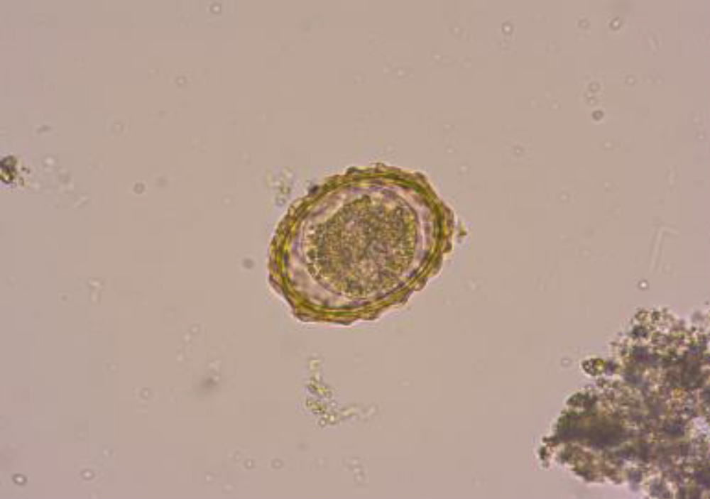
Methods
Descriptive study using systematic laboratory analyses and empirical observations.
● Sampling points were identified at each treatment stage and a sampling protocol developed with the assistance of IHE Delft Institute for Water Education.
● Parameters were selected to measure compliance with Bangladeshi limits and in accordance with international standards.

Slide 5
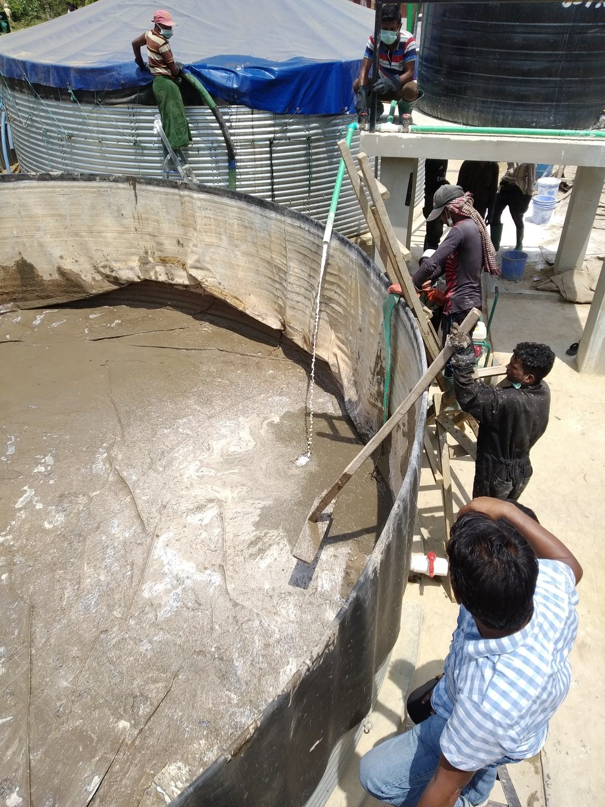
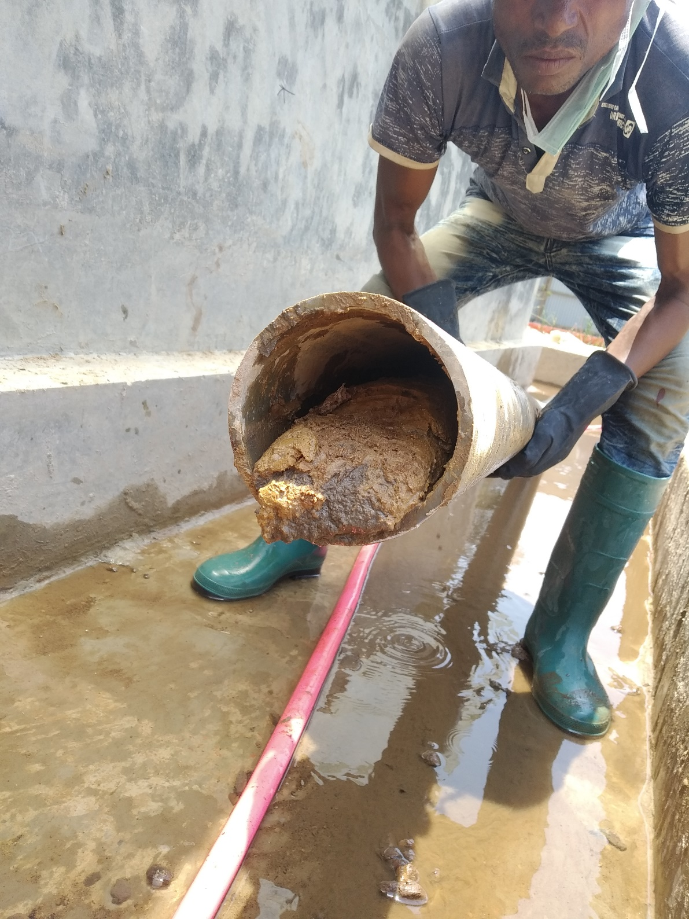
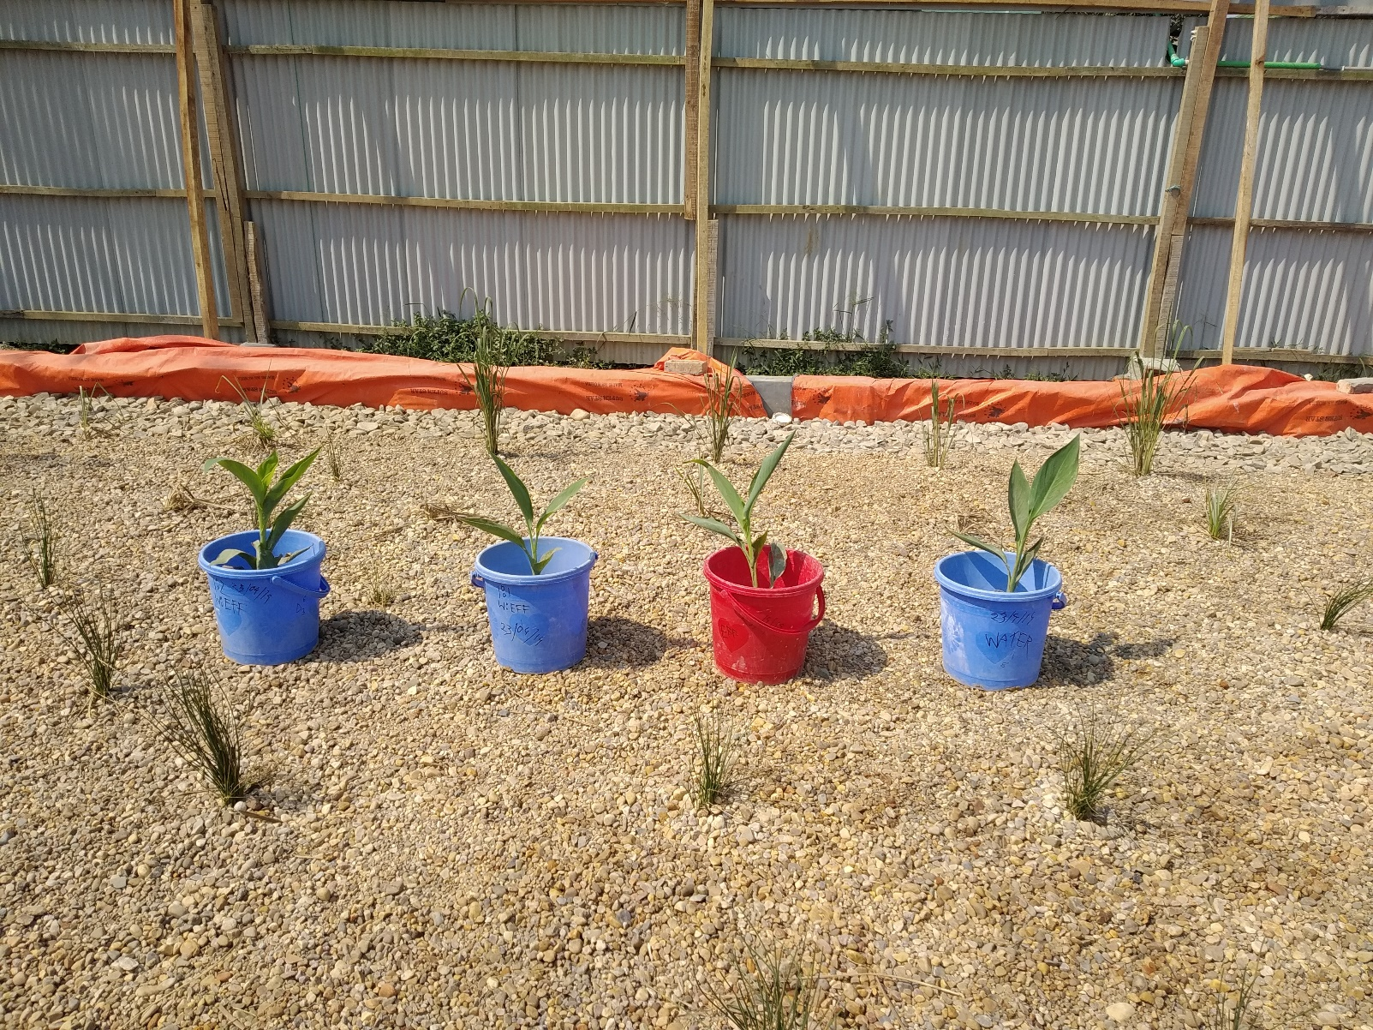
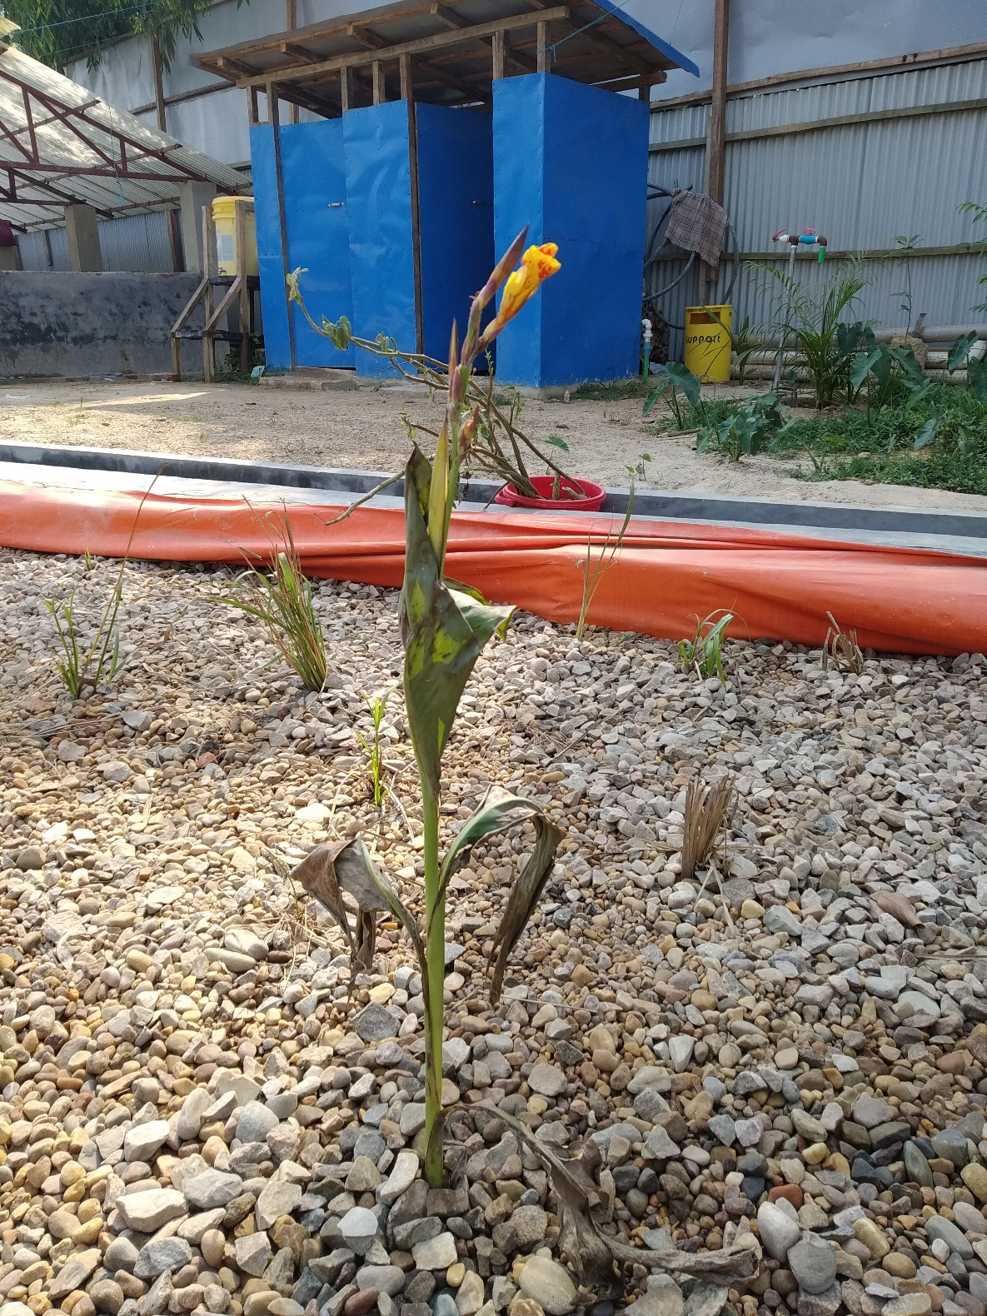
Methods
Operational challenges, limitations and successes recorded in an evolving ‘lessons learnt’ document.
Innovation project did not involve human participants or their data; the MSF Ethics Framework for Innovation was used to help identify and mitigate potential harms.

Slide 6
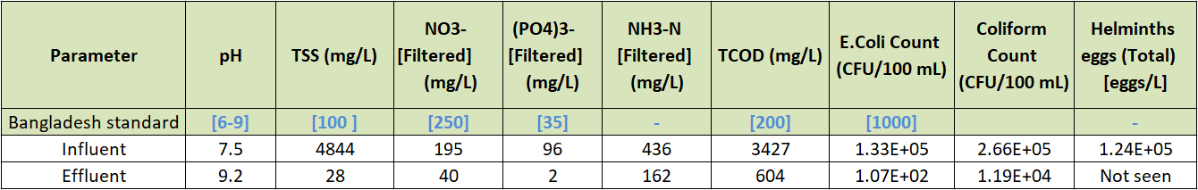
Results
Average figures for:
TSS – Total Suspended Solids
NO3- – Nitrate
(PO4)3- – Phosphate
NH3-N – Ammonia Nitrogen
TCOD – Total Chemical Oxygen Demand
E. coli – Escherichia coli
Pathogen reduction was good
Environmental pollutant reduction was insufficient

Slide 7
Results
Average figures for:
TSS – Total Suspended Solids
NO3- – Nitrate
(PO4)3- – Phosphate
NH3-N – Ammonia Nitrogen
TCOD – Total Chemical Oxygen Demand
E. coli – Escherichia coli
Pathogen reduction was good
Environmental pollutant reduction was insufficient

Slide 8
Results
Average figures for:
TSS – Total Suspended Solids
NO3- – Nitrate
(PO4)3- – Phosphate
NH3-N – Ammonia Nitrogen
TCOD – Total Chemical Oxygen Demand
E. coli – Escherichia coli
Pathogen reduction was good
Environmental pollutant reduction was insufficient

Slide 9

Results
Average figures for:
TSS – Total Suspended Solids
NO3- – Nitrate
(PO4)3- – Phosphate
NH3-N – Ammonia Nitrogen
TCOD – Total Chemical Oxygen Demand
E. coli – Escherichia coli
Pathogen reduction was good
Environmental pollutant reduction was insufficient

Slide 10

Results
Average figures for:
TSS – Total Suspended Solids
NO3- – Nitrate
(PO4)3- – Phosphate
NH3-N – Ammonia Nitrogen
TCOD – Total Chemical Oxygen Demand
E. coli – Escherichia coli
Pathogen reduction was good
Environmental pollutant reduction was insufficient

Slide 11
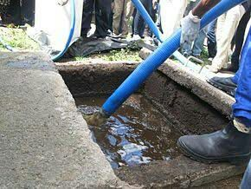
Results
1,648,300 litres of faecal sludge desludged and safely processed.
Data on previous slide were from last 14 batches totalling 350,000 litres.
Last 14 batches selected for presentation due to an improvement in sampling methodology and consistent results.

Slide 12
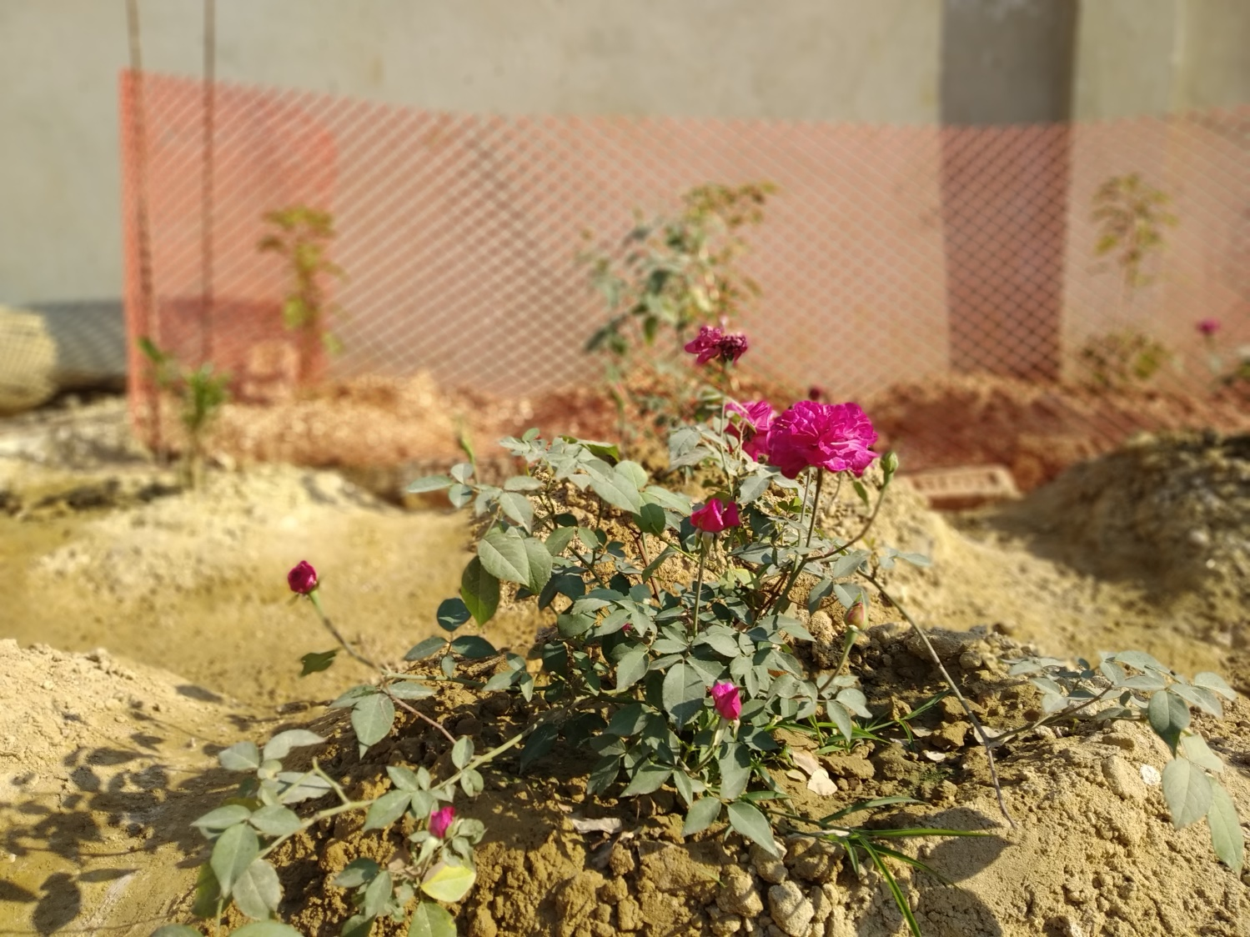
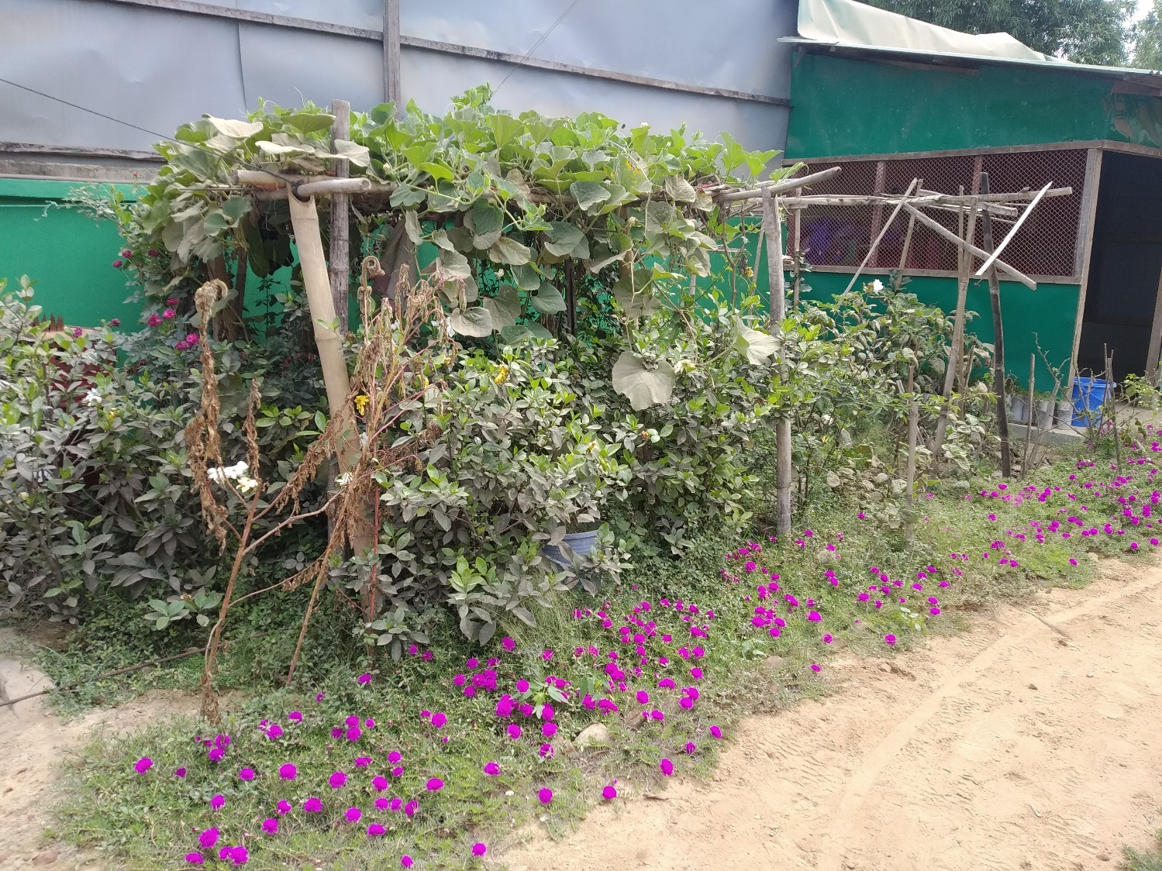
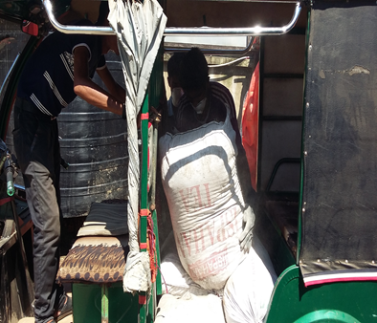
Results
Use of burned solids for brick-making was investigated, but abandoned when they failed strength tests.
Donation of burned solids to local community for use as a soil conditioner is now the preferred option.

Slide 13
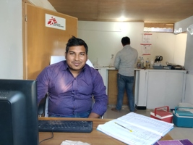
Conclusion
Lime stabilisation is an effective treatment technology for pathogen reduction.
The low skills requirement, consistent results and small physical footprint make lime stabilisation a reliable option for emergency and post-emergency interventions.
The high labour and electro-mechanical requirements, and the insufficient environmental pollutant reduction mean other options and technologies should be explored.

Slide 14
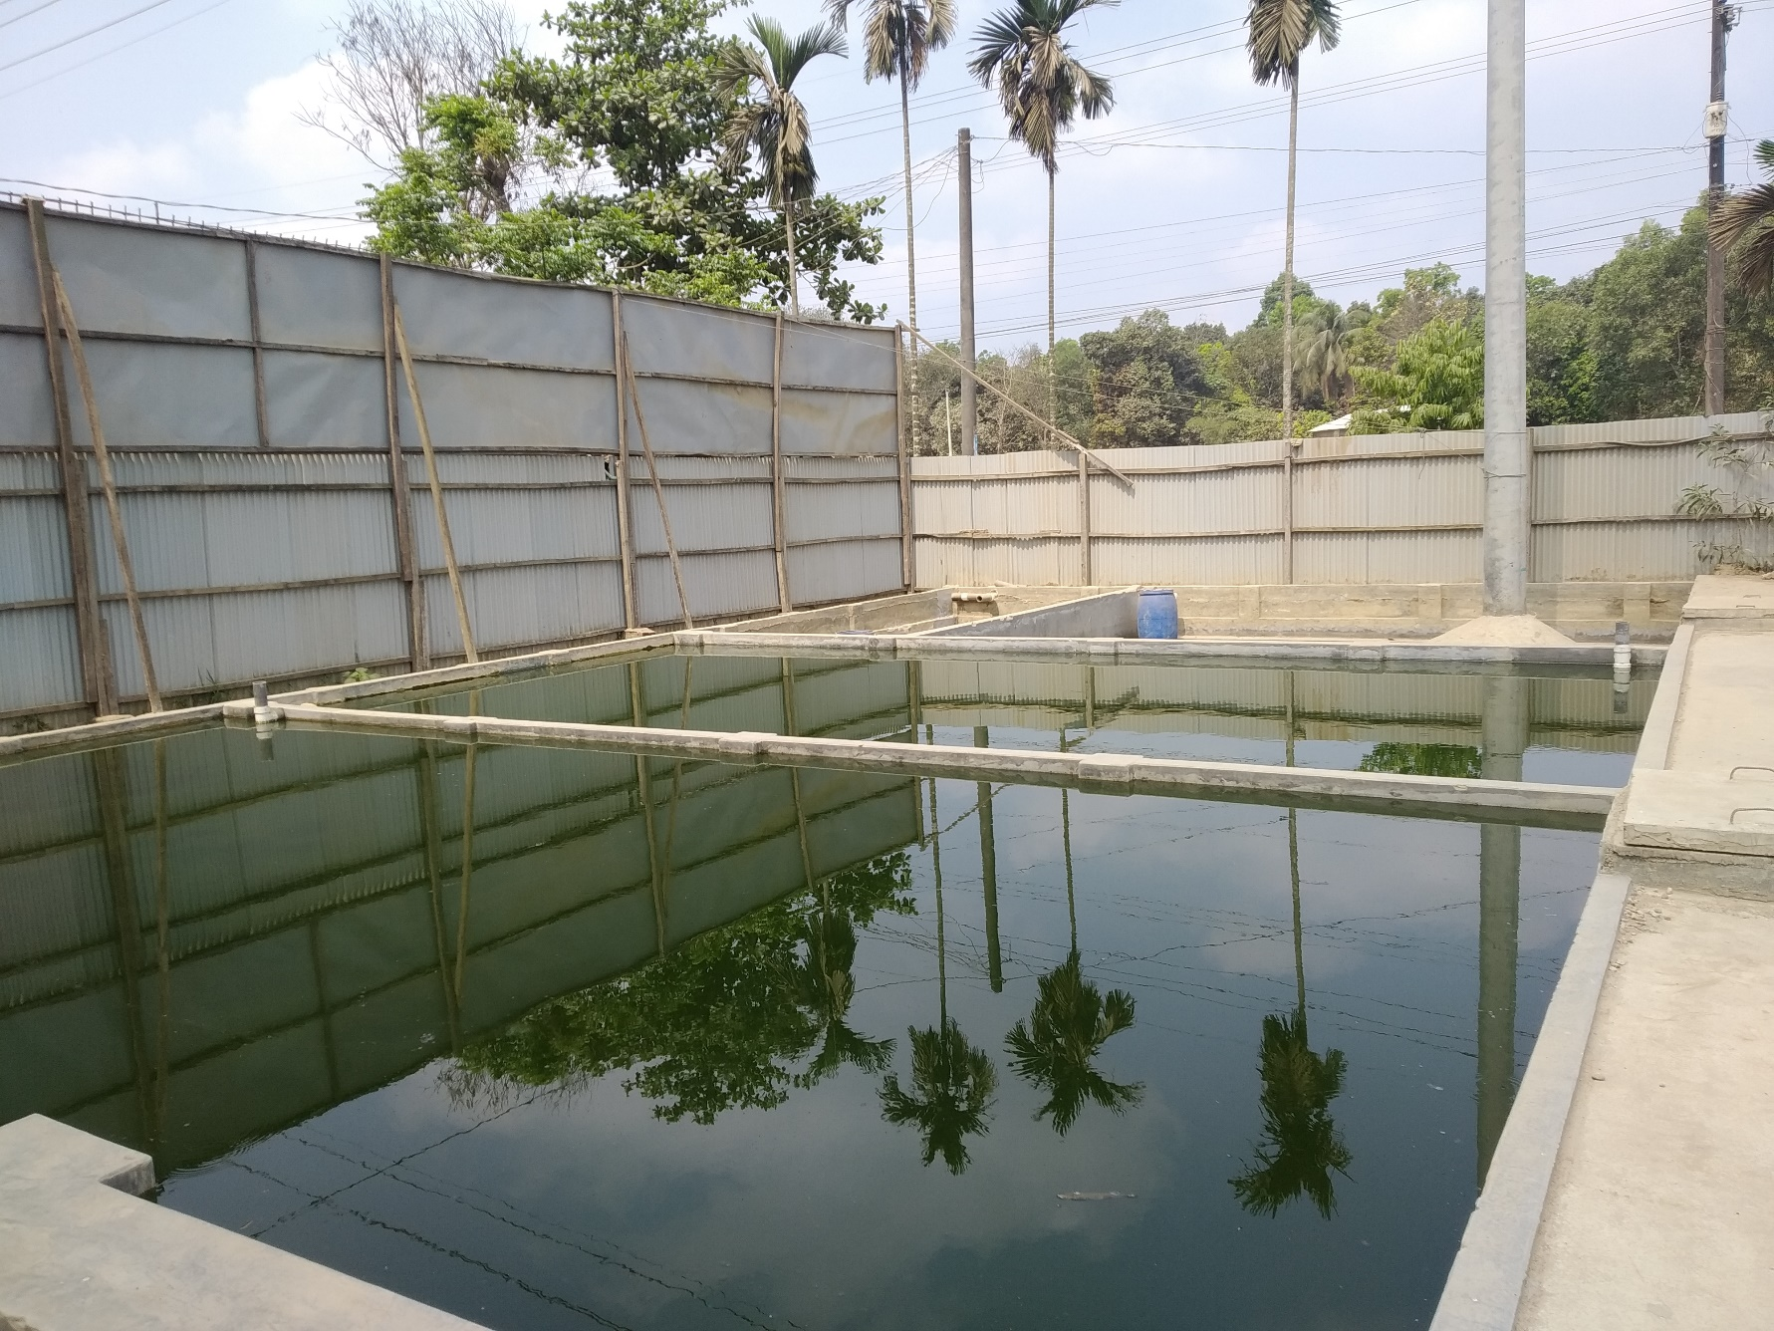
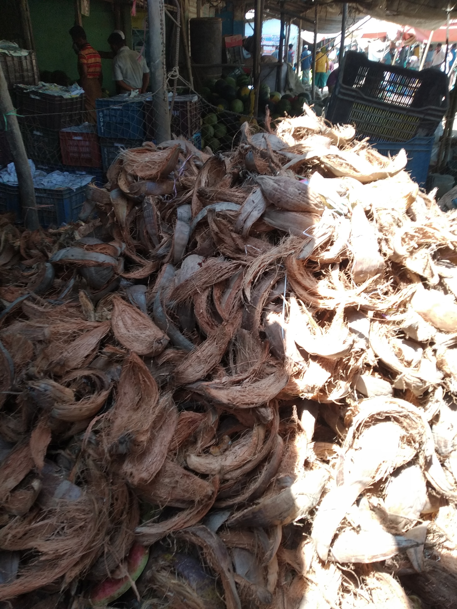
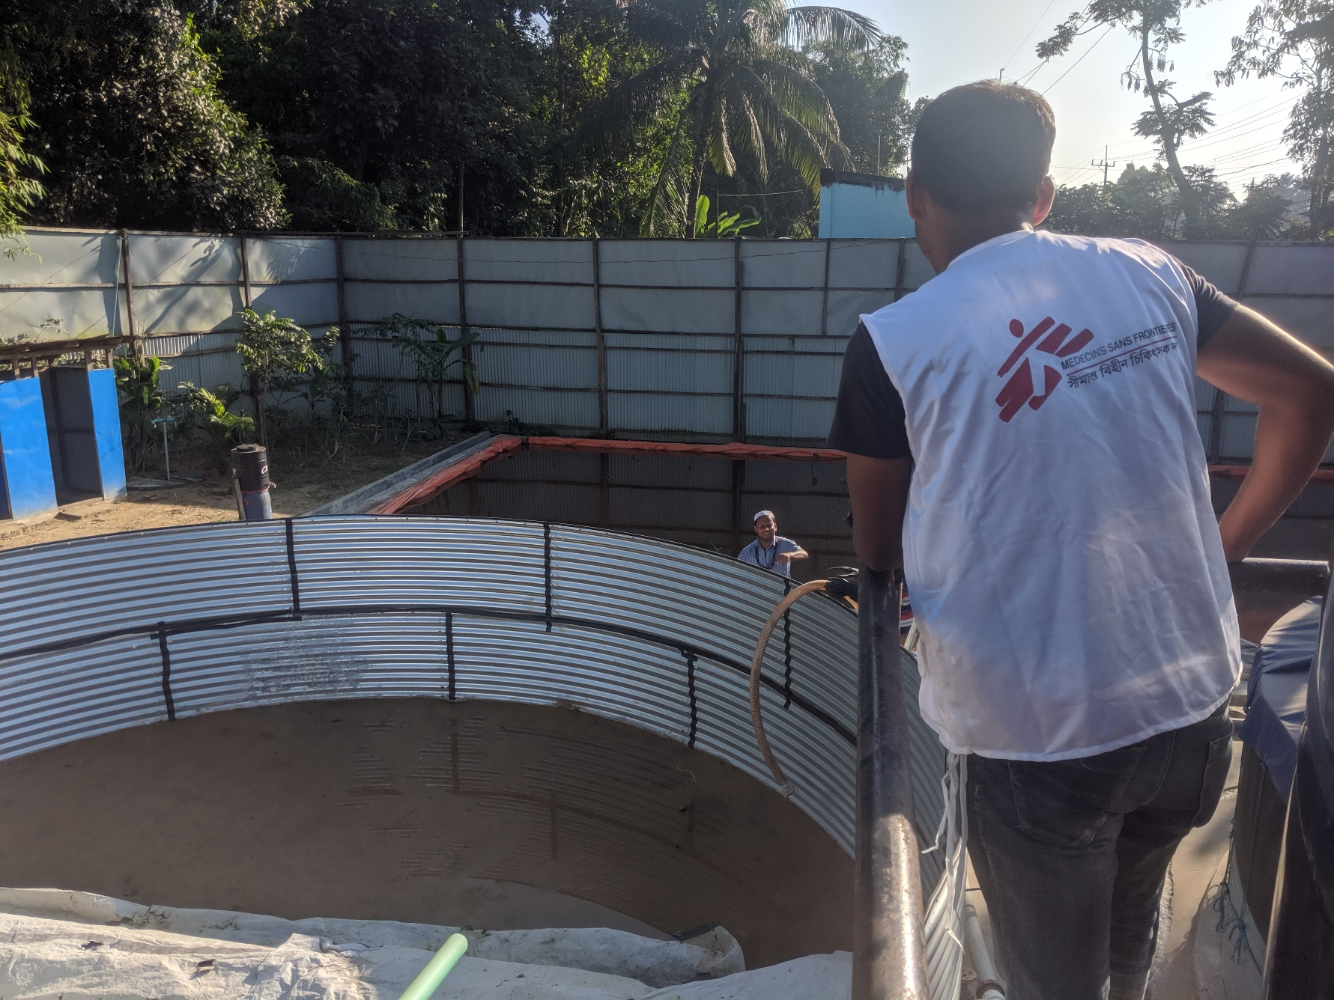
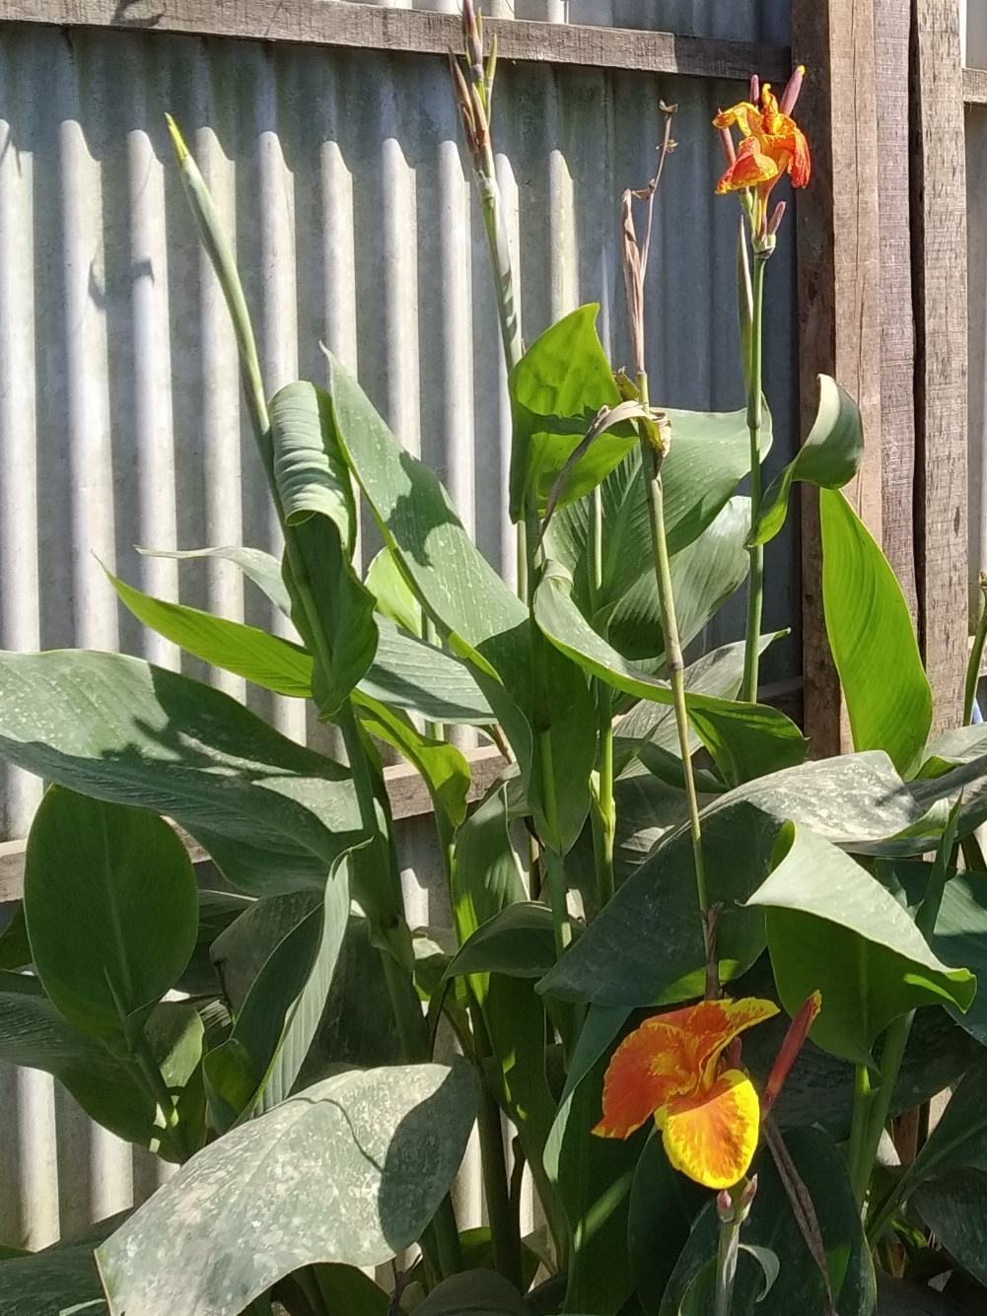
Conclusion
Data collected and experiences recorded during this innovation project have shaped our current interventions in Cox’s Bazar.
Used to justify both the adoption of biological treatment technologies to address the environmental pollutant reductions and the continuation of lime treatment during the current COVID-19 crisis.
We will continue collecting data locally, while designing and planning a full scale version.

Slide 15
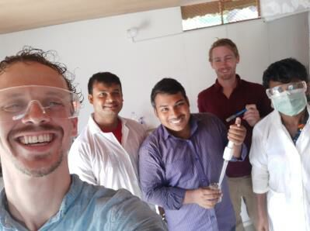
Acknowledgements
A few of the colleagues that supported this project:
Nurul Absar – MSF LabTech; Md Jakir Hossain – MSF Lab Assist; Berend Lolkema – IHE Delft; Owen Bicknell - MSF WatSan Manager; Freddy Liesner – MSF HQ; Nick Schreiner – MSF HQ; Biserka Pop-Stefanija – MSF HQ

