Slide 1
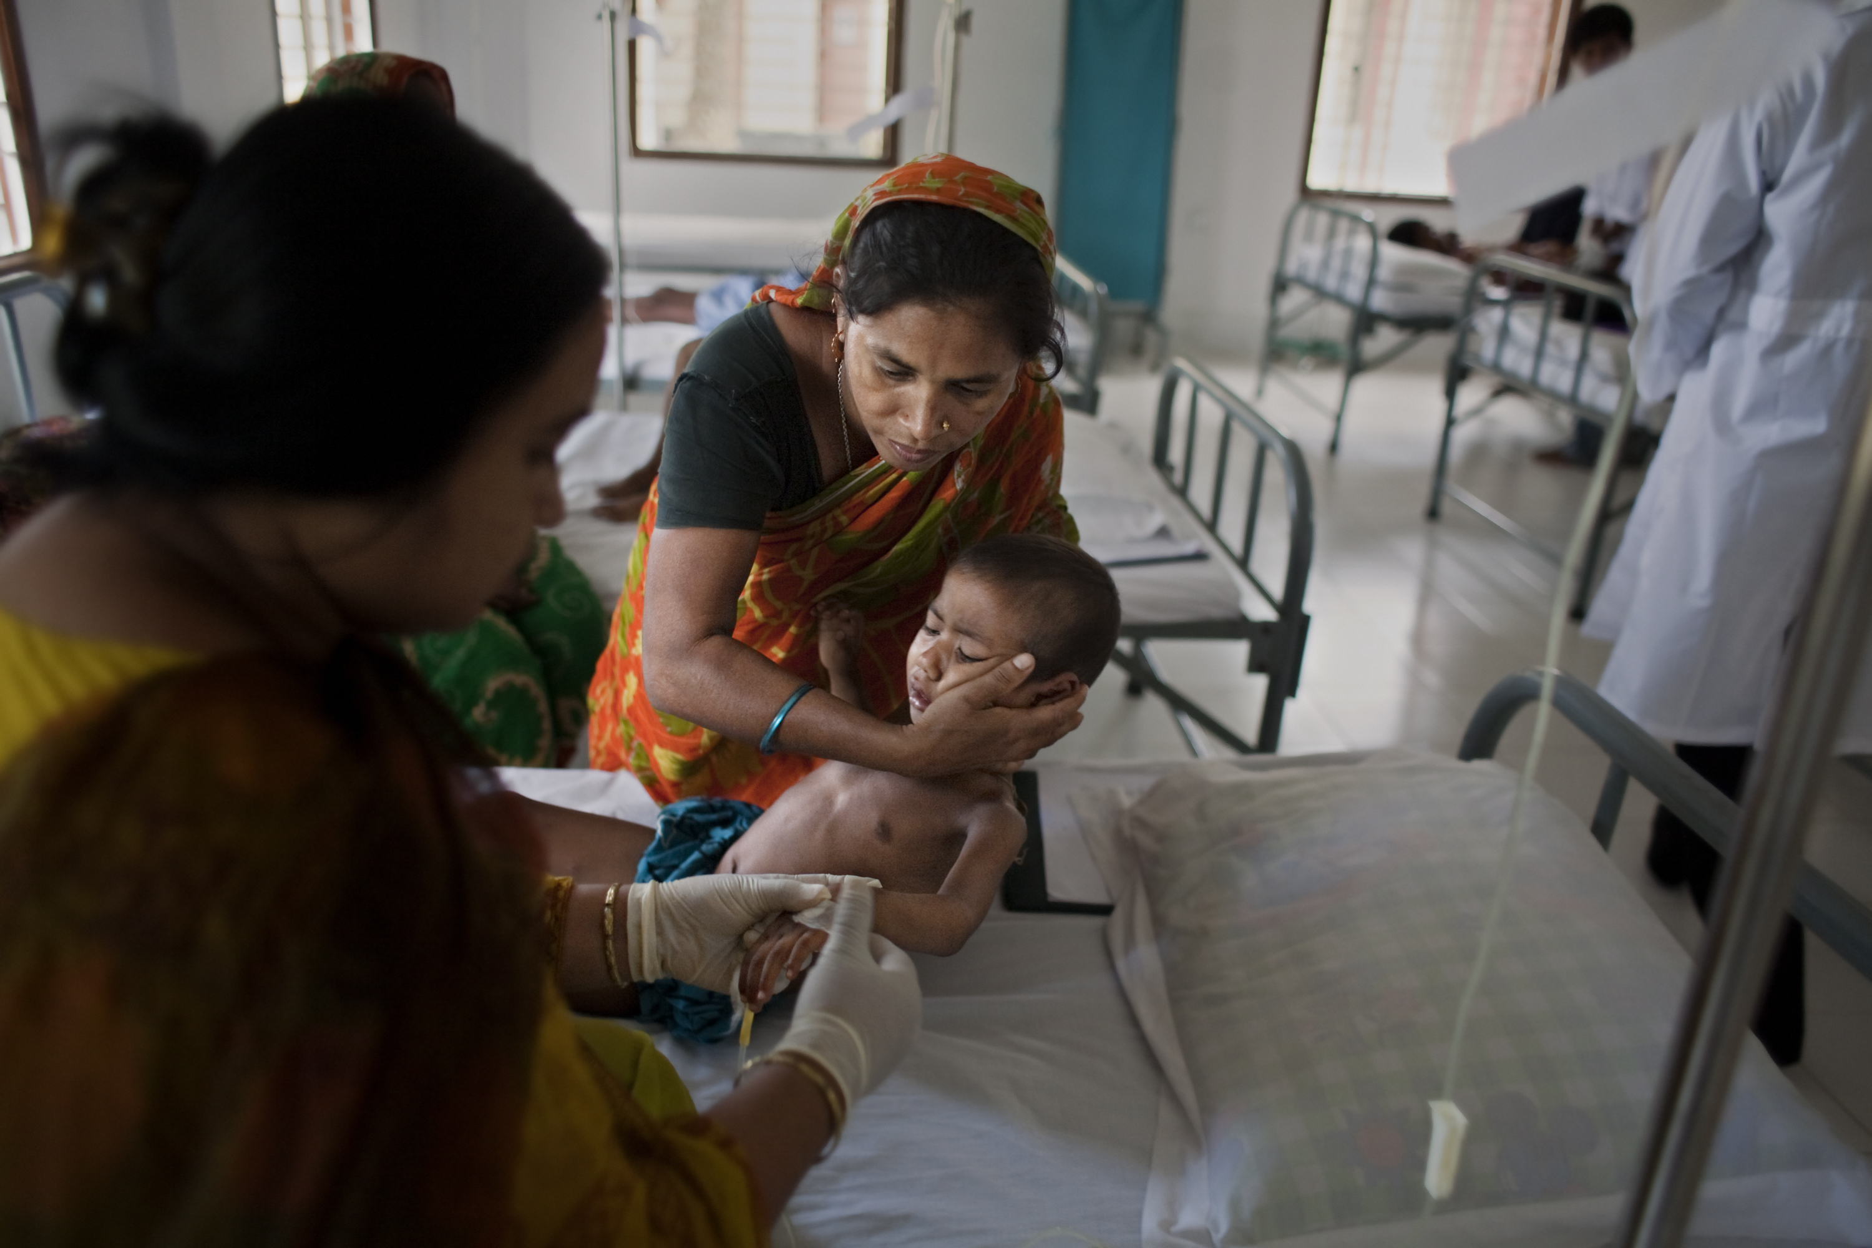
Visualising the complexity of nursing in a humanitarian setting using an app
Conflict of Interest
The author has declared no conflict of interest.
Josie Gilday¹, Vicky Treacy-Wong², Mohammed Helal Uddin³, Nanne Aben⁴, Emyr James¹, Shamsun Naher Lucky³, Francesc Galban-Horcajo¹
¹Médecins Sans Frontières (MSF), London, UK; ²MSF, Amsterdam, The Netherlands; ³MSF, Cox's Bazar, Bangladesh; ⁴ING Wholesale Banking Advanced Analytics, Amsterdam, The Netherlands

Slide 2

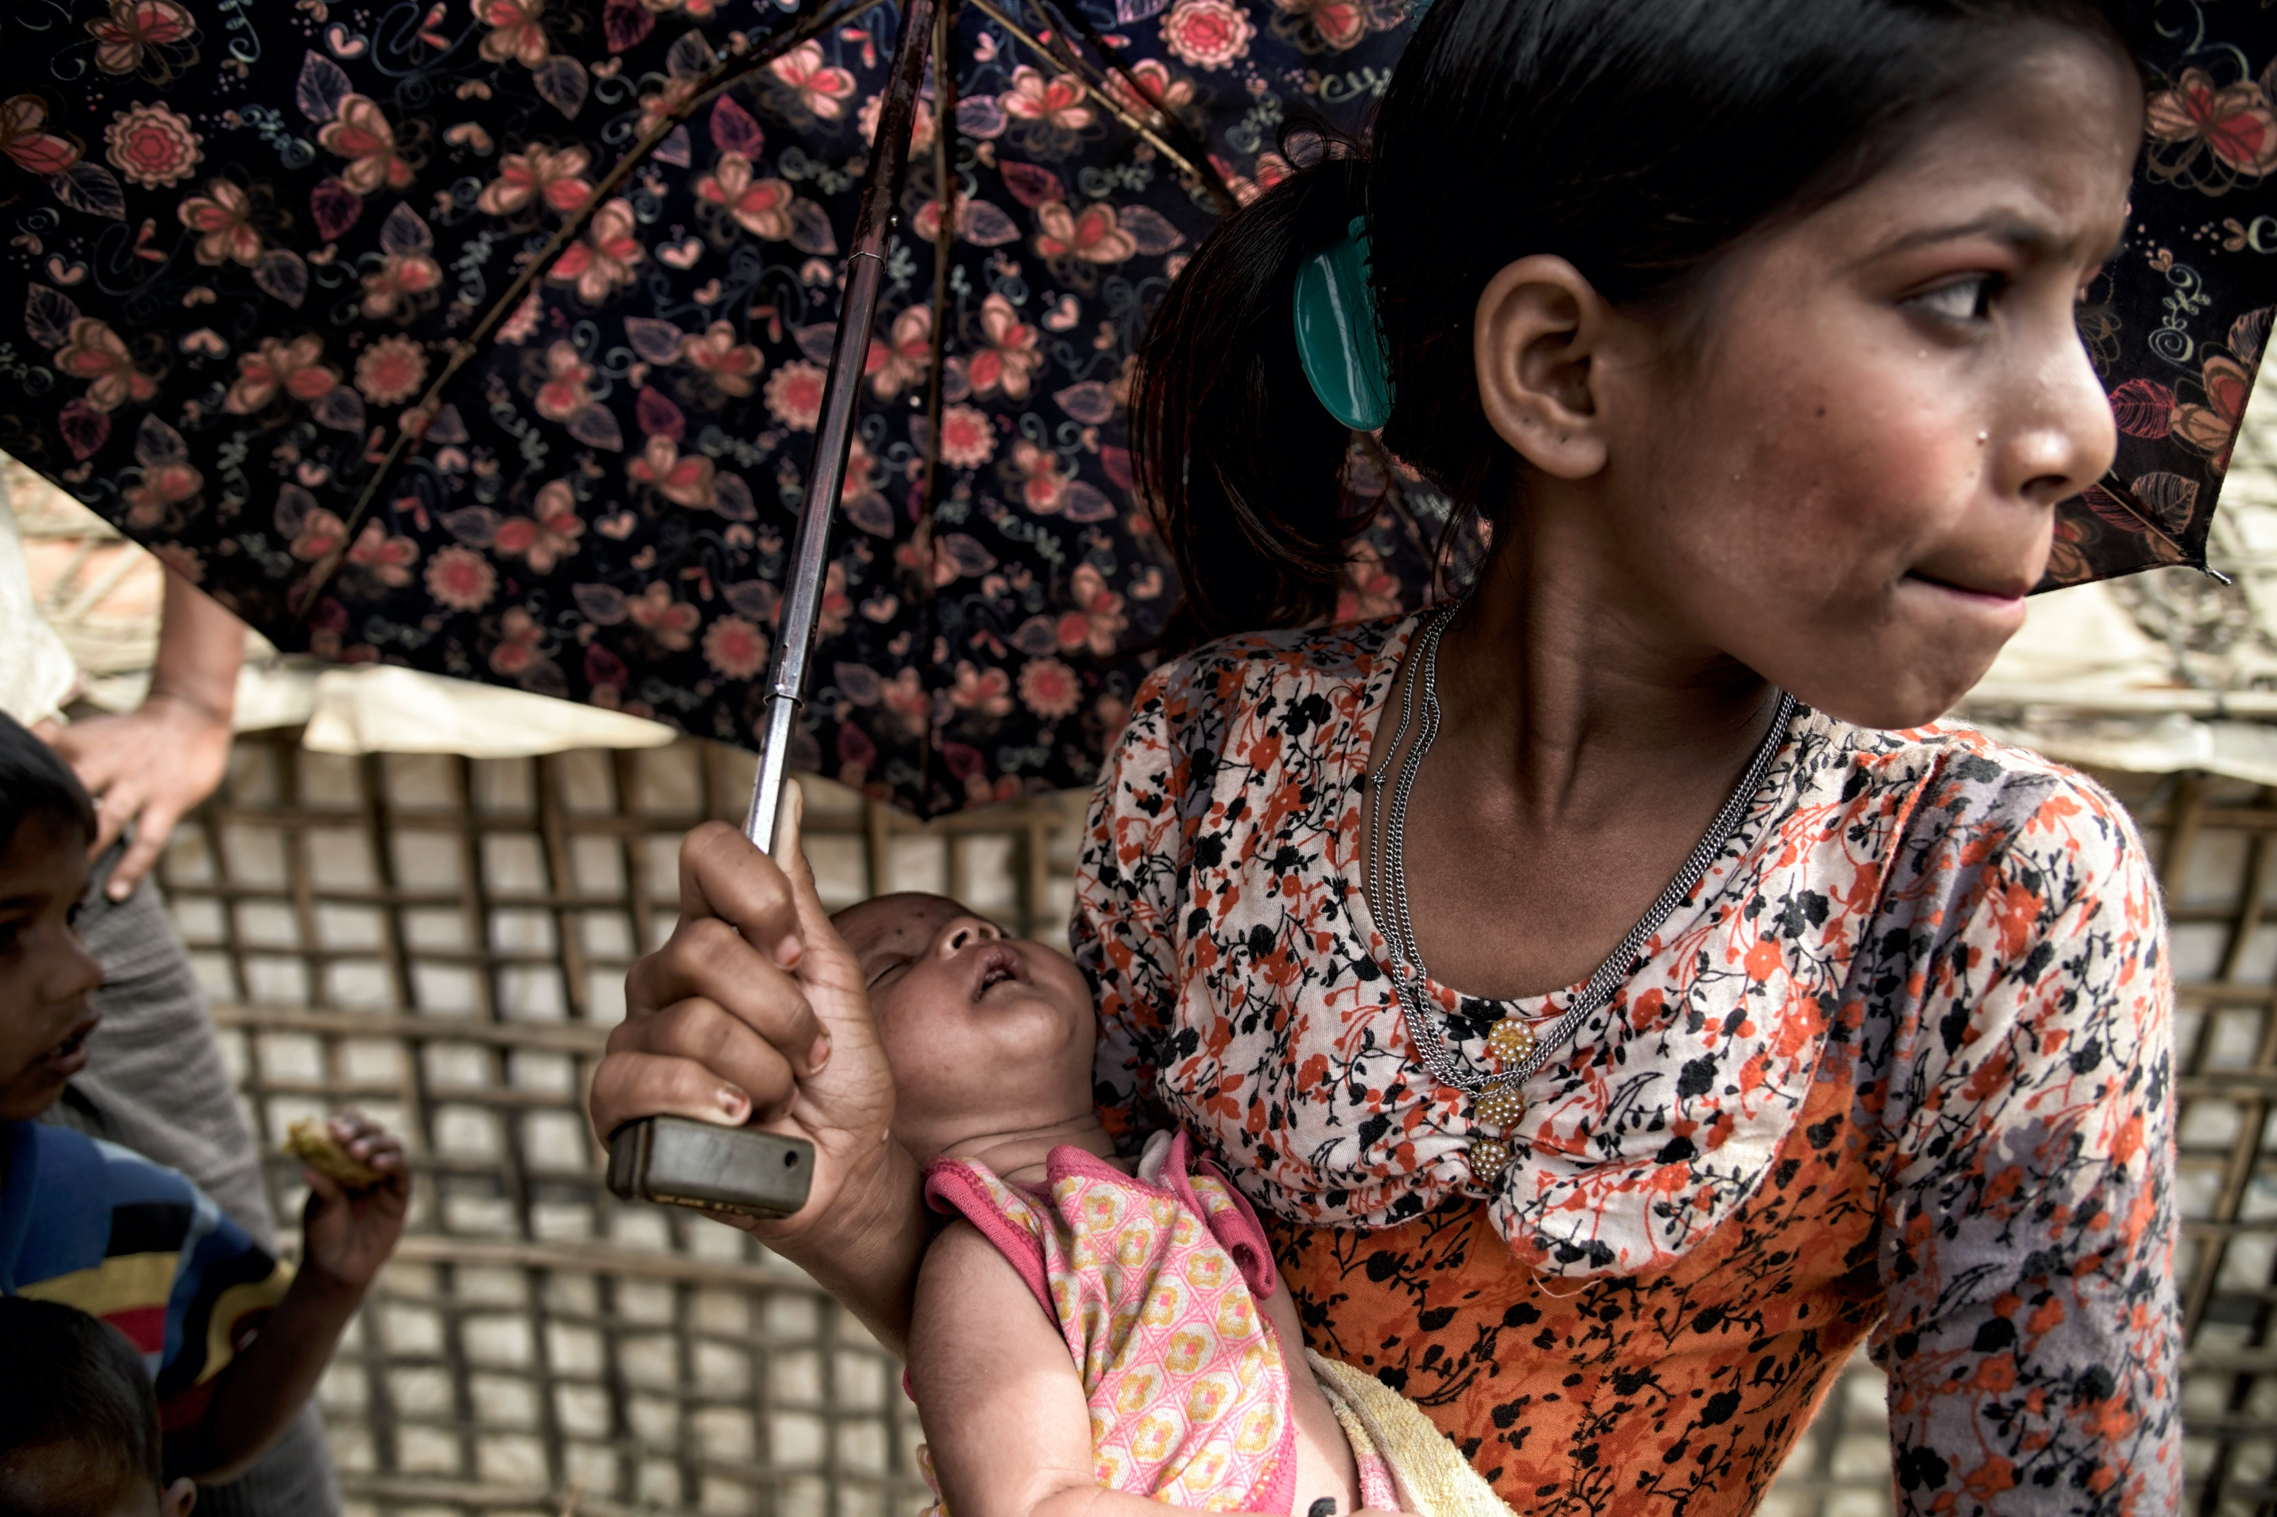

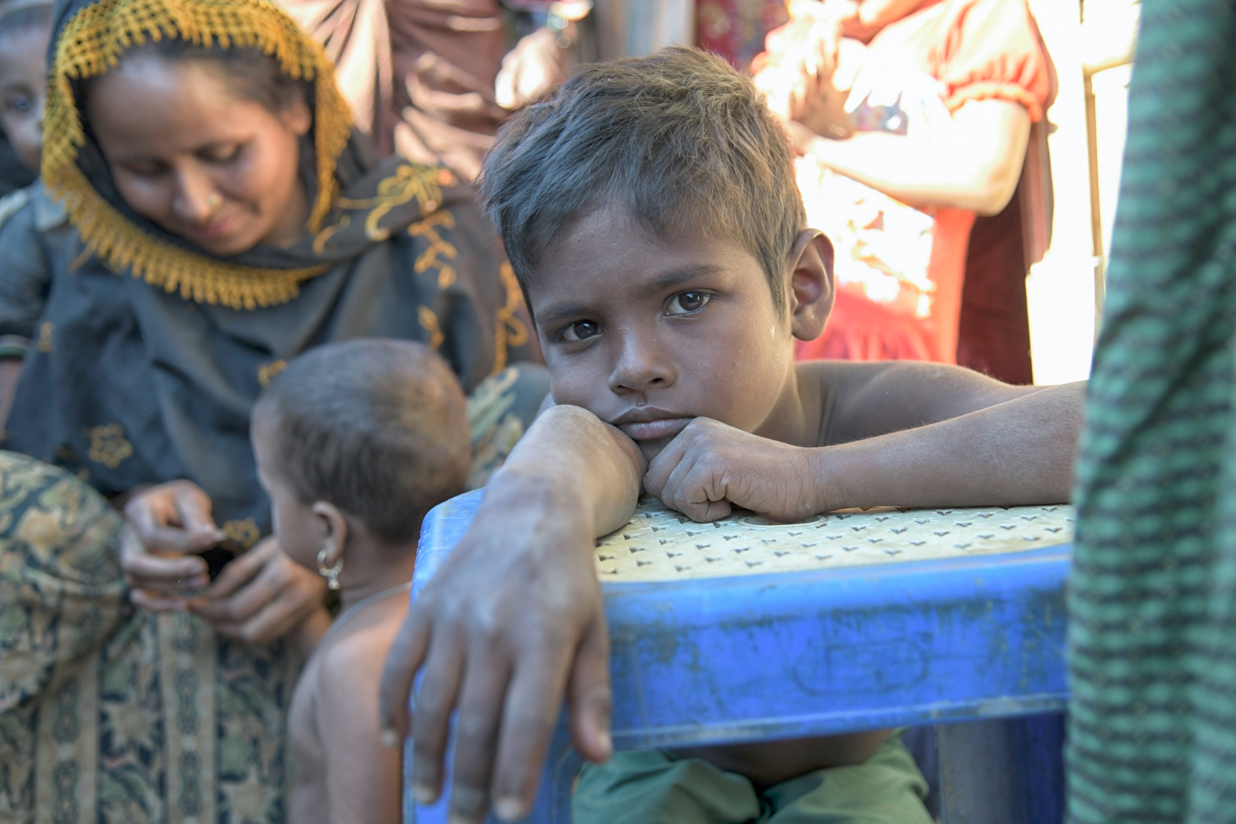


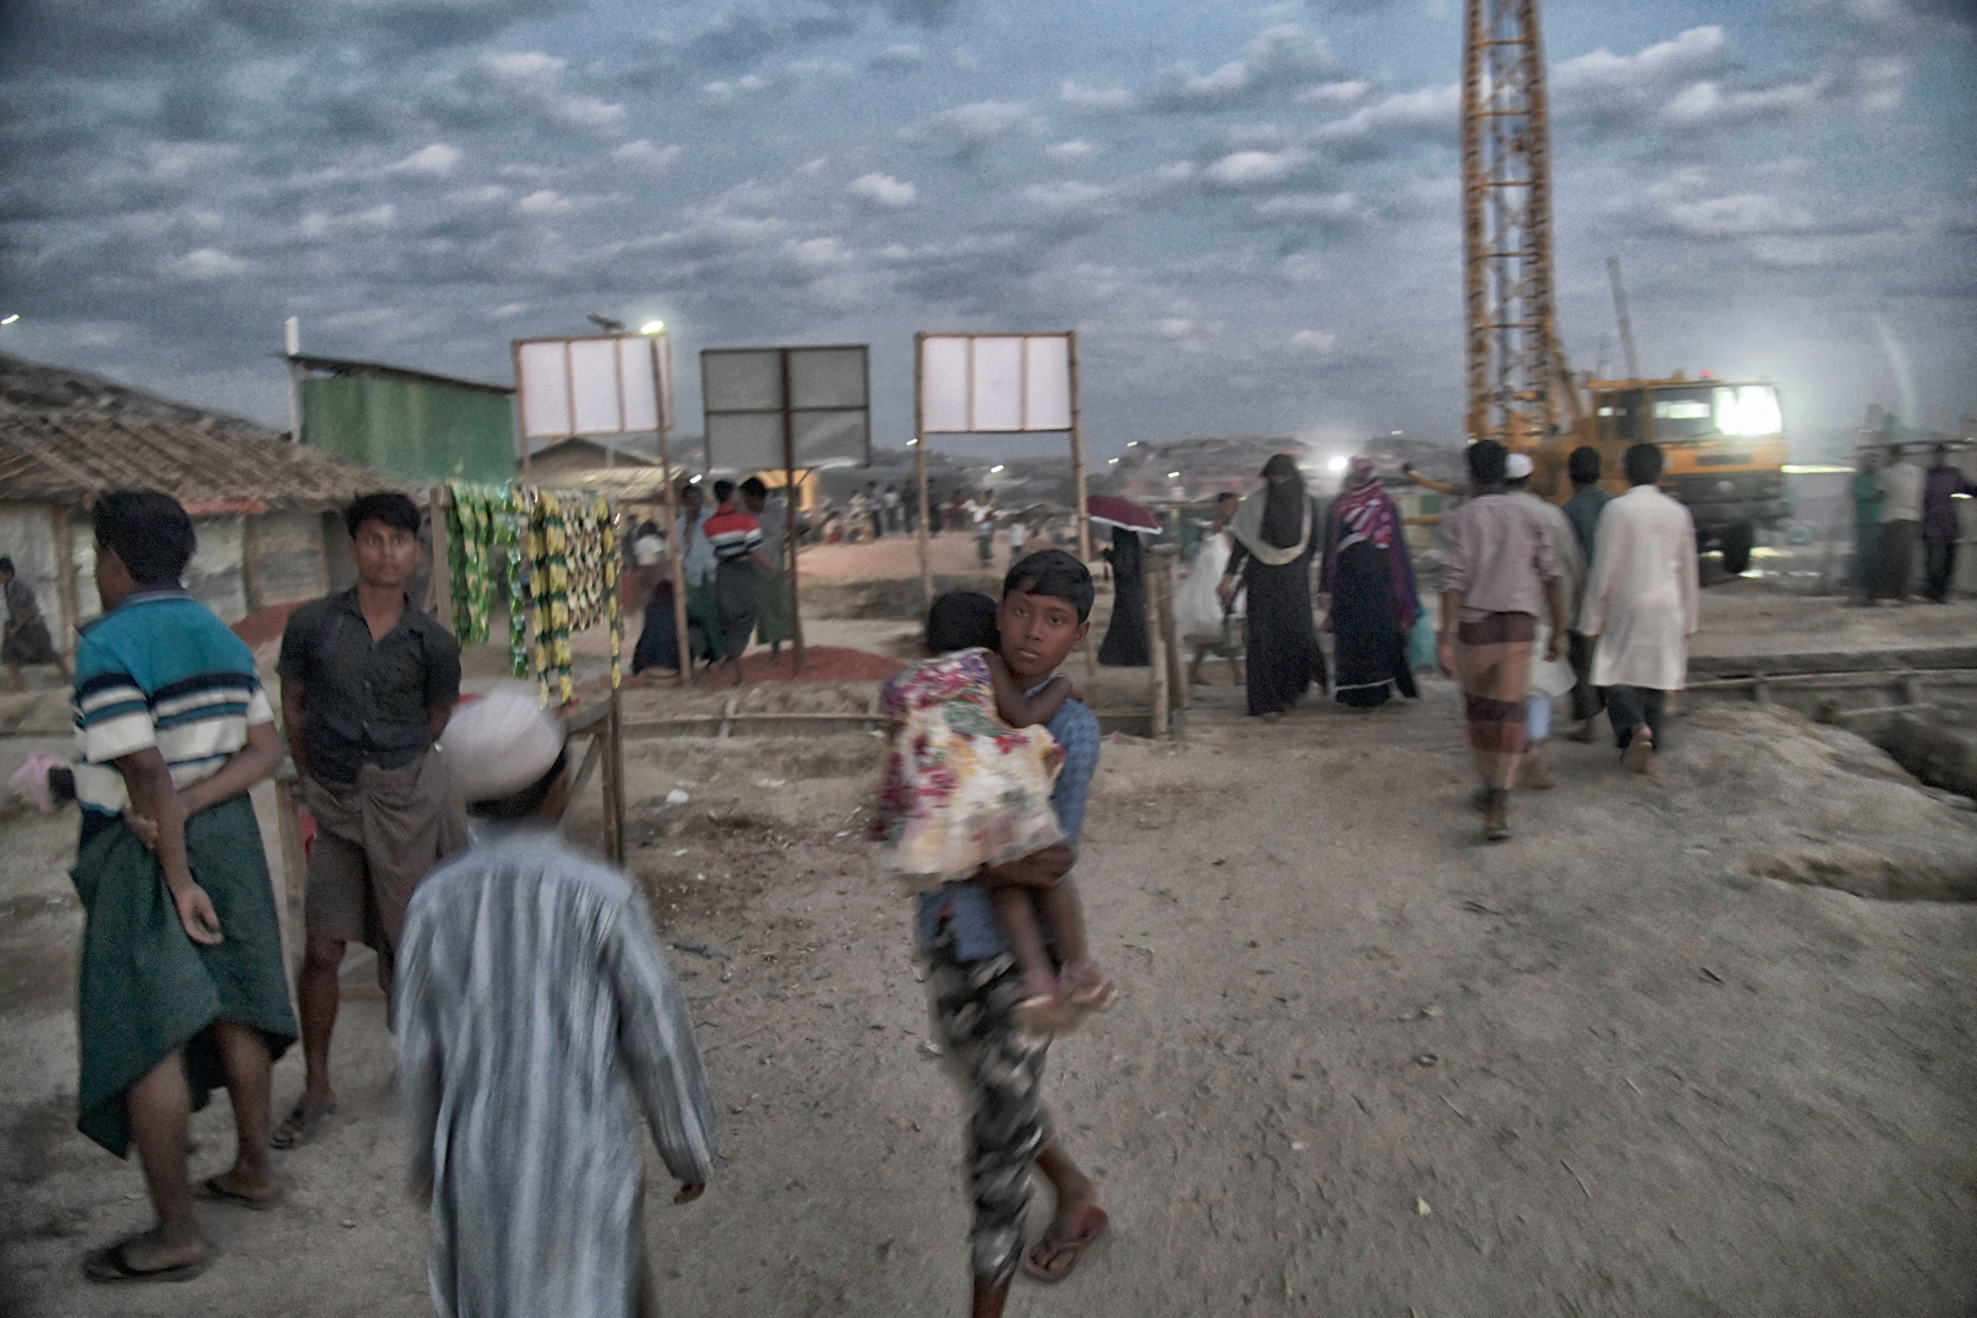
Introduction
MSF has more than 8000 nursing care providers, making it the largest medical workforce involved in direct patient care.
Nurses are on the forefront of direct patient care, playing a critical role in improving quality, reducing risk and building resilience in healthcare systems.
However, nurse staffing levels are difficult to determine, affected by the lack of:
Reliable workload data; and,
An insight into how nursing care is being delivered.

Slide 3



Objective
Existing methodologies to evaluate staffing levels such as WHO’s Workload Indicator of Staffing Need (WISN) rely on data generated by expert panels rather than evidence.
As such the care tasks being delivered, the frequency in which are being delivered and the length of time that delivery takes are being inferred from expert opinion rather than existing data.
Can data be collected to measure nursing care delivered in a humanitarian setting?

Slide 4

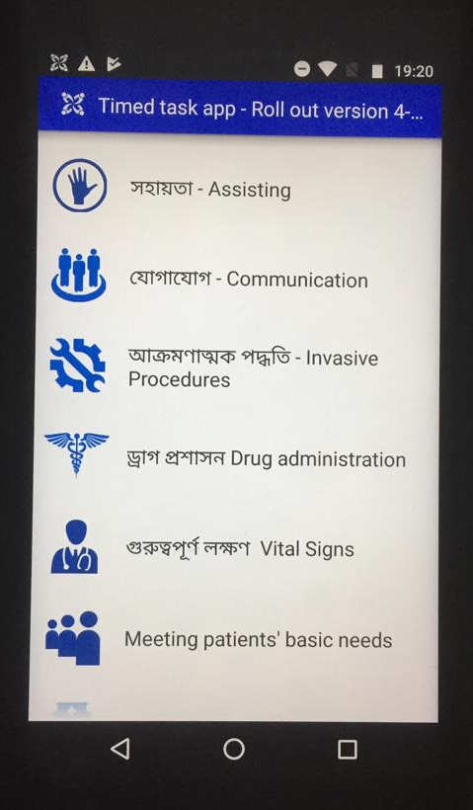


Method
1
Two paediatric wards in the Kutupalong health facility in Cox’s Bazar, Bangladesh.
2
19 nurses self-reporting activities on an app performed with a time-stamp on the background.
3
Tasks included and refined during end-user focus group discussions, study steering committee input and app iterations, during a 28-shift pilot. Final data collected during a 56-shift rollout for 4 consecutive weeks.

Slide 5
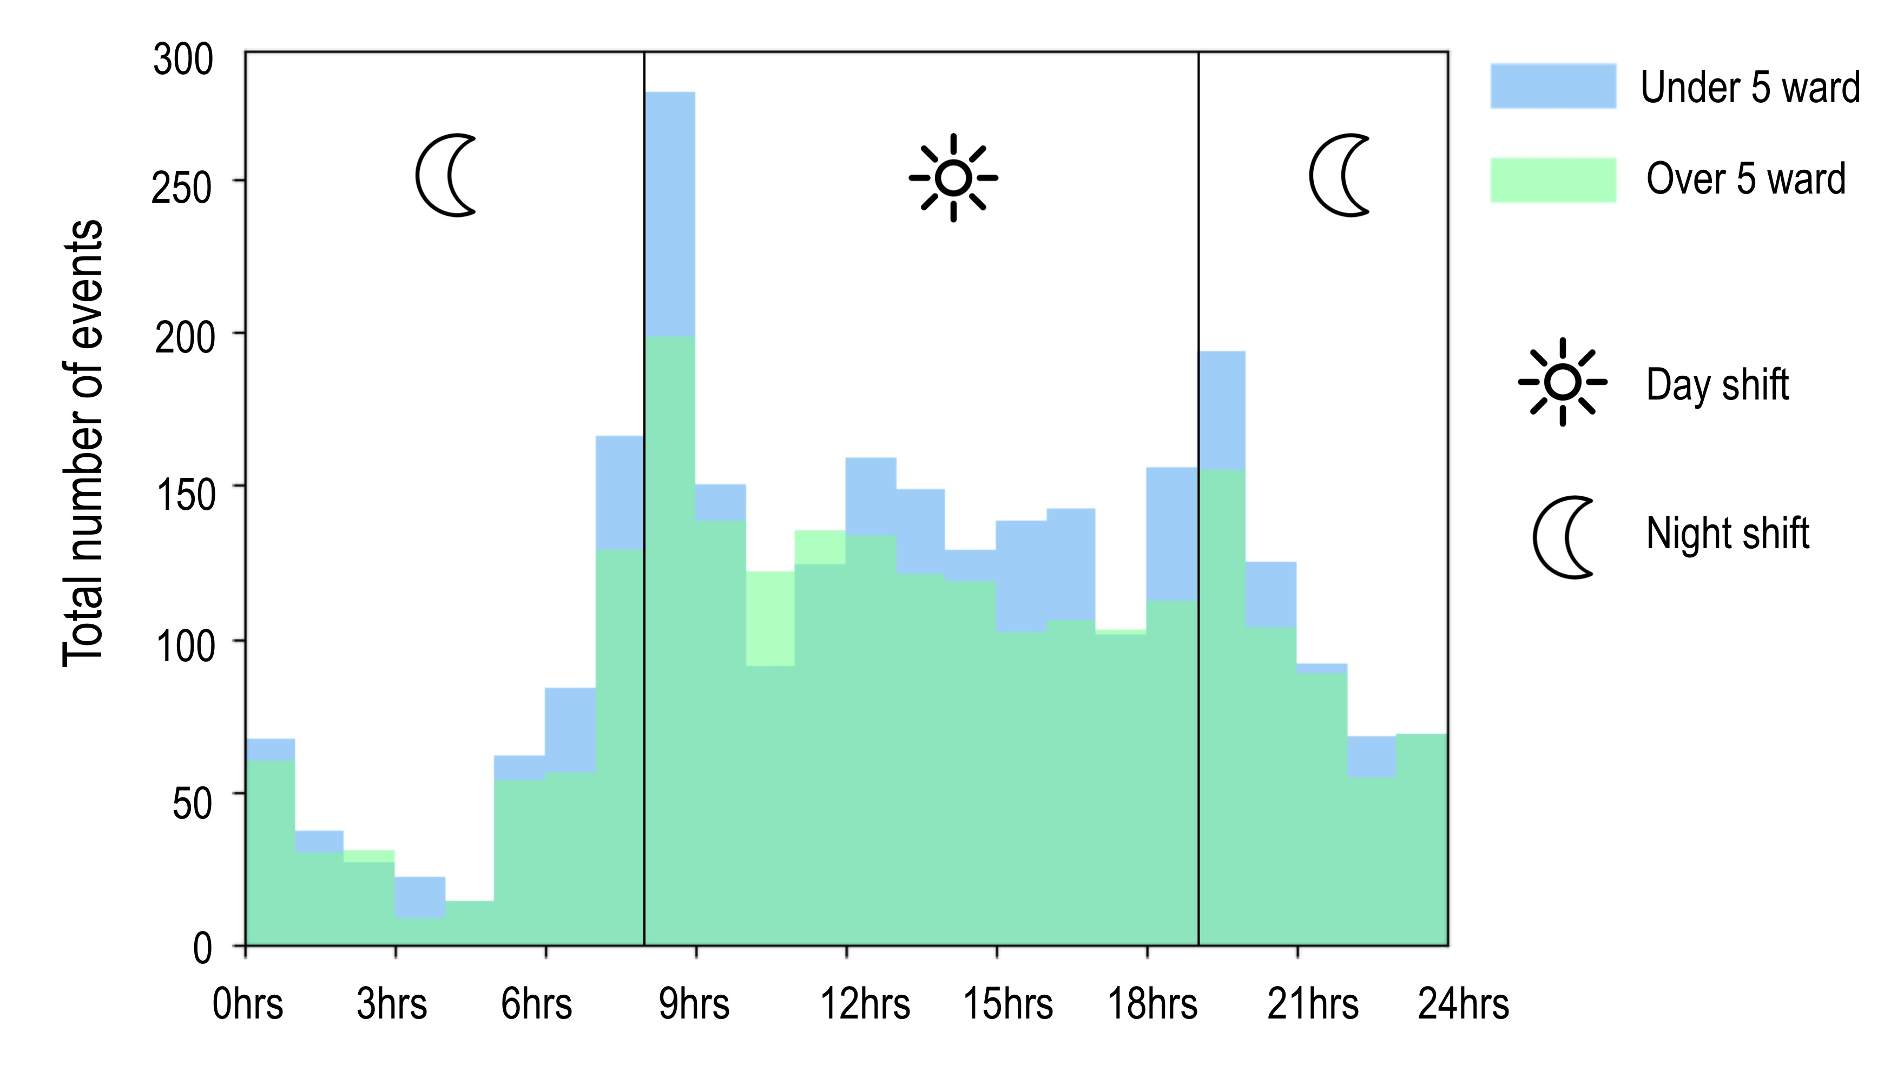
Results
A
Mapping out nursing
Identify peaks of workload.
Comparing delivery of care between wards.
Defining care model (e.g. task-oriented // patient-oriented)
Night/day patterns of task delivery aligned between wards.
Notes:
Nurse participants logged a total of 6084 tasks, an average of 27 tasks per nurse per shift.
Input workload data for a model (WISN)

Slide 6
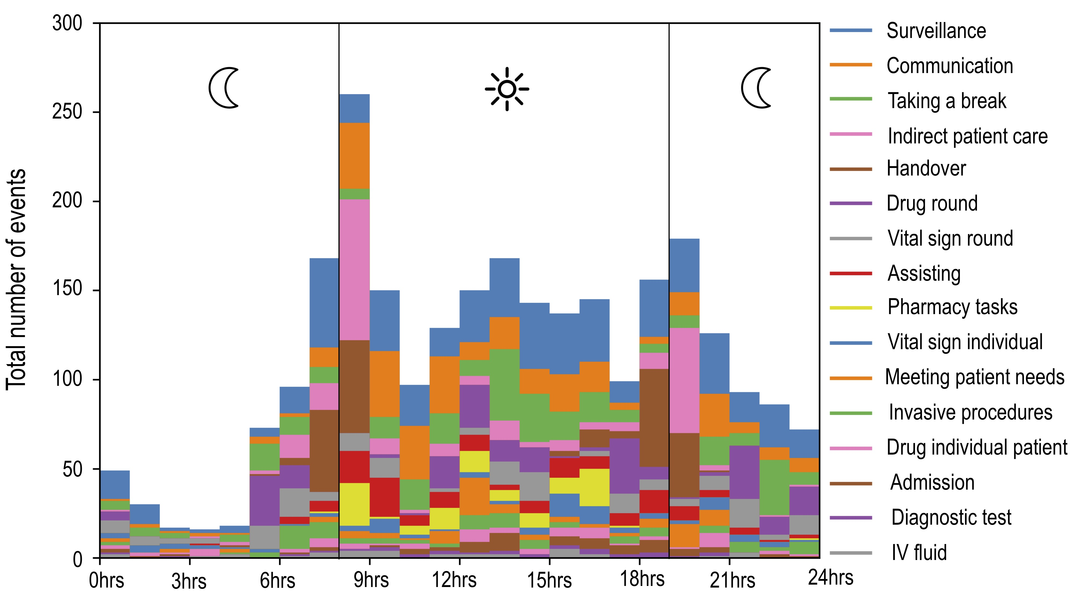
Results
* In this case task frequency and average time did not correlate with changes on patient numbers and/or acuity.

Slide 7
Results
Notes:
It is good that we understand the existing workload, but the workload can be diminished by stablishing better working practices, improving quality at the same time, and we know that and can address it by taking a data approach.

Slide 8

Results
“I never realised how often I was interrupted until I started using the app.” Kutupalong nurse participant.
20% of all tasks required leaving the ward.
Between being interrupted and having to leave the ward, 32% of all tasks collected were disrupted.
Frequent disruption to nursing processes can impact patient care, increasing potential for medical error, risk for patient harm and creates distress for the nurse.
A data-driven approach to understand the existing nursing workload, can shed some light on how care is being delivered.

Slide 9
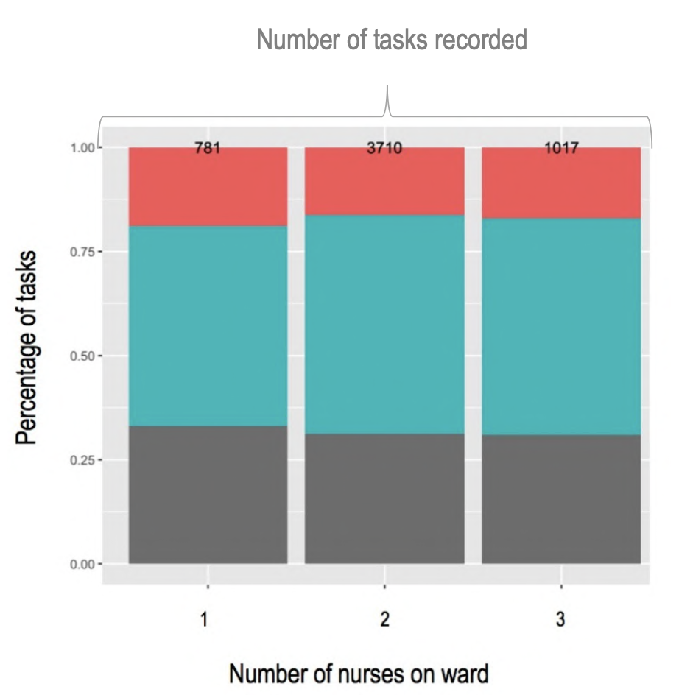
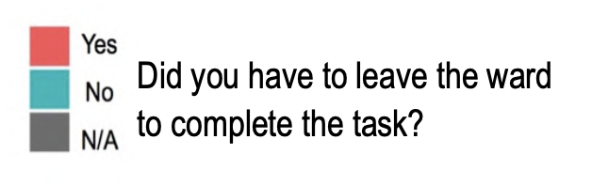
Results
Percentage of tasks where the ward was left understaffed
(n=1)
B
Percentage of tasks where the ward was left unattended
(n=0)
Improving processes
On average 20% of all tasks conducted required nurses to leave the ward.
>21% of tasks conducted when only one nurse on the ward required leaving the ward.
>14% of tasks conducted when two nurses on the ward required leaving the ward.

Slide 10
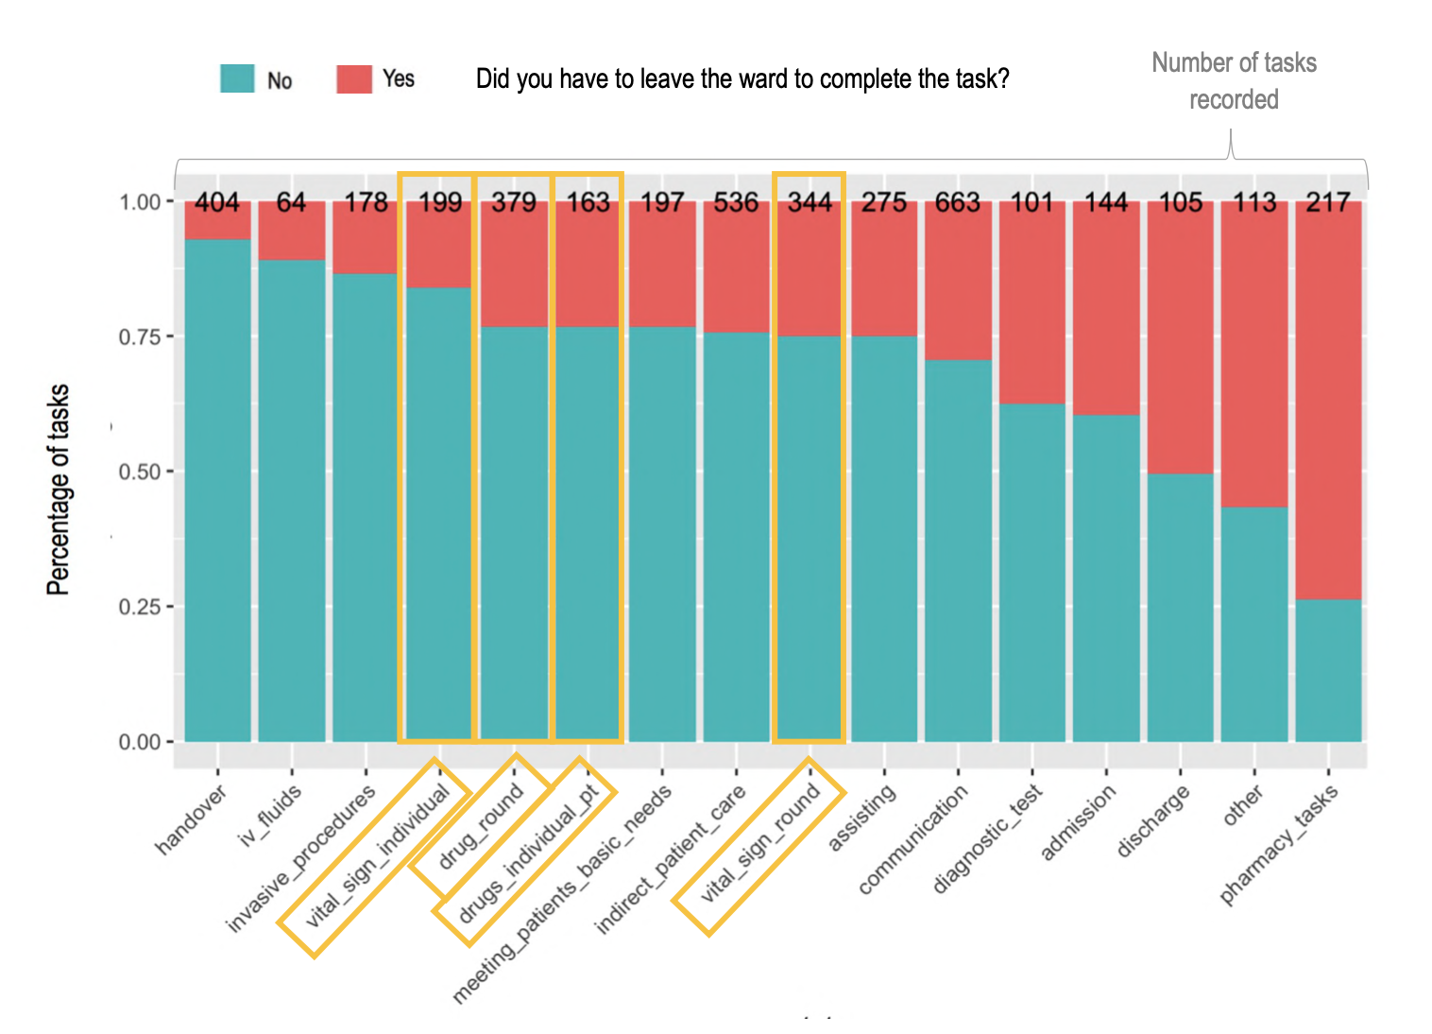
Results
B
Improving processes
On average, during drug round, vital sign round, drug individual administration, and vital sign individual tasks, nurses left the ward circa 24%, 25%, 24% and 20% respectively in order to complete the task.
Task with direct impact to patient care

Slide 11
Results
The main medical supplies (medication, icebox with open medication, materials, paperwork and stationery) were kept on the under 5 years ward. Although the over 5 ward, which often only had one nurse on shift, had a small supply they would have to leave the ward:
- Before each medication round to collect medication either from the icebox or the cupboard
- Before vital sign rounds to collect the pulse oximeter and/or additional vital sign charts
- During admissions as the patient forms and registration book were kept on the under 5 years ward
- During discharging a patient as the filing system for discharged patients and the registration book were
kept on the under 5 years ward
- For additional materials required such as gloves or cotton wool.
Improving processes by taking a data-driven approach

Slide 12
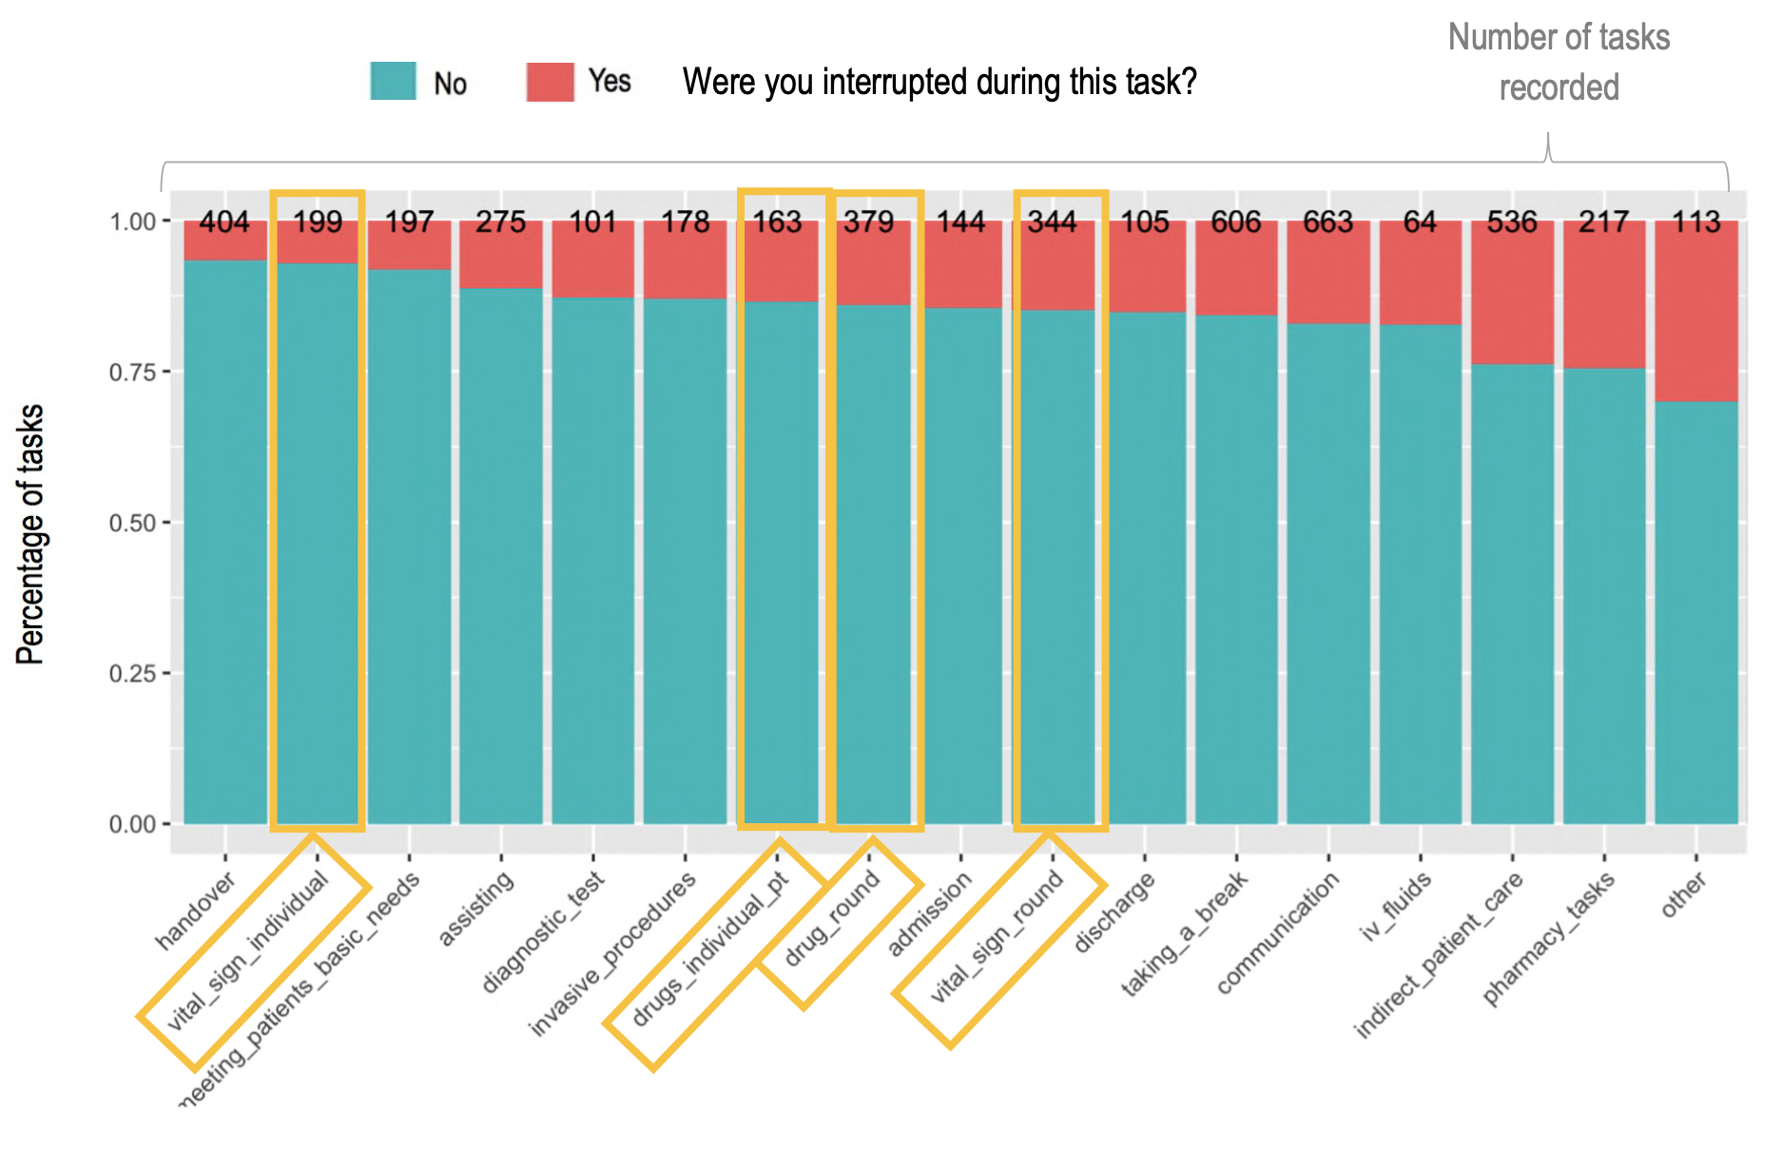
Results
B
Improving processes
Vital sign round 12% interruption rate
Drug round 14% interruption rate

Slide 13
Results
B
Improving processes
Handovers
On average verbal bedside handovers between the day and night shifts took 8 minutes for up to 14 patients.
On the Nursing Intervention Classification (NIC) where a set of activities were assigned a duration range in minutes, handover averaged between 31-45 minutes.
There was no allocated time for handovers between shifts and there was no standard process of how a handover should be conducted.

Slide 14
Results
B
Improving processes
Handovers
On average verbal bedside handovers between the day and night shifts took 8 minutes for up to 14 patients.
On the Nursing Intervention Classification (NIC) where a set of activities were assigned a duration range in minutes, handover averaged between 31-45 minutes.
There was no allocated time for handovers between shifts and there was no standard process of how a handover should be conducted.

Slide 15
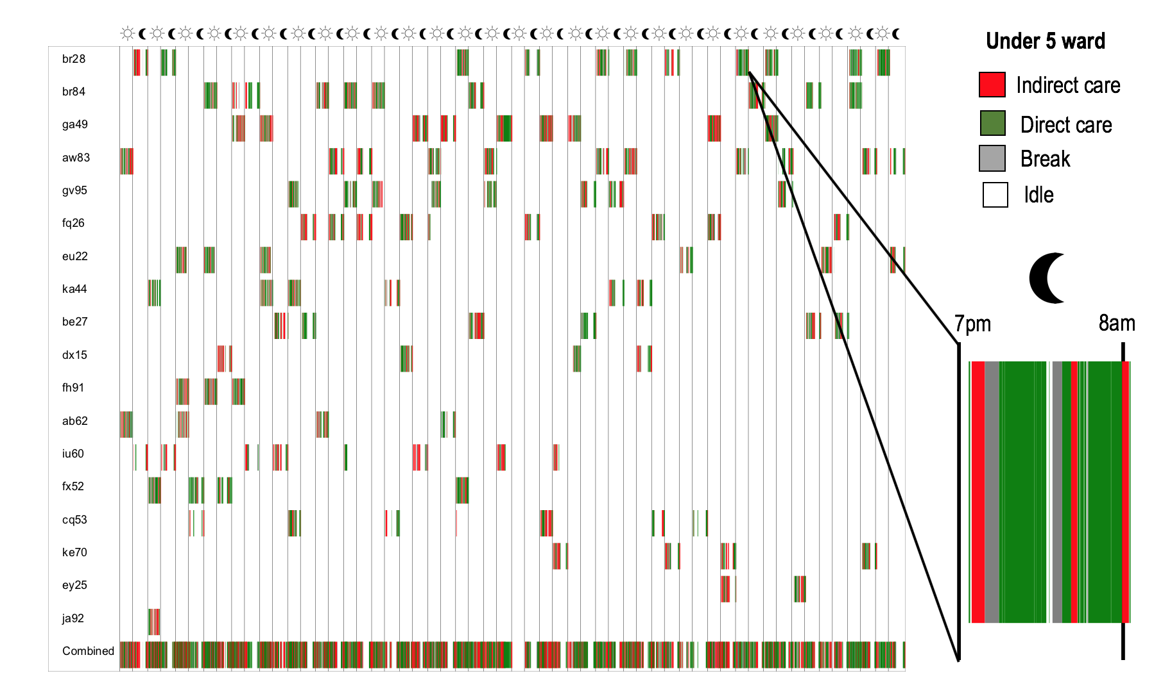
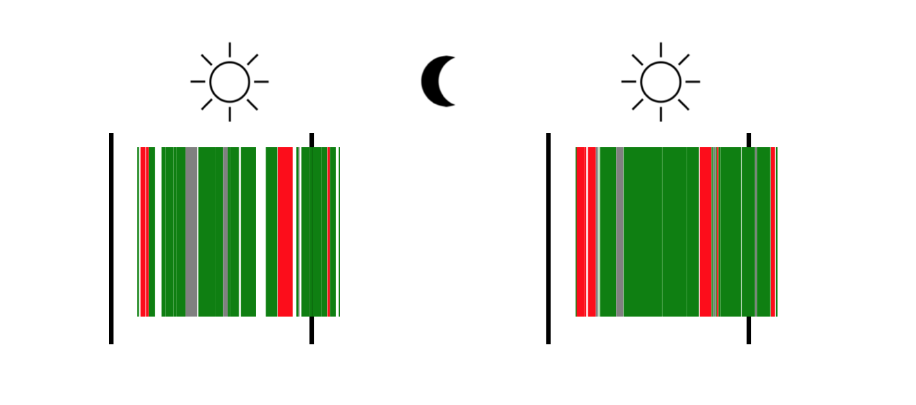
Results
B
Improving processes
Overtime
During the data collection period some of the nurses were working an additional 42hours (an extra 20%) on top of their contracted 208hrs/month.
The increase on overtime was associated to an increase on neonates and staff turnover.

Slide 16

Challenges
In this case task frequency and average time did not correlate with changes on patient numbers and/or acuity— the variability was too low between wards and the numbers of nurses between the two wards was too alike to observe differences when delivering care.
Nursing multitasking could not be captured when in the app as only one task at the time could be logged.
Some additional information that would need to be acquired would be (1) Missed care; (2) Perception of performance variability, and factors affecting it; (3) Perceived workload, job satisfaction and burn-out; and, (4) Understanding of nursing task standards and processes.
Add within the app a question regarding the reasons for having to leave the ward and for being interrupted. Additionally, it would be interesting to place a time stamp when nurses leave the ward and when they return, in order to estimate the amount of time the ward was left understaffed or unattended and assess the risk.

Slide 17
Conclusions
We can successfully collect systematic nursing activity data, and the data can be used as workload data.
We can accurately describe nursing and how the nursing tasks are being delivered.
By using a data-driven approach we can improve the delivery of nursing care.

Slide 18

Acknowledgement
Thank you to the whole MSF Bangladesh team for all the work, support and patience.
Our Study Steering Committee for their continued support and guidance
(Anna Freeman, Kate White, Debbie Duncan, Andrea Marelli, Pete Masters and Lindsay Bryson)
and the ING Wholesale Banking Advanced Analytics in Amsterdam for substantially contributing to the analytical work
(Nane Aben, Marco Pfrang and Saskia Schippers)

